Slide 1

PNSCR User Manual
v2.0
NFC MW

Slide 2
Introduction
PNSCR is the script tool which can be run on target device.
Supported platform - Android, Linux
This tool is executable binary runs with root permission under adb shell.
Working independently with installed NFC MW / eSE-SPI MW
Support protocol
- NCI , ISO7816 on SPI
Purpose
Can be used in cases below :
Bring up NFCC/eSE without M/W stack.
Simulate defect symptom.
Simulate specific debug mode.
Dynamic LMA
Self test
Read DieID
Reproduction issues on specific scenario
Nfcc / eSE concurrent access
P2P, tag reading

Slide 3
Contents of package
The package contents
Libnfc_pnscr source code
Source nxp_pnscr/libnfcspi-scr/* shall be copied to /vendor/nxp/pnscr/ in Android environment to build.
Pnscr executable binary
Shall be pushed to /system/bin folder for execution from Binary folder, binary will support all arm64 target architecture no Android version specific dependency.
Scripts
Helper windows batch files for disabling HAL service and exclusive access of NFC/eSE from tool
Scenario specific PNSCR scripts to be pushed to predefined location /data/nfc
PNSCR user manual
About tool Features
commands supported usage with examples
Guidelines and limitations

Slide 4
Executable mode
3 types of mode
Types identified by options –t. Supports input parameter 0,1 & 2.
Type 0 : Line input mode
Execute by Input NCI CMD in command window
Type 1 : Script mode
Execute script
Type 2 : Hybrid mode
Script + Line input mode
Execute script and change to line input mode

Slide 5
Example of usage
Example #1.
Test mode : Script mode
Script file : “/data/nfc/reset_ntf_reproduction.txt”
Driver name : “nxp-nci”
pnscr –t 1 -d nxp-nci –f /data/nfc/reset_ntf_reproduction.txt
Example #2.
Test mode : Line input
Driver name : “nxp-nci”
pnscr –t 0 –d nxp-nci
here tool will wait for user to enter Command - NCI/HCI commands supported
eg - 20030301A044
Example #3.
Test mode : Script + line input
Script file location : “/data/nfc/issue1.txt”
Driver name : “nxp-nci”
pnscr –t 2 -d nxp-nci –f /data/nfc/issue1.txt
after completing input script execution, tool will wait for user to enter Command - NCI/HCI commands supported.
eg - 20030301A044

Slide 6
Command list
reset
send
trigger
stop
interval
sleep
loop / end
resetspi
sendspi
#,/* */

Slide 7
Usage of Command
reset (ven behavior will be various depends on nfcc driver)
Control mode of NFCC
reset 0 : turn off NFCC (no impact on ven in case of always on)
reset 1 : set functional mode
reset 2 : set download mode
reset 5 : ven reset (valid only for SN1xx)
send
Send data to NFCC
e.g.) send 21060100 (NCI : RF_DEACTIVATE_CMD)
trigger
Wait until receive specified data and resume
Multiple data can be specified
e.g.) trigger 6105 : wait until receiving 6105xxxx from CLF
Once get specific data, then resume the script
trigger 6105|8115C0 : wait until receiving RF_INTF_ACTIVATED or HCI_ALL_PIPE_CLEARED

Slide 8
Usage of Command (Cont.)
stop
Exit program when it get specified rsp / ntf
“stop” will not block executing script
e.g.) stop 6000
=> Program will end if it gets CORE_RESET_NTF
stop 6105|8115C0 : End program if it receive RF_INTF_ACTIVATED or HCI_ALL_PIPE_CLEARED
interval
Default delay between each lines (unit : ms)
Interval will be updated with new value if it is used in the middle of script

Slide 9
Usage of Command (Cont.)
6. sleep
Wait amount of parameter (unit : ms)
e.g.) sleep 50 : sleep 50 ms
7. loop / end
Start loop as amount of parameter until meet “end”
e.g.)
loop 20
trigger 61070101
send 2F3304400040D8
end
Wait until getting RF on event then send get dynamic LMA response repeat above step 20 times

Slide 10
Usage of Command (Cont.)
8. resetspi
Open/close eSE-spi session
e.g.) resetspi 1 : open eSE session
=> this will initiate INTF_RESET
resetspi 0 : close eSE session
=> this will initiate PROP_END_APDU_REQ
9. sendspi
send ISO7816-4 apdu to eSE
e.g.) sendspi 0070000001 : open logical channel
sendspi 00A4xxxxxxx : select aid xxxx

Slide 11
Features Supported
Tool is independent of Chip type.
Any driver name can be passed as command argument, however, need to take care of IOCTL command compatibility.
Control VEN/RSTN state of NFCC.
Set NFCC mode normal or download.
Sending NCI & SPI command to NFCC/eSE.
Wait for response/notifications.

Slide 12
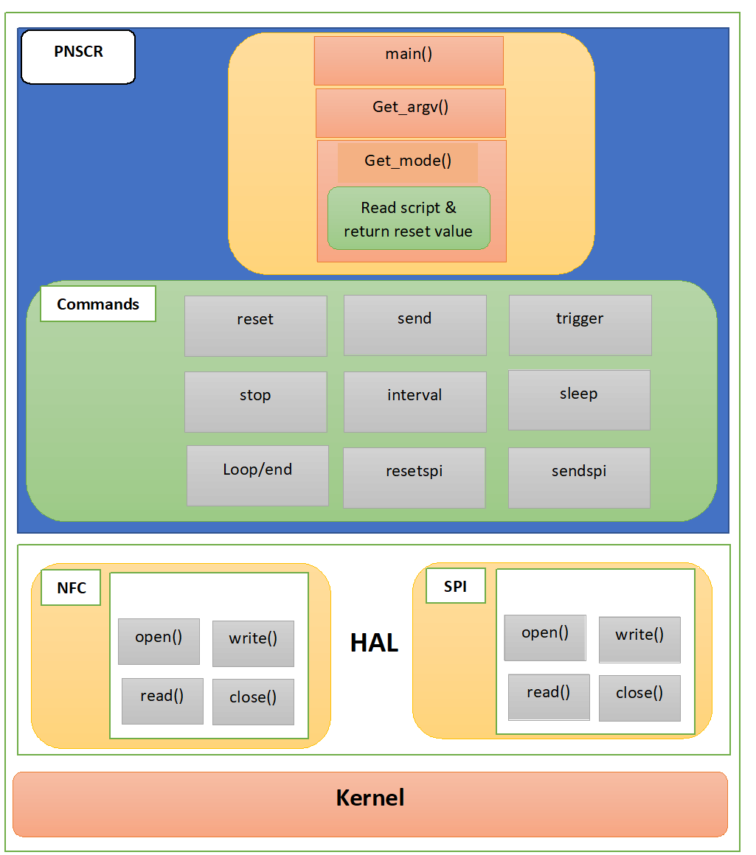
Block Diagram
Get_argv()
Parsing the input parameters like executable mode, driver & script.
Get_mode()
Read the script which is passed as runtime argument.
Decide the ioctl reset value based on reset command mentioned in the script.

Slide 13
How to execute
Follow the pre-requisite with respect to each script execution.
Init_deinit, spi test script(pnscr_sn110_init.txt, pnscr_sn110_init_deinit.txt, pnscr_test_spi.txt) -
Loop count is mentioned in script which can be modified.
Tag test(pnscr_t2t_test.txt, pnscr_t4t_test.tst) -
Tag should be placed in proximity before executing script.
Tag presence check will happen in loop, loop count can be modified in script .
Host Card Emulation(pnscr_HCE_test.txt) –
Execute batch script.
Execute following steps in jcshell
/term Remote
/reset
transitionoverDH 50 200 00 00
Loop count to jcshell script(first parameter) & in script should be same.
Execute respective batch file.
Note:-
If batch execution is aborted, rename respective HAL file with original library name as mentioned in script to recover HAL service.
In case of switching from Tool mode to MW mode, device shall be rebooted.
Loop count

Slide 14
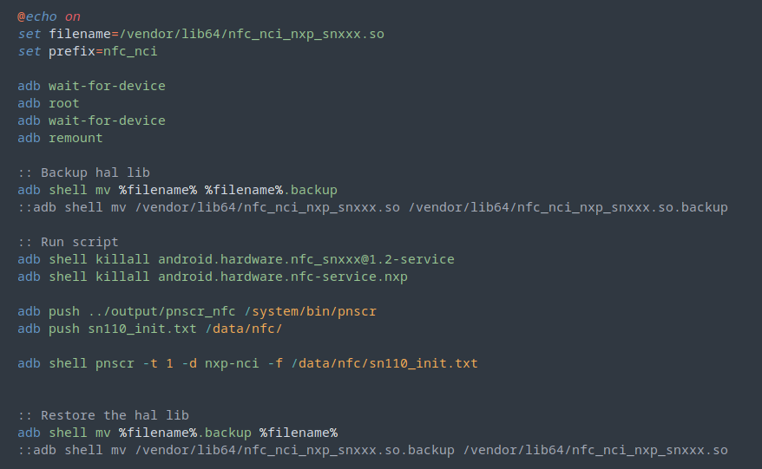
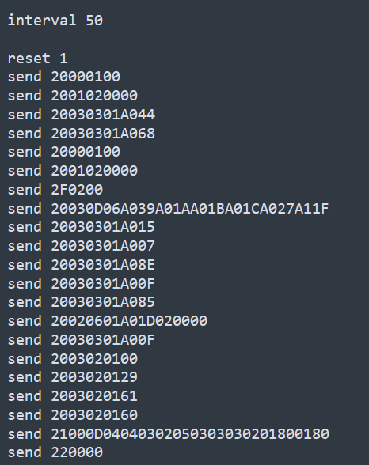
SN110 Init Script
Batch file
Script.txt
Nfc service will not restart after killing because of nfc_nci_nxp_snxxx.so is not present.
After execution, nfc service will be restarted.
Interval – sleep between execution of 2 commands(ms)

Slide 15
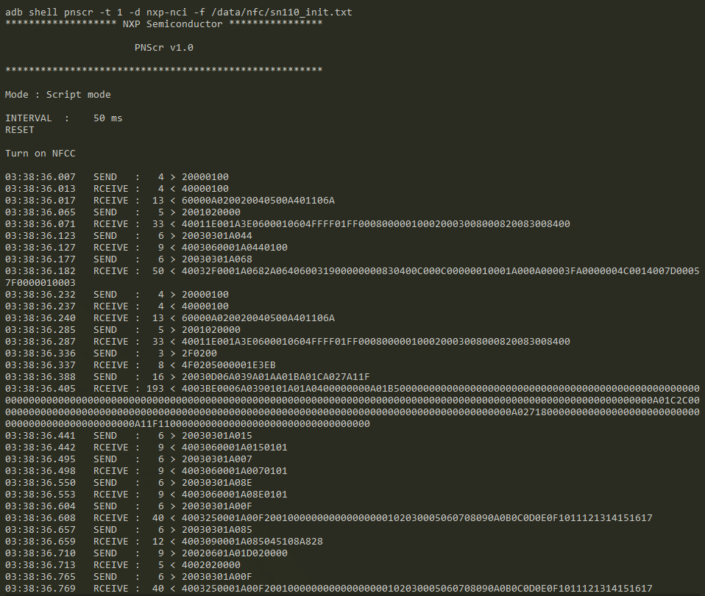
Output
Console output of Script mode

Slide 16
Guidelines
Compatible driver shall be used for IOCTL operations like (VEN RST toggle, DL/Normal Mode etc.)
Script shall be written as per Syntax/Format and prechecked/reviewed.
Total size of command packet buffer length(Header included) limited to 512 bytes due to tool & driver implementation.
Limitations
Only power management IOCTL operations are implemented not all IOCTL operations supported.
The commands execution is script based; tool does not have any response timeout handling.
There is no response validation done at tool side except length check.

Slide 18
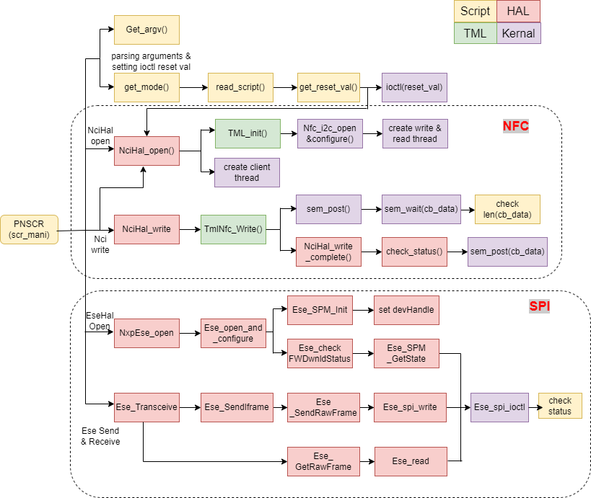
Execution flow for NFC & SPI

Slide 19
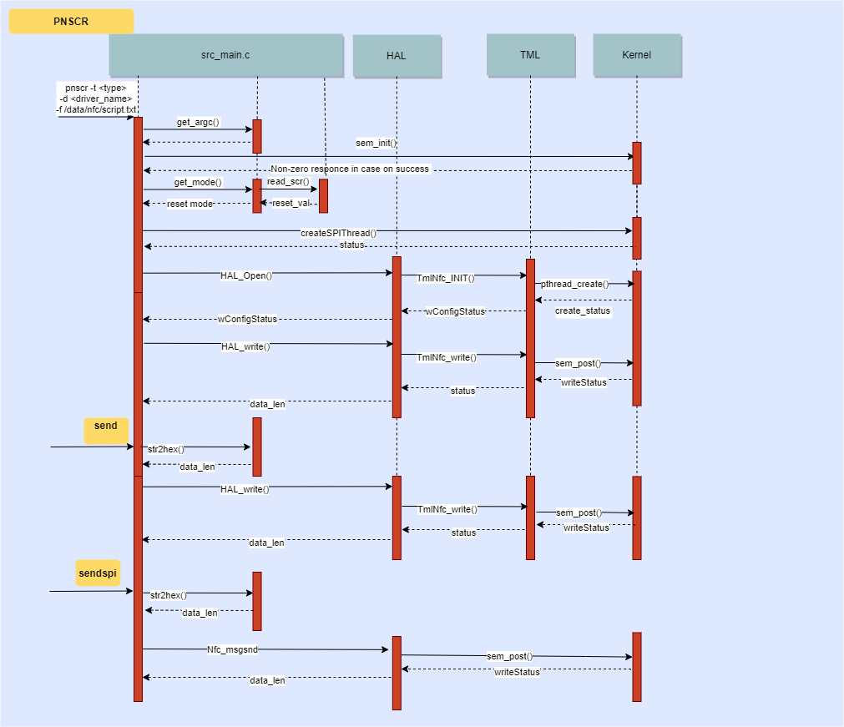
Sequence diagram for NFC & SPI

