Slide 1
Arduino 101
NTU Open Source Society
Notes:
Good evening, I am Xuan Phi, I am the technical director of NTUOSS, today I gonna guide you through Arduino workshop. I will show you guys what the Arduino is, why it is becoming more important and later we will have hands-on experience with a simulator that you will do yourself on your favourite browsers.

Slide 2
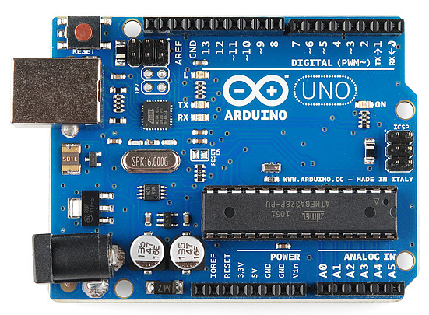
Introduction – What is it?
Electronic board to control electrical component
Use for prototyping, studying and IoT…
System specification:
MicroController: ATmega328P
Clock speed: 16 MHz (Veryyyy low)
Operating Voltage: 5V
Digital Pin: 14 (6 of which is PWM)
Analog pin: 6
RAM: 2KB (Veryyyy Small)
Flash memory: 32KB (Very small too)
Communication port: Serial, Software Serial, I2C
Notes:
So what is it, why is it becoming more and more popular among technical community. It is the emergence of IOT, arrduino makes prototyping IOT so easy and affordable. People can use Arduino to make interesting projects on IoT. We use Arduino to control analog component that is not make sense in digital world, and to communicate with physical world. So briefly you can see the system specification: we have micro controller, with a very low clock speed, it is operated at 5V which is quite high. We have a lot of digital and a number of analog pin. The ram and flash memory is extremely low so you must take into account this fact when you handle large and memory exhausting project. For example when you declare a few thousands integer variable in the program, the memory start to not make any sense as memory is overridden and broken. Remember this is not a computer where you can easily use up any memory. Other communication port can be found such as Serial, Software Serial, I2C…

Slide 3
I2C communication port
GND
Digital Pins:
13
12
11 – PWM
10 – PWM
9 – PWM
8
7
6 – PWM
5 – PWM
4
3 – PWM
2
1 – for Serial Communicate
0 – for Serial
Power pins:
3.3V
5V
Ground (GND)
Analog Pin
A0 => A5
Notes:
We have power pins (3.3 and 5V), analog pin, a lot of digital pins with some PWM function, pin 0 and 1 is purely use to serial commucation

Slide 4
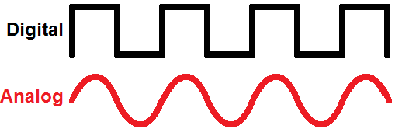
Digital vs Analog Signals
Digital
Analog
Discrete Voltage value to represent digit 0 and 1 (0V and 5V)
Only 0 or 1 value make sense
Computational language - due to its precision and explicitness.
Convert to analog: DAC 10bit to (0 – 5V)
Variant voltage or current (etc) value to show physical property (light, heat…)
All values make sense
Real world properties – human interaction and physical and electrical control
Convert to digital: ADC: (0 – 5V) to 10bit
Notes:
Arduino is embedded with its own ADC and DAC for conversion of between analog and digital signal

Slide 5
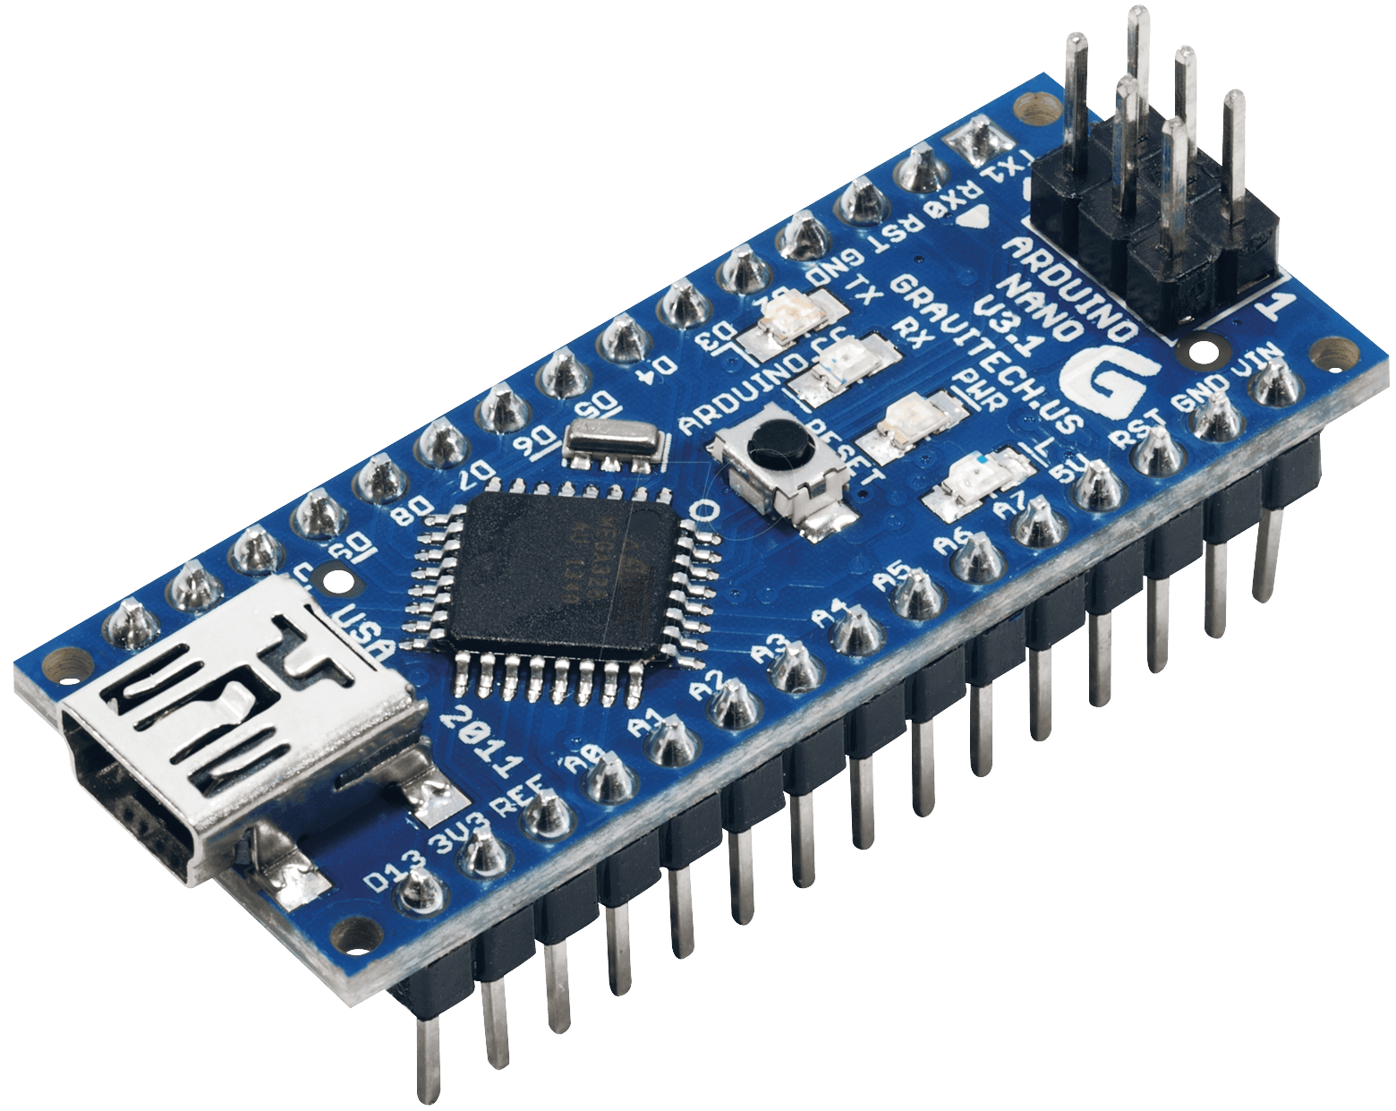
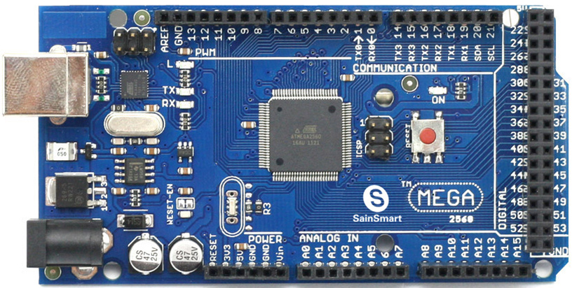
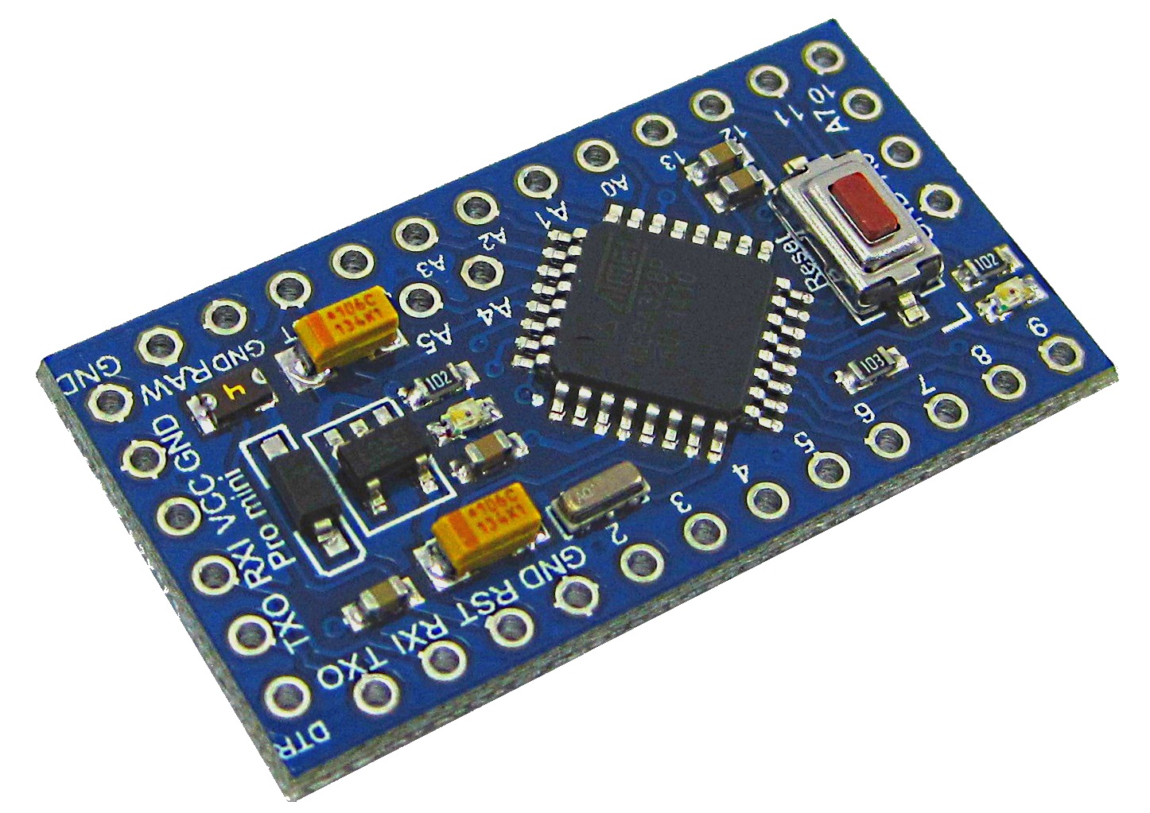
Different Kinds of Arduino
Arduino micro
Arduino Mega
Arduino Nano
Notes:
Arduino is embedded with its own ADC and DAC for conversion of between analog and digital signal

Slide 6
Installation
Real Arduino and the Arduino IDE
IDE: https://www.arduino.cc/en/Main/Software
Visual Studio + Arduino: http://www.visualmicro.com/
Plaformio – Arduino with ATOM text editor: http://platformio.org/
Virtually on the web:
https://circuits.io/

Slide 7
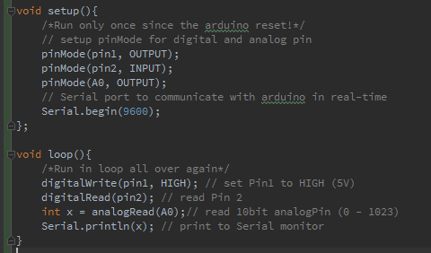
Tutorial 0 - C/C++ - more and less
.ino file uploaded to Arduino running on C/C++
Object oriented.
Lack of many C/C++ built-in library (ostream, std...)
Provide many “for – Arduino” built-in library (Servo, LiquildCrystal,…)
Support uint8_t, uint32_t… data type.
Notes:
Arduino language is more and less C/C++, many people are convinced that it is just C. But I believe it is C++ because we have OOP functionality here. However, it lacks lots of C/c++ built-in library like osstream or std namespace, but it contains other library which support the manipulation of some electrical component like the Servo.

Slide 8
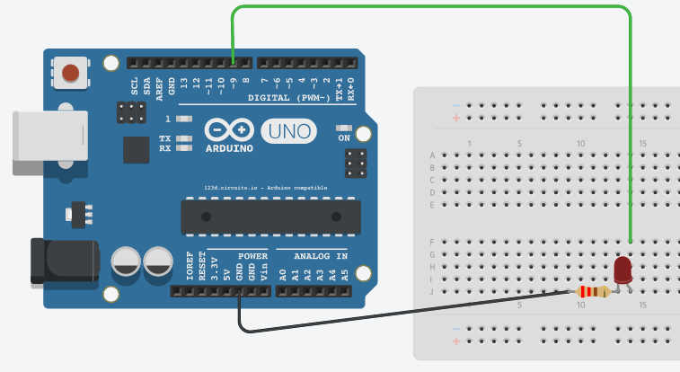
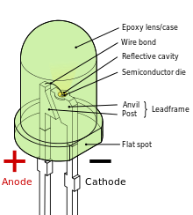
Tutorial 1 – Blinking an LED
Plug the LED to Anode to pin 13
Cathode to ground (GND)
Load the program
Serial Communication

Slide 9
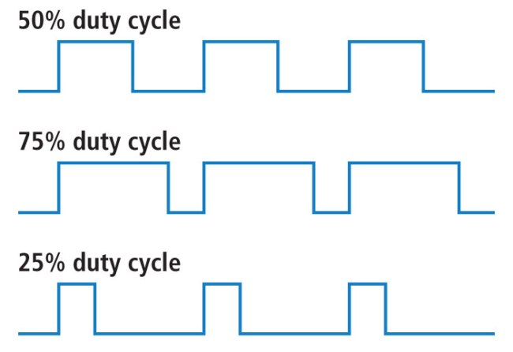
Pulse Width modulation (PWM)
The signal is ON (5V) for a proportion of time of the period – duty cycle
Duty cycle measured by percentage of ON time
Frequency usually is 500Hz
PWM create analogue effect with a digital output
Notes:
What if we want an analog output but only have a digital output. PWM mode is introduced to solve this problem. That is the digital output signal is blink so fast that it has an effectively equivalent effect that a analog signal can provide. That is, the output is on 5V for a proportion of time of a period of 20ms, say it is on for 10ms which is half the period. We then have a 50% duty circuit. This is effectively the same as we have an stable output of 2.5V as analog signal. So when it is injected to a LED, the brightess will indicate the analog value equivalently.

Slide 10
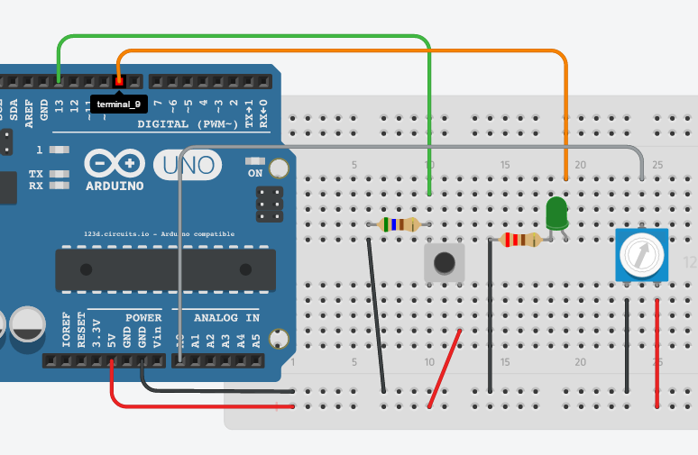
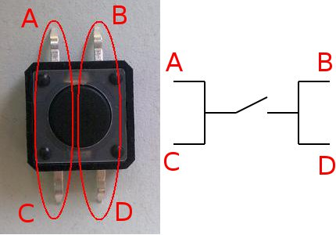
Tutorial 2 – Dimming & Flashing with button
Notes:
So we gonna make use PWM in the next tutorial. We gonna dimming an LED a push button. You can see the configuration of the button here, A-C, B-D is connected. All 4 port is connected when the button is press. So let’s make the circuit: pin 13 is deem as 0V when not pushed, when connection is make, pin 13 go straight to 5V as HIGH signal, a resistor must be there to limit the current or else it would make a short circuit. The potentiometer is there to act as a voltage divider which change the voltage of A0 when we rotate this needle. Now we go to the program part.

Slide 11
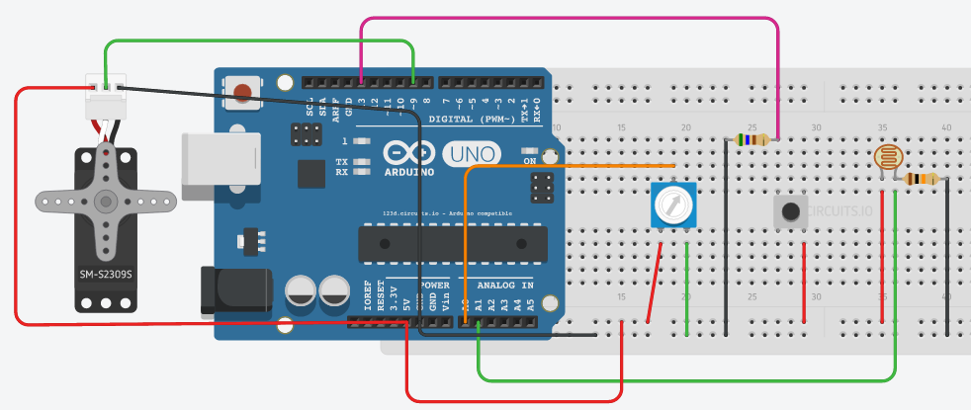
Tutorial 3 – Servo and photo resistor
Servo user PWM signal to drive the angle of the wheel
Servo will stay in that position, not rotating
Circuit with 2 mode, control servo by potentiometer or photoresistors
Notes:
Next I will introduce to you the photo resistor (light sensor) and the servo motor. Servo is a motor that is capable of maintaining a specific rotational position by controlling the PWM input. The light sensor, on the other hand, change its resistance according to the light condition surrounding it. It will become more conductive and source more current when more light intensity is injected. We gonna need a push button so that we will switch between 2 servo control modes: one is the sensor control the servo rotation, the other is the potentiometer control it instead. Let’s look into the code.

Slide 12
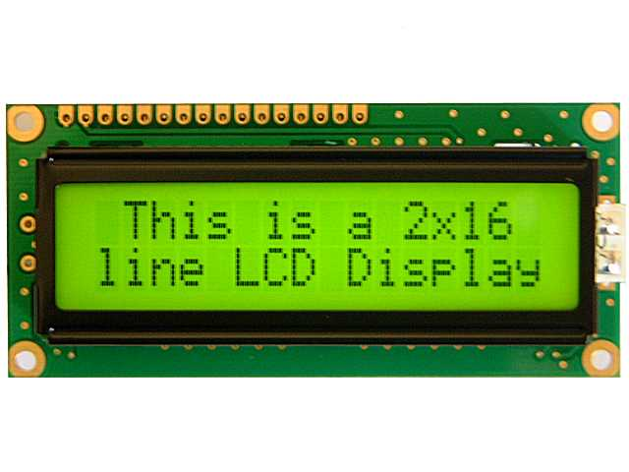
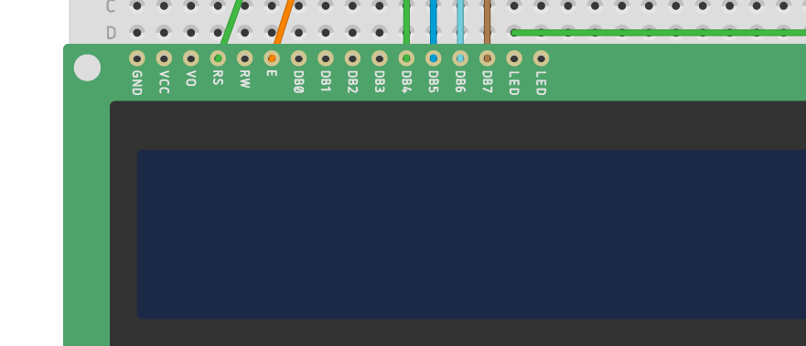
Tutorial 4 – LCD
16x2 LCD has 16 IO pin
Important: RS, EN, DB4, DB5, DB6, DB7
Control contrast (backlight): LED pin next to DB7
Other power pin: GND, VCC…
Notes:
The LCD we gonna use is the monochromatic LCD with an array of 16x2 character position and 16 IO pin, some important pin is RS, EN, DB4,5,6,7. The contrast of LED is control by the led pin next to pin DB7.

Slide 13
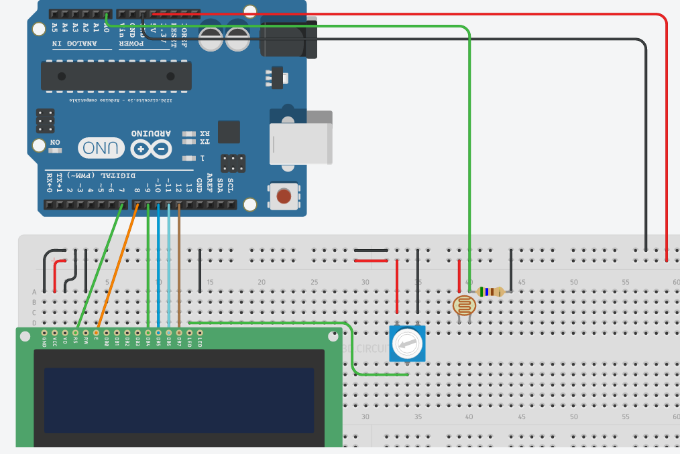
Tutorial 4 – LCD
Notes:
In this tutorial, we gonna display the current value of the light sensor on the LCD. The potentiometer is used to control the brightness of backlight. Let’s look the code.

Slide 14
Challenge: build a automatic gantry
Build an automatic gantry with Servo, photoresistor, push button, LCD
Sensor to sense a car coming
Servo to be the gantry
Button for user to press and pay
Open the gantry and close the gantry when the car pass
Display some message on the Screen with LCD
Notes:
This is the end of the workshop, I have a challenge to you that is building a automatic gantry for cars to pass. The ideas is that cars come to a gantry, tap the card and it will open the gantry, which is a servo, then close automatically when the car passed on.
Machanism is that we gonna use the light sensor to detect the car coming as it block a lazer source from the sensor. Then it ask the user to press button to unlock, then gantry open, it will only close once the car pass through (we may leave 1-2s gap for safety reason).

Slide 15
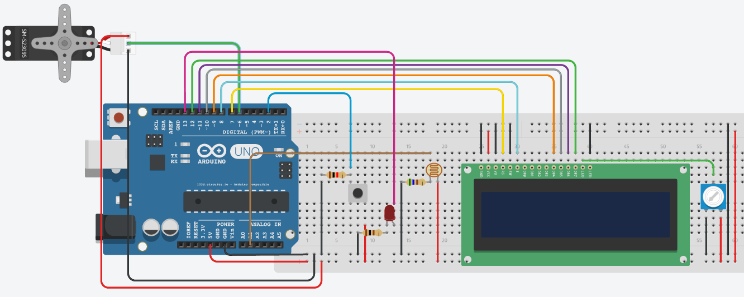
Challenge: build a automatic gantry

