Slide 1
Arduino Workshop
NTU Open Source Society

Slide 2
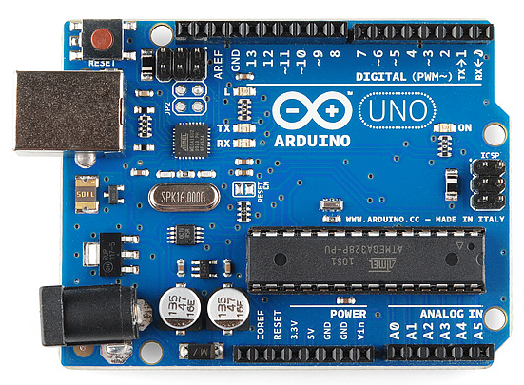
Introduction – What is it?
Electronic board to control electrical component
Deal with Digital and Analog signal
Use for prototyping, studying and more…
System specification:
MicroController: ATmega328P
Clock speed: 16 MHz (Veryyyy small)
Operating Voltage: 5V
Digital Pin: 14 (6 of which is PWM)
Analog pin: 6
RAM: 2KB (Veryyyy Small)
Flash memory: 32KB (Very small too)

Slide 3
I2C communication port
GND
Digital Pins:
13
12
11 – PWM
10 – PWM
9 – PWM
8
7
6 – PWM
5 – PWM
4
3 – PWM
2
1 – for Serial Commnicate
0 – for Serial
Power pins:
3.3V
5V
Ground (GND)
Analog Pin
A0 => A5

