Slide 1
Arduino Workshop
NTU Open Source Society

Slide 2
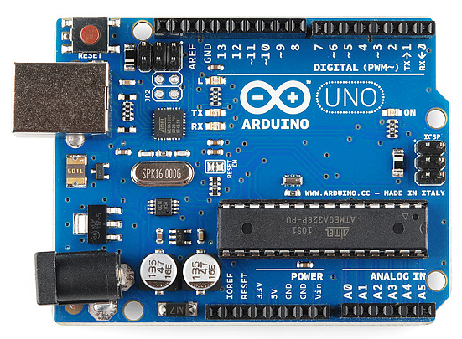
Introduction – What is it?
Electronic board to control electrical component
Deal with Digital and Analog signal
Use for prototyping, studying and IOT…
System specification:
MicroController: ATmega328P
Clock speed: 16 MHz (Veryyyy small)
Operating Voltage: 5V
Digital Pin: 14 (6 of which is PWM)
Analog pin: 6
RAM: 2KB (Veryyyy Small)
Flash memory: 32KB (Very small too)
Communication port: Serial, Software Serial, I2C
Connect the digital world to the physical world

Slide 3
I2C communication port
GND
Digital Pins:
13
12
11 – PWM
10 – PWM
9 – PWM
8
7
6 – PWM
5 – PWM
4
3 – PWM
2
1 – for Serial Commnicate
0 – for Serial
Power pins:
3.3V
5V
Ground (GND)
Analog Pin
A0 => A5

Slide 4
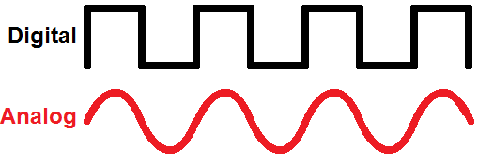
Digital vs Analog
Digital
Analog
Discrete Voltage value to represent digit 0 and 1 (0V and 5V)
Only 0 or 1 value make sense
Computational language - due to its precision and explicitness.
Convert to analog: DAC 10bit to (0 – 5V)
Variant voltage or current (etc) value to show physical property (light, heat…)
All values make sense
Real world properties – human interaction and physical and electrical control
Convert to digital: ADC: (0 – 5V) to 10bit

Slide 5
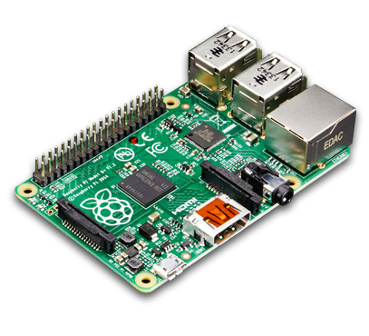
Arduino vs Raspberry Pi
Arduino
Raspberry Pi
CPU: 16MHz RAM: 2KB
Memory: Built-in flash memory (32KB)
IO Pin: 20 (both Digital & Analog) 5V
Software: NO
Price: Cheap
Good: Control electrical component (sensor, motors…), work with digital and analog signals, making robot, prototyping IOT
Bad: Slow, low memory, limit computational power.
CPU: ARM 1.2GHz RAM: 1GB
Memory: MicroSD card
IO Pin: 40 (digital only) 3.3V
Software: LINUX ( Debian-based)
Price: More expensive
Good: compact computer with all features & connection, fast, more memory for intensive computational process, low-voltage IOT project.
Bad: Low voltage(3.3V), lack of analog process,

Slide 6
Installation
Real Arduino and the Arduino IDE
IDE: https://www.arduino.cc/en/Main/Software
Visual Studio + Arduino: http://www.visualmicro.com/
Plaformio – Arduino with ATOM text editor: http://platformio.org/
Virtually on the web:
https://circuits.io/

Slide 7
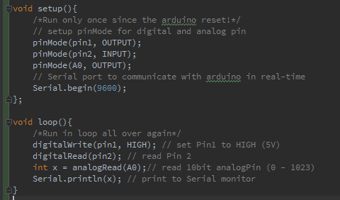
Tutorial 0 - C/C++ - more and less
.ino file uploaded to Arduino running on C/C++
Object oriented.
Lack of many C/C++ built-in library (ostream, std...)
Provide many “for – Arduino” built-in library (Servo, LiquildCrystal,…)
Support uint8_t, uint32_t… data type.

Slide 8
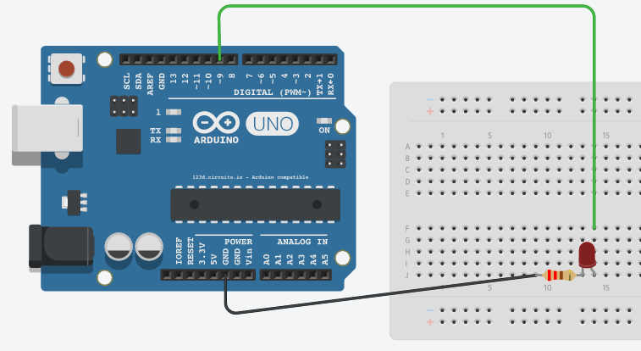
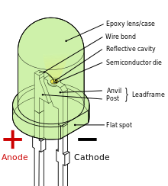
Tutorial 1 – Blinking an LED
Plug the LED to Anode to pin 13
Cathode to ground (GND)
Load the program

Slide 9
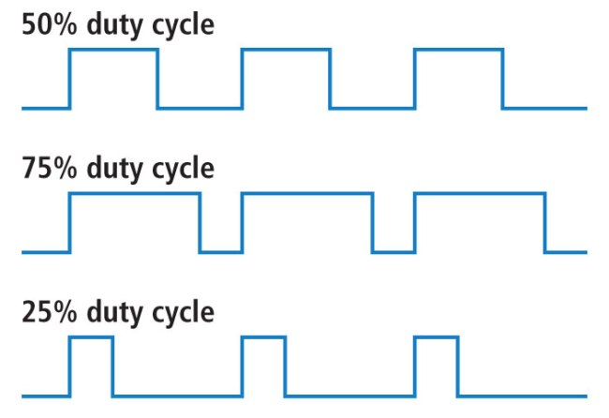
Pulse Width modulation (PWM)
The signal is ON (5V) for a proportion of time of the period – duty cycle
Duty cycle measured by percentage of ON time
Frequency usually is 500Hz
PWM create analogue effect with a digital output

Slide 10
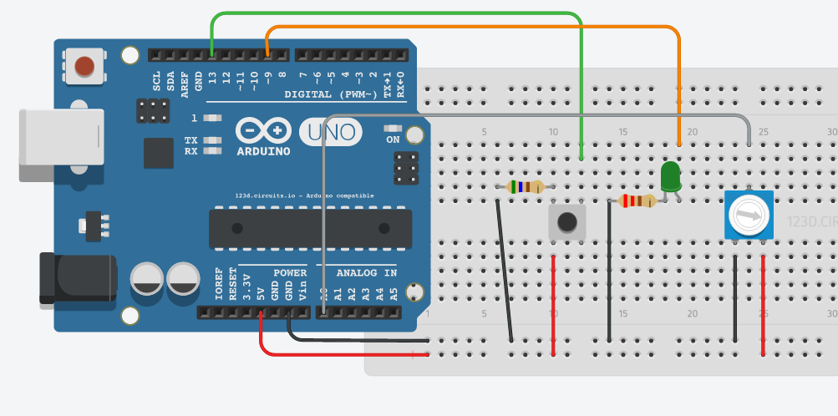
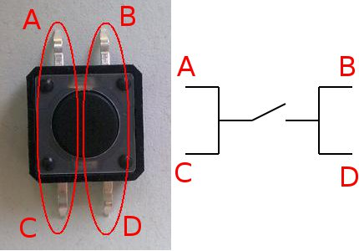
Tutorial 2 – Dimming & Flashing with button

Slide 11
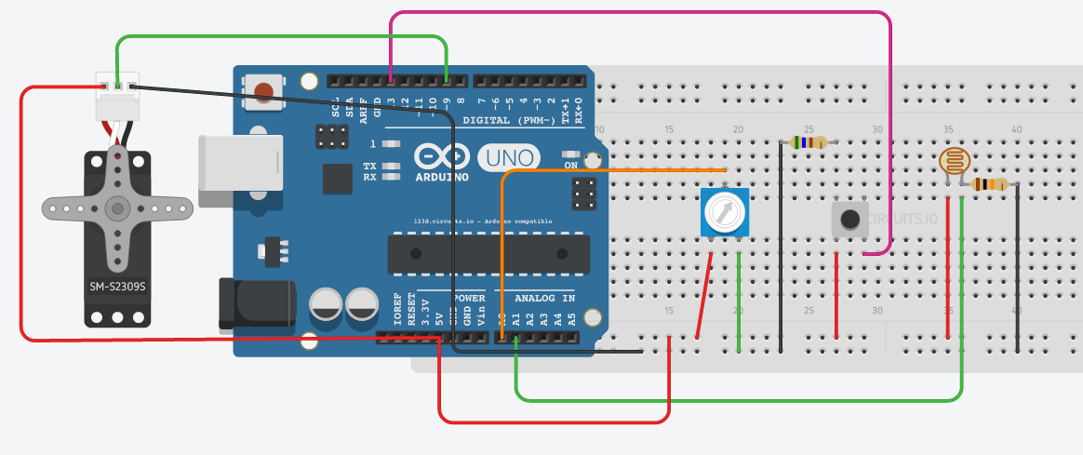
Tutorial 3 – Servo and photo resistor
Servo user PWM signal to drive the angle of the wheel
Servo will stay in that position, not rotating
Circuit with 2 mode, control servo by potentiometer or photoresistors

Slide 12
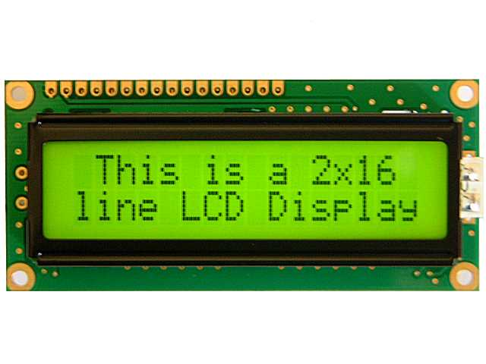
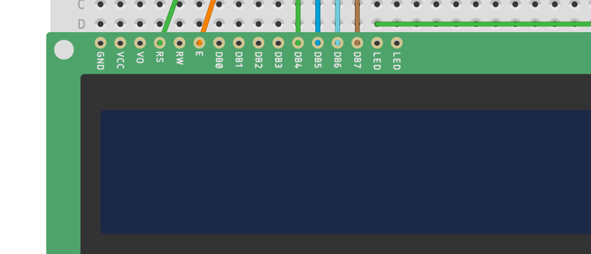
Tutorial 4 – LCD
16x2 LCD has 16 IO pin
Important: RS, EN, DB4, DB5, DB6, DB7
Control contrast: LED pin next to DB7
Other power pin: GND, VCC…

Slide 13
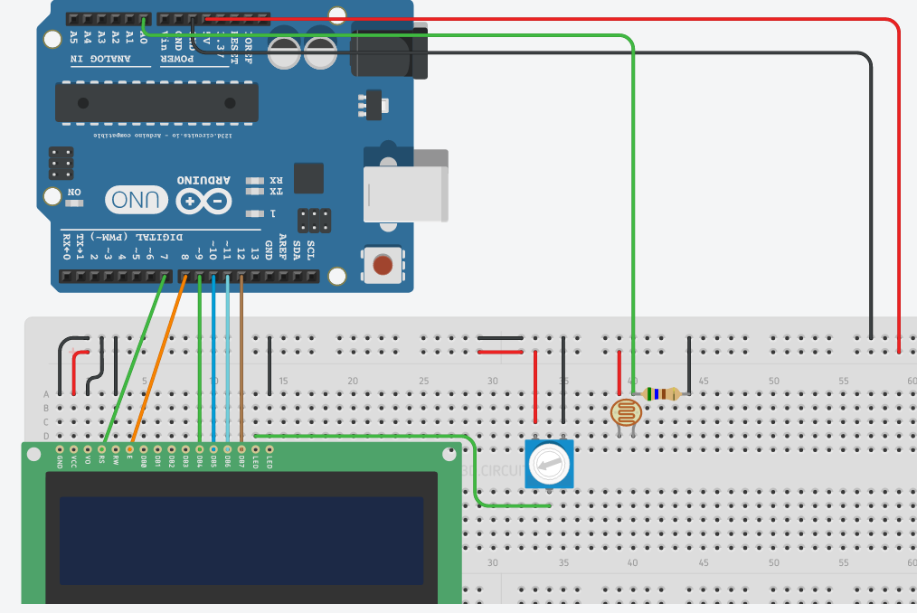
Tutorial 4 – LCD

Slide 14
Challenge: build a automatic gantry
Build an automatic gantry with Servo, photoresistor, push button, LCD
Sensor to sense a car coming
Servo to be the gantry
Button for user to press and pay
Open the gantry and close the gantry when the car pass
Display some message on the Screen with LCD

Slide 15
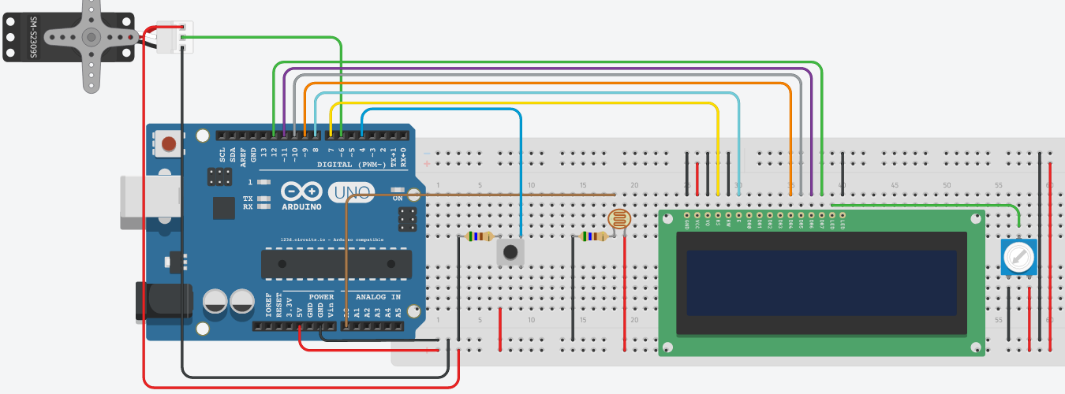
Challenge: build a automatic gantry

