Slide 1
Introduction to Raspberry Pi
NTU open source society

Slide 2
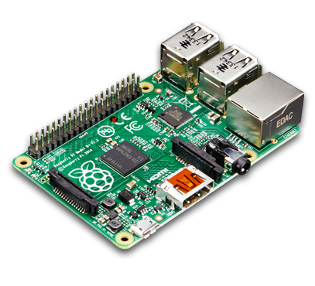
What is a Raspberry Pi?
A credit card-sized single-board which run as a portable computer with LINUX and a bunch of I/O pins
Use to promote low-cost computer science education, prototyping for IOT and electrical projects, and many more applications
Several generation:
Raspberry Pi 1 Model B (First)
Raspberry Pi 2
Raspberry Pi 3 Model B (newest)
Operation System: LINUX Raspbian (Debian)

Slide 3
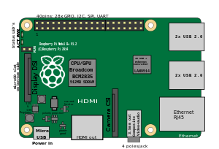
System specification (Rasp 3 model B)
CPU: 1.2 GHz quad-core ARM Cortex-A53
RAM: 1 GB LPDDR2 RAM at 900 MHz
Storage: MicroSD card
Graphic: Broadcom VideoCore
Port: 4USB, HDMI, LAN, camera, display
Network: LAN, Wifi, Bluetooth
IO pins: 40 pins (digital 3.3V)

Slide 4
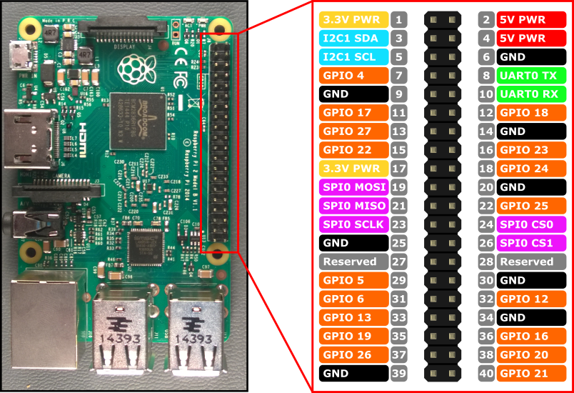
General purpose Input / Output Pin
GPIO make a raspberry pi a control circuit despite being a computer
GPIO work with 3.3V
Each pin as Pull up and down resistors
17 I/O digital pins
5 SPI pins
2 I2C pins
https://pinout.xyz/

Slide 5
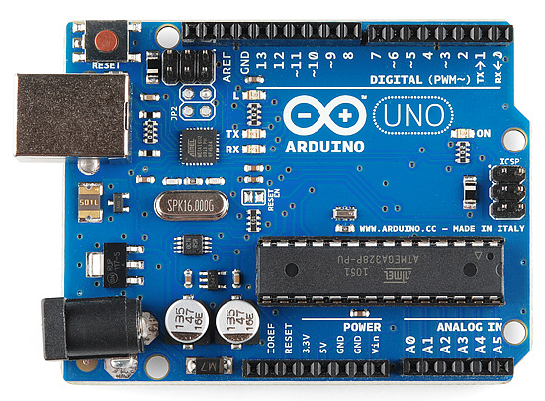
RaspBerry Pi vs Arduino
Raspberry Pi
Arduino
CPU: ARM 1.2GHz RAM: 1GB
Memory: MicroSD card
IO Pin: 40 (digital only) 3.3V
Software: LINUX ( Debian-based)
Price: More expensive (35USD)
Good: compact computer with all features & connection, fast, more memory for intensive computational process, low-voltage IOT project.
Bad: Low voltage(3.3V), lack of analog process,
CPU: 16MHz RAM: 2KB
Memory: Built-in flash memory (32KB)
IO Pin: 20 (both Digital & Analog) 5V
Software: NO
Price: Cheap
Good: Control electrical component (sensor, motors…), work with digital and analog signals, making robot, prototyping IOT
Bad: Slow, low memory, limit computational power.

Slide 6
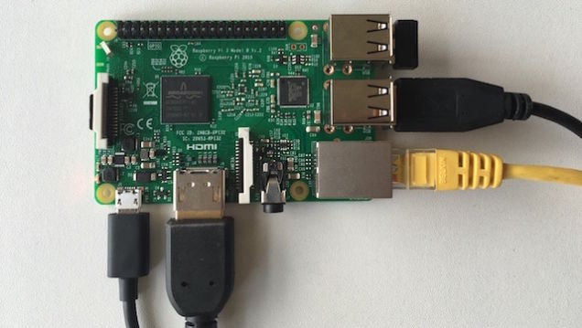
Setup – what you need
The Raspberry Pi, of course
HDMI monitor, keyboard, mouse(optional),
8GB SD card with NOOBS - https://www.raspberrypi.org/downloads/noobs/
Power supply (power bank or smartphone charger with microUSB port)
Wifi module, (before Raspberry Pi 3)
Connect them all to the Pi

Slide 7
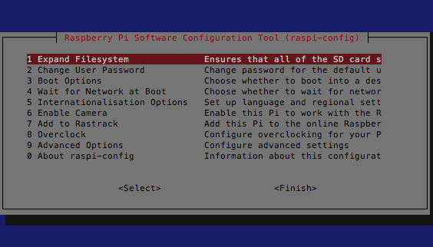
On startup
Connect to wifi
Sudo raspi-config
Change name, password
Change keyboard to US
Turn on SPI, I2C…
Turn on camera
Sudo apt-get update
Sudo apt-get install wiringpi
Sudo apt-get install python-rpi.gpio

Slide 8
SSH connection (LINUX, Mac, Windows)
You don’t need an extra monitor or keyboard…
Default in LINUX and Mac, Windows must use Putty to connect
Choose your favourite Wi-Fi, make the pi connect to it
Get the IP address: ifconfig – then look for wlan0 inet-address (192.168.xx.xx)
Get your computer connect to that wifi (linux or Mac):
ssh pi@192.168.xx.xx Then you control Pi through terminal
scp <file> pi@192.168.xx.xx:/home/pi/destination To copy file to Pi

Slide 9
GPIO Tutorial 0: LED, PWM with button
Make LED blink with GPIO pins output
Control blinking frequency with button
Make LED dim and shine gradually with PWM pins

Slide 10
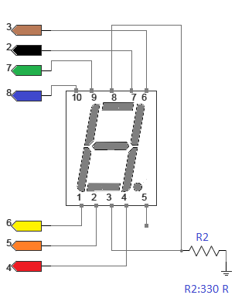
GPIO Tutorial 1: 7 segment digit
Determine the common is common Anode(+) or Cathode(-)
Connect accordingly to BCM pins of the Pi
Change the program, test run
Count from 0 – 9
Addition
Control with button

Slide 11
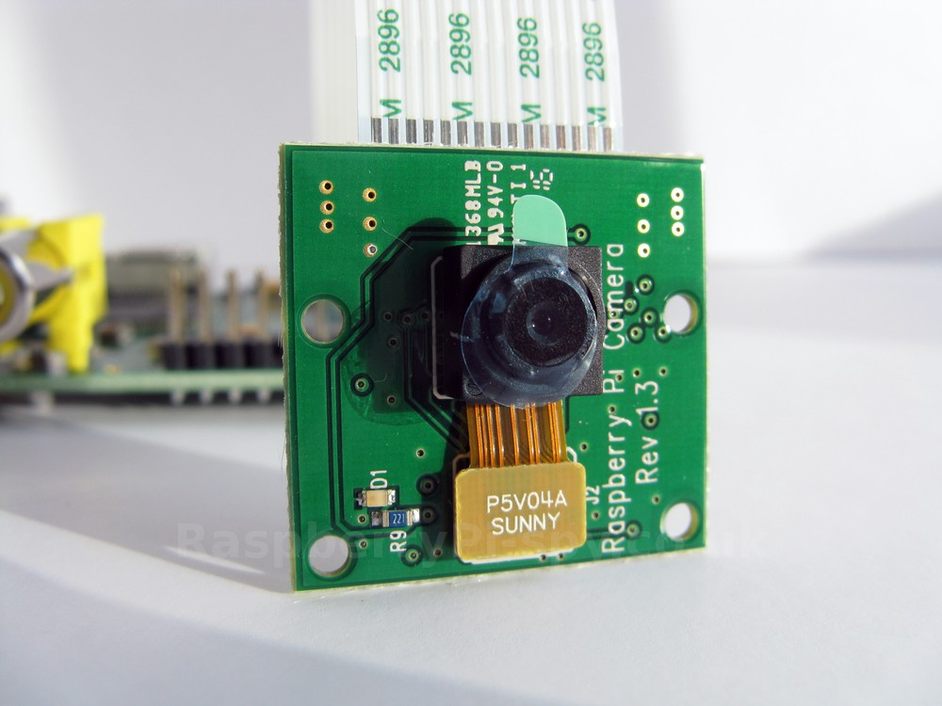
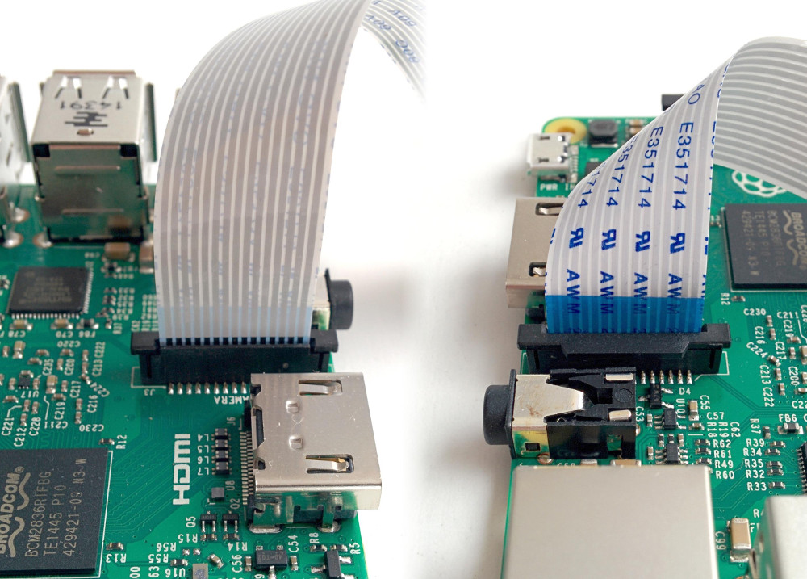
Tutorial 2: take a picture
Load the program
Take a picture,
SCP to computer and see it.

Slide 12
Reference:
https://pinout.xyz/
https://learn.sparkfun.com/tutorials/raspberry-gpio
http://wiringpi.com/
https://www.raspberrypi.org/learning/getting-started-with-picamera/worksheet/
http://www.instructables.com/id/Read-and-write-from-serial-port-with-Raspberry-Pi/

