Slide 1
Server MVS
Author: Nguyen Xuan Phi (U1522995A)
https://github.com/nxphi47/serverMVS

Slide 2
Introduction
This server database service provide shop owners a mean to manipulate the product data to match with MVS mobile application as well as provide tools for them to analyze their business management.
The server implement Spring MVC framework which use Java as platform language.

Slide 3
Usage - functionalities
Create company to manipulate product information
Upload and manage product image – used in MVS application
[Analysis] Stock tracking, profit estimation, auto-purchase-update system and other tools to support shop owner’s business
Targeted advertisement: publish and target ads, promotions to specific and relevant customers.

Slide 4
Database composition
The system use Hyper SQL database with below tables, each table attaches to a Java model class (see sourcecode for detail – “model” package)
User: fullName, username, password, email…
Company: companyName, category, address, postalCode…
Products: prodId, prodName, prodCategory, price, stock…
Images: imgName, filename, folder, description, date
Sale: saleName, saleCategory, quantity, discount, total, product<object>, buyer<object>
Please access “predefinedDB.xml” to make some initial data before launching

Slide 5
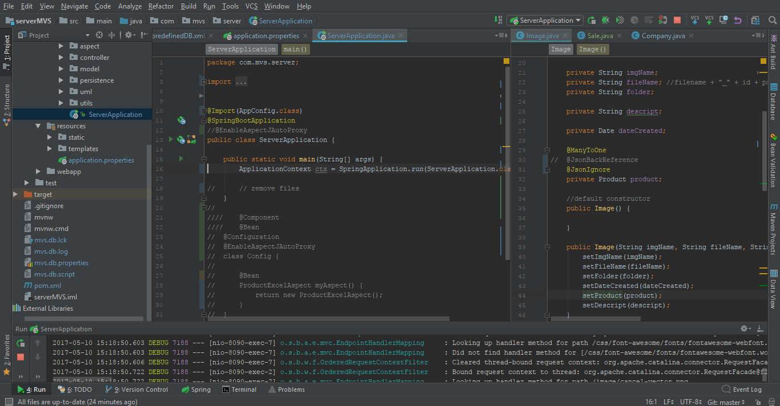
Demo: setup
Download eclipse for Java EE or Intellij IDEA professional (recommended – can use NTU account to get free license)
From IDE, open project folder and start application in ServerApplication.java main execution.

Slide 6
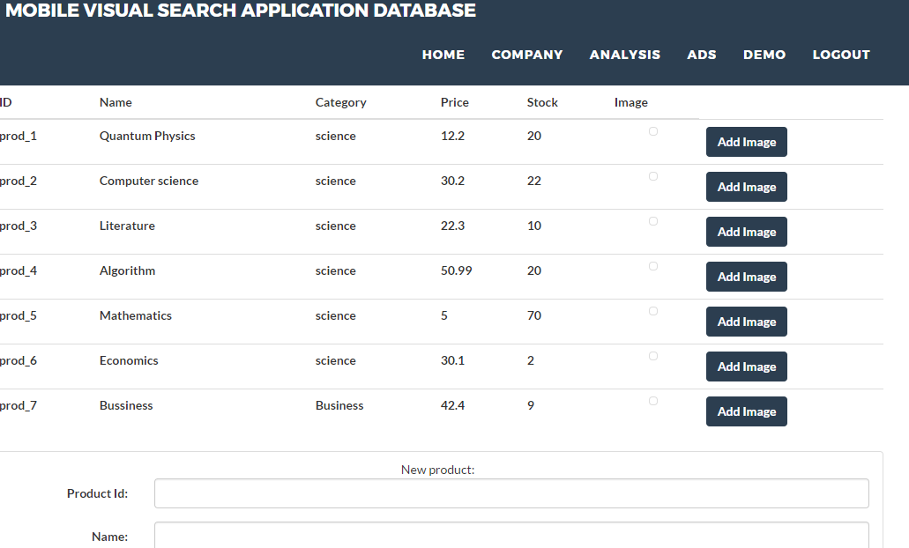
Demo: web interface
Access: http://localhost:8090
Login with a company-attached account in predefinedDB.xml as “sign up” yet to be developed
Access Company page, begin to add and modify each product and upload image

Slide 7
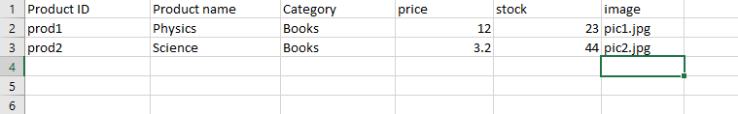
Demo: web interface
Add new product individually
Add multiple products with excel file (access template) and select as many as images at once (totally less than 100mb)
Image column define the name of image file you want to select, and must be unique, prodID must also unique

Slide 8
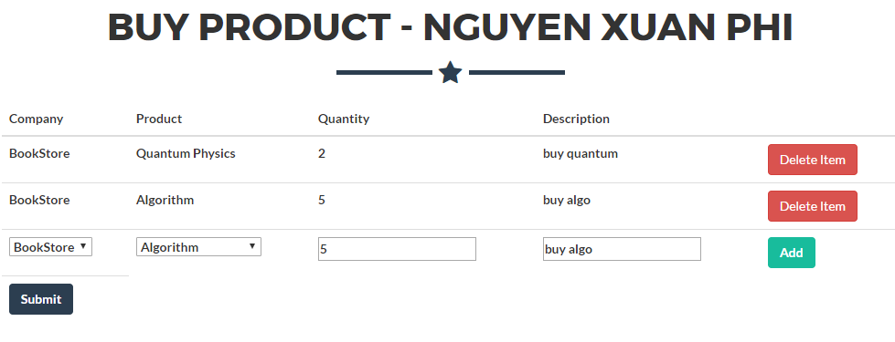
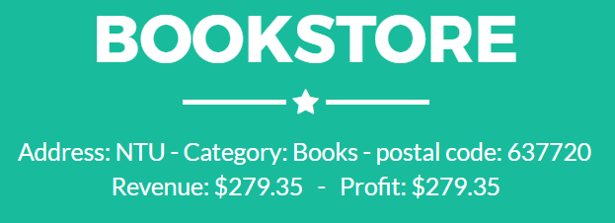
Demo: web interface - purchase
Access Demo tab – where you can make a virtual purchase (supposed to be from MVS application)
Select company, product, quantities and description then submit to buy these products.
Back to company page, profit, revenue, and specific stock value are automatically updated (not quite correctly)

Slide 9
What to be develop
Tab “analysis” is where shop owner perform business analysis, plot graph, predict trends…
Tab “ads” is where we can make promotion, targeted advertisements with our frequent customers who using MVS mobile application
Sign up and other account settings function
Profit and revenue automatic updating is not correct as we don’t know the import price

Slide 10
Database structure
company
user
One to many
One to many
One to many
product
sale
One to many
One to many
Image

Slide 11

How spring mvc works
MVC = model – controller – view
https://spring.io/ for more information
Model is database object model (user, company…)
User request to controller, controller perform the business logic on model
Model then updates the view (HTML, JSON data) back to user
All these process are separated from each other

Slide 12
server structure
Database+files
JpaService
Purchase transaction
Other
FileManager
Service
Transaction
ExcelManager
Image manager
Model
Controller
Rest + View
Front end
Observer
Observable
Aspect
Product Excel aspect
Other
Other
Point cut and join point
Other
Controller
View Controller
Rest controller

Slide 13
server structure
Request come from front end will pass to controller, controller create a transaction of that event
Transaction import the data and execute its operation with its main JPAServices
All JPAService will be retrieved from JPAServiceFactory
Transaction notifies all its observer services to execute their update() based on what transaction have done
Example: purchase is made, product and user service will mainly operation, company service as an observer will then update its profit and revenue
JPAService execute its own operation on JPA repository (call from JpaRepositoryFactory):
CompanyJpaService insert, update, delete company information (in general), update profit/revenue when purchase made
UserJpaService insert, update, delete company information (in general)
Any further specific implementation on database must be a class inheriting from these JpaService
JpaService is also an observer, it will execute update() method whenever an observable (Transaction) notify them
FileManagerService execute operation on fiels (call from FileSevicerFactory)
Filemanager, imageManager will handle uploading files and images of product, return image or file as HTTPResponseBody
ExcelManager handle uploading and reading and operate on excel file uploaded from front end
ProdAndImgExcelManager handle excel file for multiple product and multiple images upload at the same time
Extraction of data from EXCEL is done from ProductExcelAspect, where the point cut and joint point is the operation of reading excel file. Please read more on Aspect Oriented Programming, as it is important to understand and fully integrated in spring framework

