Slide 1
An Integrated Web Application Utilizing Real-Time Weather API Data to Deliver Comprehensive Forecasts, Climate Trends
by
Aziz Al Aman & Abdul Hai Siddiki Ansary

Slide 2
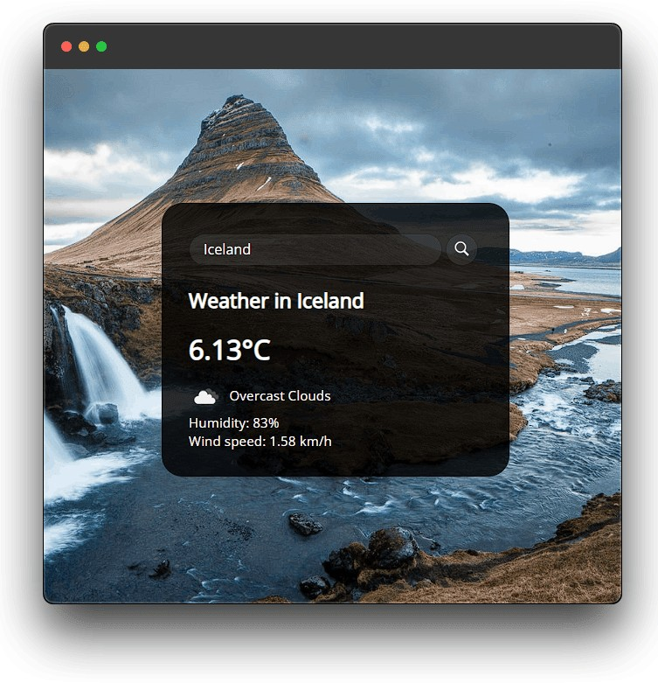
Introduction
Weather Web App: Learn how to build a weather web app using JS, CSS, HTML, and the OpenWeatherMap API. This presentation will cover everything from setting up your environment to making API calls and displaying the weather data on your web page.

Slide 3
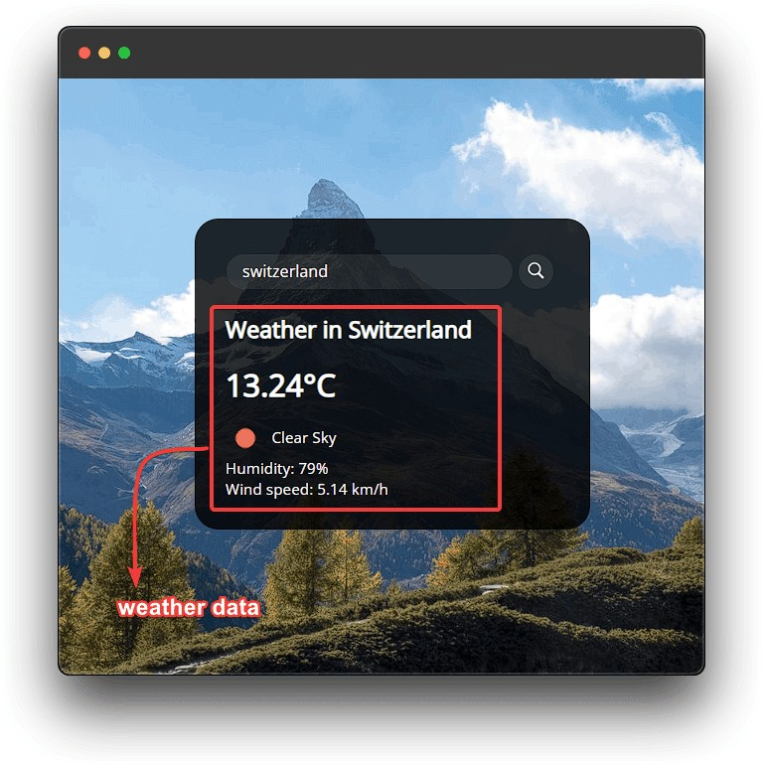
App Overview
Visualizing Data: Once you've retrieved the weather data, you need to display it on your web page. This slide will cover how to use CSS and JavaScript to create a visually appealing weather
display.

Slide 4
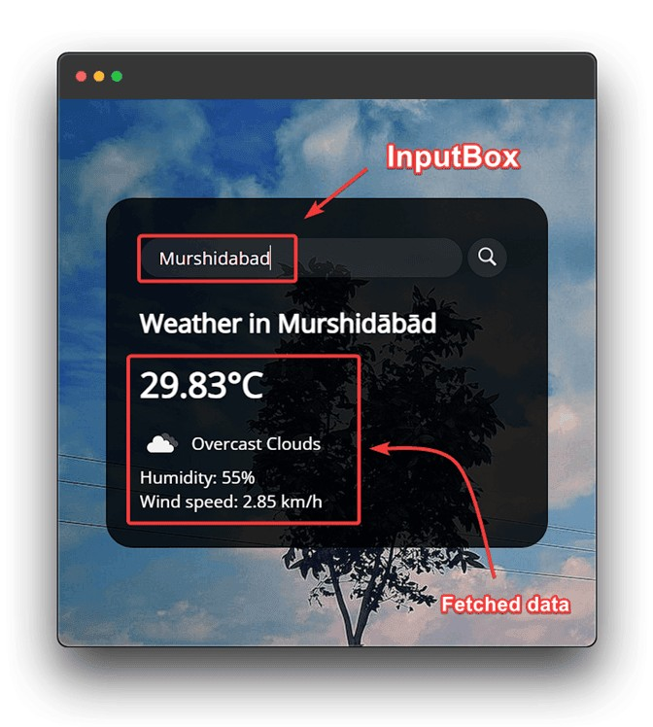
Adding User Interactivity
User Experience: A good weather web app should allow users to interact with the data. This slide will cover how to add user interactivity using JavaScript, such as allowing users to search for speciﬁc locations or toggle between different views.

Slide 5

Technologies Used
HTML, CSS, JavaScript Our app is crafted using the fundamental trio of web development: HTML for structure, CSS for style, and JavaScript for interactivity. This combination enables a dynamic and visually engaging user experience.Responsive DesignThe app's layout adapts ﬂawlessly to various devices, ensuring user-friendliness across screens..

Slide 6
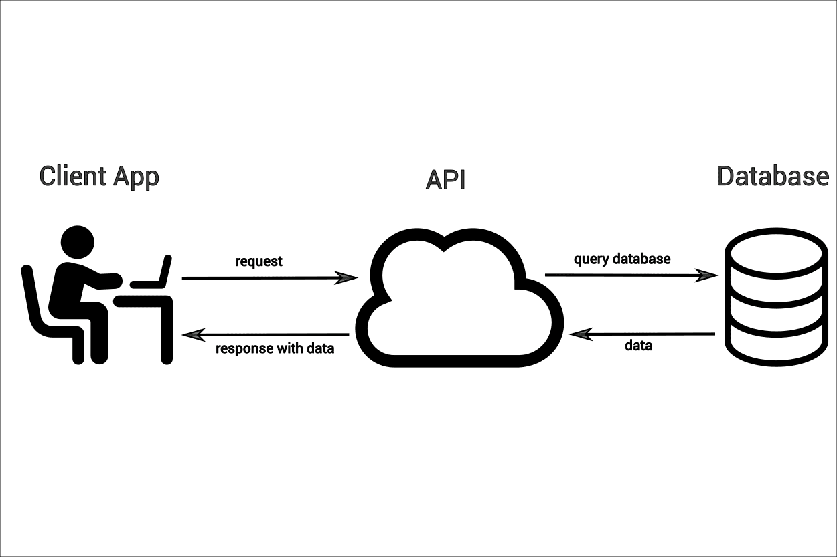
OpenWeatherMap API
Making API Calls:
Real-Time Weather DataOur app sources real-time weather data from the OpenWeatherMap API, a comprehensive weather information provider.
Features:
Current conditions: Display of up-to-date weather information.
Forecast: Accurate predictions for the upcoming days.
Location-based search: Customized weather data for user- deﬁned locations.
API Integration:
We seamlessly integrate the API into our app's JavaScript code, fetching data and dynamically updating the interface.
With the OpenWeatherMap API, our app ensures users are informed and prepared for the elements.

Slide 7
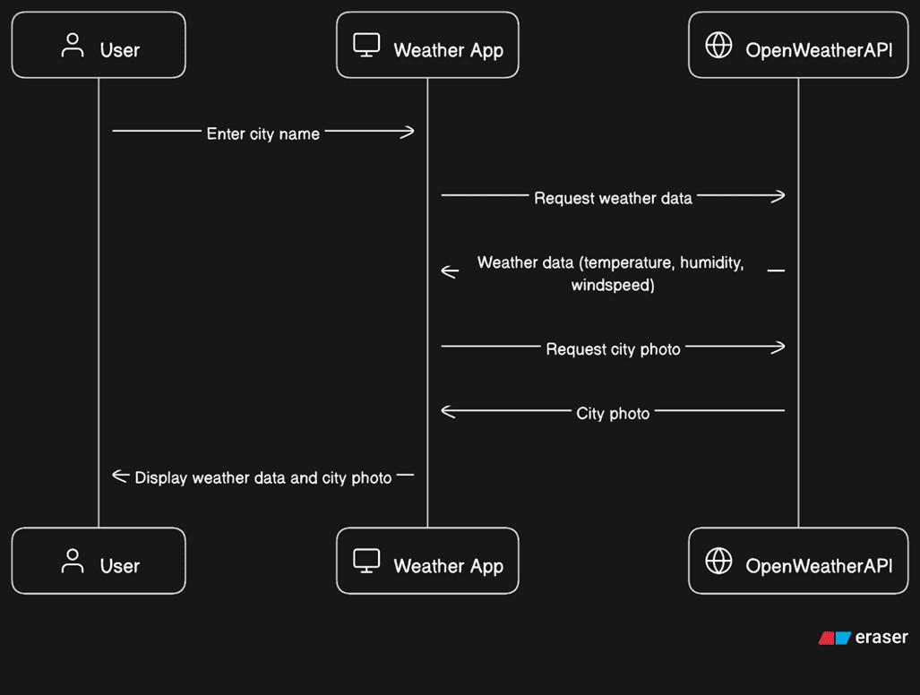
Data Flow Diagram (DFD)
This represents the main functionalities of the weather app. It consists of two main processes: "Fetch Weather Data" and "Display Weather Data."
Fetch Weather Data: This level breaks down the
"Fetch Weather Data" process into processes. The first sub-process,
two sub- "Send API
Request," sends a request to the OpenWeatherMap API to fetch weather data. The second sub-process, "Receive API Response," receives the response containing weather information.
Display Weather Data: This level elaborates on the "Display Weather Data" process. It includes two sub- processes: "Render Current Weather" and "Render Weather Forecast." These sub-processes handle the rendering of current weather information and weather forecasts, respectively.

Slide 8
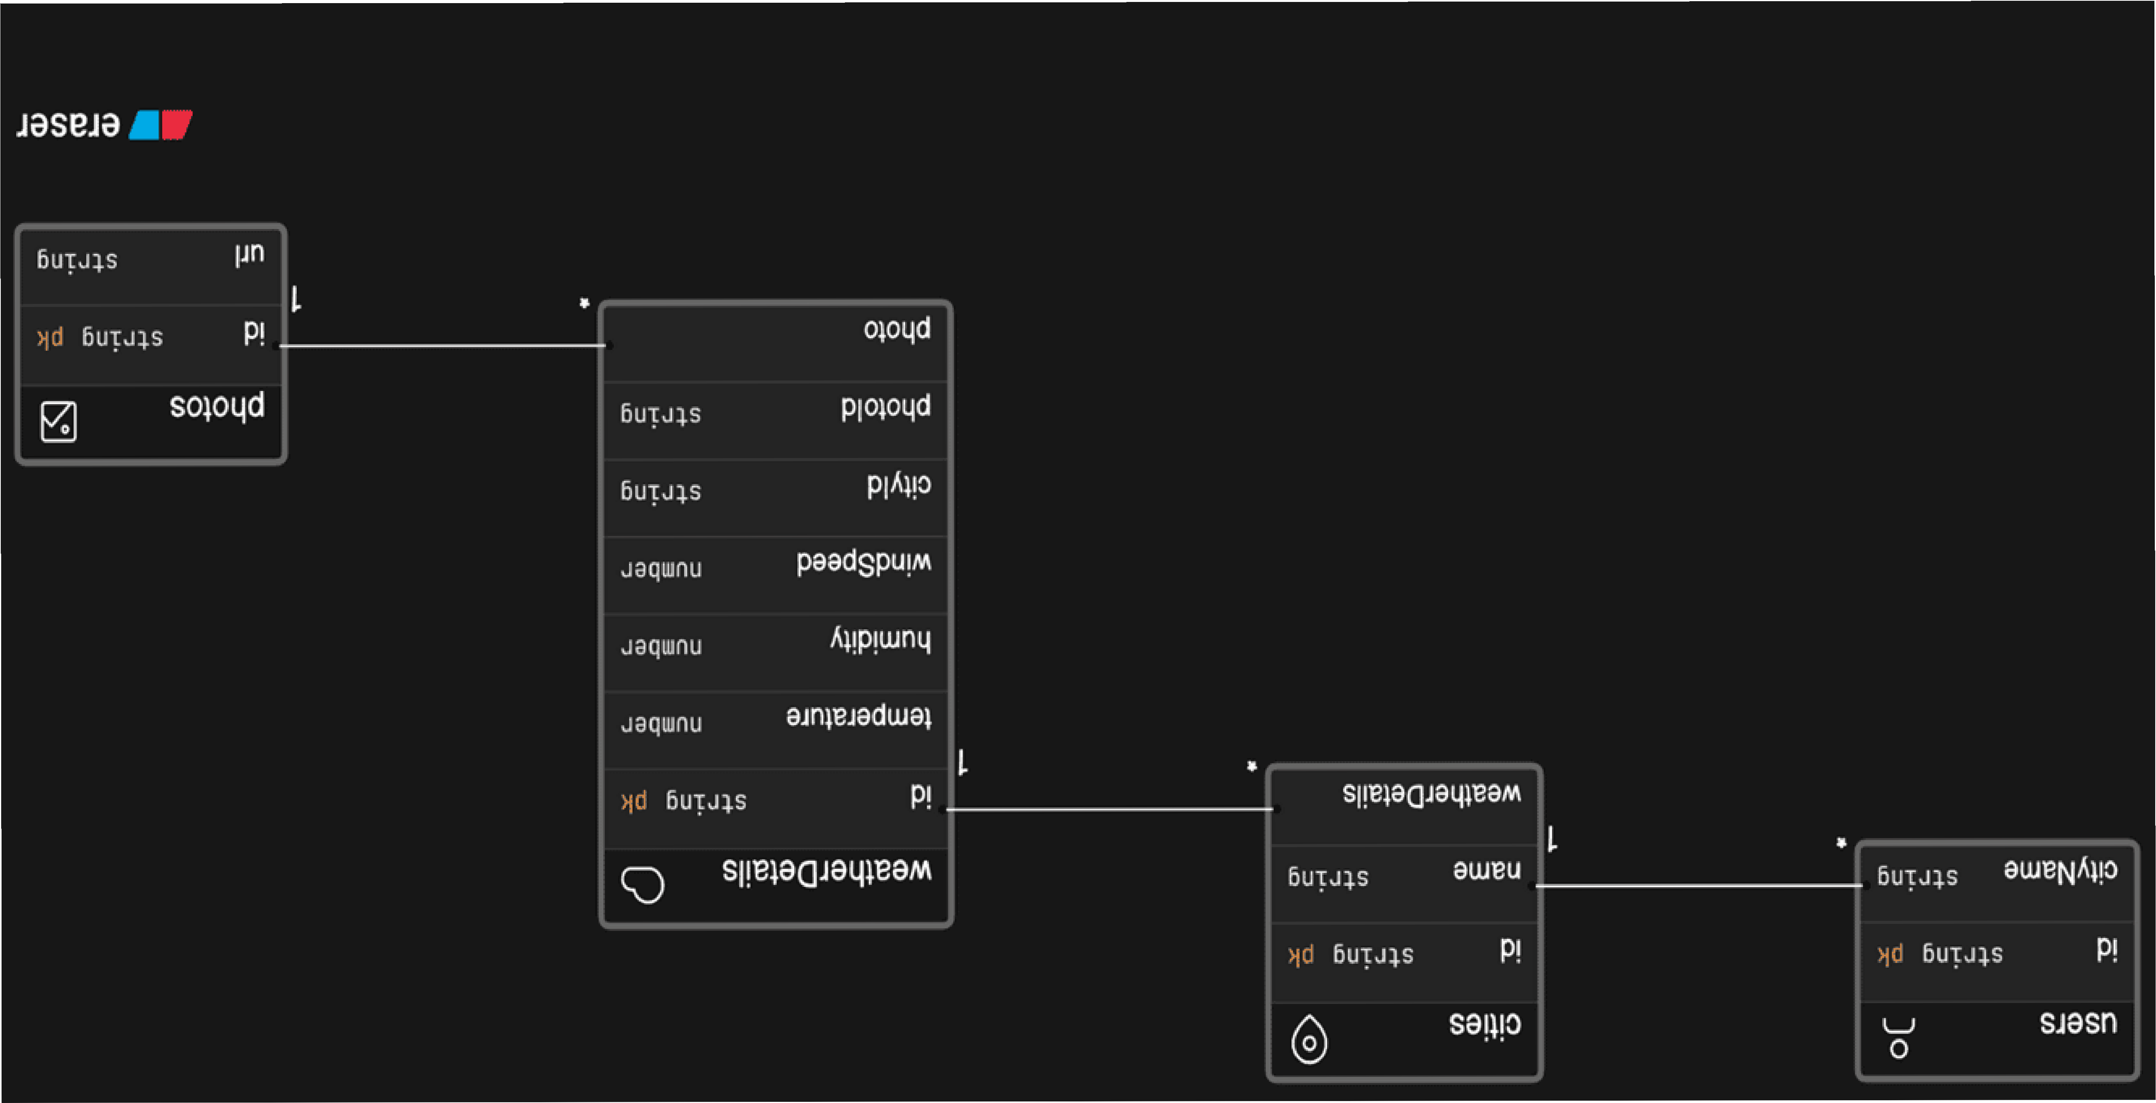
Entity Relationship Diagram (ERD):
Entities:
Location: Represents a specific location for which weather data is being fetched. Each location has a unique LocationID and includes attributes like City and Country.
WeatherData: Stores information retrieved for
the weather a particular
location. Each set of weather data has a unique WeatherDataID and is associated with a specific LocationID. The attributes include Temperature, Humidity, WindSpeed, and WeatherDescription.
Relationship: The relationship between Location and WeatherData is established through the LocationID foreign key in the WeatherData table, connecting each set of weather data to its corresponding location.

Slide 9



Challenges Faced
API Integration Complexity : Integrating the OpenWeatherMap API seamlessly into our app posed difficulties, requiring thorough understanding of API endpoints, request formats, and handling responses.
Data Presentation: Effectively visualizing comple weather data in a user-friendly manner was a challenge. We needed to strike a balance between providing comprehensive information and avoiding overwhelming the user.
Responsive Design: Ensuring that our app looked and functioned well across various devices was a challenge. Adapting the layout to di"erent screen sizes while maintaining usability was a task that required meticulous testing.
Error Handling: Managing errors that could arise from API calls or une pected user inputs was essential. Implementing robust error-handling mechanisms without disrupting the user e perience was a delicate balancing act.
Performance Optimization: Striving for optimal performance, especially when fetching data and rendering it dynamically, required careful consideration of code ekciency and minimizing network requests.

Slide 10
Conclusion
In conclusion, our Weather App powered by the OpenWeatherMap API represents the synergy of technology and user-centric design. With HTML, CSS, and JavaScript as our tools, we've crafted an application that not only delivers real-time weather data but also offers an intuitive and engaging experience.
Through challenges faced and solutions devised, we've honed our development skills and gained valuable insights into API integration, user interface design, and responsive
development. The journey has affirmed the importance of adaptability, collaboration, and continuous learning in the ever-evolving landscape of app development.
As we embrace future enhancements and possibilities, we remain committed to providing users with accurate weather information while ensuring a seamless, visually appealing, and user-friendly interaction. Thank you for joining us on this journey of innovation and exploration.

Slide 11
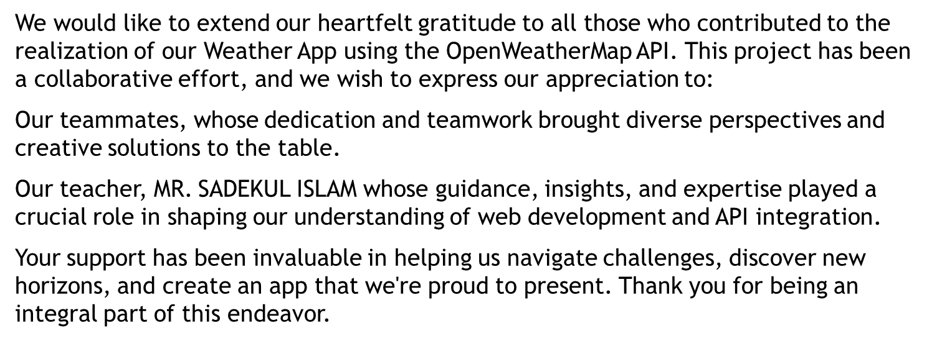
Acknowledgement

Slide 12

Thanks!

