Slide 1


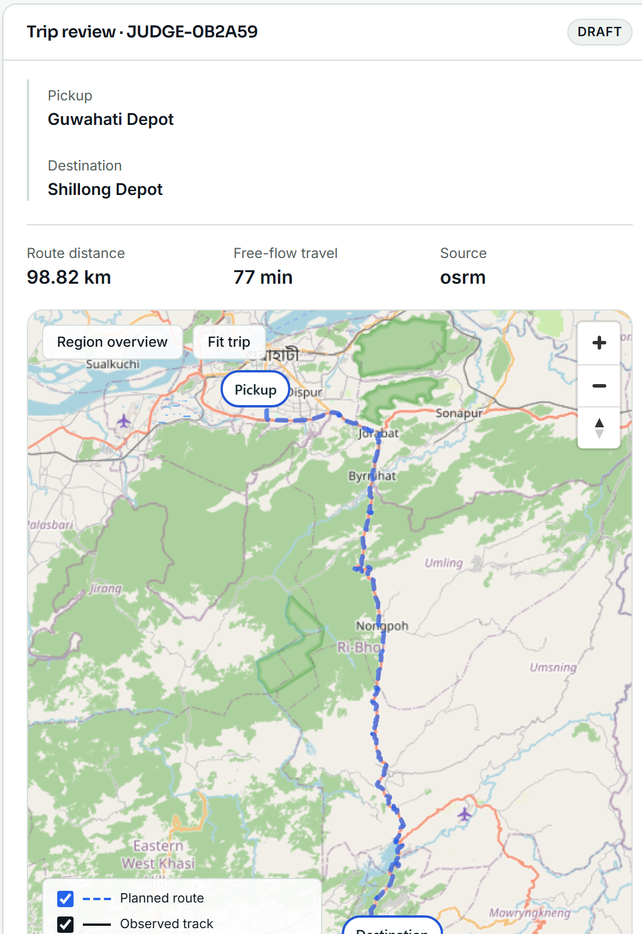
SMART INDIA HACKATHON 2026
RASTA AI
Route Intelligence for Essential-Supply Logistics in North Eastern India
SIH26002
Problem Statement ID
MDoNER · Smart Automation · Software
PROBLEM STATEMENT ID
SIH26002
PROBLEM STATEMENT TITLE
AI-Based Smart Logistics and Accessibility Intelligence Platform for North Eastern Region (NER)
THEME
Smart Automation
PS CATEGORY
Software
TEAM ID
17 (internal group no.)
TEAM NAME
NER-AI LOGISTICS
End-to-end working prototype · physical-phone validated · live demo corridor Guwahati → Shillong
Manager route review · Driver navigation — real screens

Slide 2
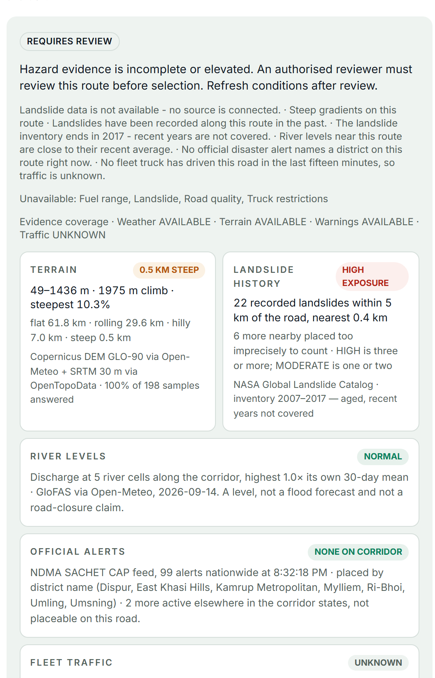
RASTA AI — ROUTE INTELLIGENCE
NER-AI LOGISTICS
PROPOSED SOLUTION
NOT THE SHORTEST ROAD. THE ROAD THAT IS OPERATIONALLY USABLE NOW.
NER corridors: mountain terrain · monsoon · landslides · floods · road disruption · weak connectivity · stale evidence. A shortest-path router still sends the truck.
A NORMAL ROUTER
RASTA AI
Origin
Origin
Real route · OSRM road, alternatives, turn steps
Shortest / fastest road
ROUTE-SPECIFIC EVIDENCE sampled along the selected road, each factor with its freshness
Truck
Terrain
Weather
Landslide exposure
Flood context
Official warnings
Fleet traffic
Evidence freshness
No terrain, weather, hazard or freshness check.
No governance. No answer when data is missing.
OPERATIONAL DECISION · CONTINUE / CAUTION / HOLD / REROUTE
Manager governance · reviews evidence, authorises, dispatches, approves reroutes
Driver · navigation, danger context, 23 languages, offline package
UNKNOWN ≠ SAFE
The system refuses to fabricate certainty: missing or stale evidence is marked UNKNOWN, never counted as safe, and the route goes to an authorised reviewer.
Manager · Check conditions (real screen)

Slide 3
TECHNICAL APPROACH
NER-AI LOGISTICS
VERIFIED DATA · provider adapters with health + freshness
WHO DECIDES — AI IS SUPPORTING
WEATHER
Open-Meteo · MET Norway
TERRAIN
Copernicus DEM · OpenTopoData
WARNINGS
NDMA SACHET (CAP)
FLOOD
GloFAS
LANDSLIDE HISTORY
NASA GLC 2007–17
TRAFFIC
fleet GPS fixes
DETERMINISTIC SAFETY ENGINE
makes every operational decision
ROUTE-SPECIFIC EVIDENCE · FastAPI backend
every factor sampled along the selected road · PostgreSQL + PostGIS (Supabase) · OSRM routes, alternatives, turn steps · freshness per factor
GEMINI / OPENROUTER (LLM)
explains the decision and assists in the driver's language — never decides
DETERMINISTIC SAFETY POLICY
11 factors · reason codes · UNKNOWN ≠ SAFE · reviewer authorisation when hazard data is missing
EXPERIMENTAL ML
research channel only; kept outside routing by the safety-validation gate
CONTINUE
CAUTION
HOLD
REROUTE
MANAGER REVIEW
DRIVER NAVIGATION
ROUTE-AHEAD MONITOR (60 s)
CONDITIONS CHANGE?
REASSESS / REROUTE
GOVERNANCE CHAIN
Verified evidence
Decision loop: conditions are re-scored every 60 s along the road ahead; a material change goes back through the policy, and a reroute is proposed to the manager — never applied silently.
Deterministic safety policy
CLIENTS Manager console — React + TypeScript, manager accounts only · Driver app — React Native / Expo, Android; one login, server-decided role, offline trip package
STACK FastAPI · PostgreSQL / PostGIS (Supabase) · React · React Native / Expo · OSRM · OpenStreetMap · Gemini
EVIDENCE Open-Meteo / MET Norway · NDMA SACHET · GloFAS · NASA historical landslides · OpenTopoData / Copernicus DEM
Manager review
Driver action

Slide 4

FEASIBILITY AND VIABILITY
NER-AI LOGISTICS
NOT A CONCEPT — A PHYSICAL, END-TO-END WORKING PROTOTYPE
MANAGER ROUTE REVIEW
DISPATCH
DRIVER ACCEPT + TRUCK CHECK
NAVIGATION
OFF-ROUTE
REROUTE
MANAGER APPROVAL
DELIVERY
PROOF
Physical Android phone · hosted backend · real roads
12/12
judge-flow steps on the phone: dispatch → accept → truck check → GPS navigation → real off-route → reroute → manager approval → stops → delivery
9/9
role steps: driver ↔ manager sign-in on one APK, no data leak
1138+
backend tests · 621+ driver tests · 170+ manager tests
PHYSICAL ANDROID · CERTIFIED
Canonical demo Guwahati → Shillong · ≈ 98.8 km real route
Manager · route review
Driver · truck check
Driver · navigation
KNOWN LIMITS → MITIGATION Render cold start → warm /health before the demo · provider rate limits → cached evidence + explicit UNKNOWN · background push needs Firebase config → in-app alerts already work · experimental ML → outside routing until the gate passes
Notes:
Judge answer on ML: We trained and evaluated a landslide-hazard model, but deliberately keep it outside production routing because its geographic false-positive rate is still too high (recall 0.95 at FPR 0.50 on the NER holdout). This prevents unreliable ML from making safety-critical decisions. Tests: backend 1138 passed / 5 skipped, driver 621, manager 170 (14 Sep 2026, commit 0b89ddf). Physical certification: docs/terrain/HANDOFF.md section 9; judge flow 12/12, role flow 9/9 on APK 1.0.18.

Slide 5


IMPACT AND BENEFITS
NER-AI LOGISTICS
RASTA AI does not ask only “Which road is shortest?” It asks “Can this truck reliably use this corridor now?”
FOOD · MEDICINE · FUEL · RELIEF SUPPLIES — essential logistics for hill communities, decided on evidence
WHO BENEFITS
FLEET MANAGERS
Route usability and uncertainty visible before dispatch; auditable decisions.
DRIVERS
Safer navigation, danger context, emergency support, 23 languages.
REMOTE COMMUNITIES
More resilient access to food, medicine, fuel and relief supplies.
GOVERNMENT / OPERATIONS
Auditable route evidence and disruption visibility per corridor.
DEMONSTRATED TODAY
Driver · 23 languages
Manager · mobile
23
selectable languages, explicit fallback status
12/12
judge-flow steps certified on a physical phone
Real screens, APK 1.0.18. One login, server-decided role: a manager gets a mobile fleet view, a driver gets navigation. Each language shows its status — Verified, Draft or English fallback — so nobody is misled.
11
route factors in every decision
100 %
of reroutes reviewed by a human
60 s
route-ahead monitor while driving
0
unknown factors counted as safe
HUMAN GOVERNANCE — AI HAS NO UNCONTROLLED AUTHORITY
Verified evidence
Deterministic safety policy
Manager governance
Driver action
No invented percentages: impact is stated as who gains what, backed by the working system.

Slide 6
RESEARCH AND REFERENCES
NER-AI LOGISTICS
RESEARCH / EVIDENCE SOURCES BEHIND THE ROUTE DECISION
EXPERIMENTAL LANDSLIDE RESEARCH · ML-ready architecture, model not in production
NASA Global Landslide Catalog
historical landslide exposure; inventory 2007–2017, ≤5 km accuracy filter
95 %
RECALL
NER geographic holdout (154 events)
50 %
FALSE-POSITIVE RATE
too high for production
NDMA SACHET (CAP feed)
official warnings, polled with freshness
GloFAS — Copernicus Emergency Management
flood context: river discharge vs 30-day mean
SAFETY GATE · NOT DEPLOYED
trained India-wide, validated on the untouched NER holdout
TRAIN
HELD-OUT TEST
FALSE POSITIVES TOO HIGH
SAFETY GATE
NOT DEPLOYED
Open-Meteo · MET Norway
weather forecast along the corridor; ERA5-Land archive for research
VALIDATION BEFORE AUTOMATION. The model is trained and geographically validated, but the safety-validation gate keeps it outside production until it meets the required geographic reliability and false-positive thresholds. Route decisions today use verified evidence and deterministic policy only.
Copernicus DEM GLO-90 · OpenTopoData
terrain profile, climb, steep segments
OpenStreetMap · OSRM
roads, route alternatives, turn steps
Technical: precision 0.32 · PR-AUC 0.55 · ROC-AUC 0.83 · Brier 0.12 · rule baseline recall 0.25 @ FPR 0.03 · logistic regression on NASA GLC events + ERA5-Land rain + DEM slope · full error analysis in docs/HAZARD_ERROR_ANALYSIS.md
MDoNER problem statement SIH26002
AI-based smart logistics and accessibility intelligence for the NER
REFERENCES
gpm.nasa.gov/landslides (NASA GLC) · sachet.ndma.gov.in · global-flood.emergency.copernicus.eu (GloFAS) · open-meteo.com · api.met.no · opentopodata.org · Copernicus DEM · project-osrm.org · openstreetmap.org · github.com/nxtlucifer/ner-ai-logistics (repository, tests, model registry, error analysis)
Notes:
Full references:
NASA Global Landslide Catalog — https://gpm.nasa.gov/landslides/ (data via https://data.nasa.gov)
NDMA SACHET CAP alerts — https://sachet.ndma.gov.in
GloFAS (Copernicus Emergency Management Service) — https://global-flood.emergency.copernicus.eu ; flood API via https://open-meteo.com/en/docs/flood-api
Open-Meteo forecast / ERA5-Land archive — https://open-meteo.com ; MET Norway Locationforecast — https://api.met.no
OpenTopoData — https://www.opentopodata.org ; Copernicus DEM GLO-90 — https://spacedata.copernicus.eu
OSRM — https://project-osrm.org ; OpenStreetMap — https://www.openstreetmap.org
Repository — https://github.com/nxtlucifer/ner-ai-logistics (docs/MODEL_REGISTRY.md, docs/HAZARD_ERROR_ANALYSIS.md, docs/AI_INVENTORY.md)
Model metrics (experimental, not deployed): NER holdout n=770, 154 events; recall 0.95, precision 0.32, F1 0.48, PR-AUC 0.55, ROC-AUC 0.83, FPR 0.50, Brier 0.12; temporal split recall 0.90 @ FPR 0.38.

