Slide 1



SMART INDIA HACKATHON 2026
RASTA AI
LIVE WORKING SYSTEM
Route Intelligence for Essential-Supply Logistics in North Eastern India
SHORTEST IS NOT ALWAYS USABLE.
“Can this essential-supply truck reliably use this corridor now?”
SIH26002
PROBLEM STATEMENT ID
MDoNER · Smart Automation · Software
PROBLEM STATEMENT TITLE
AI-Based Smart Logistics and Accessibility Intelligence Platform for North Eastern Region (NER)
THEME
Smart Automation
PS CATEGORY
Software
TEAM ID
17 (internal group no.)
TEAM NAME
NER-AI LOGISTICS
Manager route review · Driver navigation — real screens
End-to-end working prototype · physical-phone validated · live demo corridor Guwahati → Shillong

Slide 2

RASTA AI — ROUTE INTELLIGENCE
NER-AI LOGISTICS
11
Not the shortest road. The road that is usable now.
MANAGER · CHECK CONDITIONS
Terrain
Weather
Landslide exposure
Flood context
ROUTE FACTORS
Official warnings
Fleet traffic
Evidence freshness
scored on the selected road before a truck is dispatched, each with its own freshness
OPERATIONAL DECISION · CONTINUE / CAUTION / HOLD / REROUTE
A normal router checks none of them.
Origin → Shortest / fastest road → Truck
No governance. No answer when data is missing.
Manager governance · authorises, dispatches, approves reroutes
Driver · navigation, danger context, 23 languages, offline package
UNKNOWN ≠ SAFE
Missing or stale evidence is marked UNKNOWN, never counted as safe, and the route goes to an authorised reviewer.
Real screen · evidence · freshness · UNKNOWN

Slide 3
TECHNICAL APPROACH
NER-AI LOGISTICS
60 s
VERIFIED DATA
WHO DECIDES
WEATHER
Open-Meteo · MET Norway
TERRAIN
Copernicus DEM · OpenTopoData
WARNINGS
NDMA SACHET (CAP)
FLOOD
GloFAS
LANDSLIDE
NASA GLC 2007–17
TRAFFIC
fleet GPS fixes
DETERMINISTIC SAFETY ENGINE
makes every operational decision
ROUTE-SPECIFIC EVIDENCE · FastAPI backend
every factor sampled along the selected road · PostgreSQL + PostGIS (Supabase) · OSRM routes, alternatives, turn steps
ROUTE-AHEAD MONITOR
GEMINI / OPENROUTER (LLM)
explains the decision in the driver's language — never decides
the road ahead is re-scored every minute while the truck is moving; a material change goes back through the policy
DETERMINISTIC SAFETY POLICY
11 factors · reason codes · UNKNOWN ≠ SAFE · reviewer authorisation when hazard data is missing
CONTINUE
CAUTION
HOLD
REROUTE
EXPERIMENTAL ML
research channel only; held outside routing by the safety gate
A reroute is proposed to the manager, never applied silently.
MANAGER REVIEW
DRIVER NAVIGATION
60 s WATCH
REASSESS / REROUTE
CLIENTS Manager console — React + TypeScript, manager accounts only · Driver app — React Native / Expo, Android; one login, server-decided role, offline trip package
STACK FastAPI · PostgreSQL / PostGIS (Supabase) · React · React Native / Expo · OSRM · OpenStreetMap · Gemini
GOVERNANCE CHAIN
Verified evidence
Deterministic safety policy
Manager governance
Driver action

Slide 4

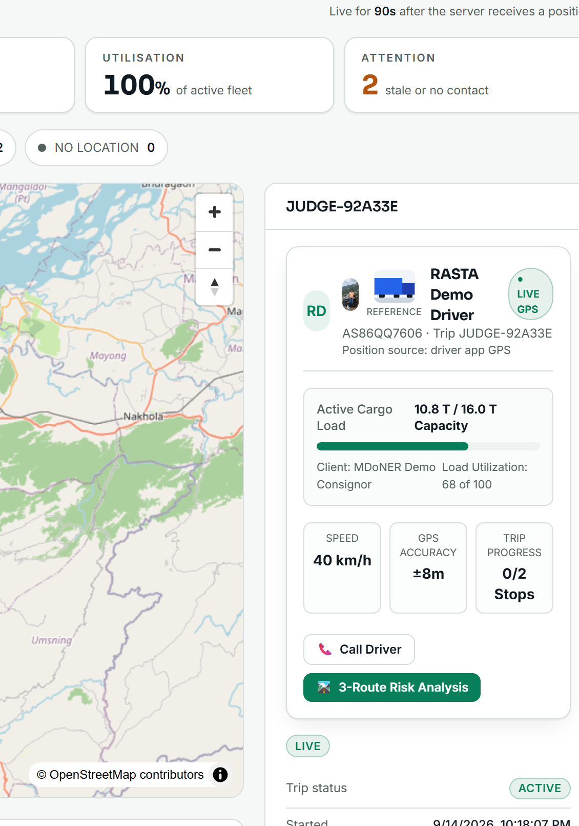
FEASIBILITY AND VIABILITY
NER-AI LOGISTICS
12/12
Not a concept. A working end-to-end prototype.
PLAN
REVIEW
DISPATCH
ACCEPT
TRUCK VERIFY
NAVIGATE
OFF-ROUTE
MANAGER REROUTE APPROVAL
DELIVERY
JUDGE-FLOW STEPS
dispatch → accept → truck check → GPS navigation → real off-route → reroute → manager approval → stops → delivery, on a physical Android phone
9/9
role-flow steps
1138+ backend · 621+ driver · 170+ manager tests
PHYSICAL ANDROID · CERTIFIED
Canonical demo
Guwahati → Shillong · ≈ 98.8 km real route
Manager · route review
Driver · truck check
Driver · navigation
Manager · reroute review
KNOWN LIMITS → MITIGATION Render cold start → warm /health before the demo · provider rate limits → cached evidence + explicit UNKNOWN · background push needs Firebase config → in-app alerts already work · experimental ML → outside routing until the gate passes

Slide 5


IMPACT AND BENEFITS
NER-AI LOGISTICS
0
RASTA AI does not ask only “Which road is shortest?” It asks “Can this truck reliably use this corridor now?”
REAL SCREENS · APK 1.0.18
WHO BENEFITS
UNKNOWN FACTORS COUNTED AS SAFE
FLEET MANAGERS
Route usability and uncertainty visible before dispatch; auditable decisions.
the rule the whole product is built on: missing or stale evidence is never read as a clear road
DRIVERS
Safer navigation, danger context, emergency support, 23 languages.
REMOTE COMMUNITIES
More resilient access to food, medicine, fuel and relief supplies.
FOOD · MEDICINE · FUEL · RELIEF SUPPLIES
essential logistics for hill communities, decided on evidence
GOVERNMENT / OPERATIONS
Auditable route evidence and disruption visibility per corridor.
DEMONSTRATED TODAY
Driver · 23 languages
Manager · mobile
23
selectable languages, explicit fallback status
12/12
judge-flow steps certified on a physical phone
Real screens, APK 1.0.18. One login, server-decided role: a manager gets a mobile fleet view, a driver gets navigation. Each language shows its status — Verified, Draft or English fallback — so nobody is misled.
11
route factors in every decision
100 %
of reroutes reviewed by a human
60 s
route-ahead monitor while driving
HUMAN GOVERNANCE — AI HAS NO UNCONTROLLED AUTHORITY
Verified evidence
Deterministic safety policy
Manager governance
Driver action

Slide 6
RESEARCH AND REFERENCES
NER-AI LOGISTICS
95 %
RESEARCH / EVIDENCE SOURCES BEHIND THE ROUTE DECISION
ROUTING / PLACES
OSRM · OpenStreetMap · Nominatim
real road geometry, alternatives and turn steps; place search on the corridor
WEATHER / TERRAIN
Open-Meteo · MET Norway · Copernicus DEM · OpenTopoData
forecast sampled along the road; climb, gradient and steep segments (GLO-90)
RECALL
on the NER geographic holdout — 154 catalogued events, no NER row used in training
OFFICIAL / FLOOD
NDMA SACHET (CAP) · Copernicus GloFAS
official warnings polled with freshness; river discharge against its 30-day mean
LANDSLIDE HISTORY
NASA Global Landslide Catalog
historical exposure; inventory 2007–2017, ≤5 km location-accuracy filter
SAFETY GATE
NOT DEPLOYED
AI ASSISTANCE
Google Gemini
explains the decision in the driver's language — never safety authority
PROBLEM STATEMENT
MDoNER · SIH26002
AI-based smart logistics and accessibility intelligence for the NER
FPR 50 %
too high for production deployment
VALIDATION BEFORE AUTOMATION.
Strong recall was not enough. Held-out testing exposed the false-positive rate, so the gate keeps the model out of routing.
TRAIN
HELD-OUT NER TEST
USEFUL SIGNAL FOUND
FALSE POSITIVES TOO HIGH
SAFETY GATE
NOT DEPLOYED
Precision 0.32 · F1 0.48 · PR-AUC 0.55 · ROC-AUC 0.83 · Brier 0.12 · calibrated logistic regression on NASA GLC + ERA5-Land rain + DEM slope · docs/HAZARD_ERROR_ANALYSIS.md
REFERENCES gpm.nasa.gov/landslides (NASA GLC) · sachet.ndma.gov.in · global-flood.emergency.copernicus.eu (GloFAS) · open-meteo.com · api.met.no · opentopodata.org · Copernicus DEM · project-osrm.org · openstreetmap.org · github.com/nxtlucifer/ner-ai-logistics (repository, tests, model registry)

