Slide 1



SMART INDIA HACKATHON 2026
RASTA AI
LIVE WORKING SYSTEM
Route Intelligence for Essential-Supply Logistics in North Eastern India
SHORTEST IS NOT ALWAYS USABLE.
“Can this essential-supply truck reliably use this corridor now?”
PROBLEM STATEMENT ID
SIH26002
THEME
Smart Automation
PS CATEGORY
Software
TEAM ID
17 (internal group no.)
TEAM NAME
NER-AI LOGISTICS
AI-Based Smart Logistics and Accessibility Intelligence Platform for North Eastern Region (NER)
Manager route review · Driver navigation — real screens, real road

Slide 2

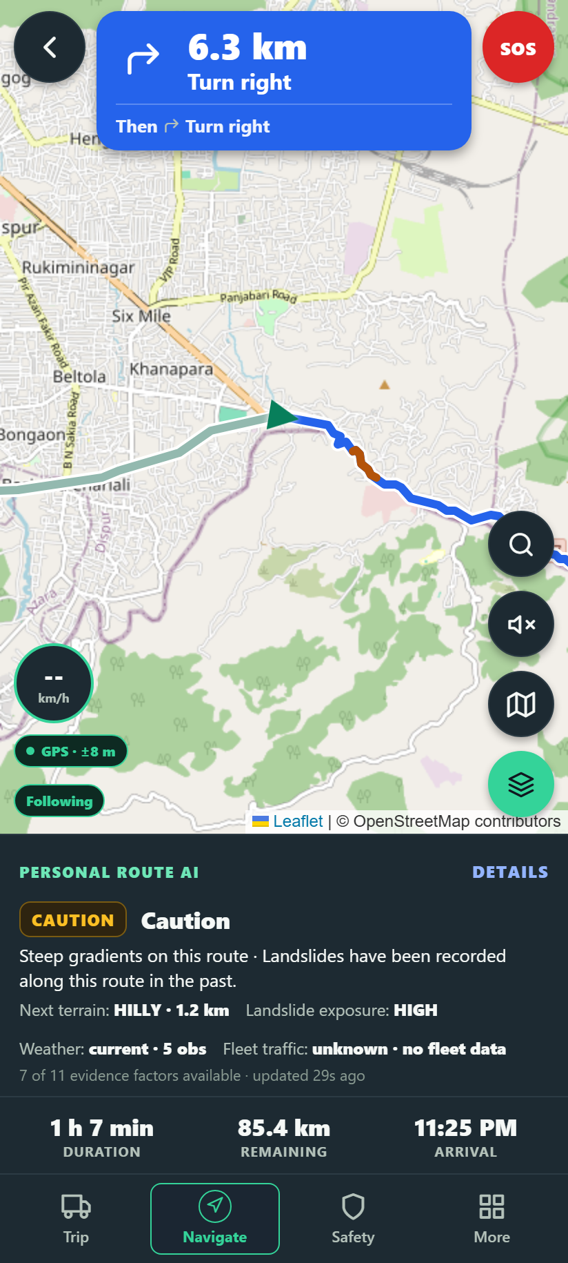
RASTA AI — ROUTE INTELLIGENCE
NER-AI LOGISTICS
PROPOSED SOLUTION
MANAGER · CHECK CONDITIONS
Not the shortest road. The road that is usable now.
NER corridors close without notice: monsoon rain, landslides, floods, official warnings, single-lane hill roads, no phone signal. A shortest-path router still sends the truck.
A NORMAL ROUTER
Origin → Shortest / fastest road → Truck
No governance. No answer when data is missing.
RASTA AI
Terrain
Weather
Landslide exposure
Flood context
Official warnings
Fleet traffic
Evidence freshness
CONTINUE
CAUTION
HOLD
REROUTE
Manager governance → driver navigation, 23 languages, offline package
UNKNOWN ≠ SAFE
Missing or stale evidence is marked UNKNOWN, never counted as safe, and the route goes to an authorised reviewer.
Manager evidence · Driver route AI — the same decision, both ends

Slide 3
TECHNICAL APPROACH
NER-AI LOGISTICS
VERIFIED DATA
STACK · CLIENTS · GOVERNANCE
WEATHER
Open-Meteo · MET Norway
TERRAIN
Copernicus DEM · OpenTopoData
WARNINGS
NDMA SACHET (CAP)
FLOOD
GloFAS
LANDSLIDE
NASA GLC 2007–17
TRAFFIC
fleet GPS fixes
CLIENTS Manager console — React + TypeScript, manager accounts only · Driver app — React Native / Expo, Android; one login, server-decided role, offline trip package
STACK FastAPI · PostgreSQL / PostGIS (Supabase) · React · React Native / Expo · OSRM · OpenStreetMap · Gemini
ROUTE-SPECIFIC EVIDENCE · FastAPI backend
every factor sampled along the selected road · PostgreSQL + PostGIS (Supabase) · OSRM routes, turn steps
DETERMINISTIC SAFETY POLICY
11 factors · reason codes · UNKNOWN ≠ SAFE · reviewer authorisation when hazard data is missing
GOVERNANCE CHAIN
Verified evidence
CONTINUE
CAUTION
HOLD
REROUTE
Deterministic safety policy
MANAGER REVIEW
DRIVER NAV
60 s WATCH
REASSESS
Re-scored every 60 s along the road ahead; a reroute is proposed to the manager, never applied silently.
Manager governance
DETERMINISTIC SAFETY ENGINE
makes every operational decision
Driver action
GEMINI / OPENROUTER (LLM)
explains the decision in the driver's language — never decides
Diagnostics reports every provider's real state — healthy, degraded, fallback active or unknown — so a judge can see exactly what a decision rested on.
EXPERIMENTAL ML
research channel only; held outside routing by the safety gate

Slide 4

FEASIBILITY AND VIABILITY
NER-AI LOGISTICS
Not a concept. A working end-to-end prototype.
REAL SCREENS FROM THE CERTIFIED RUN
CERTIFIED LIFECYCLE
PLAN
ACCEPT
OFF-ROUTE
REVIEW
TRUCK VERIFY
MANAGER REROUTE APPROVAL
DISPATCH
NAVIGATE
DELIVERY
12/12
physical judge-flow steps
9/9
physical role-flow steps
1138+ backend · 621+ driver · 170+ manager tests
PHYSICAL ANDROID · CERTIFIED
Manager · route review
Driver · truck check
Driver · navigation
Canonical demo Guwahati → Shillong · ≈ 98.8 km real route
KNOWN LIMITS → MITIGATION Render cold start → warm /health before the demo · provider rate limits → cached evidence + explicit UNKNOWN · background push needs Firebase config → in-app alerts already work · experimental ML → outside routing until the gate passes

Slide 5


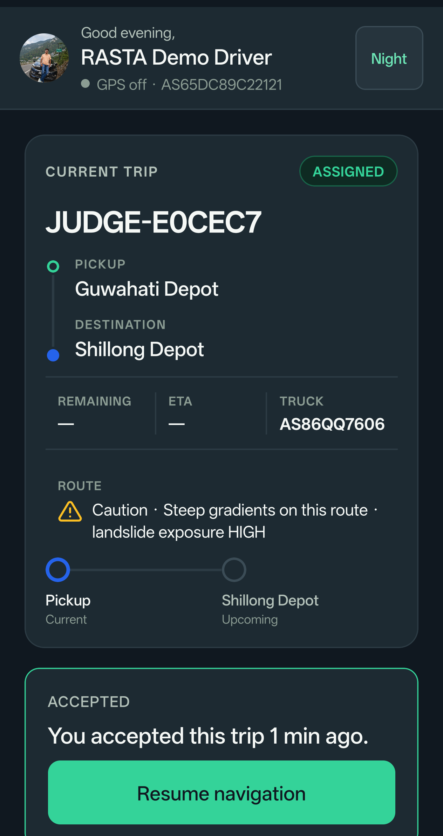
IMPACT AND BENEFITS
NER-AI LOGISTICS
“Can this truck reliably use this corridor now?”
REAL SCREENS · APK 1.0.18
FOOD · MEDICINE · FUEL · RELIEF SUPPLIES
essential logistics for hill communities, decided on evidence
FLEET MANAGERS
Route usability and uncertainty visible before dispatch; auditable decisions.
DRIVERS
Safer navigation, danger context, emergency support, 23 languages.
REMOTE COMMUNITIES
More resilient access to food, medicine, fuel and relief supplies.
GOVERNMENT / OPERATIONS
Auditable route evidence and disruption visibility per corridor.
23 languages
Manager · mobile
Driver · assigned trip
HUMAN GOVERNANCE — AI HAS NO UNCONTROLLED AUTHORITY
Verified evidence
23
selectable languages, explicit fallback status
11
route factors in every decision
60 s
route-ahead monitor while driving
12/12
judge-flow steps certified on a physical phone
Deterministic safety policy
100 %
of reroutes reviewed by a human
0
unknown factors counted as safe
Manager governance

Slide 6
RESEARCH AND REFERENCES
NER-AI LOGISTICS
EXPERIMENTAL LANDSLIDE RESEARCH
RESEARCH / EVIDENCE SOURCES BEHIND THE ROUTE DECISION
95 %
RECALL
on the NER geographic holdout — 154 catalogued events, no NER row used in training
ROUTING / PLACES
OSRM · OpenStreetMap · Nominatim
real road geometry, alternatives and turn steps; place search on the corridor
WEATHER / TERRAIN
Open-Meteo · MET Norway · Copernicus DEM · OpenTopoData
forecast sampled along the road; climb, gradient and steep segments (GLO-90)
SAFETY GATE
NOT DEPLOYED
OFFICIAL / FLOOD
NDMA SACHET (CAP) · Copernicus GloFAS
official warnings polled with freshness; river discharge against its 30-day mean
FPR 50 % too high for production deployment
TRAIN
HELD-OUT NER TEST
USEFUL SIGNAL FOUND
LANDSLIDE HISTORY
NASA Global Landslide Catalog
historical exposure; inventory 2007–2017, ≤5 km location-accuracy filter
FALSE POSITIVES TOO HIGH
SAFETY GATE
NOT DEPLOYED
AI ASSISTANCE
Google Gemini
explains the decision in the driver's language — never safety authority
VALIDATION BEFORE AUTOMATION. Strong recall was not enough. Held-out testing exposed the false-positive rate, so the gate keeps the model out of routing.
PROBLEM STATEMENT
MDoNER · SIH26002
AI-based smart logistics and accessibility intelligence for the NER
Precision 0.32 · F1 0.48 · PR-AUC 0.55 · ROC-AUC 0.83 · Brier 0.12 · calibrated logistic regression on NASA GLC + ERA5-Land rain + DEM slope · docs/HAZARD_ERROR_ANALYSIS.md
REFERENCES gpm.nasa.gov/landslides (NASA GLC) · sachet.ndma.gov.in · global-flood.emergency.copernicus.eu (GloFAS) · open-meteo.com · api.met.no · opentopodata.org · Copernicus DEM · project-osrm.org · openstreetmap.org · github.com/nxtlucifer/ner-ai-logistics (repository, tests, model registry)

