Slide 1


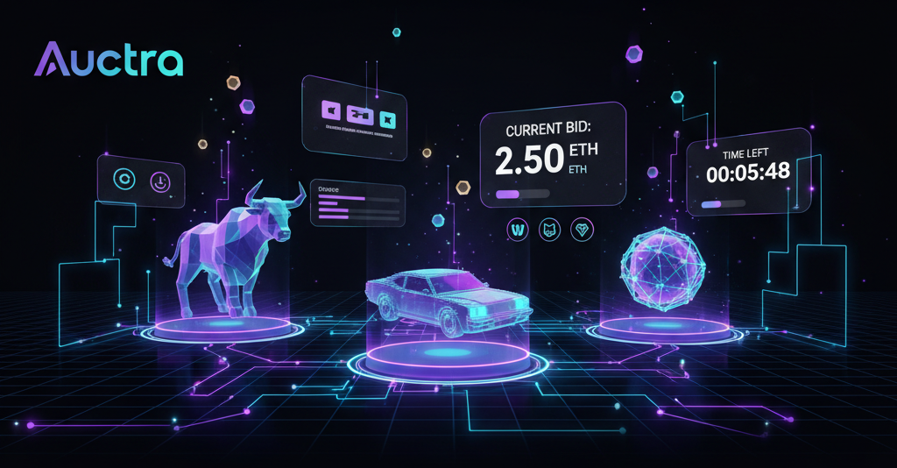
Decentralized Auction Platform
A Transparent, Automated, and Secure Bidding Ecosystem
Team Name - TriChain
Subject - Web3 and Decentralized Technologies
GitHub Link – Click Here
Live Demo – Click Here
Guided By – Mr. Abhi Mitra
Presented By – Manoj Kumar Panigrahi
Registration Number - 240720100084

Slide 2
Architecture & Functional Summary of Auctra DApp
Fully decentralized, smart-contract driven auction platform
Role-based access: Admin, Seller, Bidder
Secure bidding with automatic on-chain refunds
Each auction deployed as a separate contract (factory pattern)
Transparent bid history, time-based auction closing, platform fee logic
Uses IPFS for product media storage (Blockchain + Storage Web3 integration)
Works without centralized servers, ensuring trustless ownership transfer

Slide 3
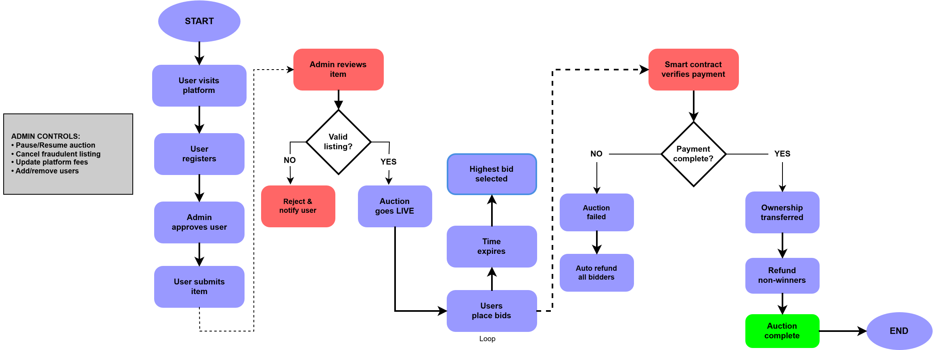
Auctra - System Workflow Overview
This workflow illustrates the end-to-end process of how Auctra operates -from user registration to auction creation, bidding, winner selection, and fund settlement. Every action is verified and executed through smart contracts, ensuring trustless, transparent, and automated operations on the blockchain.

Slide 4
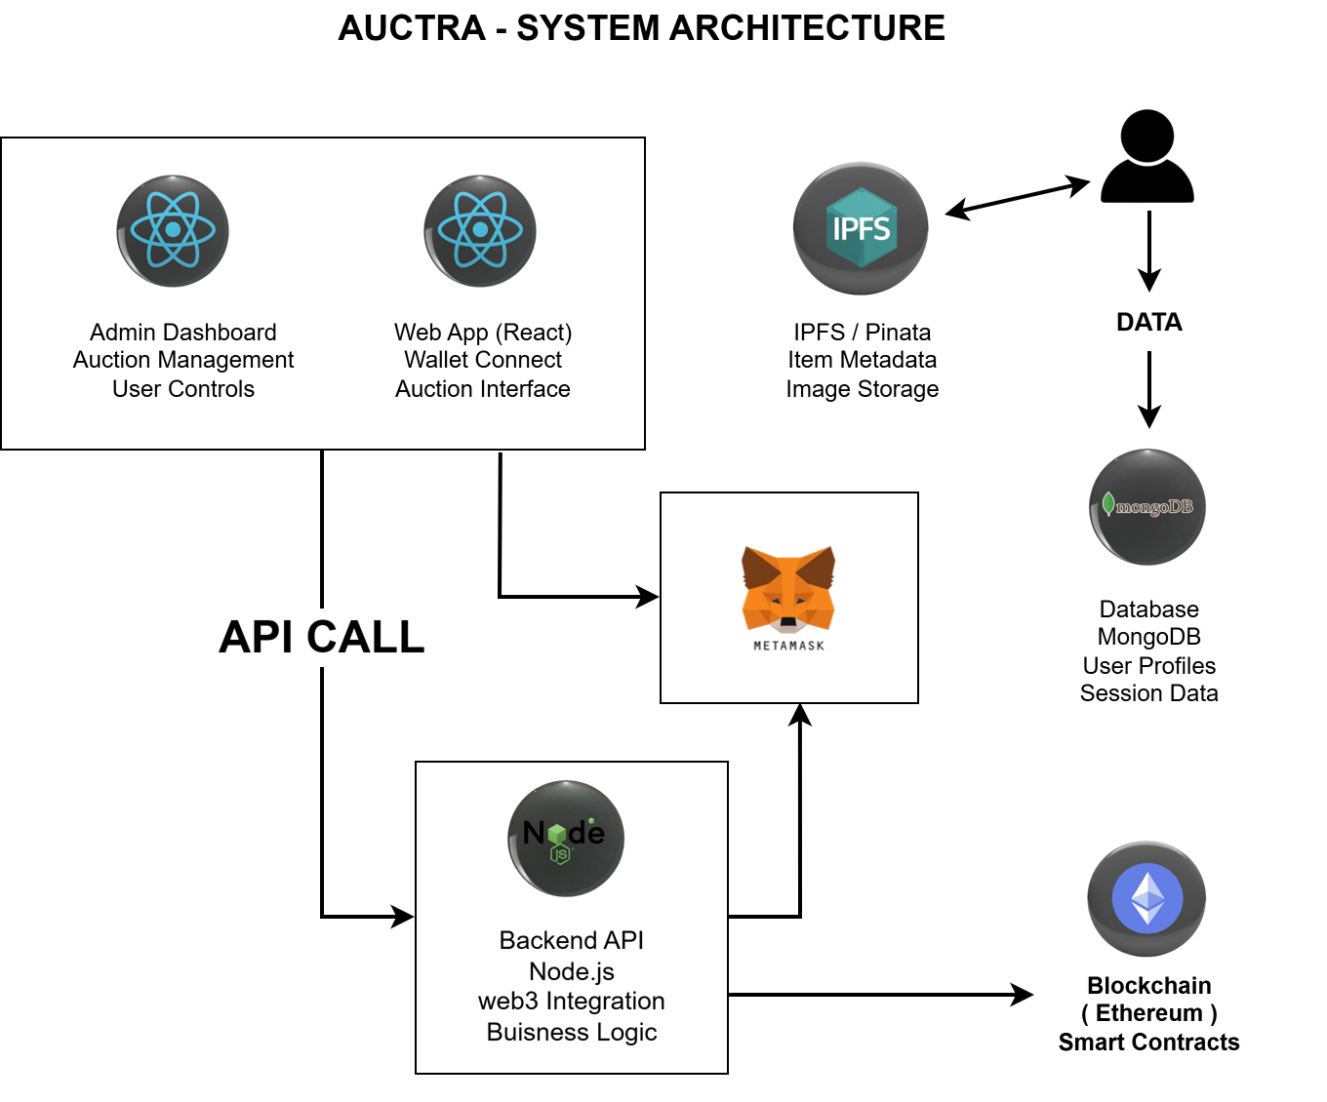
System Architecture & Tech Stack
Frontend:
React.js
Ethers.js / Web3.js
MetaMask
Bootstrap
Smart Contracts:
Solidity (AuctionFactory & SimpleAuction contracts)
OpenZeppelin Libraries
Hardhat (Development + Local Testing)
Etherscan Block Explorer for contract verification
Storage Layer:
IPFS + Pinata (Auction item images & metadata)
Backend / Indexing (Optional):
Node.js + Express API
MongoDB

Slide 5
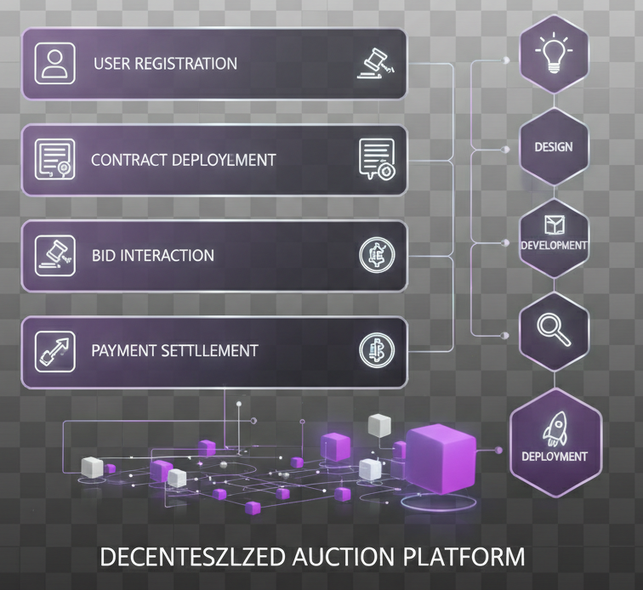
Project Feasibility & Implementation Strategy
Technical Feasibility
Uses reliable and widely adopted Web3 stack (Solidity, React, MetaMask, IPFS), ensuring long-term support and integration with existing blockchain tools.
Modular smart contract architecture (AuctionFactory + SimpleAuction) enables unlimited auctions and easy upgrades without redeploying the whole system.
Operational Feasibility
Simple and automated workflow: registration → create/join auction → bid → refund → winner declaration, requiring no backend admin intervention.
Admin controls (pause, cancel, fee update, user verification) make it manageable even for non-technical operators in real environments.
Economic Feasibility
Low maintenance cost: most logic runs on-chain → no server hosting + only gas fees when users interact.
Built-in revenue model via configurable platform fee (%) deducted automatically from each successful auction, making it self-sustaining.

Slide 6
Business Impact and User Benefits
Impact
Business Impact
Benefits
Trust and Transparency in Auctions
The platform leverages blockchain to ensure every bid, transaction, and auction state is transparent and tamper-proof. This significantly improves trust among participants, especially in high-value or global auctions.
User Ownership and Decentralized Access
Users control their interactions through smart contracts, without relying on a central authority. This empowers users, ensures censorship resistance, and allows permissionless auction participation.
Global Reach and Participation
Anyone with a crypto wallet can register, create auctions, or place bids, removing geographical barriers found in traditional auction systems.
Reduced Operational Costs
Eliminates the need for expensive centralized servers, manual verification processes, and third-party payment processors.
Scalable Revenue Opportunities
The platform can earn through service fees, premium auction options, and integration of new features like NFT-based auctions.
Automated Fraud Prevention
Smart contracts enforce rules and safeguards, reducing the need for manual dispute resolutions and customer support.
Cost-Efficiency for Sellers and Bidders
The system minimizes middleman fees and delays, ensuring both sellers and bidders save money and time during auction processes.
Data Integrity and Security
All actions are stored on the blockchain, making them immutable and publicly verifiable. This protects users against fraud and data manipulation.
Flexible for Future Integrations
The architecture is modular and smart contract-based, allowing developers to add new features like multi-chain support, reward systems, or AI-powered bidding in future iterations.

Slide 7
What Makes Auctra Unique & Future Scope
What Makes Auctra Unique?
Future Scope
Fully Decentralized & Transparent Auctions
No centralized authority controls bidding or fund transfers — all actions are recorded on-chain for verifiable transparency.
Smart-Contract-Based Escrow & Refund System
Funds are securely held by the contract until the auction ends, ensuring fair handling and automatic refunds to non-winning bidders.
User Verification + Role-Based Access
Only admin-approved users can create auctions or bid, making the platform resistant to fraud and misuse while maintaining decentralization.
IPFS-Powered Product Storage
Auction items are stored via decentralized storage (IPFS), ensuring no data loss and tamper-proof product metadata.
Cross-Chain Auction Support
Integrate multi-chain deployment (e.g., Polygon, Solana) to expand user reach and reduce gas costs.
AI-Based Bid Prediction & Auction Analytics
Enable bidders and sellers with real-time insights, price predictions, and bidding trends.
Integration with Web3 Identity (DID) & Tokenized Payments
Allow users to log in using decentralized identity and enable bidding with multiple tokens, not just native crypto.
Mobile App + Push Notifications
Launch a full-featured mobile app with real-time bid status alerts and wallet integration for broader accessibility.

Slide 8


