Slide 1
Receiver Sensitivity Tables for MIMO-OFDM 802.11n
November 2003
Ravi Mahadevappa, ravi@realtek-us.com
Stephan ten Brink, stenbrink@realtek-us.com
Realtek Semiconductors, Irvine, CA
Slide <number>
Ravi Mahadevappa, Stephan ten Brink, Realtek
Notes:
doc.: IEEE 802.11-03/845r1
Realtek
Page <number>

Slide 2
Overview
November 2003
PHY options for increasing data rate
Simulation environment
Rate versus RX sensitivity
Rate versus distance
Comparison of MIMO detectors
Observations and recommendations
Appendix: Rate/RX sensitivity tables
Slide <number>
Ravi Mahadevappa, Stephan ten Brink, Realtek

Slide 3
PHY options for increasing data rate
November 2003
Increasing modulation order
  RF more demanding
Increasing channel code rate (e.g. 3/4 to 7/8)
  Viterbi decoder traceback length increases
  Operating close to constellation capacity saturation
Increasing bandwidth
  Spectrally inefficient (but: 255MHz become available)
Increasing number of transmit antennas
  Costs: parallel RF chains; channel correlations
Purpose of study
  Determine rate tables
  Determine suitable combinations of PHY options
Slide <number>
Ravi Mahadevappa, Stephan ten Brink, Realtek

Slide 4
Simulation Environment
November 2003
802.11a PHY simulation environment, plus
  Higher order QAM constellations
  Higher/lower channel code rates
  TX/RX diversity/MIMO OFDM
    ZF detection and soft post processing (shown in plots)
    APP and reduced APP detection
  Increased channel bandwidth, from 20MHz to 40MHz (64 to 128 FFT)
Slide <number>
Ravi Mahadevappa, Stephan ten Brink, Realtek
Notes:
doc.: IEEE 802.11-03/845r1
Realtek
Page <number>

Slide 5
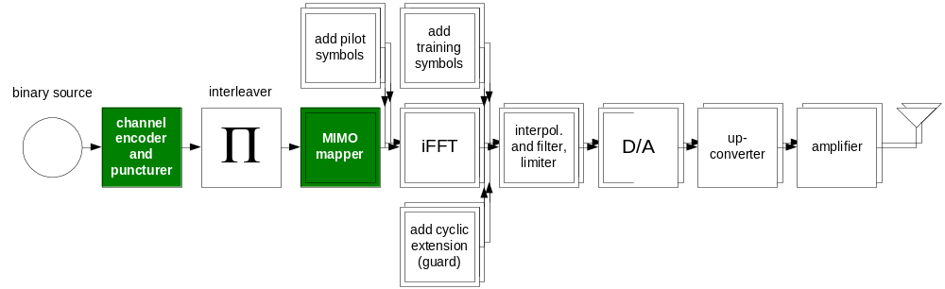
Likely 802.11n Transmitter
November 2003
Shown with 2 TX antennas
Slide <number>
Ravi Mahadevappa, Stephan ten Brink, Realtek

Slide 6
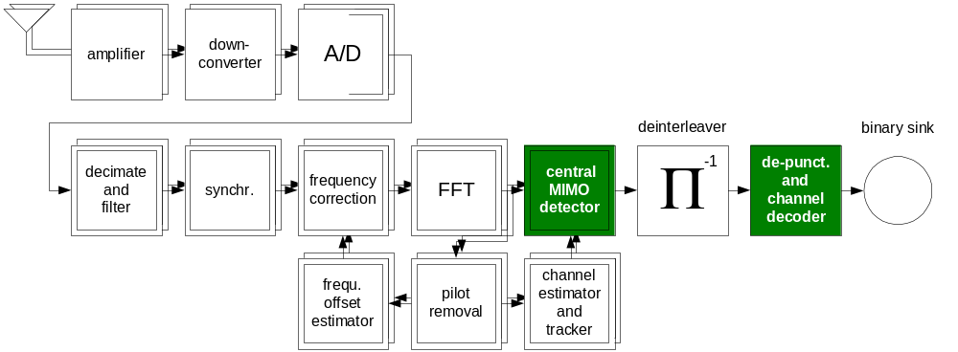
Likely 802.11n Receiver
November 2003
Shown with 2 RX antennas
Slide <number>
Ravi Mahadevappa, Stephan ten Brink, Realtek

Slide 7
Simulation Assumptions
November 2003
Perfect channel knowledge/synchronization
Idealized multipath MIMO channel
  More optimistic than [3]
  Sub-channels independent; exponential decay, T_{rms} = 60ns
  Quasi static (channel stays constant during one packet)
Packet length: 1000 bits
10dB noise figure (conservative [4])
5dB implementation margin (conservative [4])
Not yet incorporated in results:
  Channel estimation
  Packet detection, synchronization
  f_{off} estimation
  Clipping DAC/finite precision ADC
  Front-end filtering
Slide <number>
Ravi Mahadevappa, Stephan ten Brink, Realtek
Notes:
doc.: IEEE 802.11-03/845r1
Realtek
Page <number>

Slide 8
Performance Criteria
November 2003
Receiver sensitivity for 10% PER
Abbreviations:
  SEL: selection diversity at RX
  MRC: maximum ratio combining at RX
  AMRC: Alamouti Space/Time [8] with MRC at RX
  SMX: spatial multiplexing (i.e. MIMO mode, [6,7])
MIMO detection used in following plots
  ZF and APP post processing
Slide <number>
Ravi Mahadevappa, Stephan ten Brink, Realtek

Slide 9
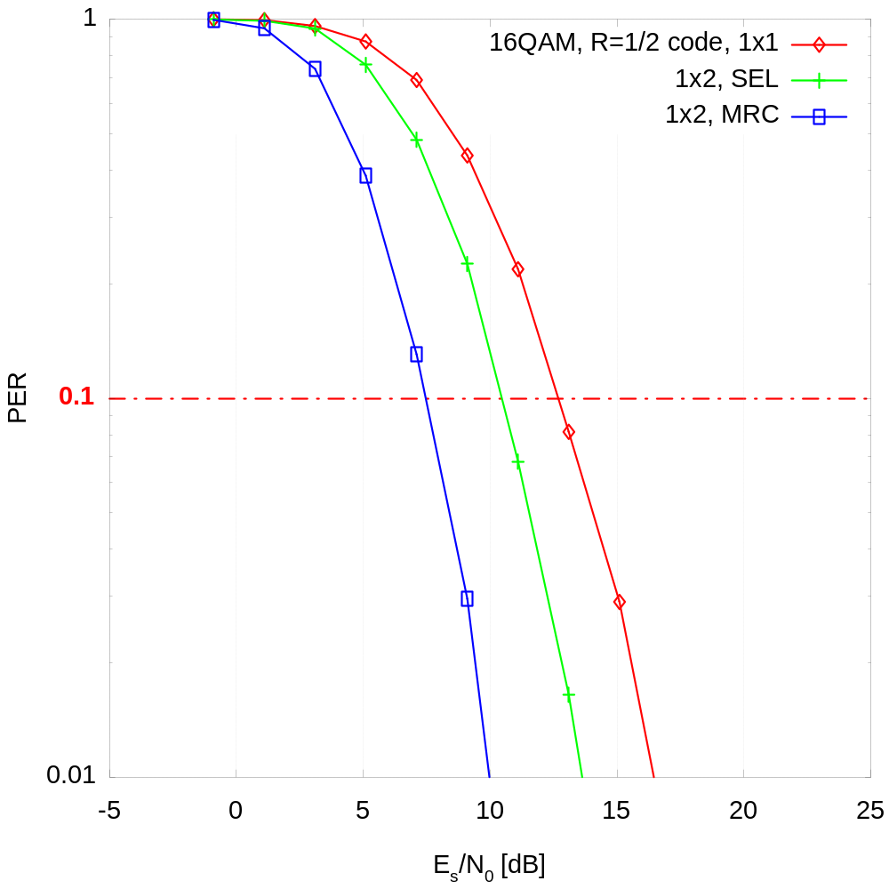
Example: PER curve
November 2003
802.11a set-up
24Mbps mode:
  16QAM
  Rate 1/2 memory 6 conv. code
Channel: Exp. decay
T_{rms} = 60ns
Packet length 1000bits
Averaged over 2000 packets
Slide <number>
Ravi Mahadevappa, Stephan ten Brink, Realtek

Slide 10
Example, from Appendix: Rate Table 2 802.11a modes, RX SEL Diversity, 1x2
November 2003
Data rate (Mbps) | Constel- lation | Code rate | MIMO mode | Bandwidth (MHz) | Simulation result: required E_{s}/N₀ [dB] | RX sensitivity (10% PER, NF=10dB, margin of 5dB) 20MHz: (-174+73+10+5)dBm+E_{s}/N₀
6 | BPSK | 1/2 | 1x2 SEL | 20 | 2.1 | -83.9
9 | BPSK | 3/4 | 1x2 SEL | 20 | 6.2 | -79.8
12 | QPSK | 1/2 | 1x2 SEL | 20 | 4.9 | -81.1
18 | QPSK | 3/4 | 1x2 SEL | 20 | 9.5 | -76.5
24 | 16QAM | 1/2 | 1x2 SEL | 20 | 10.5 | -75.5
36 | 16QAM | 3/4 | 1x2 SEL | 20 | 15.4 | -70.6
48 | 64QAM | 2/3 | 1x2 SEL | 20 | 18.1 | -67.9
54 | 64QAM | 3/4 | 1x2 SEL | 20 | 20.2 | -65.8
63 | 64QAM | 7/8 | 1x2 SEL | 20 | 25.8 | -60.2
63 | 128QAM | 3/4 | 1x2 SEL | 20 | 22.9 | -63.1
73.5 | 128QAM | 7/8 | 1x2 SEL | 20 | 28.0 | -58.0
84 | 256QAM | 7/8 | 1x2 SEL | 20 | 30.6 | -55.4
Data presented as rate versus RX sensitivity
Slide <number>
Ravi Mahadevappa, Stephan ten Brink, Realtek

Slide 11
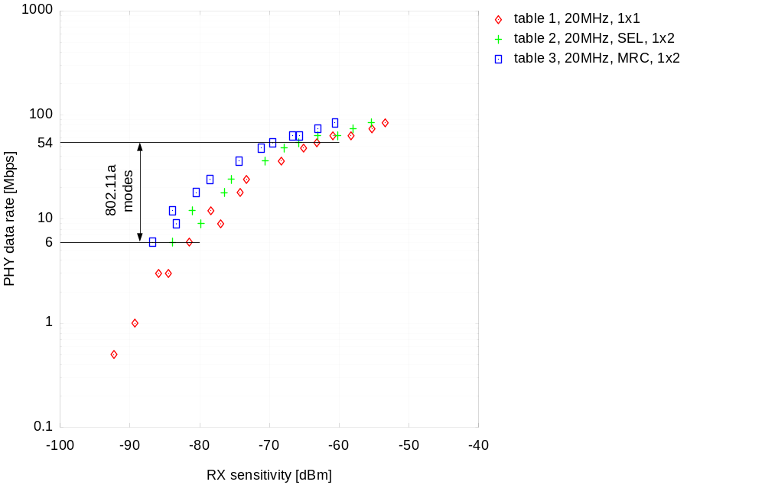
802.11a modes, 1x1, 1x2 SEL,1x2 MRC
November 2003
Rate tables 1-13, see appendix of document
10% PER
10dB NF
5dB implementation margin
802.11a modes as reference for high-rate modes in following slides
Better sensitivity
Worse sensitivity
SEL gives ca. 3dB, MRC ca. 6dB improvement
Slide <number>
Ravi Mahadevappa, Stephan ten Brink, Realtek

Slide 12
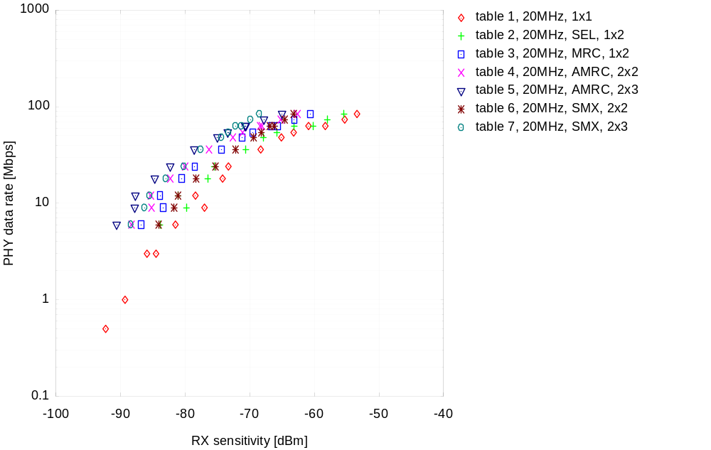
2 TX antennas, AMRC or SMX, 11a rates
November 2003
AMRC and code rate R
SMX and code rate R/2
(ZF detection)
Generally, for increasing range, use AMRC (not SMX)
Slide <number>
Ravi Mahadevappa, Stephan ten Brink, Realtek

Slide 13
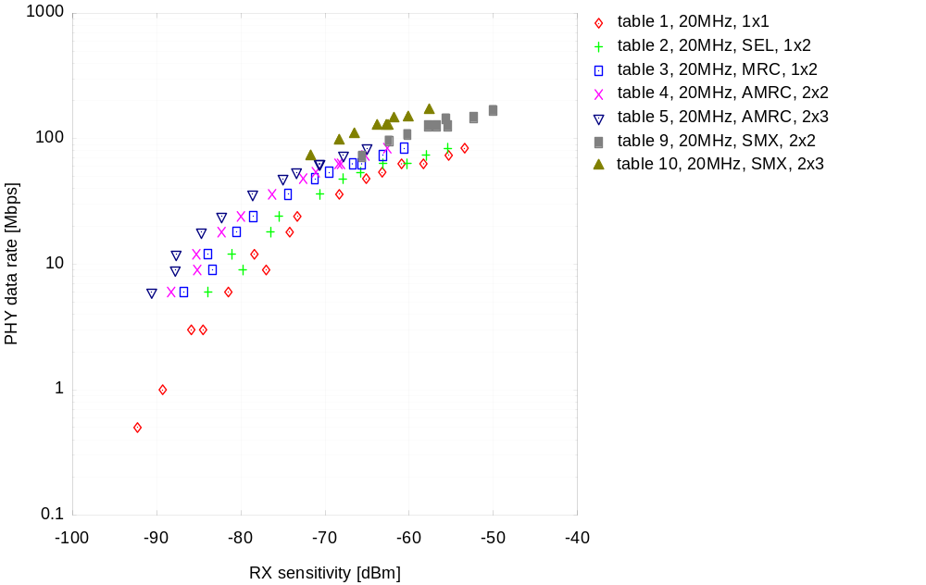
2 TX antennas, high-rate modes
November 2003
SMX (MIMO) 2x2
SMX 2x3
High-rate modes: 2x3 gains about 8dB over 2x2
Slide <number>
Ravi Mahadevappa, Stephan ten Brink, Realtek

Slide 14
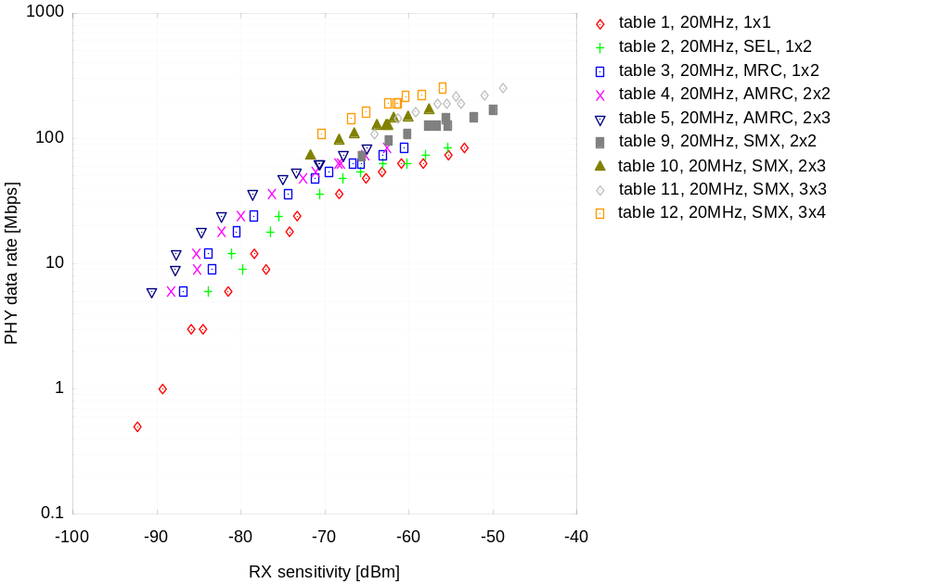
3 TX antennas, high-rate modes
November 2003
SMX 3x3
SMX 3x4
High-rate modes: 3x4 gains about 8dB over 3x3
Slide <number>
Ravi Mahadevappa, Stephan ten Brink, Realtek

Slide 15
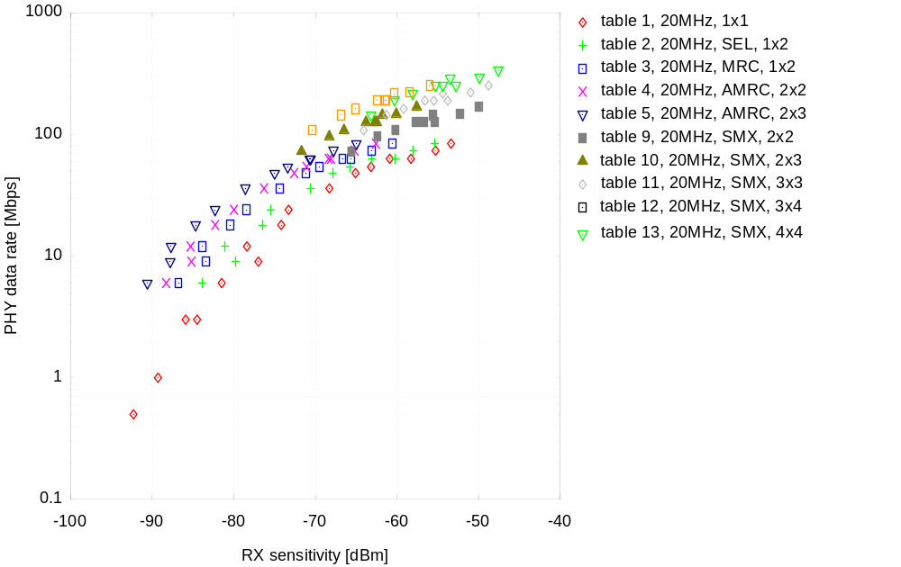
4 TX antennas, high-rate modes
November 2003
SMX 4x4
4x4 only for very high-rates
Slide <number>
Ravi Mahadevappa, Stephan ten Brink, Realtek

Slide 16
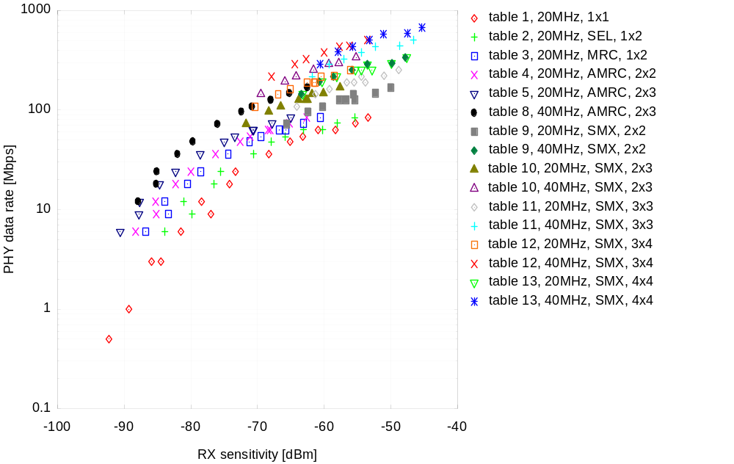
40MHz channel bandwidth
November 2003
Doubling bandwidth reduces spectral efficiency
Slide <number>
Ravi Mahadevappa, Stephan ten Brink, Realtek

Slide 17
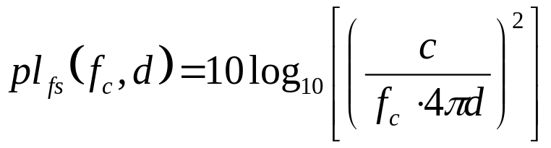
Path loss model
November 2003
Free-space path loss (in dB)
with c=3e8m/s, and f_{c} about 5GHz
Keenan-Motley partition path loss model (in dB) [1]
Linear path loss coefficient α (typ. indoor 0.44dB/m [2])
Slide <number>
Ravi Mahadevappa, Stephan ten Brink, Realtek

Slide 18
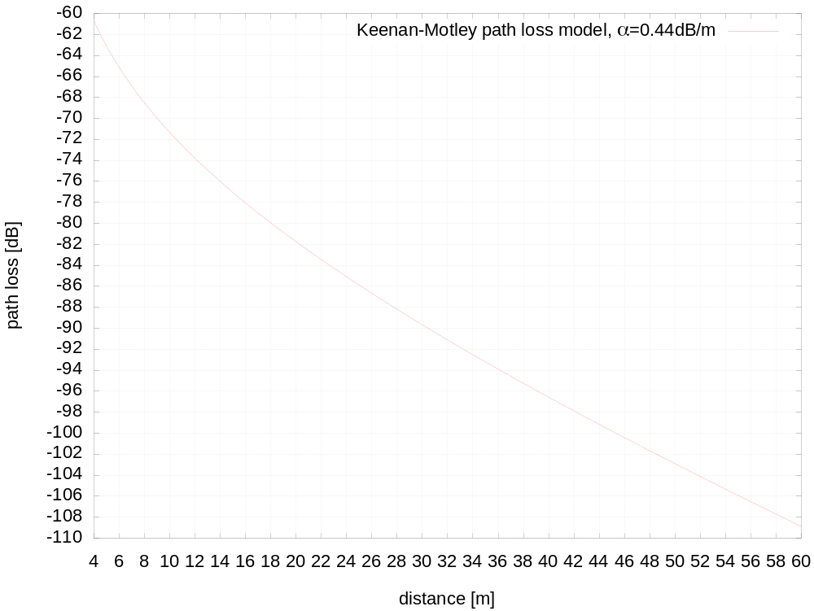
Path loss model
November 2003
Slide <number>
Ravi Mahadevappa, Stephan ten Brink, Realtek

Slide 19
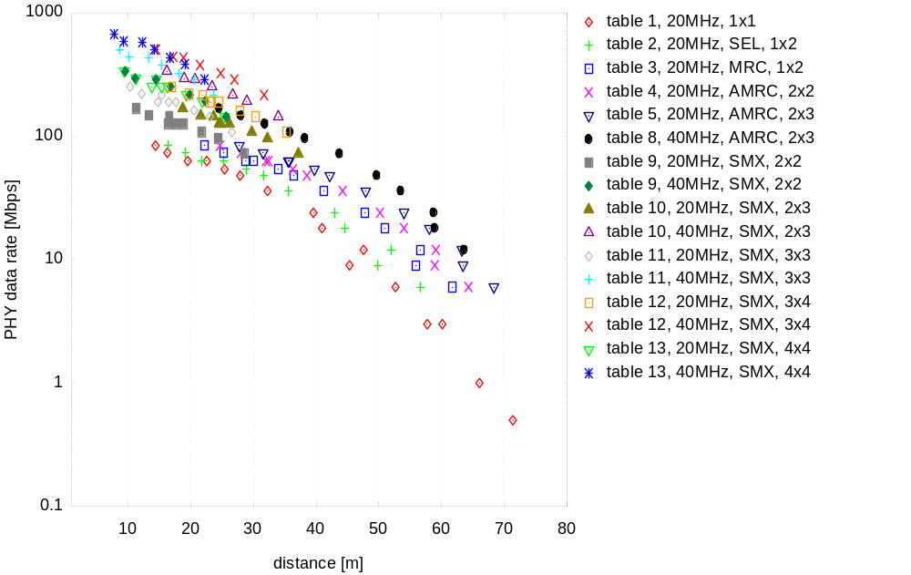
Rate versus distance
November 2003
Total transmit power P_{T}=23dBm, 0dBi
10% PER
NF 10dB
5dB implementation margin
Keenan-Motley path loss model, α=0.44dB/m
Slide <number>
Ravi Mahadevappa, Stephan ten Brink, Realtek

Slide 20
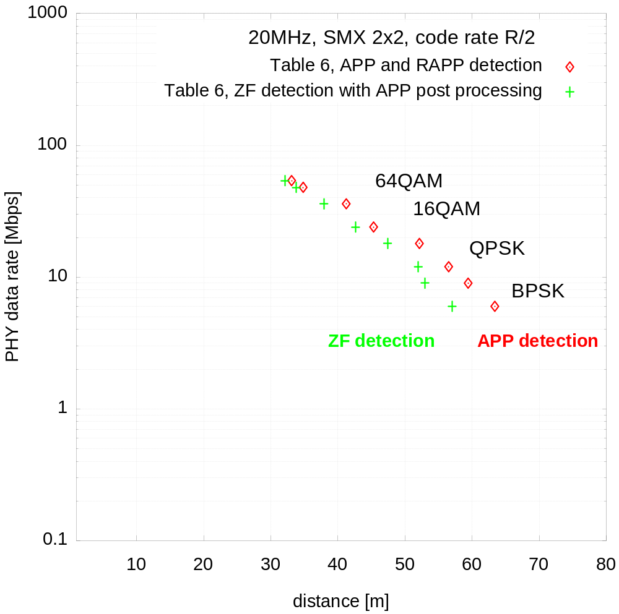
Comparison of MIMO detectors
November 2003
From table 6:
SMX 2x2, code rate R/2
802.11a modes, 6-54Mbps
ZF is close to APP detection for high-order modulation
Slide <number>
Ravi Mahadevappa, Stephan ten Brink, Realtek

Slide 21
Observations
November 2003
Range: ‘AMRC’ is better than ‘SMX and low rate codes’ to increase range (Table 4-7)
MIMO: 2x3, 3x4 by 6-8dB better than 2x2, 3x3 respectively (Table 9-12)
ZF detection is close to APP detection for 64QAM and higher (Table 6)
To achieve 100Mbps MAC throughput, a higher PHY peak rate than 2x54=108Mbps is required [16]; target of 150Mbps peak rate is a reasonable estimate;
can be achieved by
  more than 2 TX ant., as 2x54Mbps is just 108Mbps
  or, 2 TX antennas, 128QAM and higher, code rate 7/8
  or, 2 TX antennas and doubling bandwidth to 40MHz
Slide <number>
Ravi Mahadevappa, Stephan ten Brink, Realtek

Slide 22
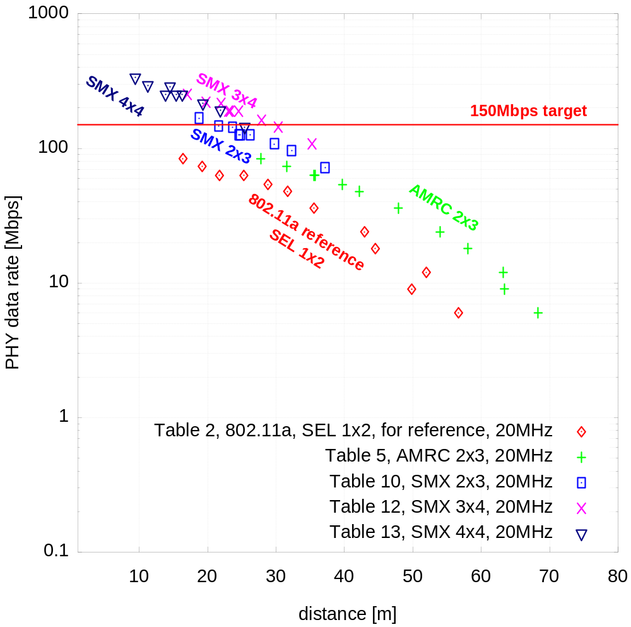
20MHz, rate versus distance
November 2003
Recommendation
Optional, for high data rates/short range: SMX 3x4, up to 64QAM, rate 3/4
Mandatory, for medium data rates/medium range: SMX 2x3, up to 128QAM (or higher), rate 7/8
Mandatory, low data rates/long range: AMRC 2x3, up to 64QAM, rate 3/4
Parameters for plot:
Transmit power P_{T}=23dBm
10% PER
NF 10dB
5dB implementation margin
Keenan-Motley path loss model α=0.44dB/m
Slide <number>
Ravi Mahadevappa, Stephan ten Brink, Realtek

Slide 23
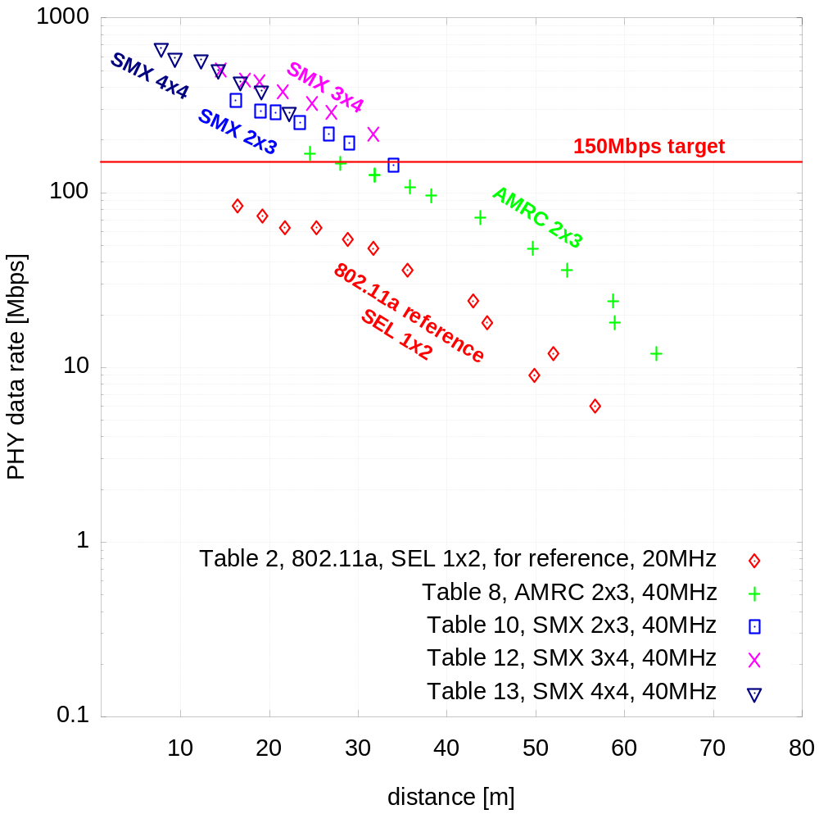
40MHz, rate versus distance
November 2003
Recommendation
40MHz gives better range (about 10m) for the same data rate
Mandatory, for high data rates/medium range: SMX 2x3, up to 64QAM, rate 3/4
Mandatory, low data rates/long range: AMRC 2x3, up to 64QAM, rate 3/4
Parameters for plot:
Transmit power P_{T}=23dBm
10% PER
NF 10dB
5dB implementation margin
Keenan-Motley path loss model α=0.44dB/m
Slide <number>
Ravi Mahadevappa, Stephan ten Brink, Realtek

Slide 24
November 2003
Some conclusions
At least 2 TX antennas required to achieve target peak rate of 150Mbps
128QAM and higher, code rate 7/8 realistic candidates to achieve peak rate
40MHz would allow to relax requirements on constellation size and code rate
  64QAM sufficient
  Code rate 3/4 sufficient
  Provides about 10m range increase for the same data rate
Slide <number>
Ravi Mahadevappa, Stephan ten Brink, Realtek

Slide 25
Some References
November 2003
[1] J. M. Keenan, A. J. Motley, “Radio coverage in buildings”, British Telecom Technology Journal, vol. 8, no. 1, Jan. 1990, pp. 19-24
[2] J. Medbo, J.-E. Berg, “Simple and accurate path loss modeling at 5GHz in indoor environments with corridors”, Proc. VTC 2000, pp. 30-36
[3] J. P. Kermoal, L. Schumacher, K. I. Pedersen, P. E. Mogensen, F. Frederiksen, “A stochastic MIMO radio channel model with experimental validation”, IEEE Journ. Sel. Areas. Commun., vol. 20, no. 6, pp. 1211-1226, Aug. 2002
[4] IEEE Std 802.11a-1999, Part 11: Wireless LAN Medium Access Control (MAC) and Physical Layer (PHY) Specifications, High-speed Physical Layer in the 5 GHz Band
[5] J. H. Winters, J. Salz, R. D. Gitlin, “The impact of antenna diversity on the capacity of wireless communication systems”, IEEE Trans. Commun., vol. 42, no. 2/3/4, pp. 1740-1751, Feb./Mar./Apr. 1994
[6] G. J. Foschini, “Layered space-time architecture for wireless communication in a fading environment when using multi-element antennas”,Bell Labs. Tech. J., vol. 1, no. 2, pp. 41-59, 1996
[7] H. Sampath, S. Talwar, J. Tellado, V. Erceg, A. Paulraj, “A fourth-generation MIMO-OFDM broadband wireless system: Design, performance, and field trial results”, IEEE Commun. Mag., pp. 143-149, Sept. 2002
[8] S. M. Alamouti, “A simple transmit diversity technique for wireless communications”, IEEE J. on Select. Areas in Commun., vol. 16, pp. 1451-1458, Oct. 1998
Some submissions to 802.11 HTSG/11n with information on PHY rate increase:
[9] M. Ghosh, X. Ouyang, G. Dolmans, “On The Use Of Multiple Antennae For 802.11”, 802.11-02/180r0
[10] S. Coffey, “Suggested Criteria for High Throughput Extensions to IEEE 802.11 Systems”, 802.11-02/252r0
[11] S. Simoens, A. Ghosh, A. Buttar, K. Gosse, K. Stewart, “Towards IEEE802.11 HDR in the Enterprise”, 802.11-02/312r0
[12] G. Fettweis, G. Nitsche, “1/4 Gbit WLAN”, 802.11-02/320r0
[13] A. Gorokhov, P. Mattheijssen, M. Collados, B. Vandewiele, G. Wetzker, “MIMO OFDM for high-throughput WLAN: experimental results”, 802.11-02/708r1
[14] S. Parker, M. Sandell, M. Lee, P. Strauch, “The Performance of Popular Space-Time Codes in Office Environments”, 802.11-03/298r0
[15] T. Jeon, H. Yu, S.-K. Lee, “Optimal Combining of STBC and Spatial Multiplexing for MIMO-OFDM”, 802.11-03/513r0
[16] J. Boer, B. Driesen, P.-P. Giesberts, “Backwards Compatibility”, 802.11-03/714r0
[17] A. P. Stephens, “802.11 TGn Functional Requirements”, 802.11-03/813r2
Slide <number>
Ravi Mahadevappa, Stephan ten Brink, Realtek

Slide 26
Appendix
November 2003
Receiver sensitivity tables 1-13
Abbreviations, diversity/MIMO modes:
  SEL: selection diversity at RX
  MRC: maximum ratio combining at RX
  AMRC: Alamouti Space/Time [8] with MRC at RX
  SMX: spatial multiplexing (i.e. MIMO mode, [6,7])
Abbreviations, MIMO detection algorithms
  APP: A Posteriori Probability detection (exhaustive search)
  RAPP: A Posteriori Probability detection (reduced search)
  ZF: Zero Forcing with APP post processing
Change to 802.11-03/845r0: modified interleaving for SMX modes
Slide <number>
Ravi Mahadevappa, Stephan ten Brink, Realtek

Slide 27
A note on E_{s}/N₀
November 2003
E_{s}/N₀ denotes the time-domain SNR_{ti} of a “channel symbol”, as required for RX sensitivity computations, used in tables, charts (it is not the SNR_{fr} of a QAM or OFDM symbol in the frequency domain, but related)
SNR_{fr} [dB] = SNR_{ti} [dB] + 10log₁₀ (N_{sc}/N_{su})
N_{sc} = total nb of subcarriers (e.g. 64)
N_{su} = nb of used subcarriers (e.g. 52)
10log₁₀ (64/52) is about 0.9dB
Reason:
  Time domain SNR_{ti} = P_{ti}/σ²
  After FFT at receiver, the noise power σ² is spread over N_{sc} subcarriers, but the signal power P_{ti} is concentrated on N_{su} used subcarriers
  Per used subcarrier, the signal power is now P_{ti} N_{sc}/N_{su}, and thus, SNR_{fr} = SNR_{ti} N_{sc}/N_{su}
  For N_{sc} = N_{su}, SNR_{ti}=SNR_{fr}
Slide <number>
Ravi Mahadevappa, Stephan ten Brink, Realtek

Slide 28
Rate Table 1: Standard 802.11a, 1x1
November 2003
Data rate (Mbps) | Constellation | Code rate | MIMO mode | Bandwidth (MHz) | Simulation result: required E_{s}/N₀ [dB] (in time-domain) | RX sensitivity (10% PER, NF=10dB, margin of 5dB) 20MHz: (-174+73+10+5)dBm+E_{s}/N₀ 40MHz: (-174+76+10+5)dBm+E_{s}/N₀ [dBm]
0.5 | BPSK 1/12 REP | 1/2 | 1x1 | 20 | 4.5-10.8 = -6.3 | -92.3
1 | BPSK 1/6 REP | 1/2 | 1x1 | 20 | 4.5-7.8 = -3.3 | -89.3
3 | BPSK 1/2 REP | 1/2 | 1x1 | 20 | 4.5-3 = 1.5 | -84.5
3 | BPSK | 1/4 | 1x1 | 20 | 0.1 | -85.9
6 | BPSK | 1/2 | 1x1 | 20 | 4.5 | -81.5 (-82, see [4])
9 | BPSK | 3/4 | 1x1 | 20 | 9.0 | -77.0 (-81, see [4])
12 | QPSK | 1/2 | 1x1 | 20 | 7.6 | -78.4 (-79, see [4])
18 | QPSK | 3/4 | 1x1 | 20 | 11.8 | -74.2 (-77, see [4])
24 | 16QAM | 1/2 | 1x1 | 20 | 12.7 | -73.3 (-74, see [4])
36 | 16QAM | 3/4 | 1x1 | 20 | 17.7 | -68.3 (-70, see [4])
48 | 64QAM | 2/3 | 1x1 | 20 | 20.9 | -65.1 (-66, see [4])
54 | 64QAM | 3/4 | 1x1 | 20 | 22.8 | -63.2 (-65, see [4])
63 | 64QAM | 7/8 | 1x1 | 20 | 27.7 | -58.3
63 | 128QAM | 3/4 | 1x1 | 20 | 25.1 | -60.9
73.5 | 128QAM | 7/8 | 1x1 | 20 | 30.7 | -55.3
84 | 256QAM | 7/8 | 1x1 | 20 | 32.6 | -53.4
REP: repetition code
Slide <number>
Ravi Mahadevappa, Stephan ten Brink, Realtek

Slide 29
Rate Table 2: with RX SEL Diversity, 1x2
November 2003
Data rate (Mbps) | Constel- lation | Code rate | MIMO mode | Bandwidth (MHz) | Simulation result: required E_{s}/N₀ [dB] | RX sensitivity (10% PER, NF=10dB, margin of 5dB) 20MHz: (-174+73+10+5)dBm+E_{s}/N₀ 40MHz: (-174+76+10+5)dBm+E_{s}/N₀
6 | BPSK | 1/2 | 1x2 SEL | 20 | 2.1 | -83.9
9 | BPSK | 3/4 | 1x2 SEL | 20 | 6.2 | -79.8
12 | QPSK | 1/2 | 1x2 SEL | 20 | 4.9 | -81.1
18 | QPSK | 3/4 | 1x2 SEL | 20 | 9.5 | -76.5
24 | 16QAM | 1/2 | 1x2 SEL | 20 | 10.5 | -75.5
36 | 16QAM | 3/4 | 1x2 SEL | 20 | 15.4 | -70.6
48 | 64QAM | 2/3 | 1x2 SEL | 20 | 18.1 | -67.9
54 | 64QAM | 3/4 | 1x2 SEL | 20 | 20.2 | -65.8
63 | 64QAM | 7/8 | 1x2 SEL | 20 | 25.8 | -60.2
63 | 128QAM | 3/4 | 1x2 SEL | 20 | 22.9 | -63.1
73.5 | 128QAM | 7/8 | 1x2 SEL | 20 | 28.0 | -58.0
84 | 256QAM | 7/8 | 1x2 SEL | 20 | 30.6 | -55.4
Slide <number>
Ravi Mahadevappa, Stephan ten Brink, Realtek

Slide 30
Rate Table 3: with RX MRC Diversity, 1x2
November 2003
Data rate (Mbps) | Constel- lation | Code rate | MIMO mode | Bandwidth (MHz) | Simulation result: required E_{s}/N₀ [dB] | RX sensitivity (10% PER, NF=10dB, margin of 5dB) 20MHz: (-174+73+10+5)dBm+E_{s}/N₀ 40MHz: (-174+76+10+5)dBm+E_{s}/N₀
6 | BPSK | 1/2 | 1x2 MRC | 20 | -0.8 | -86.8
9 | BPSK | 3/4 | 1x2 MRC | 20 | 2.6 | -83.4
12 | QPSK | 1/2 | 1x2 MRC | 20 | 2.1 | -83.9
18 | QPSK | 3/4 | 1x2 MRC | 20 | 5.5 | -80.5
24 | 16QAM | 1/2 | 1x2 MRC | 20 | 7.5 | -78.5
36 | 16QAM | 3/4 | 1x2 MRC | 20 | 11.6 | -74.4
48 | 64QAM | 2/3 | 1x2 MRC | 20 | 14.8 | -71.2
54 | 64QAM | 3/4 | 1x2 MRC | 20 | 16.5 | -69.5
63 | 64QAM | 7/8 | 1x2 MRC | 20 | 20.3 | -65.7
63 | 128QAM | 3/4 | 1x2 MRC | 20 | 19.3 | -66.7
73.5 | 128QAM | 7/8 | 1x2 MRC | 20 | 22.9 | -63.1
84 | 256QAM | 7/8 | 1x2 MRC | 20 | 25.4 | -60.6
Slide <number>
Ravi Mahadevappa, Stephan ten Brink, Realtek

Slide 31
Rate Table 4: Incr. Range, AMRC, 2x2
November 2003
Data rate (Mbps) | Constel- lation | Code rate | MIMO mode | Bandwidth (MHz) | Simulation result: required E_{s}/N₀ [dB] | RX sensitivity (10% PER, NF=10dB, margin of 5dB) 20MHz: (-174+73+10+5)dBm+E_{s}/N₀ 40MHz: (-174+76+10+5)dBm+E_{s}/N₀
6 | BPSK | 1/2 | 2x2 AMRC | 20 | -2.3 | -88.3
9 | BPSK | 3/4 | 2x2 AMRC | 20 | 0.8 | -85.2
12 | QPSK | 1/2 | 2x2 AMRC | 20 | 0.7 | -85.3
18 | QPSK | 3/4 | 2x2 AMRC | 20 | 3.7 | -82.3
24 | 16QAM | 1/2 | 2x2 AMRC | 20 | 6.0 | -80.0
36 | 16QAM | 3/4 | 2x2 AMRC | 20 | 9.7 | -76.3
48 | 64QAM | 2/3 | 2x2 AMRC | 20 | 13.4 | -72.6
54 | 64QAM | 3/4 | 2x2 AMRC | 20 | 14.9 | -71.1
63 | 64QAM | 7/8 | 2x2 AMRC | 20 | 17.9 | -68.1
63 | 128QAM | 3/4 | 2x2 AMRC | 20 | 17.6 | -68.4
73.5 | 128QAM | 7/8 | 2x2 AMRC | 20 | 20.8 | -65.2
84 | 256QAM | 7/8 | 2x2 AMRC | 20 | 23.4 | -62.6
Slide <number>
Ravi Mahadevappa, Stephan ten Brink, Realtek

Slide 32
Rate Table 5: Incr. Range, AMRC, 2x3
November 2003
Data rate (Mbps) | Constel- lation | Code rate | MIMO mode | Bandwidth (MHz) | Simulation result: required E_{s}/N₀ [dB] | RX sensitivity (10% PER, NF=10dB, margin of 5dB) 20MHz: (-174+73+10+5)dBm+E_{s}/N₀ 40MHz: (-174+76+10+5)dBm+E_{s}/N₀
6 | BPSK | 1/2 | 2x3 AMRC | 20 | -4.6 | -90.6
9 | BPSK | 3/4 | 2x3 AMRC | 20 | -1.8 | -87.8
12 | QPSK | 1/2 | 2x3 AMRC | 20 | -1.7 | -87.7
18 | QPSK | 3/4 | 2x3 AMRC | 20 | 1.3 | -84.7
24 | 16QAM | 1/2 | 2x3 AMRC | 20 | 3.7 | -82.3
36 | 16QAM | 3/4 | 2x3 AMRC | 20 | 7.4 | -78.6
48 | 64QAM | 2/3 | 2x3 AMRC | 20 | 11.0 | -75.0
54 | 64QAM | 3/4 | 2x3 AMRC | 20 | 12.6 | -73.4
63 | 64QAM | 7/8 | 2x3 AMRC | 20 | 15.4 | -70.6
63 | 128QAM | 3/4 | 2x3 AMRC | 20 | 15.3 | -70.7
73.5 | 128QAM | 7/8 | 2x3 AMRC | 20 | 18.2 | -67.8
84 | 256QAM | 7/8 | 2x3 AMRC | 20 | 21.0 | -65.0
Slide <number>
Ravi Mahadevappa, Stephan ten Brink, Realtek

Slide 33
Rate Table 6: Incr. Range, SMX, 2x2
November 2003
Data rate (Mbps) | Constel- lation | Code rate | MIMO mode | Bandwidth (MHz) | Simulation result: required E_{s}/N₀ [dB] default: APP detection | RX sensitivity (10% PER, NF=10dB, margin of 5dB) 20MHz: (-174+73+10+5)dBm+E_{s}/N₀ 40MHz: (-174+76+10+5)dBm+E_{s}/N₀
6 | BPSK | 1/4 | 2x2 SMX | 20 | -1.8 (1.9 ZF) | -87.8
9 | BPSK | 3/8 | 2x2 SMX | 20 | 0.5 (4.3 ZF) | -85.5
12 | QPSK | 1/4 | 2x2 SMX | 20 | 2.2 (4.9 ZF) | -83.8
18 | QPSK | 3/8 | 2x2 SMX | 20 | 4.8 (7.7 ZF) | -81.2
24 | 16QAM | 1/4 | 2x2 SMX | 20 | 9.0 (10.7 ZF) | -77.0
36 | 16QAM | 3/8 | 2x2 SMX | 20 | 11.6 (13.4 ZF) | -74.4
48 | 64QAM | 1/3 | 2x2 SMX | 20 | 16.6 ZF (15.9 RAPP) | -69.4
54 | 64QAM | 3/8 | 2x2 SMX | 20 | 17.8 ZF (17.1 RAPP) | -68.2
63 | 64QAM | 7/16 | 2x2 SMX | 20 | 19.1 ZF | -66.9
63 | 128QAM | 3/8 | 2x2 SMX | 20 | 19.8 ZF | -66.2
73.5 | 128QAM | 7/16 | 2x2 SMX | 20 | 21.4 ZF | -64.6
84 | 256QAM | 7/16 | 2x2 SMX | 20 | 22.8 ZF | -63.2
MIMO detection:
APP A Posteriori Probability detection (exhaustive search)
RAPP A Posteriori Probability detection (reduced search)
ZF Zero Forcing with APP post processing
Slide <number>
Ravi Mahadevappa, Stephan ten Brink, Realtek

Slide 34
Rate Table 7: Incr. Range, SMX, 2x3
November 2003
Data rate (Mbps) | Constel- lation | Code rate | MIMO mode | Bandwidth (MHz) | Simulation result: required E_{s}/N₀ [dB] default: ZF detection | RX sensitivity (10% PER, NF=10dB, margin of 5dB) 20MHz: (-174+73+10+5)dBm+E_{s}/N₀ 40MHz: (-174+76+10+5)dBm+E_{s}/N₀
6 | BPSK | 1/4 | 2x3 SMX | 20 | -2.4 ZF ; -4.3 APP | -88.4
9 | BPSK | 3/8 | 2x3 SMX | 20 | -0.3 | -86.3
12 | QPSK | 1/4 | 2x3 SMX | 20 | 0.5 | -85.5
18 | QPSK | 3/8 | 2x3 SMX | 20 | 3.0 | -83.0
24 | 16QAM | 1/4 | 2x3 SMX | 20 | 5.8 | -80.2
36 | 16QAM | 3/8 | 2x3 SMX | 20 | 8.4 | -77.6
48 | 64QAM | 1/3 | 2x3 SMX | 20 | 11.6 | -74.4
54 | 64QAM | 3/8 | 2x3 SMX | 20 | 12.7 | -73.3
63 | 64QAM | 7/16 | 2x3 SMX | 20 | 13.8 | -72.2
63 | 128QAM | 3/8 | 2x3 SMX | 20 | 14.7 | -71.3
73.5 | 128QAM | 7/16 | 2x3 SMX | 20 | 16.1 | -69.9
84 | 256QAM | 7/16 | 2x3 SMX | 20 | 17.5 | -68.5
Slide <number>
Ravi Mahadevappa, Stephan ten Brink, Realtek

Slide 35
Rate Table 8: AMRC, 40MHz, 2x3
November 2003
Data rate (Mbps) | Constel- lation | Code rate | MIMO mode | Bandwidth (MHz) | Simulation result: required E_{s}/N₀ [dB] | RX sensitivity (10% PER, NF=10dB, margin of 5dB) 20MHz: (-174+73+10+5)dBm+E_{s}/N₀ 40MHz: (-174+76+10+5)dBm+E_{s}/N₀
12 | BPSK | 1/2 | 2x3 AMRC | 40 | -4.9 | -87.9
18 | BPSK | 3/4 | 2x3 AMRC | 40 | -2.2 | -85.2
24 | QPSK | 1/2 | 2x3 AMRC | 40 | -2.1 | -85.1
36 | QPSK | 3/4 | 2x3 AMRC | 40 | 1.0 | -82.0
48 | 16QAM | 1/2 | 2x3 AMRC | 40 | 3.3 | -79.7
72 | 16QAM | 3/4 | 2x3 AMRC | 40 | 7.0 | -76.0
96 | 64QAM | 2/3 | 2x3 AMRC | 40 | 10.6 | -72.4
108 | 64QAM | 3/4 | 2x3 AMRC | 40 | 12.2 | -70.8
126 | 64QAM | 7/8 | 2x3 AMRC | 40 | 15.0 | -68.0
126 | 128QAM | 3/4 | 2x3 AMRC | 40 | 15.0 | -68.0
147 | 128QAM | 7/8 | 2x3 AMRC | 40 | 17.8 | -65.2
168 | 256QAM | 7/8 | 2x3 AMRC | 40 | 20.5 | -62.5
Slide <number>
Ravi Mahadevappa, Stephan ten Brink, Realtek

Slide 36
Rate Table 9: Higher Data Rate, 2x2
November 2003
Data rate (Mbps) | Constel- lation | Code rate | MIMO mode | Bandwidth (MHz) | Simulation result: required E_{s}/N₀ [dB] default: ZF detection | RX sensitivity (10% PER, NF=10dB, margin of 5dB) 20MHz: (-174+73+10+5)dBm+E_{s}/N₀ 40MHz: (-174+76+10+5)dBm+E_{s}/N₀
72 | 16QAM | 3/4 | 2x2 SMX | 20 | 20.4 (17.4 APP) | -65.6
96 | 64QAM | 2/3 | 2x2 SMX | 20 | 23.6 (22.2 RAPP) | -62.4
108 | 64QAM | 3/4 | 2x2 SMX | 20 | 25.8 (24.0 RAPP) | -60.2
126 | 64QAM | 7/8 | 2x2 SMX | 20 | 30.6 (28.0 RAPP) | -55.4
126 | 128QAM | 3/4 | 2x2 SMX | 20 | 28.3 | -57.7
126 | 128QAM shifted | 3/4 | 2x2 SMX | 20 | 29.3 | -56.7
147 | 128QAM | 7/8 | 2x2 SMX | 20 | 33.7 | -52.3
144 | 256QAM | 3/4 | 2x2 SMX | 20 | 30.4 | -55.6
168 | 256QAM | 7/8 | 2x2 SMX | 20 | 36.0 | -50.0
144 | 16QAM | 3/4 | 2x2 SMX | 40 | 19.6 (16.8 APP) | -63.4
192 | 64QAM | 2/3 | 2x2 SMX | 40 | 22.3 (21.3 RAPP) | -60.7
216 | 64QAM | 3/4 | 2x2 SMX | 40 | 24.4 (23.3 RAPP) | -58.6
252 | 128QAM | 3/4 | 2x2 SMX | 40 | 27.2 | -55.8
294 | 128QAM | 7/8 | 2x2 SMX | 40 | 33.2 | -49.8
288 | 256QAM | 3/4 | 2x2 SMX | 40 | 29.5 | -53.5
336 | 256QAM | 7/8 | 2x2 SMX | 40 | 35.2 | -47.8
Slide <number>
Ravi Mahadevappa, Stephan ten Brink, Realtek

Slide 37
Rate Table 10: Higher Rate, 2x3
November 2003
Data rate (Mbps) | Constel- lation | Code rate | MIMO mode | Bandwidth (MHz) | Simulation result: required E_{s}/N₀ [dB] default: ZF detection | RX sensitivity (10% PER, NF=10dB, margin of 5dB) 20MHz: (-174+73+10+5)dBm+E_{s}/N₀ 40MHz: (-174+76+10+5)dBm+E_{s}/N₀
72 | 16QAM | 3/4 | 2x3 SMX | 20 | 14.3 | -71.7
96 | 64QAM | 2/3 | 2x3 SMX | 20 | 17.7 | -68.3
108 | 64QAM | 3/4 | 2x3 SMX | 20 | 19.5 | -66.5
126 | 64QAM | 7/8 | 2x3 SMX | 20 | 23.3 | -62.7
126 | 128QAM | 3/4 | 2x3 SMX | 20 | 22.2 | -63.8
126 | 128QAM shifted | 3/4 | 2x3 SMX | 20 | 23.5 | -62.5
147 | 128QAM | 7/8 | 2x3 SMX | 20 | 25.9 | -60.1
144 | 256QAM | 3/4 | 2x3 SMX | 20 | 24.2 | -61.8
168 | 256QAM | 7/8 | 2x3 SMX | 20 | 28.4 | -57.6
144 | 16QAM | 3/4 | 2x3 SMX | 40 | 13.5 | -69.5
192 | 64QAM | 2/3 | 2x3 SMX | 40 | 17.1 | -65.9
216 | 64QAM | 3/4 | 2x3 SMX | 40 | 18.8 | -64.2
252 | 128QAM | 3/4 | 2x3 SMX | 40 | 21.4 | -61.6
294 | 128QAM | 7/8 | 2x3 SMX | 40 | 25.2 | -57.8
288 | 256QAM | 3/4 | 2x3 SMX | 40 | 23.7 | -59.3
336 | 256QAM | 7/8 | 2x3 SMX | 40 | 27.8 | -55.2
Slide <number>
Ravi Mahadevappa, Stephan ten Brink, Realtek

Slide 38
Rate Table 11: Higher Rate, 3x3
November 2003
Data rate (Mbps) | Constel- lation | Code rate | MIMO mode | Bandwidth (MHz) | Simulation result: required E_{s}/N₀ [dB] default: ZF detection | RX sensitivity (10% PER, NF=10dB, margin of 5dB) 20MHz: (-174+73+10+5)dBm+E_{s}/N₀ 40MHz: (-174+76+10+5)dBm+E_{s}/N₀
108 | 16QAM | 3/4 | 3x3 SMX | 20 | 21.9 | -64.1
144 | 64QAM | 2/3 | 3x3 SMX | 20 | 24.7 | -61.3
162 | 64QAM | 3/4 | 3x3 SMX | 20 | 26.8 | -59.2
189 | 64QAM | 7/8 | 3x3 SMX | 20 | 32.2 | -53.8
189 | 128QAM | 3/4 | 3x3 SMX | 20 | 29.4 | -56.6
189 | 128QAM shifted | 3/4 | 3x3 SMX | 20 | 30.5 | -55.5
220.5 | 128QAM | 7/8 | 3x3 SMX | 20 | 35.0 | -51.0
216 | 256QAM | 3/4 | 3x3 SMX | 20 | 31.6 | -54.4
252 | 256QAM | 7/8 | 3x3 SMX | 20 | 37.2 | -48.8
216 | 16QAM | 3/4 | 3x3 SMX | 40 | 21.2 | -61.8
288 | 64QAM | 2/3 | 3x3 SMX | 40 | 23.8 | -59.2
324 | 64QAM | 3/4 | 3x3 SMX | 40 | 26.0 | -57.0
378 | 128QAM | 3/4 | 3x3 SMX | 40 | 28.6 | -54.4
441 | 128QAM | 7/8 | 3x3 SMX | 40 | 34.4 | -48.6
432 | 256QAM | 3/4 | 3x3 SMX | 40 | 30.7 | -52.3
504 | 256QAM | 7/8 | 3x3 SMX | 40 | 36.4 | -46.6
Slide <number>
Ravi Mahadevappa, Stephan ten Brink, Realtek

Slide 39
Rate Table 12: Higher Rate, 3x4
November 2003
Data rate (Mbps) | Constel- lation | Code rate | MIMO mode | Bandwidth (MHz) | Simulation result: required E_{s}/N₀ [dB] default: ZF detection | RX sensitivity (10% PER, NF=10dB, margin of 5dB) 20MHz: (-174+73+10+5)dBm+E_{s}/N₀ 40MHz: (-174+76+10+5)dBm+E_{s}/N₀
108 | 16QAM | 3/4 | 3x4 SMX | 20 | 15.6 | -70.4
144 | 64QAM | 2/3 | 3x4 SMX | 20 | 19.1 | -66.9
162 | 64QAM | 3/4 | 3x4 SMX | 20 | 20.9 | -65.1
189 | 64QAM | 7/8 | 3x4 SMX | 20 | 24.5 | -61.5
189 | 128QAM | 3/4 | 3x4 SMX | 20 | 23.5 | -62.5
189 | 128QAM shifted | 3/4 | 3x4 SMX | 20 | 24.7 | -61.3
220.5 | 128QAM | 7/8 | 3x4 SMX | 20 | 27.5 | -58.5
216 | 256QAM | 3/4 | 3x4 SMX | 20 | 25.6 | -60.4
252 | 256QAM | 7/8 | 3x4 SMX | 20 | 30.0 | -56.0
216 | 16QAM | 3/4 | 3x4 SMX | 40 | 15.1 | -67.9
288 | 64QAM | 2/3 | 3x4 SMX | 40 | 18.6 | -64.4
324 | 64QAM | 3/4 | 3x4 SMX | 40 | 20.3 | -62.7
378 | 128QAM | 3/4 | 3x4 SMX | 40 | 23.0 | -60.0
441 | 128QAM | 7/8 | 3x4 SMX | 40 | 26.8 | -56.2
432 | 256QAM | 3/4 | 3x4 SMX | 40 | 25.3 | -57.7
504 | 256QAM | 7/8 | 3x4 SMX | 40 | 29.5 | -53.5
Slide <number>
Ravi Mahadevappa, Stephan ten Brink, Realtek

Slide 40
Rate Table 13: Higher Rate, 4x4
November 2003
Data rate (Mbps) | Constel- lation | Code rate | MIMO mode | Bandwidth (MHz) | Simulation result: required E_{s}/N₀ [dB] default: ZF detection | RX sensitivity (10% PER, NF=10dB, margin of 5dB) 20MHz: (-174+73+10+5)dBm+E_{s}/N₀ 40MHz: (-174+76+10+5)dBm+E_{s}/N₀
144 | 16QAM | 3/4 | 4x4 SMX | 20 | 22.8 | -63.2
192 | 64QAM | 2/3 | 4x4 SMX | 20 | 25.7 | -60.3
216 | 64QAM | 3/4 | 4x4 SMX | 20 | 27.9 | -58.1
252 | 64QAM | 7/8 | 4x4 SMX | 20 | 33.2 | -52.8
252 | 128QAM | 3/4 | 4x4 SMX | 20 | 30.7 | -55.3
252 | 128QAM shifted | 3/4 | 4x4 SMX | 20 | 31.6 | -54.4
294 | 128QAM | 7/8 | 4x4 SMX | 20 | 36.1 | -49.9
288 | 256QAM | 3/4 | 4x4 SMX | 20 | 32.5 | -53.5
336 | 256QAM | 7/8 | 4x4 SMX | 20 | 38.4 | -47.6
288 | 16QAM | 3/4 | 4x4 SMX | 40 | 22.4 | -60.6
384 | 64QAM | 2/3 | 4x4 SMX | 40 | 25.1 | -57.9
432 | 64QAM | 3/4 | 4x4 SMX | 40 | 27.3 | -55.7
504 | 128QAM | 3/4 | 4x4 SMX | 40 | 29.8 | -53.2
588 | 128QAM | 7/8 | 4x4 SMX | 40 | 35.5 | -47.5
576 | 256QAM | 3/4 | 4x4 SMX | 40 | 31.9 | -51.1
672 | 256QAM | 7/8 | 4x4 SMX | 40 | 37.7 | -45.3
Slide <number>
Ravi Mahadevappa, Stephan ten Brink, Realtek

