Slide 1
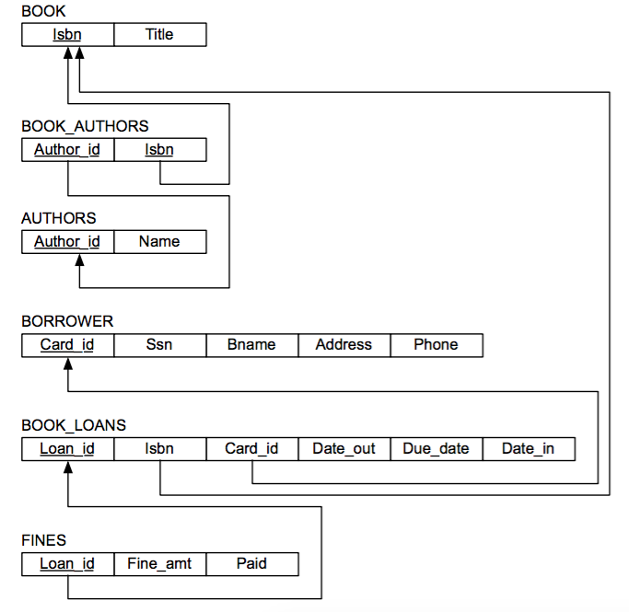
PAID
Card-id
Paid_amt

