Slide 1
Star Formation
28 April 2003
Astronomy G9001 - Spring 2003
Prof. Mordecai-Mark Mac Low

Slide 2
Gravitational Stability
Criterion for gravitational stability found by Jeans (1902).
Pressure opposes collapse: sound waves must cross region to communicate pressure changes before collapse
λ_{J}
density ρ

Slide 3
Jeans instability
Jeans swindle: in homogeneous medium
  not generally true, but usually justified
Linearize equations of motion for this medium

Slide 6
Timescales
What determines the rate of star formation in galaxies?
Free-fall time
Galaxy lifetimes greater than 10⁹ yr.
Yet star formation continues today.
How are starbursts, low surface brightness galaxies different?

Slide 7
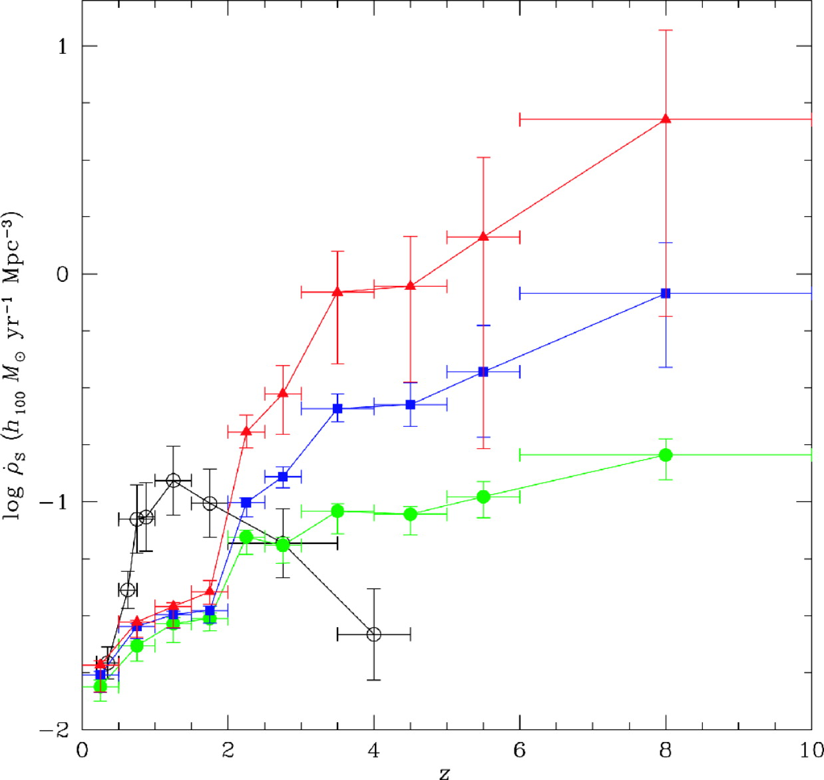
Cosmic Star Formation Rate
Star formation rate higher at high z
Actual value depends on corrections for dust obscuration, surface-brightness dimming
Different methods still give drastically different results.
Lanzetta et al. (2002)
Madau et al.
(1996, 1998)

Slide 8
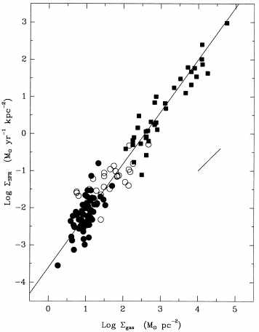
Schmidt Law
Empirically Kennicutt (1989, 1998) finds
This can be seen as a free-fall collapse:
but what is
Kennicutt 1998

Slide 9
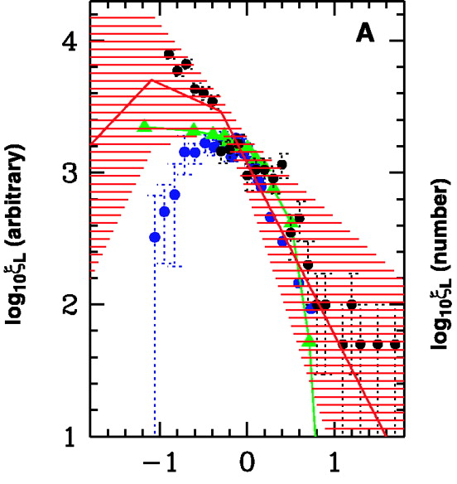
Initial Mass Function
Salpeter (1955): α = 2.35
Describes high mass stars well.
Low mass stars described by log-normal (Miller & Scalo) or multiple power laws (Kroupa 2002)
Why is form universal?
What determines peak?
Galaxy
ONC
Pleiades
M35
Kroupa 2002

Slide 10
How can stars form?
Gravity is counteracted by
  thermal pressure
  angular momentum
  magnetic pressure and tension
Each must be overcome for collapse to occur

Slide 11
Isothermal Sphere Solutions
This is the Lane-Emden equation, which forms the basis for stellar structure. When

Slide 12
Bonnor-Ebert Spheres
Ebert (1955) and Bonnor (1956) found solutions to the modified Lane-Emden equation for finite external pressure P_{ext}

Slide 14
Isothermal Collapse
Larson (1969) and Penston (1969) found similarity solutions for the collapse of a uniform density, isothermal sphere
Shu (1977) gave the collapse solution for an initially hydrostatic isothermal sphere (but this has a density singularity at the center).
Whitworth & Summers (1985) showed that many isothermal collapse solutions exist; all can be described with two parameters measuring the initial and final density concentration
Isothermal sphere with central singularity is only the most extreme case

Slide 15
MHD Support
Magnetic fields can prevent collapse if magnetic energy exceeds potential energy
Remember, virial theorem analysis yields
So, flux must be lost at some stage to allow stars to form, or gas must be accumulated along field lines over large distances.

Slide 16
Ambipolar Diffusion
Neutral-ion drift (note different def’n in plasma physics: electron-ion drift)
Collisional drag force F_{ni} = -F_{in} = γρ_{i}ρ_{n}(v_{i} - v_{n})
  drag coefficient γ constant for v_{d} < 10 km s⁻¹
For low ionization fraction, drag balances Lorentz
The induction equation is a non-linear diffusion equation

Slide 17
In molecular clouds, t_{AD} ~ 10 t_{ff} so suggested as solution to both flux and timescale problems.
  However, stars form within ~ 1 Myr despite varying local ionization states
  Magnetic field measurements suggest fields already weak when cores form
  is flux problem solved at larger scales? How?

Slide 18
Importance of Ambipolar Diffusion
May be most important dissipation mechanism in turbulence
Mediates shock waves, reducing heating, but causing instability
Determines binary formation by modulating magnetic braking in protostellar cores
Controls viscosity in accretion disks by suppressing magnetorotational instability
Forms current sheets in turbulent flows, perhaps melting meteoritic chondrules in protoplanetary disks?

Slide 19
Turbulent Fragmentation
Gravitational fragmentation in a turbulent flow may explain some features of star formation
  collapse time depends on strength of turbulence
  slow, isolated collapse occurs in regions globally supported against collapse by turbulence
  fast, clustered collapse occurs in unsupported regions
  IMF appears log normal near Jeans mass
Turbulent state of molecular clouds suggests this mechanism indeed operates
  most observed cores magnetically unsupported

Slide 20
Angular Momentum
Consider ISM with M = 1 M, n = 1 cm⁻³
Angular momentum not conserved:
  Diffuse gas > molecular clouds
  molecular clouds > cloud cores
  cloud cores > protostars
  protostars > main sequence stars
  J ~ 10⁴⁸ g cm⁻² s⁻¹
Where does it go? (Binary formation insufficient)

Slide 21
Magnetic Braking
Magnetic fields can redistribute angular momentum away from a collapsing region
Outgoing helical Alfvèn waves must couple with mass equal to mass in collapsing region (Mouschovias & Paleologou 1979, 1980)

Slide 22
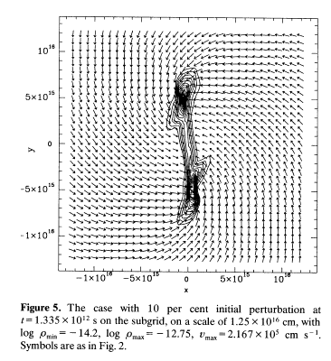
Binary Formation
In absence of magnetic fields, binary formation occurs from the collapse of rotating regions
Ratio of gravitational to rotational energy determines fragmentation
However, magnetic braking can effectively drain rotational energy, preventing binary formation
Burkert & Bodenheimer 93
does ambipolar diffusion allow decoupling of core from field to explain high binary rate?

Slide 23
Piecewise Parabolic Method
Third-order advection
Godunov method for flux estimation
Contact discontinuity steepeners
Small amount of linear artificial viscosity
Described by Colella & Woodward 1984, JCP, compared to other methods by Woodward & Colella 1984, JCP.

Slide 24
Parabolic Advection
Consider the linear advection equation
Zone average values must satisfy
A piecewise continuous function with a parabolic profile in each zone that does so is

Slide 25
Interpolation to zone edges
To find the left and right values a_{L} and a_{R}, compute a polynomial using nearby zone averages. For constant zone widths Δξ_{j}
In some cases this is not monotonic, so add:
And similarly for a_{R,j} to force montonicity.

Slide 26
Conservative Form
Euler’s equations in conservation form on a 1D Cartesian grid
conserved
variables
gravity or
other body
forces
fluxes
pressure

Slide 27
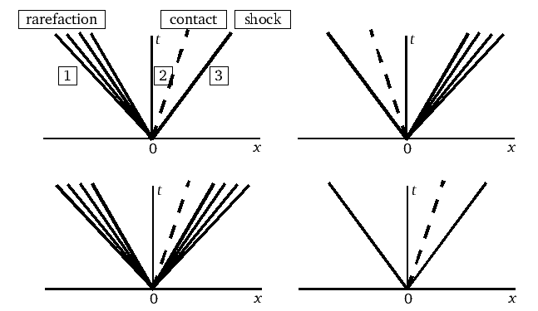
Godunov method
Solve a Riemann shock tube problem at every zone boundary to determine fluxes

Slide 28
Characteristic averaging
To find left and right states for Riemann problem, average over regions covered by characteristic: max(c_{s},u) Δt
t_{n+1}
t_{n+1}
or
t_{n}
t_{n}
x_{j}
x_{j}
x_{j-1}
x_{j+1}
x_{j-1}
x_{j+1}
subsonic
flow
supersonic
flow
(from left)

Slide 29
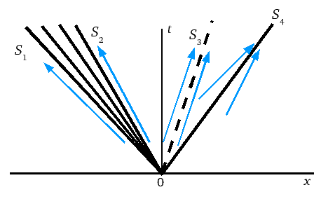
Characteristic speeds
Characteristic speeds are not constant across rarefaction or shock because of change in pressure

Slide 30
Riemann problem
A typical analytic solution for pressure (P. Ricker) is given by the root of

