Slide 1
dust properties: based on CRISM, MARCI/IUVS, and Mastcam-Z

Slide 2
A set of dust properties for Mars
https://gemelli.spacescience.org/~wolff/files/aerosols/dust/
Current version: mars045i_all_area_s0780.fits.gz
wavelengths = [0.2, 95] µm, r_{eff} = [0.1,5.75] µm, v_{eff} = 0.3

Slide 3
More Realistic Particle Shapes
The use of an oblate cylinder has provided a reasonably robust representation of dust aerosol shapes, at least with respect to producing a self-consistent microphysical model. Perhaps not correct, but the calculations were self-consistent, i.e., refractive indices, constraints on particle size, etc. The edges on the particle shape are important in breaking up resonances from smoother shapes.
Advances in light scattering techniques allow one to take one step further, asymmetric hexahydra.
L. Bi, P. Yang, G. W. Kattawar and R. Kahn, Applied Optics, 49, 334, 2010.
M. Saito, P. Yang, J. Ding and X. Liu Journal of Atmospheric Sciences, 78, 2089, 2021

Slide 4
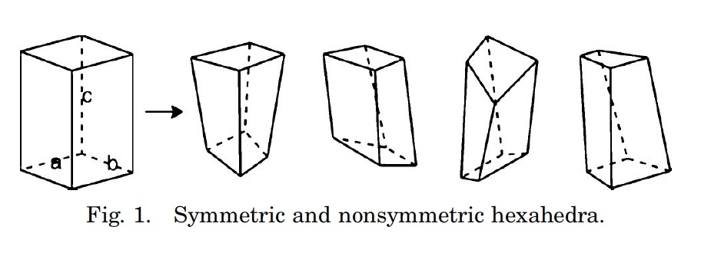
Asymmetric Hexahydra
Fig 1, Bi et al., 2010
The original work of Bi et al. explored the utility of the shape. The asymmetric structure is even more efficient at breaking up the interference structure (i.e., resonances).
Saito et al. develop the numerical techniques to make such computations tractable (and created a database.

Slide 5
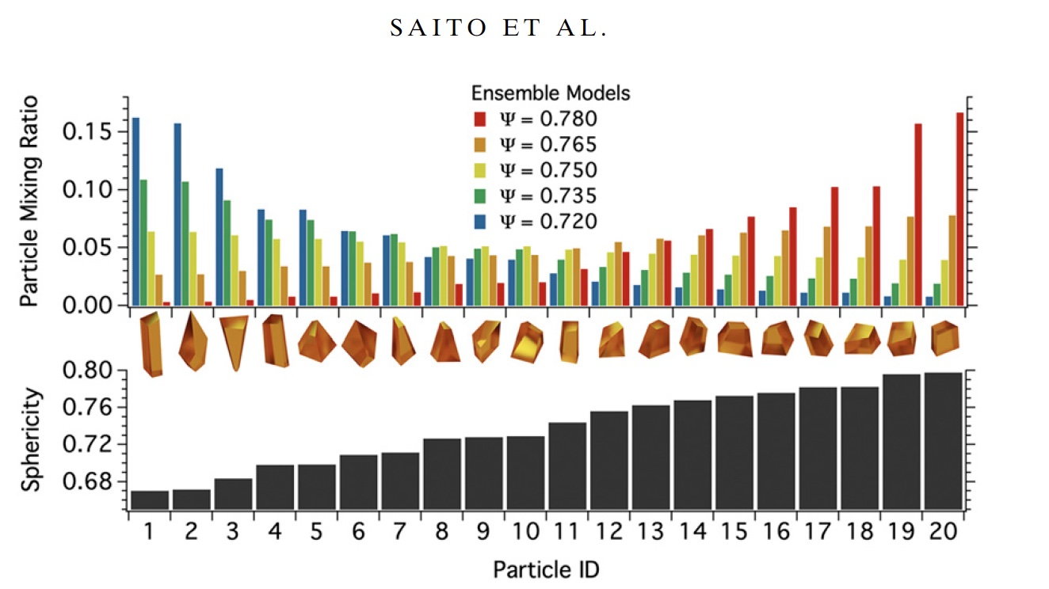

Slide 6
Refractive Index Set
We repeated the analysis of Wolff et al. (2009) using the radiative property database of Saito et al. (2021); we derived the refractive indices that fit the 2007 global dust event observations for a grid of effective particle sizes (1.5, 1.8, 2.1, 2.4 µm) and particle sphericity (0.695 – 0.785).
UV refractive indices have NOT (yet) been redone. They are just the Wolff et al., 2010, Connour et al., 2022 values.
With these, we analyzed the MCZ Dust Sky Surveys to constrain the particle sphericity (choose the appropriate refractive index function)

Slide 7
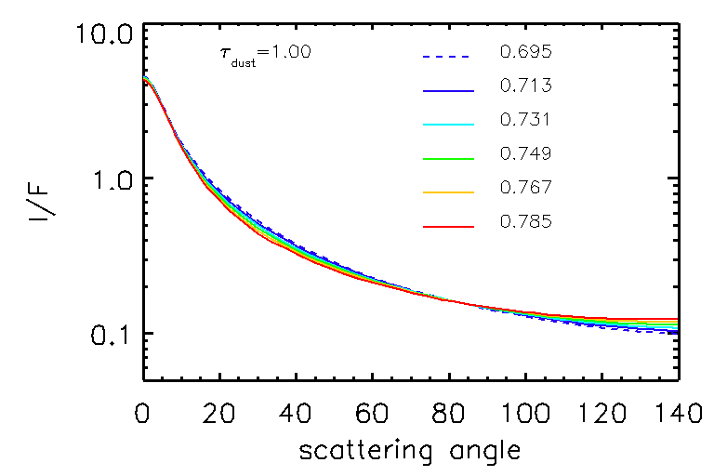
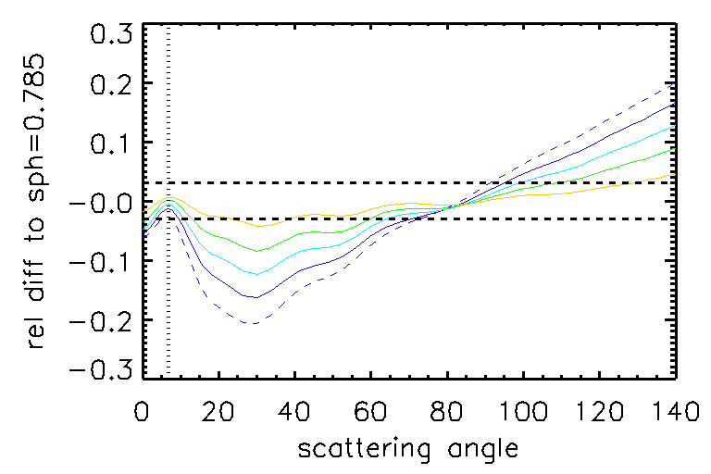
Sensitivity to particle shape
Typical Dust Sky Survey geometry
Dustier atmosphere, but still sensitive with lower optical depths.
Radiative transfer is sensitive to particle shape in the near-forward scattering and backscattering directions.
We choose backscattering to avoid sensitivity to particle size.

Slide 8
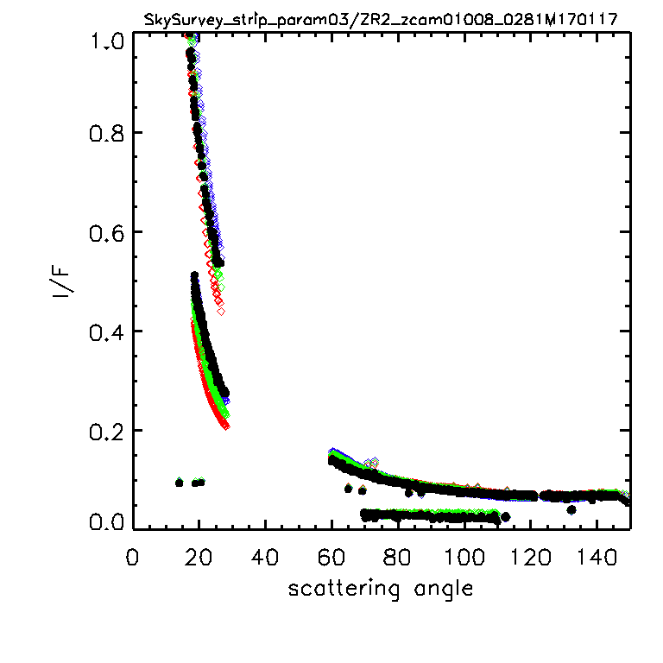
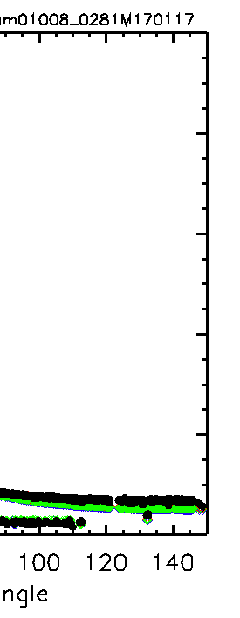
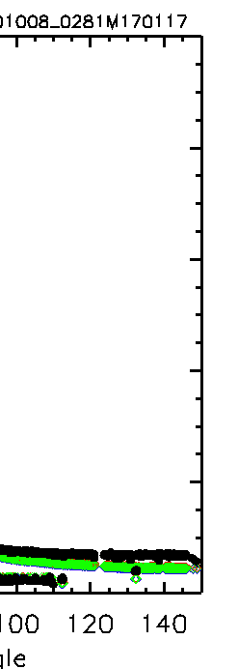
Dust Sky Survery fron Sol 281: black-data, color-model
s = 0.785
s = 0.731
s = 0.685

Slide 9
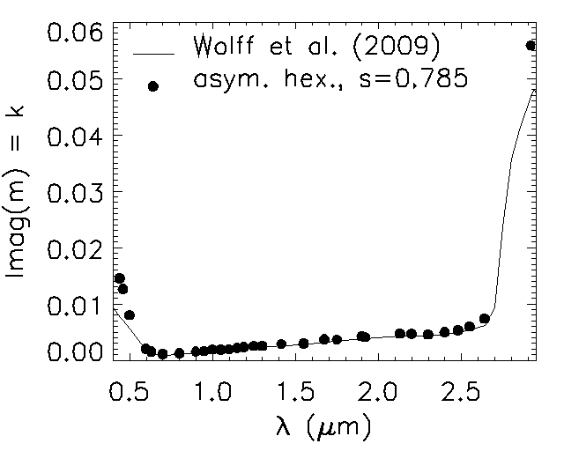
Advanced Light Scattering calculations are necessary…
Mainly to get the more absorbing wavelengths right: UV, 3 micron band, thermal IR…
This suggests that one needs to re-do the UV analyses as well…

Slide 10
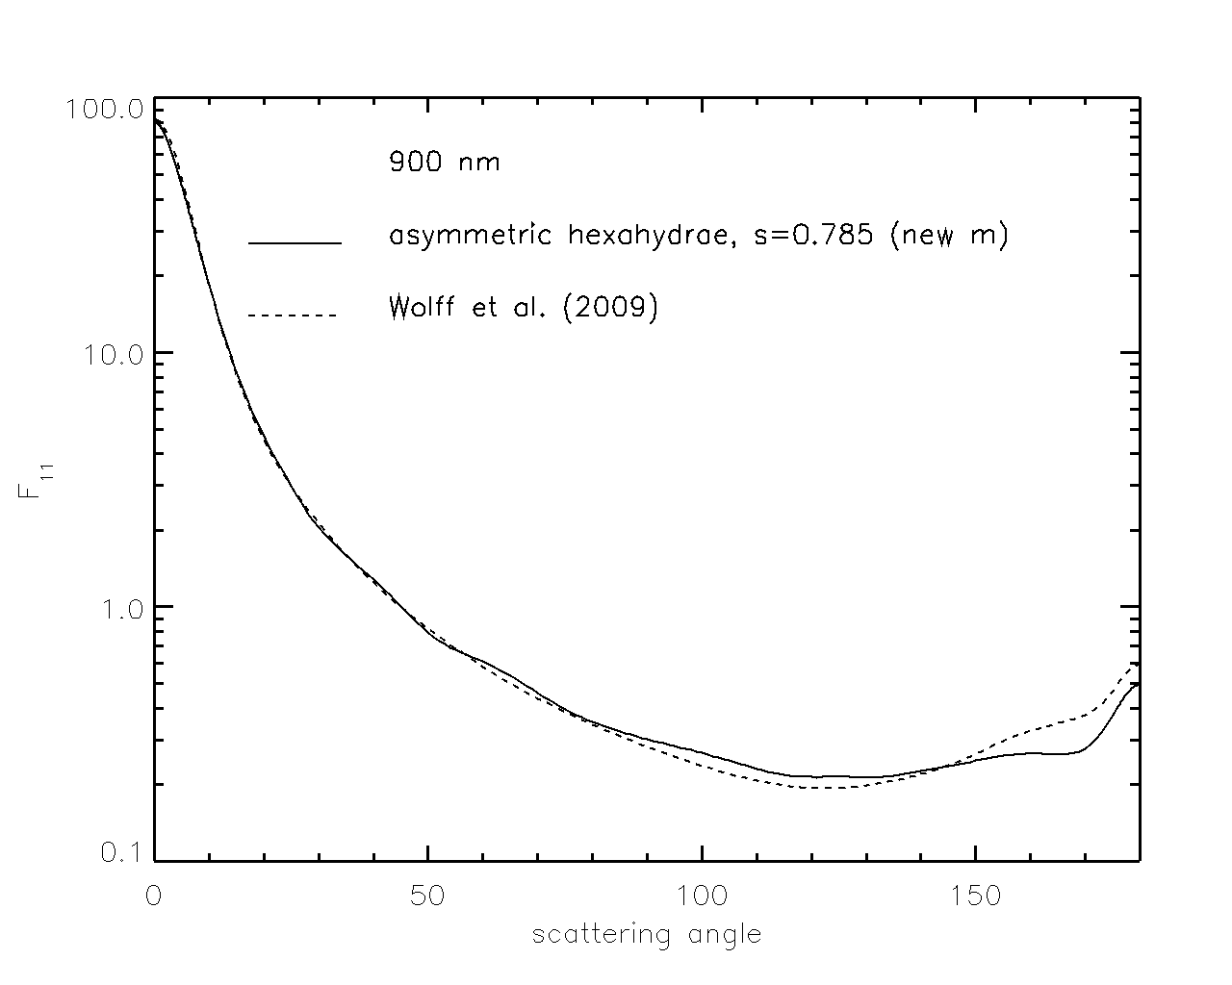
Simple oblate cylinders do a pretty good job compared to the much more complex current shape.
This is at 900 nm (so very little absorption).
The D/L=1 T-matrix cylinder does a reasonable job.

Slide 11
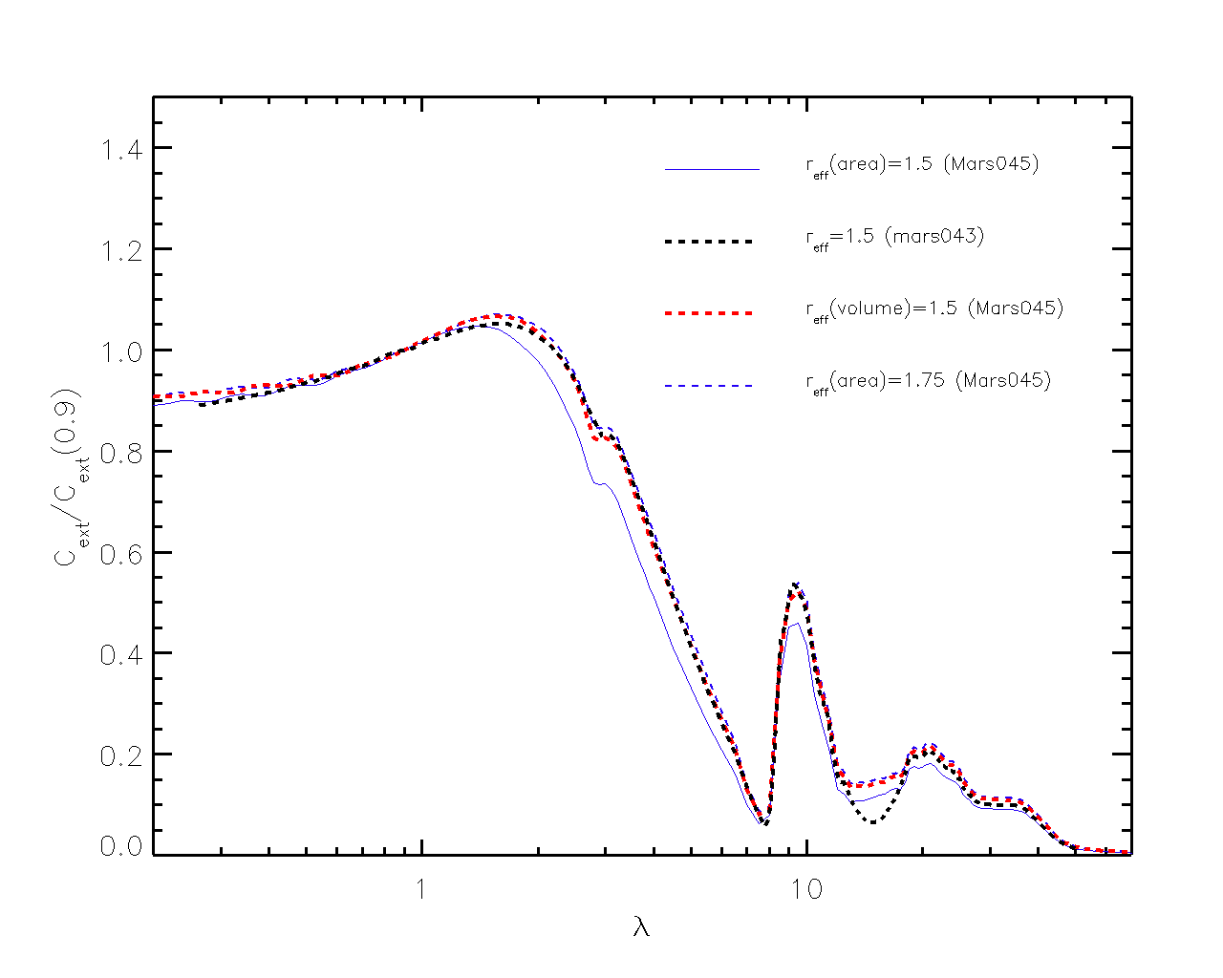
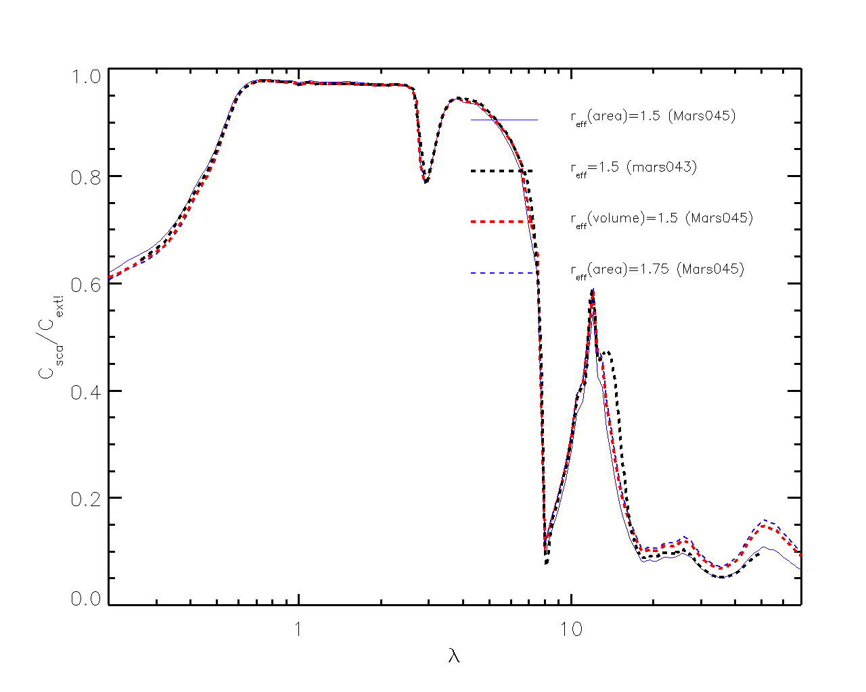
It is important to know which surface equivalent sphere you are using; SSA relatively unchanged.

Slide 12
File structure - FITS
FITS was chosen to allow easy storage of unlike objects with significant software support in the public domain.
The primary header contains general information about the database construction
The primary data unit is not used.
The various quantities are stored in the associated Header Data Units (HDUs)

Slide 13
HDUs
NW = number of wavelengths, NR = number of r_{eff}, NMOM = number of Legendre terms, NT = number of angles
Extension 1 -- FORW Cext, Csca, g -- (3, NW, NR)
Extension 2 -- PMOM Legendre coefficients of PHSFN (NW, NR, NMOM)
Extension 3 -- PHSFN phase function (F₁₁) (NW, NR, NT)
Extension 4 – EXPANSION expansion of F₁₁ using PMOM (NW, NR, NT)
Extension 5 -- PARTICLE_SIZES r_{eff}(µm) (NR)
Extension 6 – WAVELENGTHS (µm)
Extension 7 -- SCATTERING_ANGLE (degrees) (NT)

Slide 14
Useful KEYWORDS in the Primary Header
DATE = '2023-03-27' / Creation UTC (CCCC-MM-DD) date of FITS header
EQUSPH = 'AREA ' / radius of equivalent sphere using area
SPHERIC = 0.780000 /sphericity of the particle ensemble
DIEL = 'mars045i.tab' /source of refractive
HISTORY Using database of Saito et al., 2021, Atmos. Sci., 78, 2089–2111.
HISTORY https://sites.google.com/site/masanorisaitophd/data-and-resources/
Notes:
VERSION = ' 1.20' / Version of (this) library generation softare.
FIX_F11 = '1 ' / Phase function size grid artifacts removed
EQUSPH = 'AREA ' / radius of equivalent sphere using area
VEFF = 0.100000 / v_{eff}, 2nd moment of size distribution
MODEL = 'droxtal_050_tmat1' /base model
VERSION = ' 1.20' / Version of (this) library generation softare.
FIX_F11 = '1 ' / Phase function size grid artifacts removed
EQUSPH = 'AREA ' / radius of equivalent sphere using area
VEFF = 0.100000 / v_{eff}, 2nd moment of size distribution
MODEL = 'droxtal_050_tmat1' /base model

