Slide 1
KidGuard
🛡
AI-Powered Child Safety for the Modern Internet
KidGuard
Real-time grooming detection on Roblox — built for parents, powered by AI.
Child Safety Intelligence
Protecting children. One conversation at a time.

Slide 2
The Problem
Online child grooming is growing — and most parents have no idea it's happening
500 M+
67%
1 in 7
93%
Roblox monthly active users
are under 16 years old
children receive online sexual solicitation
of grooming starts with normal conversation
⚠ Children are targeted through legitimate gaming platforms — Roblox, Minecraft, Fortnite — where parents assume they are safe.
⚠ Grooming is gradual. It begins with friendship, trust-building, and compliments before escalating.
⚠ Most parents only discover grooming after serious harm has already occurred.
⚠ Existing tools block content — they don't understand conversations.
KidGuard | Child Safety Intelligence Platform
2 / 10

Slide 3
What Else Exists — and Why It Falls Short
Current solutions are either too broad, too slow, or too blind to context
Net Nanny
Bark
Qustodio
Roblox Chat Filter
✗ Full device agent install ✗ Blocks websites — can't read chat ✗ No AI understanding of context ✗ Expensive monthly subscription ✗ Not gaming-platform aware
✗ Monitors after the fact (not real-time) ✗ Email/social focused — misses Roblox ✗ No conversation context captured ✗ No SMS instant alert ✗ High false-positive rate
✗ Keyword-based filtering only ✗ Easily bypassed with synonyms ✗ No AI grooming pattern detection ✗ Network-level only — misses encryption ✗ Generic parental controls
✗ Only filters profanity, not grooming ✗ No parent notification system ✗ No conversation history ✗ Bypass patterns widely known ✗ No risk scoring or AI analysis
KidGuard | Child Safety Intelligence Platform
3 / 10

Slide 4
Introducing KidGuard
A lightweight, AI-native solution built specifically for gaming platforms
🎯 Platform-Specific
🤖 AI-Native Detection
⚡ Real-Time Alerts
Built exclusively for Roblox — understands the context, the language, and the risk patterns unique to gaming chat.
Uses Claude AI (Anthropic) to understand conversation intent — not just keywords. Detects manipulation, trust-building, and bypass attempts.
Parents receive an SMS the moment a risk is detected — not hours later when the damage is done.
🪶 Zero Installation
📋 Evidence-Ready
🔒 Privacy First
A simple Chrome extension. No device agents, no VPNs, no router changes. Works in minutes.
Captures 10-message conversation context at the moment of detection — ready for authorities if needed.
Monitors only Roblox chat. No screenshots, no full device surveillance.
KidGuard | Child Safety Intelligence Platform
4 / 10

Slide 5
KidGuard vs The Competition
Not just better — fundamentally different in approach
Feature
Net Nanny
Bark
Roblox Filter
KidGuard ✓
Real-time detection
✗
✗
✗
✓
AI conversation understanding
✗
Partial
✗
✓
Grooming bypass detection
✗
✗
✗
✓
SMS instant parent alert
✓
✓
✗
✓
Conversation evidence capture
✗
✗
✗
✓
No device install needed
✗
✗
✓
✓
Roblox-specific context
✗
✗
Partial
✓
Free / low cost
✗
✗
✓
✓
KidGuard | Child Safety Intelligence Platform
5 / 10

Slide 6
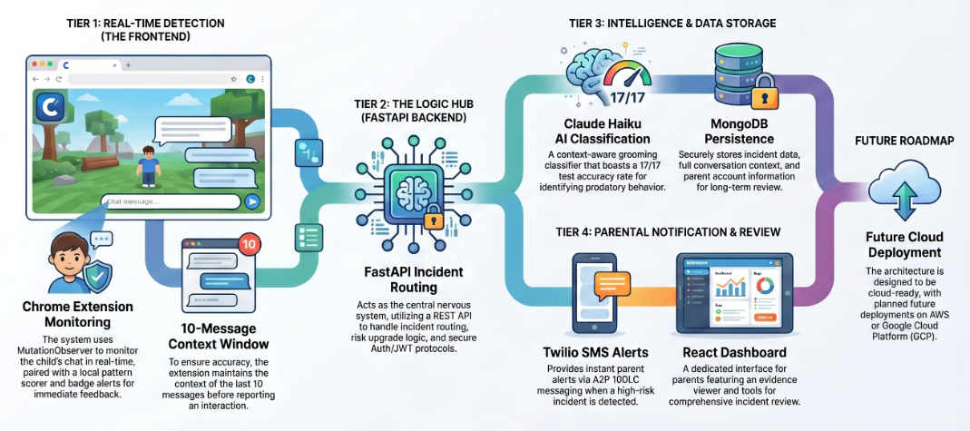
System Architecture
Lightweight, modular, and cloud-ready
👦 Child on Roblox
Claude Haiku AI
• Grooming classifier • 17/17 test accuracy • Context-aware
Twilio SMS
Chrome Extension
FastAPI Backend
• Instant parent alert • A2P 10DLC
• MutationObserver • Pattern scorer • 10-msg context • Badge alerts
• REST API • Incident routing • Risk upgrade logic • Auth / JWT
MongoDB
React Dashboard
• Incident storage • Conversation context • Parent accounts
• Incident review • Evidence viewer
Future: Cloud
• AWS / GCP deploy
KidGuard | Child Safety Intelligence Platform
6 / 10

Slide 7
The AI Detection Layer
Claude Haiku — purpose-built for Roblox child safety classification
17 / 17
✦ Context-aware, not keyword-based
Understands that 'are you alone?' means something very different in a grooming context than in a normal conversation.
Test accuracy on real grooming scenarios
✦ Roblox-specific training context
System prompt grounds every classification in the Roblox gaming environment — reducing false positives from normal gaming chat.
✦ Three-tier risk output
Returns GROOMING / SUSPICIOUS / SAFE with a confidence score (0-1) and a human-readable reason for parent review.
Detects bypass attempts
"h3y wanna b fr1ends?" "can we talk on discord instead?" "don't tell your parents about me"
✦ Risk upgrade logic
AI confidence ≥ 0.9 → upgrades incident to HIGH risk. Confidence ≥ 0.8 → MEDIUM. Layered defence with rule-based scorer.
✦ Evidence-quality reasoning
Every detection includes a written reason — e.g. 'Asking child to move conversation off-platform is a classic isolation tactic.'
KidGuard | Child Safety Intelligence Platform
7 / 10

Slide 8
What Makes KidGuard Remarkable
A combination of innovations that no existing product offers
Zero-Install Deployment
AI That Actually Understands
Sub-Second Parent Alert
🎯
A Chrome extension. Parents install it in under 2 minutes — no IT skills, no router config, no VPN.
🤖
Most tools match keywords. KidGuard reads the room — detecting manipulation patterns, urgency, secrecy requests.
⚡
From chat message to parent SMS in under 2 seconds. Real-time response during the critical window.
Court-Ready Evidence
Bypass-Proof Detection
Privacy by Design
📋
10-message conversation context automatically captured — structured, timestamped, downloadable JSON evidence.
🕵️
Predators use leetspeak, coded language, and platform-switching tactics. KidGuard is trained to spot all of them.
🔒
Only monitors Roblox chat. No screenshots, no keystroke logging, no browsing history. Surgical and ethical.
KidGuard | Child Safety Intelligence Platform
8 / 10

Slide 9
How It Works
From Roblox chat to parent awareness in real time
STEP 1
STEP 2
STEP 3
STEP 4
STEP 5
STEP 6
Child Opens Roblox
Chat is Monitored
Risk Scored Locally
AI Classifies the Threat
Incident Logged
Parent Alerted
Extension activates automatically on roblox.com. No action needed from the child.
MutationObserver watches for new messages in real time. Existing chat is skipped — no false replay.
Built-in pattern engine scores the message (0-10). Suspicious messages are escalated to AI.
Claude Haiku reviews the message and conversation context. Returns label + confidence + reason.
Incident stored with 10-message context. Risk level upgraded if AI confidence is high.
SMS sent instantly via Twilio. Parent opens dashboard to review the full conversation evidence.
KidGuard | Child Safety Intelligence Platform
9 / 10

Slide 10
Lessons Learned
What we would do differently tackling a similar project in the future
Start A2P 10DLC Registration Early
Use Live Twilio Credentials from Day One
Account for Platform DOM Opacity
📋
A2P registration takes weeks for carrier approval. Apply before writing a single line of SMS code, not after the rest of the system is built.
📞
Test credentials silently succeed via the API but never deliver an actual SMS. The confusion costs significant debugging time. Start with live credentials immediately.
🌐
Roblox uses dynamic, minified CSS class names. Relying on specific selectors breaks without warning. Plan for opaque frontends using broad observers with text-based deduplication.
Lead with AI Detection, Not Rules
Standardise Environment Naming Early
Build Dynamic Alert Templates from the Start
🤖
Rule-based detection was fragile and easily bypassed. Claude Haiku delivered 17/17 accuracy on real grooming scenarios. AI-first is the right architecture for context-sensitive safety.
🔧
Windows virtual environment path mismatches (.venv vs venv) caused silent module-not-found errors. Agree on a naming convention before writing code and document it in startup scripts.
📱
A generic alert SMS is useless to a parent. A dynamic alert with child name, platform, flagged message, and AI reasoning is actionable. Design around the parent's response, not the system's output.
KidGuard | Child Safety Intelligence Platform
11 / 12

Slide 11
Blockers We Encountered
Challenges that tested us along the way
Twilio A2P 10DLC Requirement
SMS Rate Limiting During Testing
Chrome Extension Processing Chat History on Load
🚫
US carriers require A2P 10DLC business registration before routing SMS from a 10-digit number. Without approval, all messages are silently filtered. Registration was still pending at project completion.
⏱
The 5-per-hour per-parent SMS rate limit was hit repeatedly during back-to-back test runs, causing delays in validating alert delivery and requiring careful management of test incidents.
🧩
The MutationObserver stability check used Roblox-specific CSS selectors that never matched, causing it to fire before chat history loaded. Historical messages were treated as new, triggering false alerts on every page load.
Twilio Trial vs Live Mode Confusion
🚧
Trial credentials return a successful API response but never deliver SMS to real phones. This caused extended debugging before identifying that the issue was credential type, not code logic.
KidGuard | Child Safety Intelligence Platform
12 / 12

Slide 12
The Vision
KidGuard is not just a Chrome extension — it is a platform.
Now
Next
Future
Roblox grooming detection SMS alerts + evidence capture AI-powered classification
Minecraft & Discord support Mobile companion app Parent dashboard mobile view
Multi-platform AI safety layer School district licensing Law enforcement integration
"Every child deserves to play freely online. Every parent deserves to know they are safe."
🛡 KidGuard — Built for Today. Ready for Tomorrow.

