Slide 1
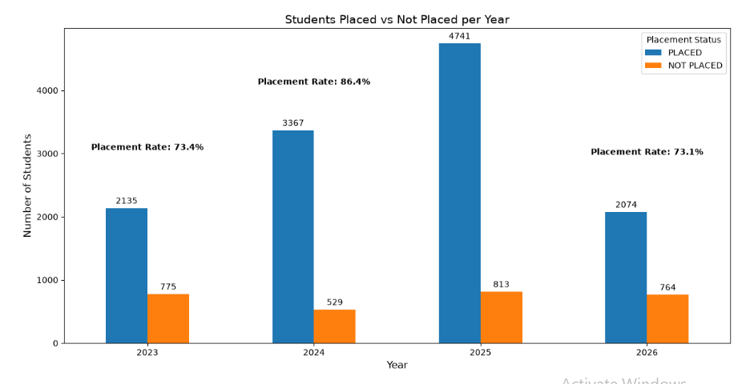
Students Placed Vs Not Placed Per Year

Slide 2
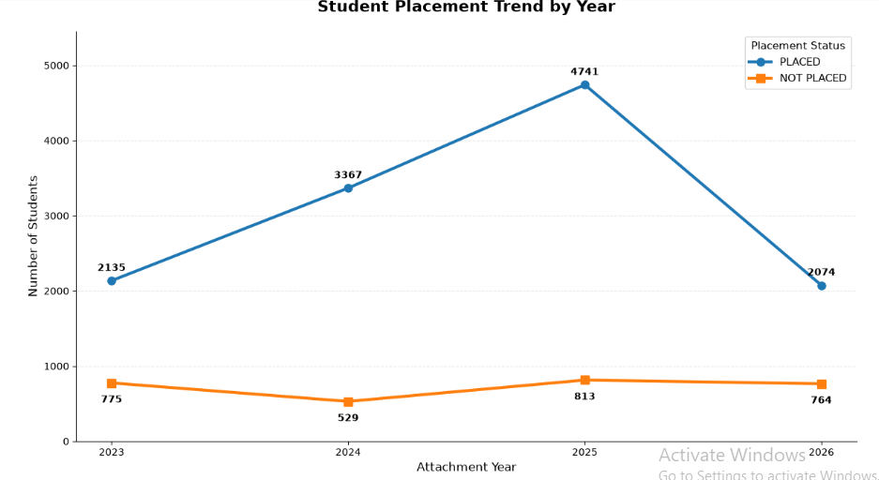
Student Placement Trend by Year

Slide 3
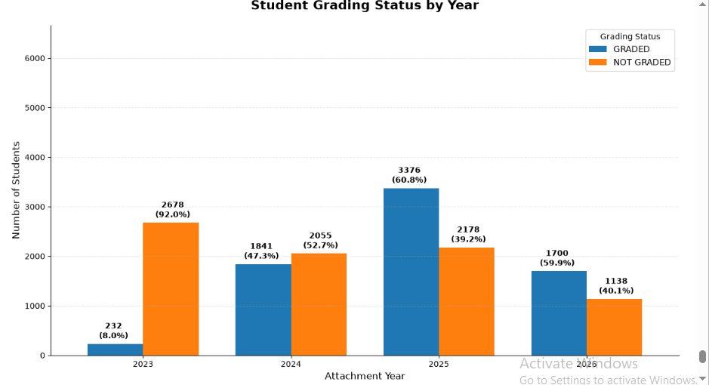
Students Grading Status by year

Slide 4
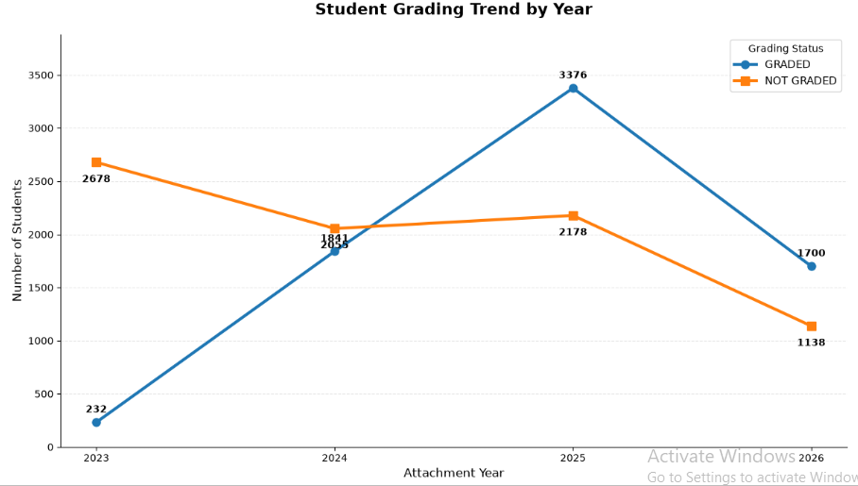
Student Grading Trend by Year

Slide 5
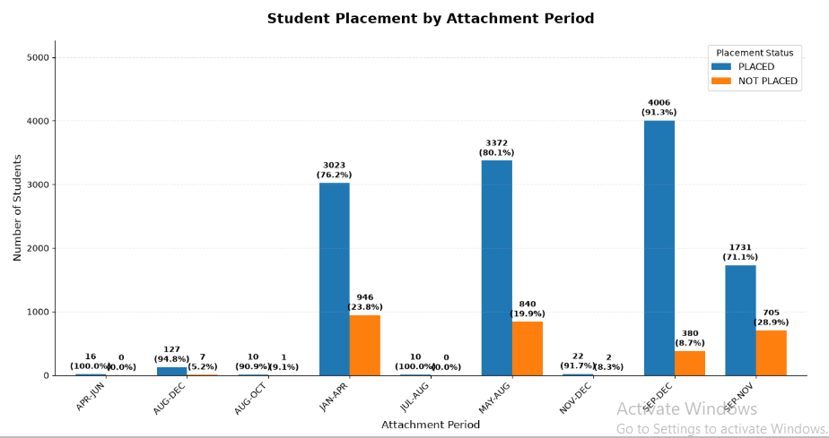
Student Placement by attachment Period

Slide 6
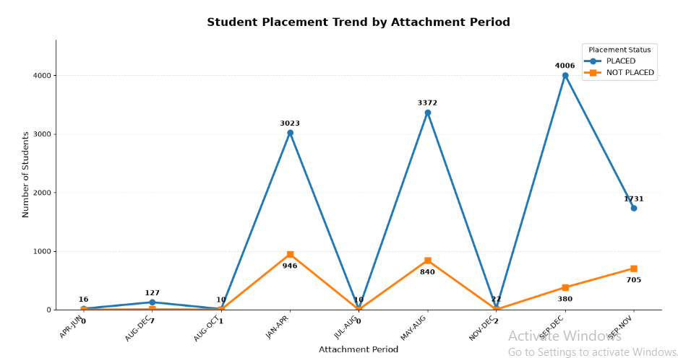
Student Placement trend by attachment Period

Slide 7
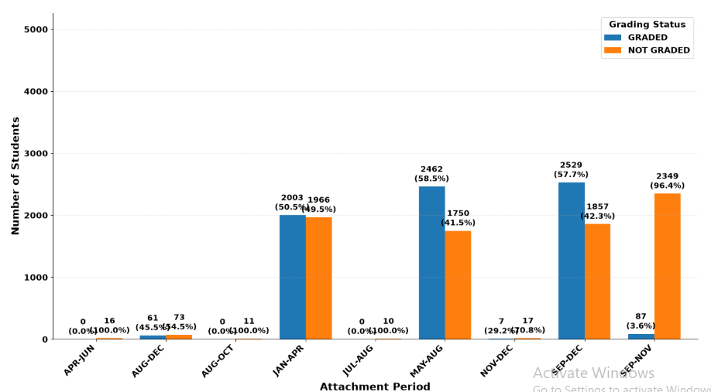
Student Grading Status by attachment Period

Slide 8
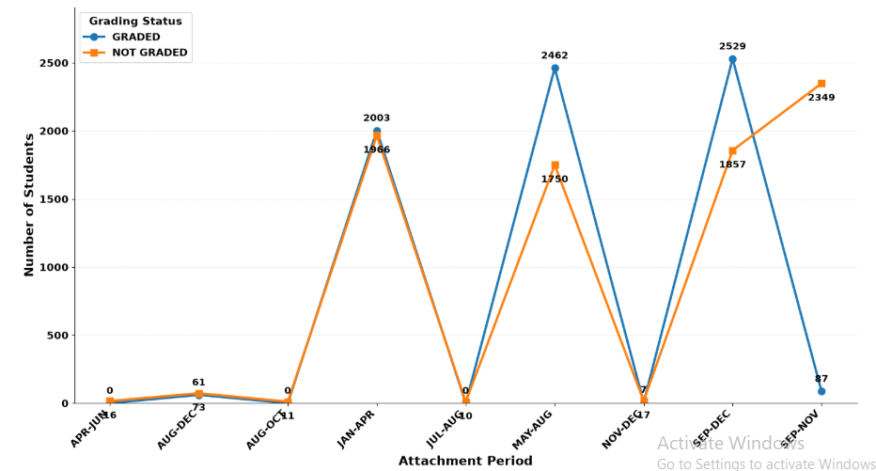
Student Placement trend by attachment Period

