Slide 1
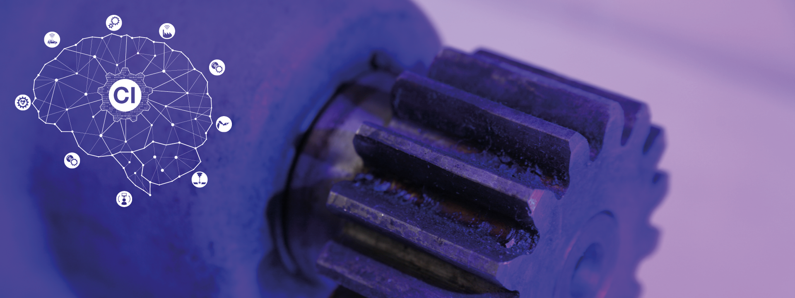
Project Aim2 Task14
Group5

Slide 2
Team Introduction
Responsibilities
Alejandro Delgadillo, Data preprocessing
Jinyang Yu, Data preprocessing
Nayoung Ahn, Data preprocessing
Shuteng Wang, Data preprocessing
Xiaoyang Liu, Neural network model

Slide 3
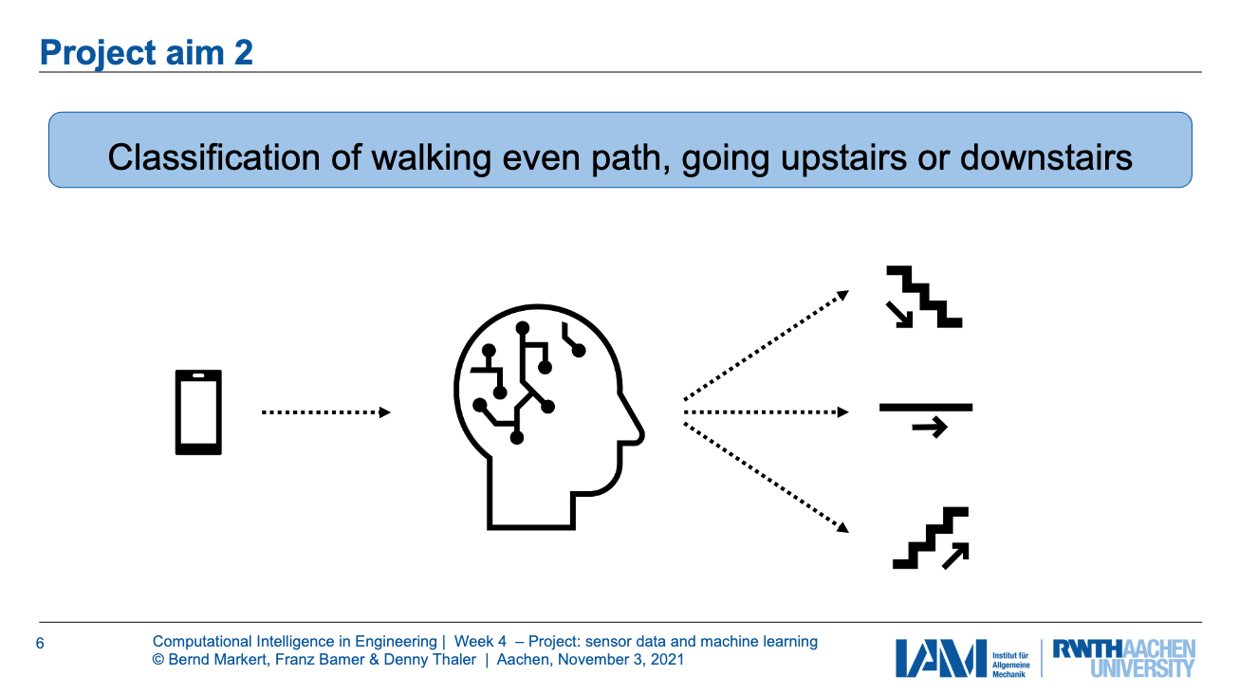
Motivation and Aim
Inputs
Data source:
Smartphone 3
Sensor signal: acc and gyr
weight and height
Notes:
Using neural network, our aim is to predict the subject’s gait, i.e. whether the subject walked on event(normal) path, went upstairs or downstairs.
Our task was to take the sensor signals (acceleration and gyroscope) from Smartphone3 with weight or height, perform 5-fold subject-wise validation and compare error based on different anthropometric parameters.

Slide 4
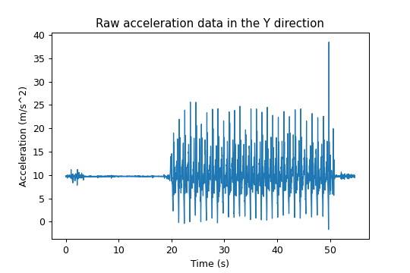
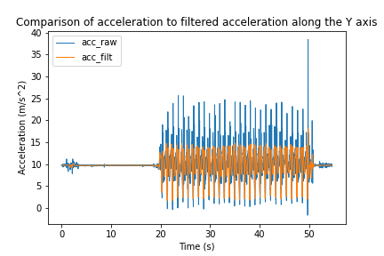
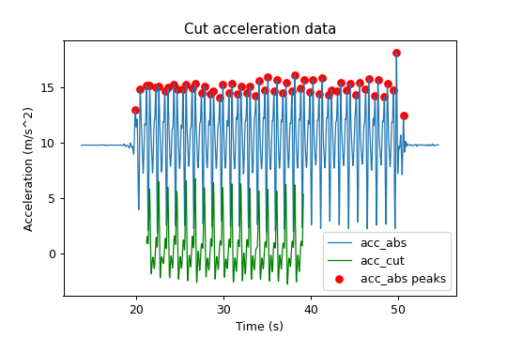
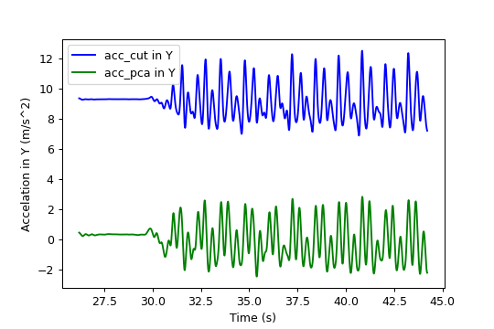
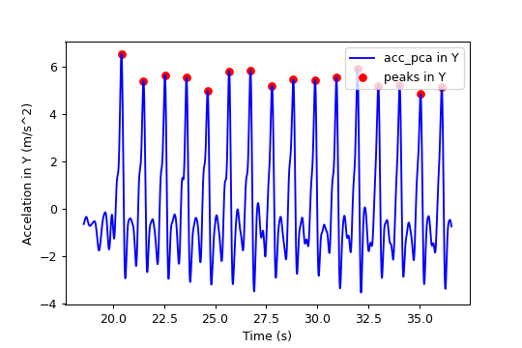
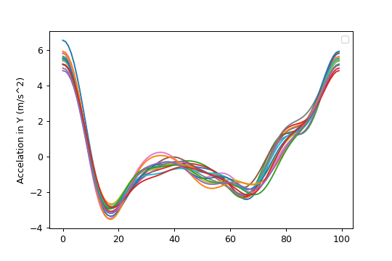
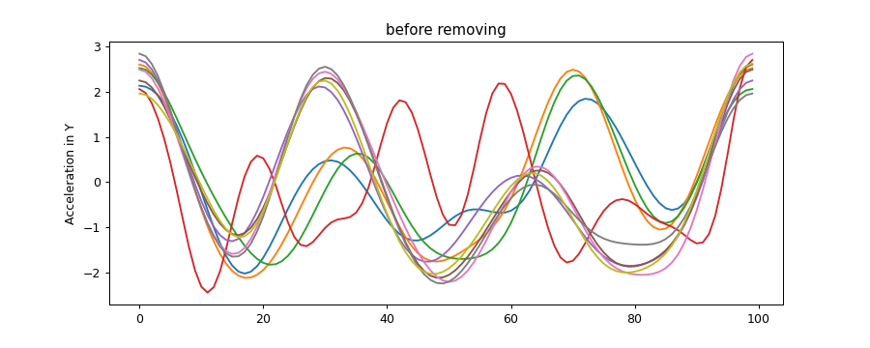
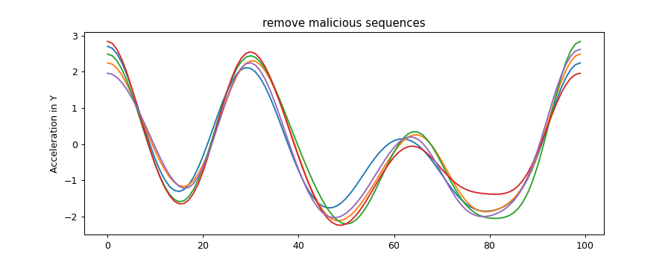
Data Preprocessing - Summary
Read csv
Get frequency
Filter noise
Extract motion sequence
anthro_2021.csv
Accelerometer.csv
Gyroscope.csv
Rotate data
Segment trials into samples
Resample to same frame #
Remove bad sequences

Slide 5
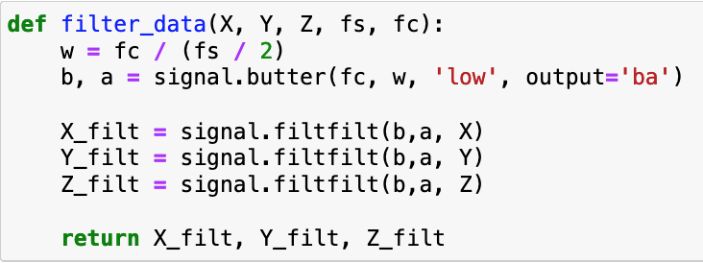
Data filtering
Applied Butterworth low pass filter
Cut off frequency of 4Hz
Avg. walking freq. of a person
Fast Fourier Transform
Notes:
Butterworth filter is used to filter the very high frequency noise present in data.

Slide 6
Extract Motion Sequence
Precut data
Get bounds to find peaks
Cut data
Precut signals with a precut factor e.g. 0.25
Precut factor was empirically determined by observing all data
Get upper and lower bounds to find peaks of the signal
Starting point: maximum difference between two neighboring peaks
Duration of e.g. 18s was set manually from the starting pt.

Slide 7
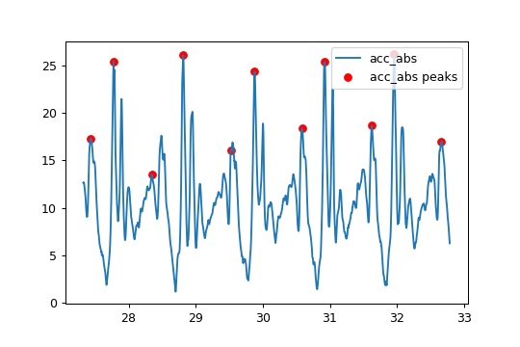
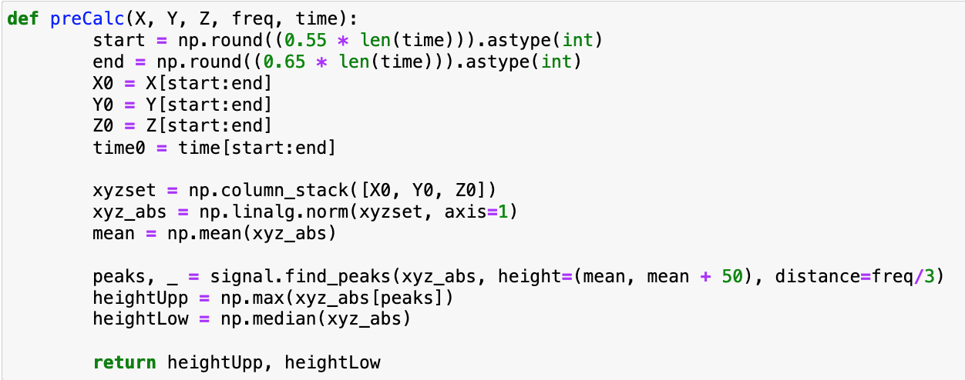
Pre-calculation of parameters
Get upper and lower bounds of the height signal to find peaks
to avoid loss of characteristics of different data
used median and max. frequency of the initial data (55% - 65%) to determine the peaks

Slide 8
Extract Motion Sequence
Precut data
Get bounds to find peaks
Cut data
Precut signals with a precut factor e.g. 0.25
Precut factor was empirically determined by observing all data
Get upper and lower bounds to find peaks of the signal
Starting point: maximum difference between two neighboring peaks
Duration of e.g. 18s was set manually from the starting pt.

Slide 9
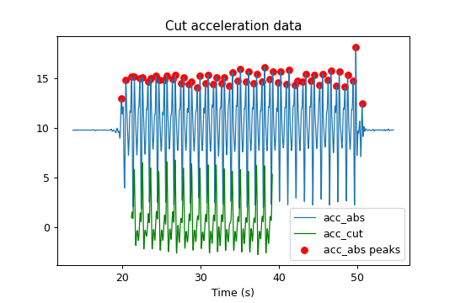
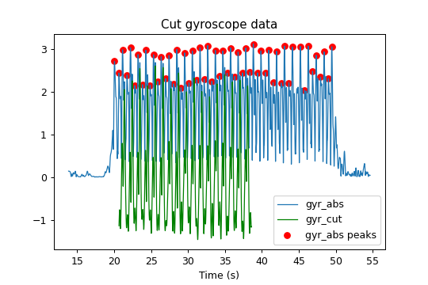
Cutting of accelerometer and gyroscope data
Notes:
Take 18 seconds
Use height parameters we calculated before to get peaks

Slide 10
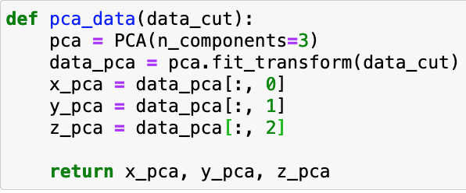
Rotate data using PCA
Notes:
The data is scaled and centered to have zero mean and variance equal to one. And then the data set is rotated such that the acceleration is maximum along one axis. This is done to correct the different initial orientation of different smartphones.

Slide 11
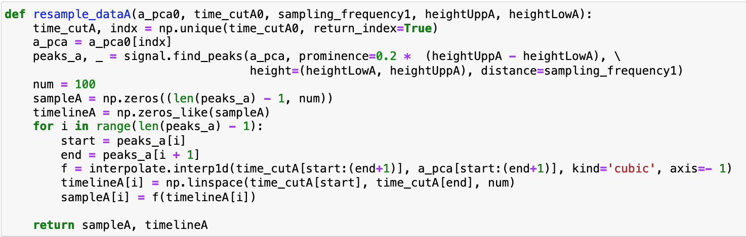
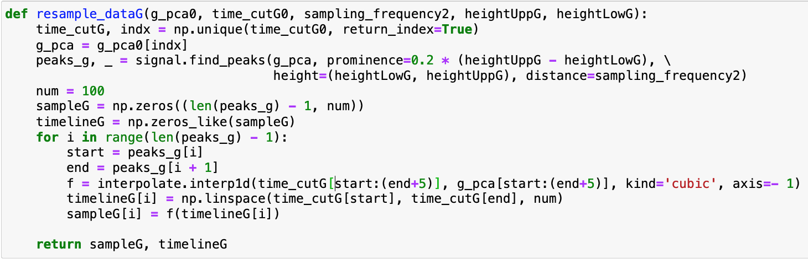
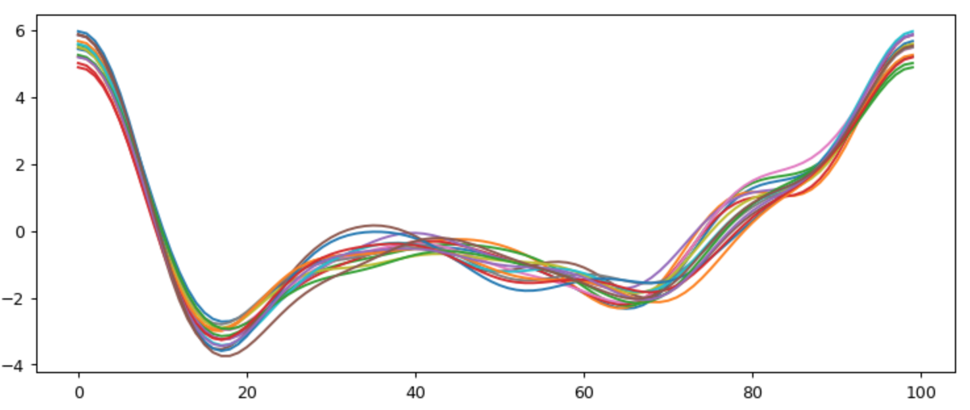
Resample to same frame
Find all peaks after PCA and resample between neighboring peaks
Each walking cycle in the sequence was resampled to 100 frames per cycle
The figure shows acceleration in the Y direction

Slide 12
Remove malicious sequences
Using the mean of absolute values of the sequences and the standard deviation of the population.

Slide 13
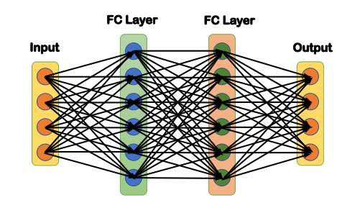
Neural Network Architecture
Our initial neural network architecture
Input | Input Shape = (8,100)
FC layer | 64 neurons, activation =‘elu’
FC layer | 32 neurons, activation =‘elu’
Output | 3 outputs, activation =‘softmax’
Notes:
Chose parameters : chose diff no. of neurons in each layer, chose diff. Activation function
Default choice for classification

Slide 14
5-fold cross-validation and tuning process
Tab1. Performance with deeper network
Validation process
Choose 10% of the dataset as test set
Cut the rest 90% of the dataset into 5 folds
Use 5-fold cross validation to experiment, compute avg. accuracy and compare
2 FC layers | 3 FC layers
88.76% | 90.12%
Tab2. The effect of input normalization (3FC layers)
Without normalization | With normalization
90.12% | 89.24%
Some results
4 + layers did not show improvement.
Input normalization has minimal affect
Batch normalization even reduces the accuracy.
The information of height and weight seems to be redundant.
Tab3. The effect of weight/height information
Without Height/Weight | With Height/Weight
94.86% | 90.12%
Notes:
Batch not shown in table since it doesnt make too big a difference.

Slide 15
Final Test
Our final neural network architecture
The 5-fold validation accuracy for our final neural network is 94.86%.
The accuracy on the test set is 84.15%.
The accuracy with the information of height and weight on the test set is 79.24%.
Input | Input shape = (6,100)
FC layer | 64 neurons,activation=‘elu’
FC layer | 32 neurons,activation=‘elu’
FC layer | 16 neurons,activation=‘elu’
Output | 3 outputs, activation = ‘softmax’
Notes:
Decided not to use weight and height

Slide 16
Conclusion
We could classify and predict the walking patterns with a good degree of accuracy from just a well processed smartphone data on a simple neural network architecture.
Anthropometric data had minimal contribution to the accuracy of the prediction.
Hence we deduced that acceleration and gyroscope data is most important when determining gait

Slide 17
Discussion
Preprocessing:
Despite several instances of inconsistent or incomplete raw data we were able to isolate most of those cases and produce a clean dataset to train the neural network.
Accurately extracting the motion sequence from raw data was the most challenging preprocessing step.
When removing the malicious sequences, x, y and z axes were examined independently. This means that for one subject, the samples may include parts from different time frames/ walking cycles. We did this to keep the maximum possible number of samples.
Neural Network:
Do we really need a neural network to classify the trajectory from accelerometer and gyroscope data?
In what ways is a neural network more effective than conventional estimation method?
In the future, could also try:
Recurrent neural network like LSTM
Convolutional neural network using rectangular convolution kernel
Notes:
Initial raw data included 102 test subjects, from which ### were left after preprocessing.
When removing the malicious sequences, x, y and z axes were examined independently. This means that for one subject, the samples may include parts from different time frames/ walking cycles. We did this to keep the maximum possible number of samples.

