Slide 1

University of Dar es Salaam
AQ 399: Proposal Presentation
Name:XXXXX Reg #: XXXXXX Supervisor: XXXXX

Slide 2
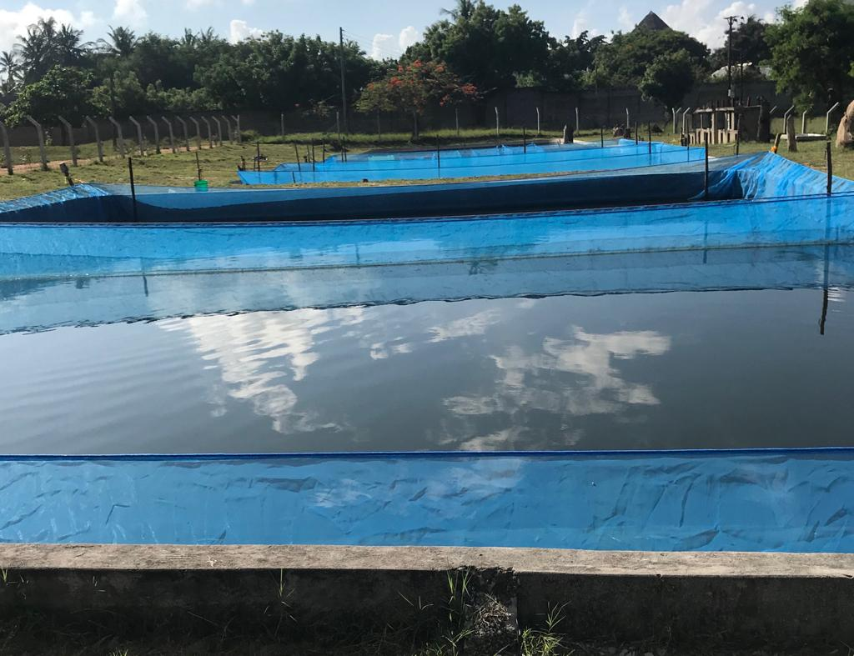
Research title
University of Dar es Salaam
Title: A comparison study of water quality parameters and primary productivity between tilapia aquaculture ponds of local fish farmers, academic and research institutions in Dar es Salaam

Slide 3
University of Dar es Salaam
Statement of research problem

Slide 4
University of Dar es Salaam

Slide 5
University of Dar es Salaam

Slide 6
University of Dar es Salaam

Slide 7
University of Dar es Salaam

Slide 8
University of Dar es Salaam

Slide 9
University of Dar es Salaam

Slide 10
University of Dar es Salaam

Slide 11
University of Dar es Salaam

Slide 12
University of Dar es Salaam

