Slide 1

University of Dar es Salaam
AQ 399: RESEARCH PROPOSAL
PRESENTATION
NAME: BAKARI MAHADI HUSSEIN
REG NO#: 2020-04-00568
SUPERVISOR: Ms NYAMISI PETER

Slide 2
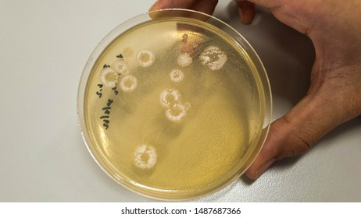
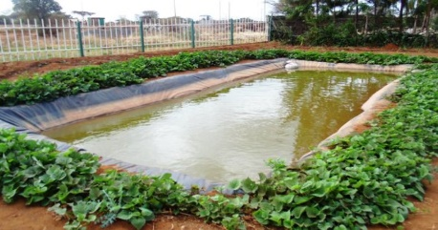
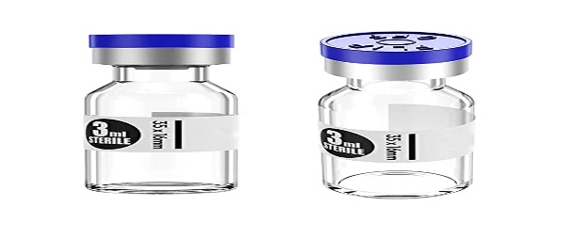


Research title Title: Assessment of microbiological quality of pond water used for fish culture at Kunduchi
University of Dar es Salaam

Slide 3


University of Dar es Salaam
STATEMENT OF RESEARCH PROBLEM
Water used for culturing of fish in order to generate better yield, offers a solution to the problem associated with water quality deterioration.
The aim of study is to address gap in knowledge left by other study that based on assessing water quality using physicochemical parameters for pond water
An alternative solution of Microbiological analysis is needed.

Slide 4
University of Dar es Salaam
Main Objective
To assess microbiological quality of Pond Water used for fish culture Culture at Kunduchi

Slide 5

s
University of Dar es Salaam
specific objectives
To determine bacterial load of pond water at Kunduchi (Total plate count)
To identify pathogenic and indicator bacteria of pond water at Kunduchi
hypotheses of the study
Bacterial load of ponds water at Kunduchi will expected to be more concentrated
Indicator bacteria will be significant difference with pathogenic bacteria present in ponds water at Kunduchi

Slide 6
University of Dar es Salaam
SIGNIFICANCE OF THE STUDY
The result that will obtained from this study shall be useful in future management of aquaculture system. and assist fish farmers to manage or control water quality
Also it helps fish farmer to improve fish health and their ecology of pond
Fish depend quality water for better growth, Reproduction and successfully healthy

Slide 7

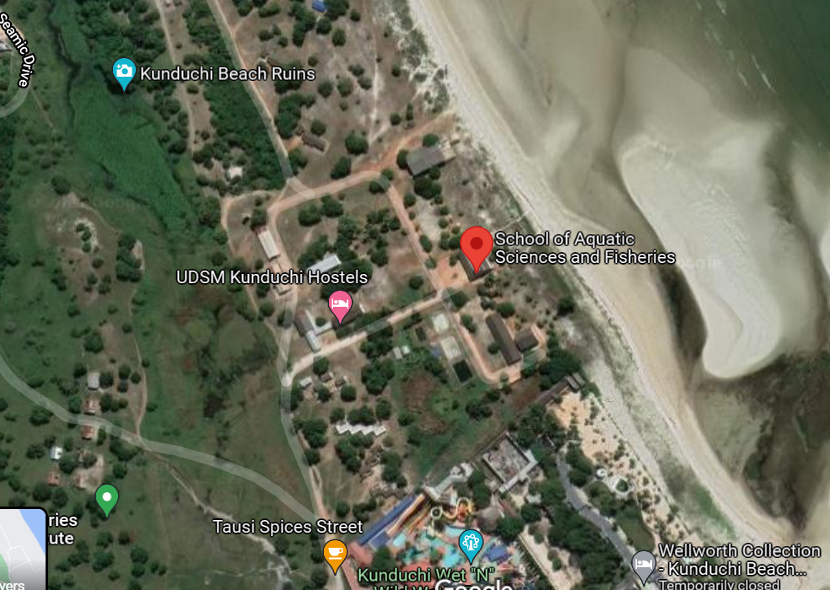
University of Dar es Salaam
MATERIAL AND METHODS
STUDY SITE
The study site is within SoAF at Knduchi that located at Latitude 6°40'0"S and Longitude 39°13'0"E in Kinondoni district Region of Dar es salaam, Tanzania. sample analysis will be conducted in the laboratory at SoAF, Kunduchi
Aquaculture production site

Slide 8
sample collection
University of Dar es Salaam
Water sample will be collected from three pond designed as Pond A, B and Pond C respectively
Water sample will be collected at surface once a week for Two week using sterile bottles with appropriate labelled.
transported to Laboratory immediately for storage in refrigerator about 24 hours
After 24hours microbial analysis will performed to identify indicators bacteria and pathogenic bacteria

Slide 9
SAMPLING DESIGN
University of Dar es Salaam
POND A
POND B
POND C
LABORATORY STORAGE 24Hours
After 24Hours lsolation of stored sample for analysis of indicator and pathogenic bacteria
Indicator bacteria
Coliform bacteria
Escherichia coli
Pathogenic bacteria
Vibrio cholera
Salmonella sp

Slide 10
University of Dar es Salaam
METHODS OF DATA COLLECTION
Total plate count method (TPC)
Right volume of water sample will placed into sterilized petri dish followed by addition of specific volume of sterilized nutrient agar(NA) medium.
petri dish incubated for 24 hours at specific range of temperature 34 to 45C (Yin et al 2020) for further analysis based on viable cell

Slide 11
University of Dar es Salaam
Plate count(cfu/g) can be obtained mathematical
Plate count (cfu/g) = (Number of colonies x Dilution) / Weight of sample

Slide 12
University of Dar es Salaam
The most probable number (MPN)
Method will be used to identify the number of bacteria present in water sample using. Three sets of test tubes contain lactose broth and the right sample volumes (Nikaeen et al 2010).
The number of bacteria present will determined statistically using Most probable table (MPT) under consideration of the guiding steps

Slide 13

University of Dar es Salaam
DATA ANALYSIS
Statistical analyses weill done by SPSS and Past Softwares.
Data for bacterial number will be tested under normality and homogeneity of variance using one-way ANOVA, parametric test at a significance level of 0.05.
If data will not conform to parametric-conditions, non parametric test Kruskal Wallis

Slide 14
University of Dar es Salaam
REFERENCES
Nikaeen, M., Pejhan, A., Jalali, M., & Zadeh, A. H. (2010). Comparison of Enzymatic Assay
And Multiple Tube Fermentation Technique in the Assessment of Microbial Quality of
The Karoon River. Journal of Water and Wastewater; Ab va Fazilab (in persian)
Yin, Q., Nie, M., Diwu, Z., Zhang, Y., Wang, L., Yin, D., & Li, L. (2020). Establishment and
Application of a novel fluorescence-based analytical method for the rapid detection of
Visible bacteria in different samples. Analytical Methods

Slide 15
University of Dar es Salaam
MATERIAL AND METHOD CONT….
END

