Slide 1

PowerShell User Group
London 25/01/2018
@LONPSUG

Slide 2
agenda!
7.00pm - Arrival
7.00pm - Welcome / User Group Introduction - @ebrucucen
7.05pm - Part 1 - Session1: "Adventures in AST" by Chris Dent
8.05pm - Break / Refreshments
8.15pm – Part 2 - Session 2: "Friends Don't Let Friends Do IaaS" by Chris Gardner - @HalbaradKenafin
9.15pm - Wrap up / Pub

Slide 3
sponsors!

Slide 4
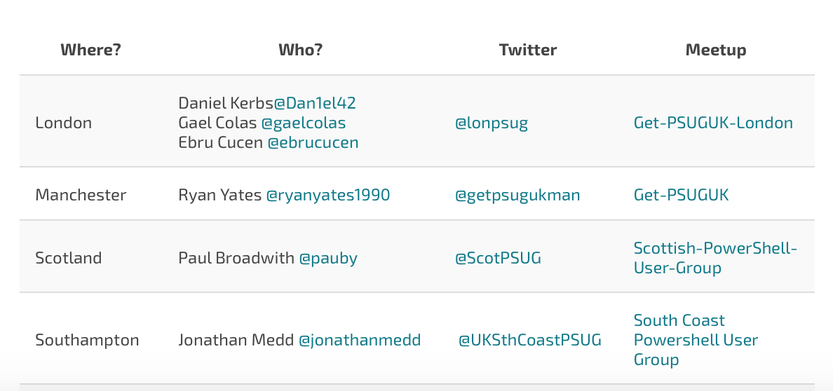

WHO Are WE?
https://get-psuguk.herokuapp.com

Slide 5
Other PowerShell events
PS ConfEU – Hanover, Germany
April 17-20, 2018: Registration open
http://www.psconf.eu/
PowerShell Summit – Seattle, USA
April 9 – 12, 2018: Registration open
https://powershell.org/summit/
PowerShell & WinOps Fundamentals (Online monthly)
https://www.eventbrite.com/e/powershell-winops-fundamentals-tickets-38501821986

Slide 6
PowerShell news
PowerShell Core 6.0: Generally Available (GA)
https://blogs.msdn.microsoft.com/powershell/2018/01/10/powershell-core-6-0-generally-available-ga-and-supported/
Really useful summary of changes here:
http://wragg.io/powershell-core/

Slide 7
Let us know
If you want to present [10 mins/30 mins/1 hour?]
If you know a sponsor to feed us?
Any topics you are interested in?

