Slide 1
Making your work visible
Including telemetry in your PowerShell modules
Jan-Hendrik Peters Author

Slide 2
Agenda
Who
What
Why
How
What’s next?

Slide 3
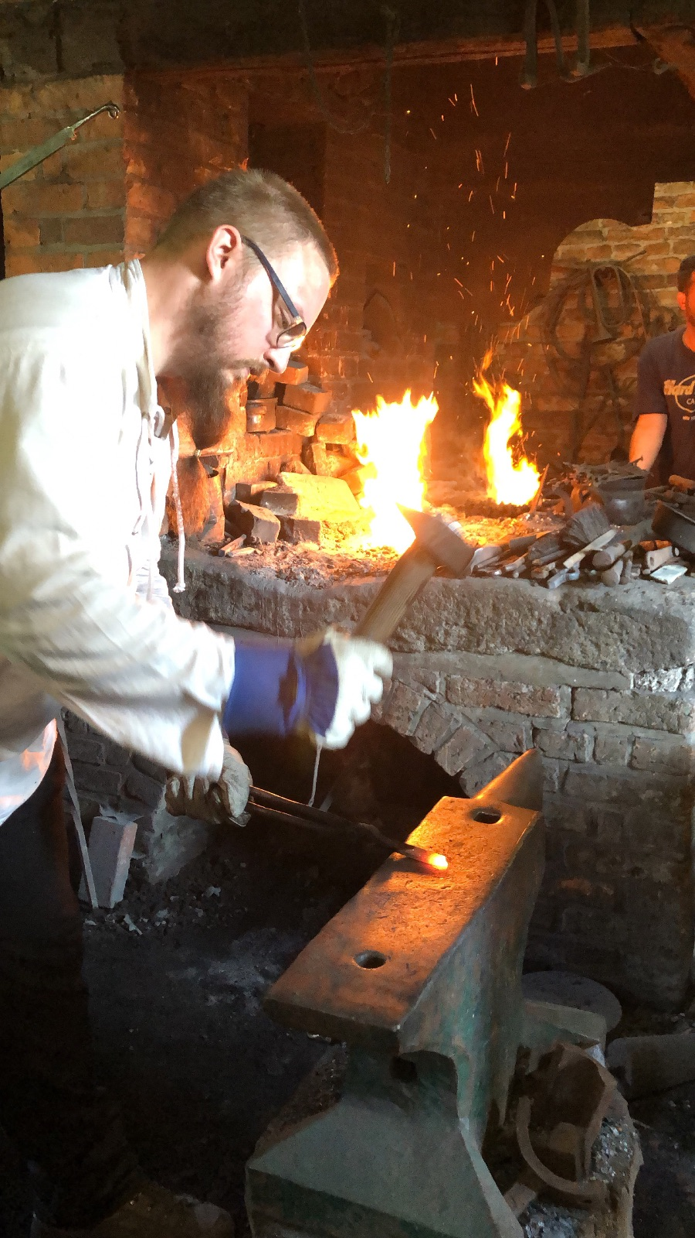
Who
Jan-Hendrik Peters
32 years old
Author
I love:
Blacksmithing
Beer brewing
Paintball
Automation!

Slide 4
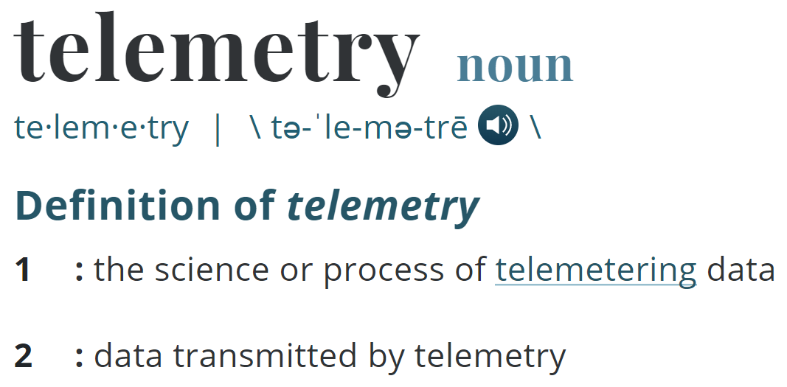
What

Slide 5
What
Collecting data from remote or inaccessible systems
Azure Application Insights
Metric, Trace and Event gathering
Uses Kusto query language to enrich and assess collected data points
Various languages like Java, C#, node.js supported
Now available in PowerShell through TelemetryHelper!

Slide 6
Why
Enables fast reaction to emerging issues
Gain insights into your user base
Aids decision making
Which features are popular?
Does the community adopt new versions quickly?
Is my team’s communication enough to announce new versions?

Slide 7
Case study – Automated Lab

Slide 8
Case Study – Automated Lab
AutomatedLab is a lab deployment framework
Until Q1/2018 we had no idea if and where it was used
Telemetry helps us tremendously to discover
Which server roles are used most often
Where our user base is (surprisingly nearly everywhere)
How long a lab is in use before it is destroyed
How long deployments take on average

Slide 9
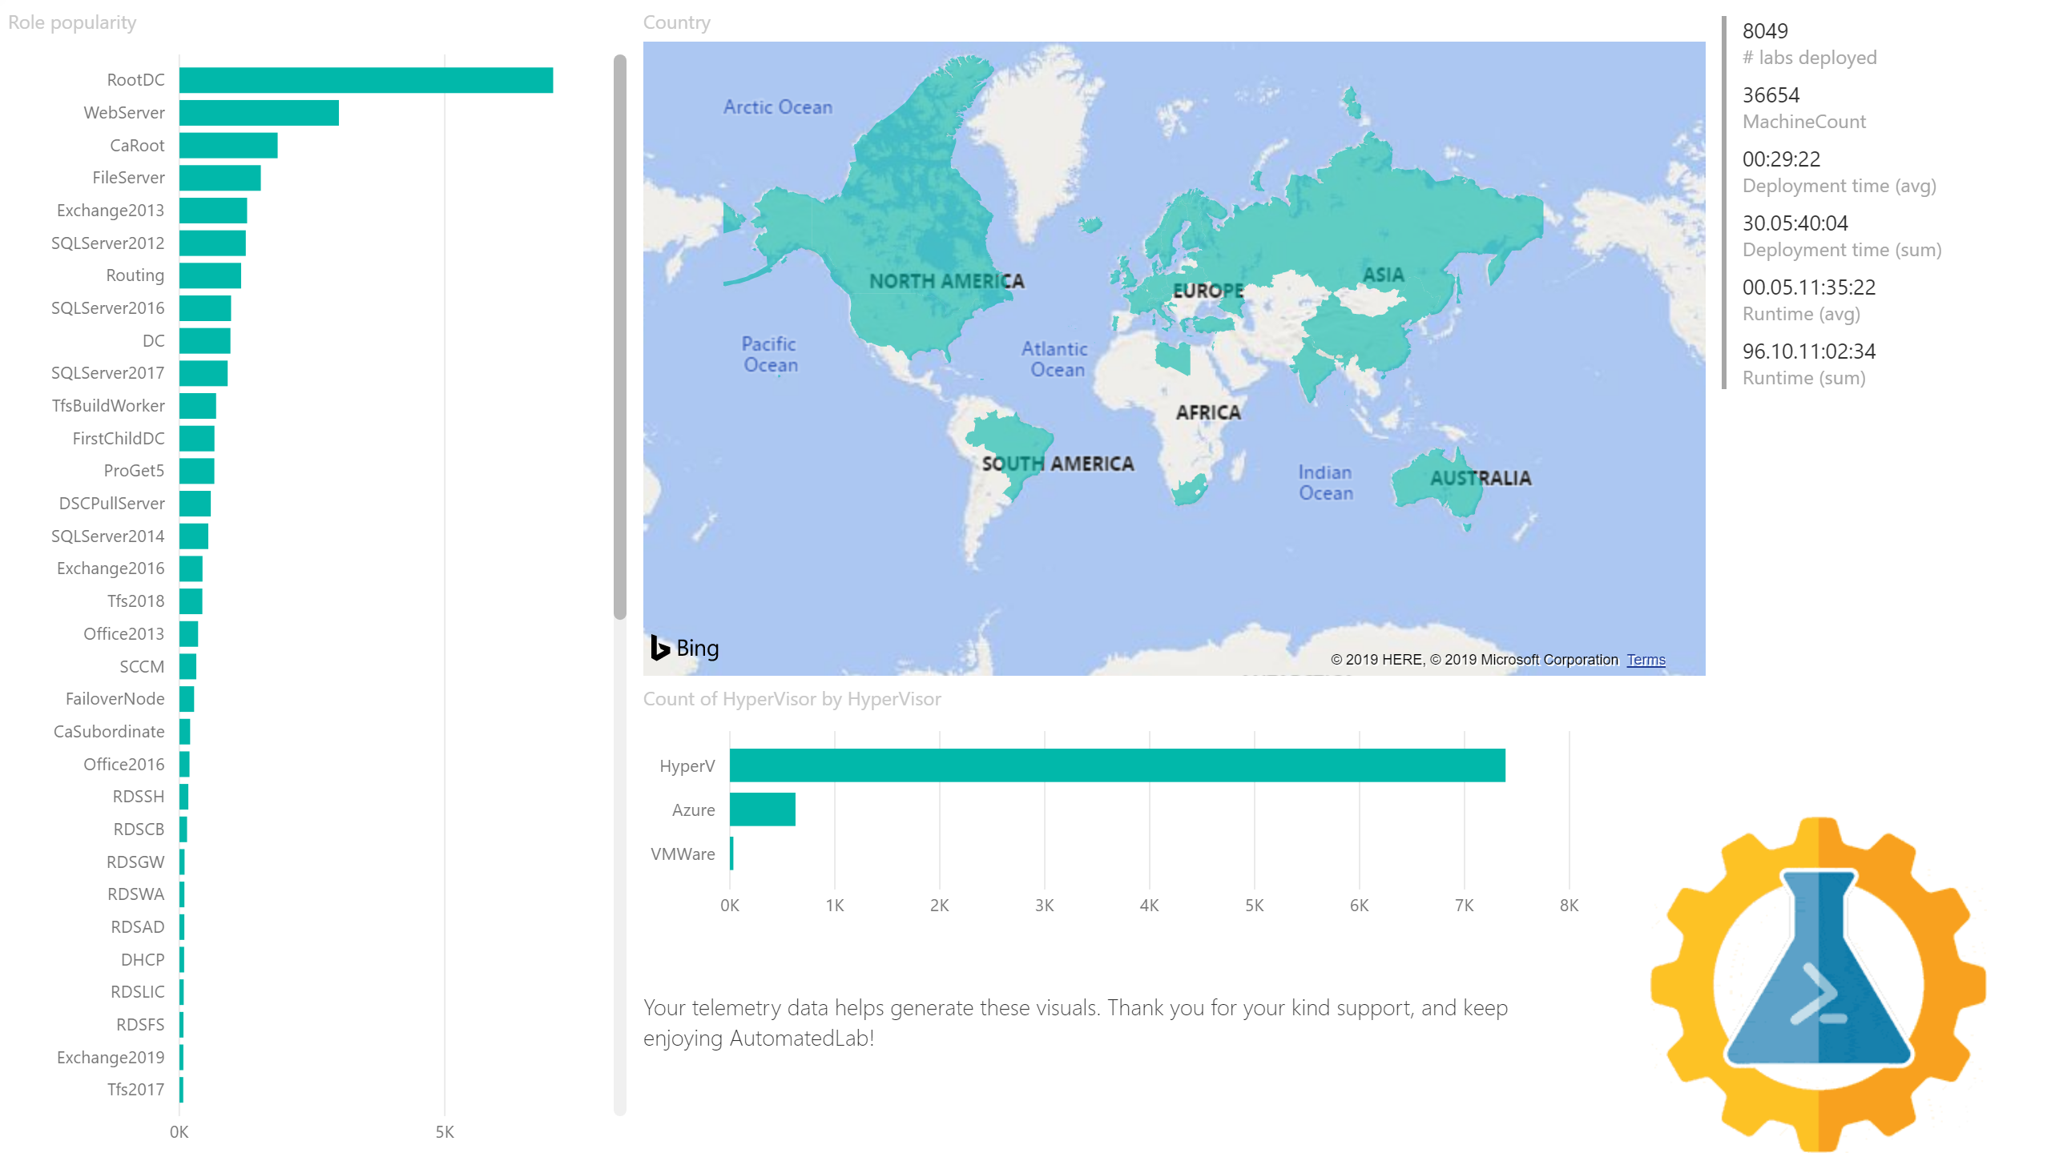

Slide 10
How
Create Azure Application Insights account
Add TelemetryHelper as a dependency
Configure your module with PSFramework
Collect telemetry about
Your OS deployment
Your infra components
Your awesome open-source PowerShell modules
Your DSC resources
…

Slide 11
DEMO TIME!

Slide 12
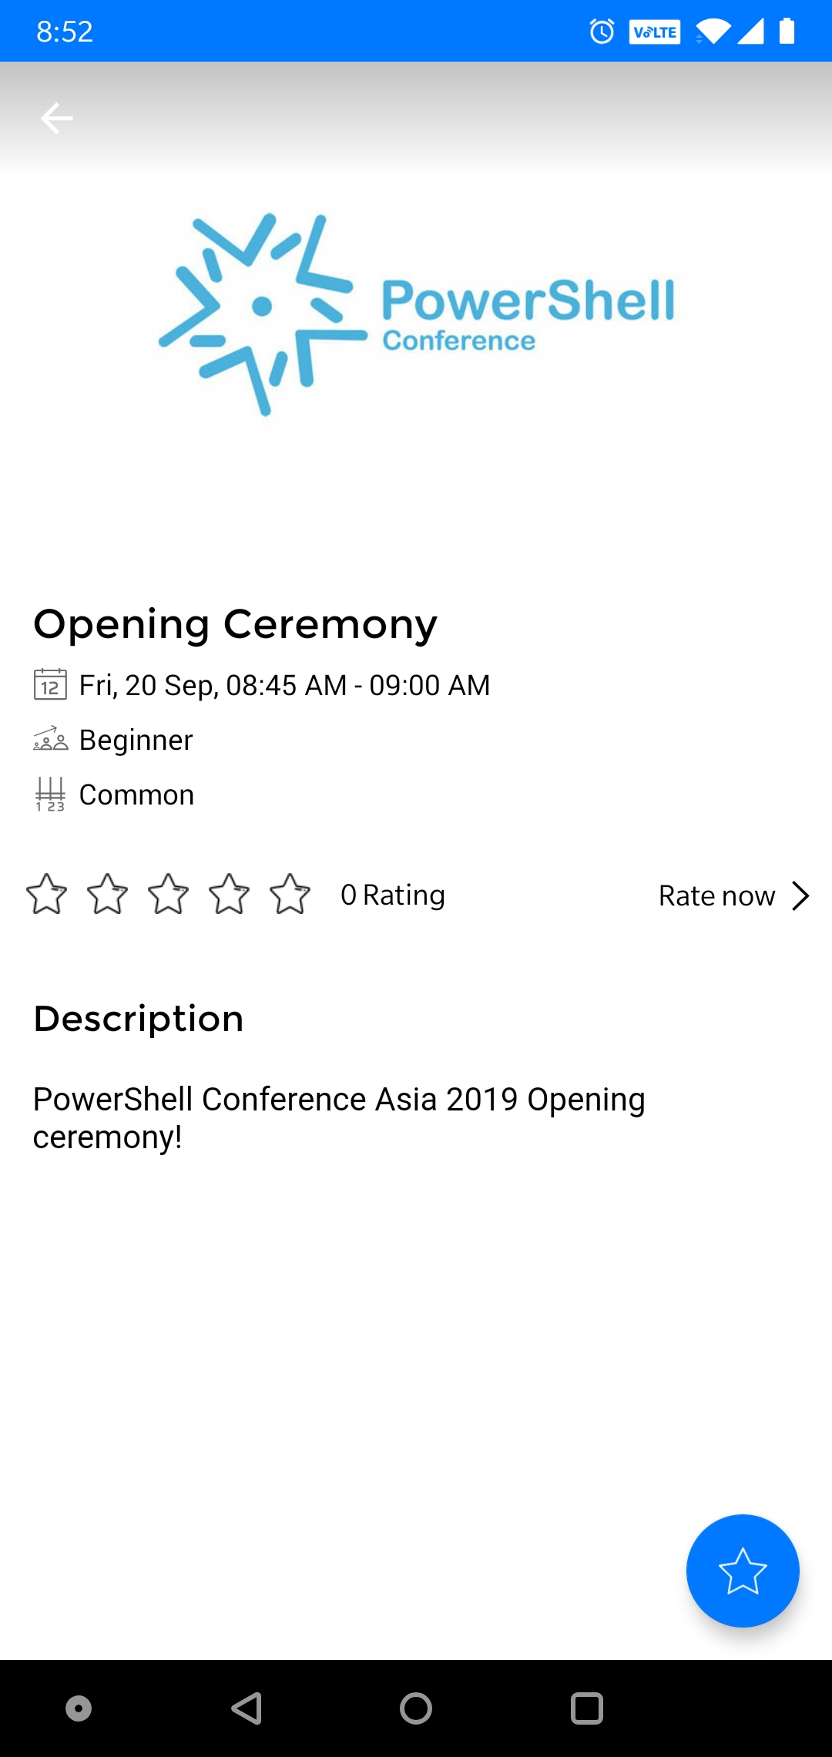
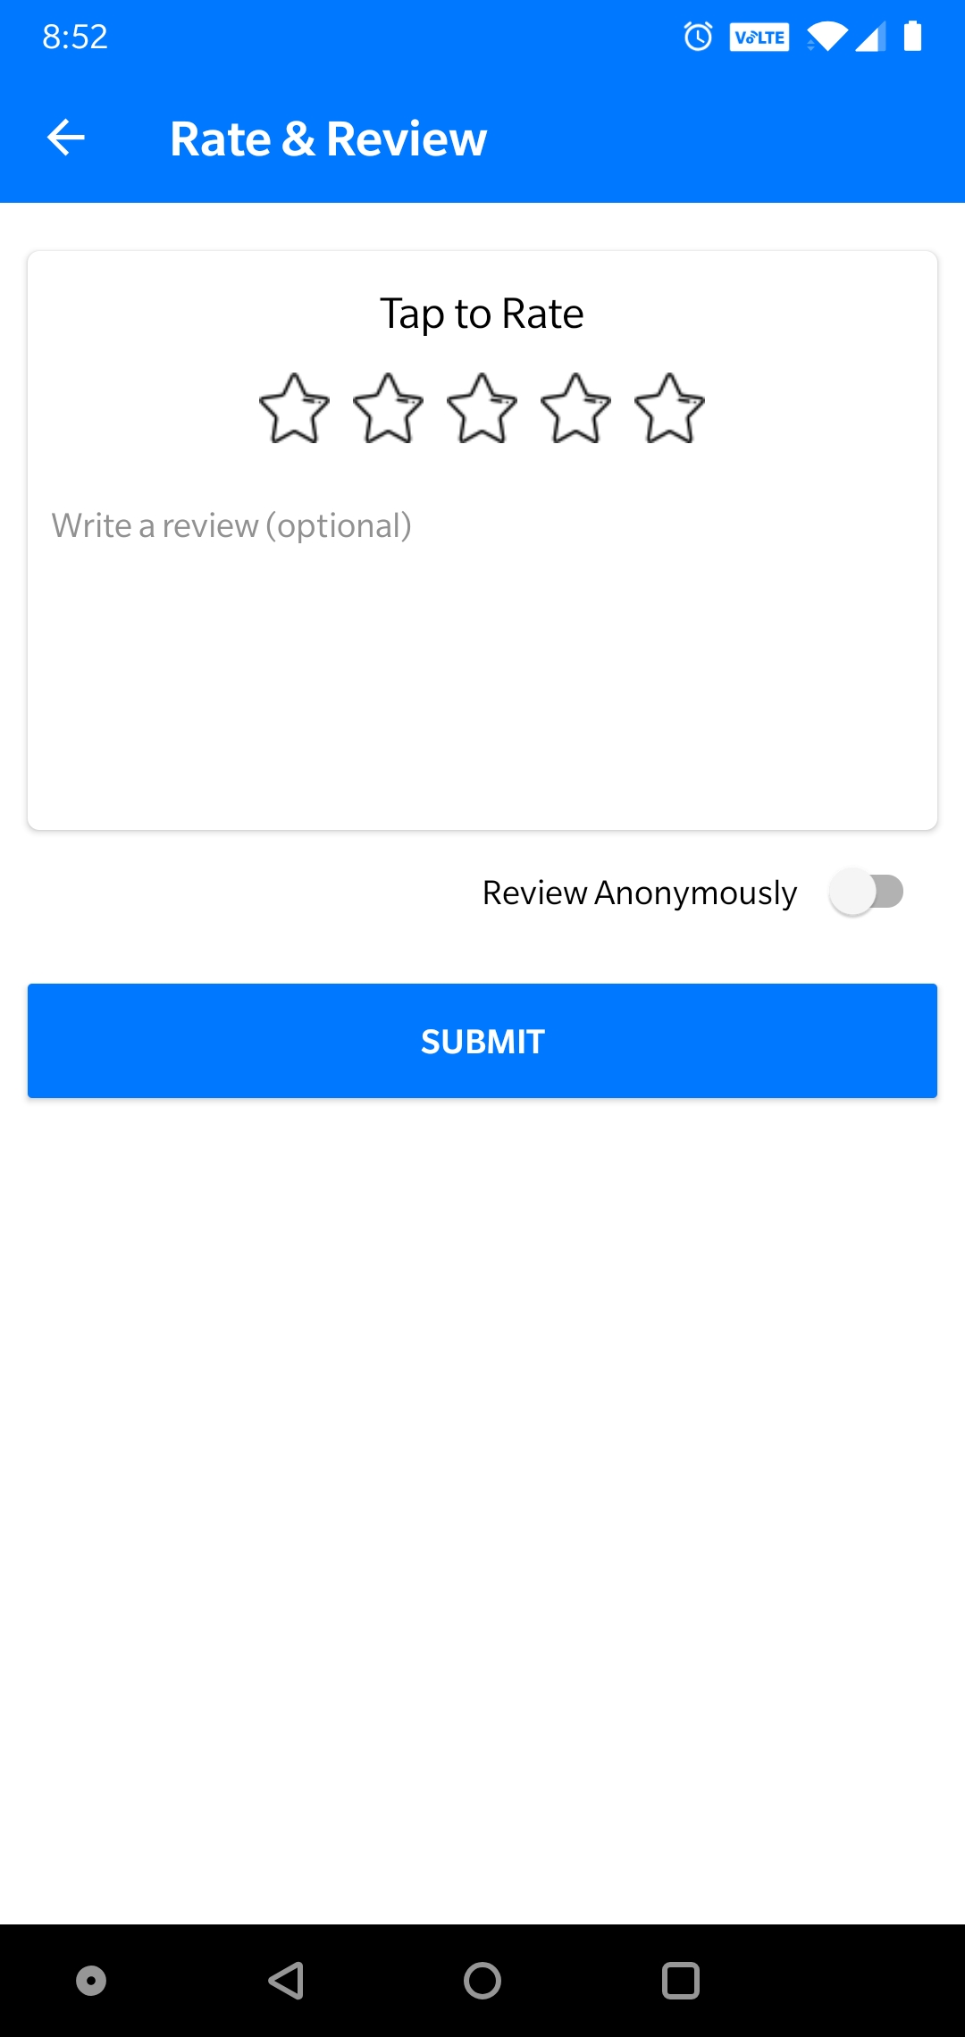

DO NOT Forget to rate the sessions!
https://my.eventraft.com/psconfasia19

Slide 13
More about Jan-Hendrik
Follow me on Twitter: @nyanhp
Browse my stuff on GitHub: https://github.com/nyanhp
Help us out at https://automatedlab.org
Buy my books
PowerShell Core 6.2 Cookbook
Learn PowerShell Core 6.0
In or around Düsseldorf? Let me know and grab a beer with me!

Slide 14
