Slide 1

PowerShell & DEVOPS User Group
Scotland 28/06/2018
@ScotPSUG

Slide 2







scottish POWERSHELL & DEVOPS user group
Scottish PowerShell & Devops User Group
Organiser – Paul Broadwith (@pauby)
Co-Organiser – Craig Porteous (@cporteous)
https://psdevopsug.scot
@scotpsug
https://git.psdevopsug.scot
https://facebook.psdevopsug.scot
https://video.psdevopsug.scot
https://call.psdevopsug.scot
https://slack.psdevopsug.scot
@ScotPSUG

Slide 3
uk POWERSHELL & DEVOPS user groups
You can find details of all of the groups:
https://powershell.org.uk/
https://github.com/powershellorguk
@ScotPSUG

Slide 4
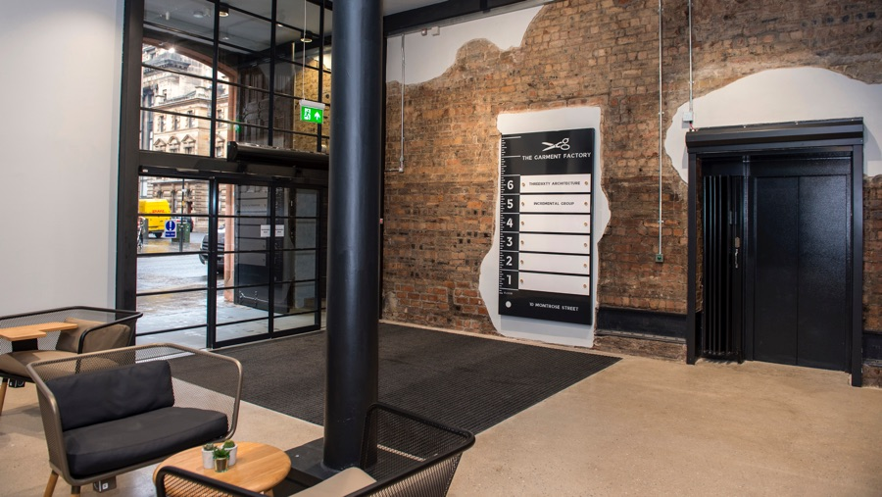


June meetup venue
Incremental Group are kindly hosting us for our June meetup
Location - 5th Floor, The Garment Factory, 10-12 Montrose Street, Glasgow, G1 1RE
Website - https://garment-factory.co.uk
@ScotPSUG

Slide 5

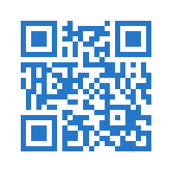

SAVE THE DATE
Scotland’s only FREE Data Platform Community Event
14
September
2018
A full day and 2 tracks of training sessions covering all
aspects of the Microsoft Data Platform:
SQL Server | Azure | Power BI | PowerShell | Business Intelligence | Data Warehousing | Analytics
Speaker Submissions now OPEN | Registration opens June
More info at:
SQLGLA.co.uk
@SQLGLA
Get news first with our mailing
list: http://bit.ly/sqlgla2018

Slide 6


Glasgow Azure User Group
Founded in early 2017 as an independent body GAUG aims to bring the together the IT community to collaborate, network and learn from each other.
www.gaug.co.uk @GlasgowAzureUG

Slide 7
agenda!
6.00pm – Arrive and mingle
6.15pm - Introduction
6.20pm – Getting Started: SharePoint PowerShell PnP by Veronique Lengelle (@veronicageek)
6.50pm - Either Git Fundamentals or Messing Around With Chocolatey by Paul Broadwith (@pauby)
7.20pm - Pizza, drinks and chat
7.50pm - Simplifying Extended Events with PowerShell by Chrissy LeMaire (@cl)
@ScotPSUG

Slide 8
Let us know
If you want to present [10 mins/30 mins/1 hour?]
Any topics you are interested in?
@ScotPSUG

