Slide 1

PowerShell & DEVOPS User Group
Scotland 21/06/2017
@ScotPSUG

Slide 2
agenda!
7.00pm – Waiting room for general chit chat
7.10pm – Welcome, introductions and agenda (Paul Broadwith @pauby)
7.20pm – Learn PowerShell In A Month Of Lunches (Colin Westwater @cwestwater)
7.40pm – Be A Good PowerShell Citizen (Paul Broadwith @pauby)
8.40pm – Wrap up / Close
@ScotPSUG

Slide 3

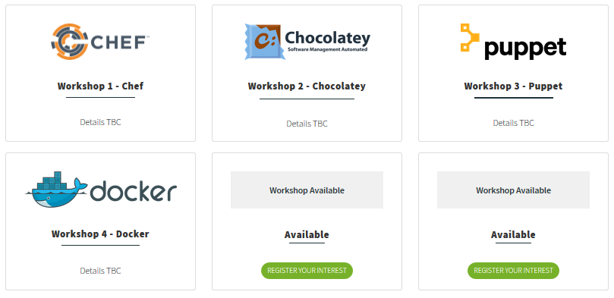
events
WinOps 2017
Wed 20th – Thur 21st September
http://winops.org
@ScotPSUG

Slide 4
Powershell News!
PowerShell Core 6 Beta 1
PowerShell Team Blog at https://blogs.msdn.microsoft.com/powershell/
VS Code PowerShell extension reached version 1.0
Azure Cloud Shell – PowerShell version in preview
More information at https://azure.microsoft.com/en-gb/features/cloud-shell/
Private preview signup at http://aka.ms/pscloudsignup
Glasgow Azure User Group
Next meetup 23 August
@ScotPSUG

Slide 5

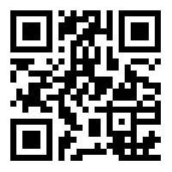
Join the PSUG Slack TEAM
We’re here:
https://get-psuguk.herokuapp.com
Or
http://bit.ly/2eQyxOD
@ScotPSUG

