Slide 1

PowerShell & DEVOPS User Group
Scotland 30/08/2017
@ScotPSUG

Slide 2



scottish POWERSHELL & DEVOPS user group
Scottish PowerShell & Devops User Group
https://psdevopsug.scot
@scotpsug
https://goo.gl/RGi2N2
Organiser – Paul Broadwith (@pauby)
@ScotPSUG

Slide 3
uk POWERSHELL & DEVOPS user groups
London PowerShell & Devops User Group
https://powershell.org.uk/ @lonpsug
Organisers - Iain Brighton (@iainbrighton), Gael Colas (@gaelcolas), Ebru Cucen (@ebrucucen), Daniel Krebs (@dan1el42)
Southampton PowerShell & Devops User Group
https://powershell.org.uk/ @UKSthCoastPSUG
Organiser – Jonathan Medd (@jonathanmedd)
@ScotPSUG

Slide 4


uk POWERSHELL & DEVOPS user groups
You can find details of all of the groups:
https://powershell.org.uk/
https://github.com/powershellorguk
https://psuguk.video
@ScotPSUG

Slide 5
agenda!
7.00pm – Waiting room for general chit chat;
7.05pm – Welcome, introductions and agenda;
7.10pm – PowerShell and Devops news and events roundup;
7.30pm – Validate Your PowerShell Parameters with Enums; (Paul Broadwith @pauby)
8.10pm – Wrap up / close;
@ScotPSUG

Slide 6

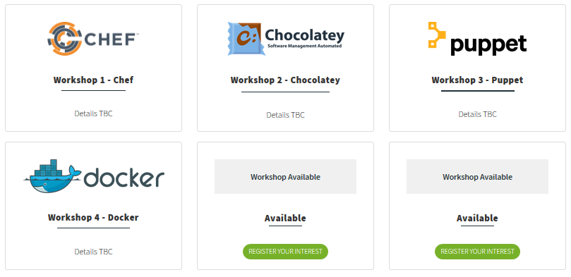
events
WinOps 2017
Wed 20th – Thur 21st September
http://winops.org
@ScotPSUG

Slide 7
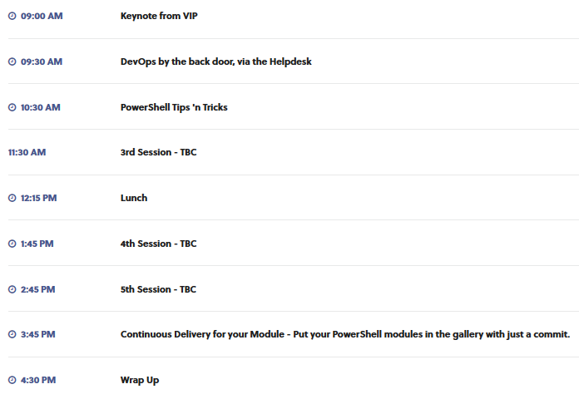

events
PSDAY.UK
Friday 22nd September
Same venue as Winops
http://psday.uk
@ScotPSUG

Slide 8
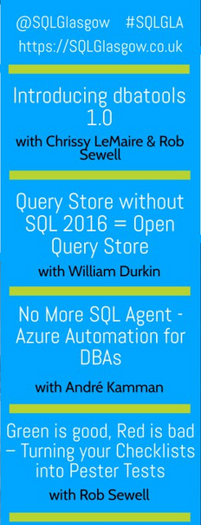

events
SQL-GLA 2017
Friday 10 November 13:30 to 20:00
Trongate, Glasgow
Free entry
http://sqlglasgow.co.uk
@ScotPSUG

Slide 9
Powershell News!
Windows PowerShell 2 Deprecated
Deprecated in Windows 10 Creators Update
No timeline to remove it but you should move away from PS 2 to PowerShell Core compatibility;
https://blogs.msdn.microsoft.com/powershell/2017/08/24/windows-powershell-2-0-deprecation/
DSC Resource Kit Release for August 2017
Includes 9 new module updates;
https://blogs.msdn.microsoft.com/powershell/2017/08/23/dsc-resource-kit-release-august-2017/
PSSwagger has been released as open-source
First talked about at PowerShell Conference EU in May;
Generates PowerShell cmdlets automatically from a RESTful Web Service using OpenAPI / Swagger;
https://blogs.msdn.microsoft.com/powershell/2017/08/15/psswagger-automatically-generate-powershell-cmdlets-from-openapi-f-k-a-swagger-specification/
@ScotPSUG

Slide 10

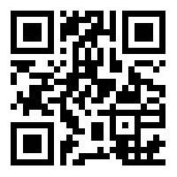
Join the PSUG Slack TEAM
We’re here:
https://get-psuguk.herokuapp.com
Or
http://bit.ly/2eQyxOD
@ScotPSUG

