Slide 1




Monitoring DFSR with PowerShell And NAgios
Tony Roud
@anthonyroud tonyroud@outlook.com github.com/tonyroud

Slide 2


About me
Who is Tony Roud?
Senior Systems Engineer
Currently working for Iomart (MSP)
Previously worked for Attenda in London
Not a developer
tonyroud@outlook.com
@anthonyroud
https://github.com/tonyroud
https://www.linkedin.com/in/anthonyroud

Slide 3
Scope
Lots of customers using DFSR for various purposes
Poor visibility of issues, often customers first to notice
Need to be able to react before situation becomes unrecoverable
Needed something PowerShell based that could tie into Nagios / Check_MK
Easy for monitoring techs to see where the issue is at a glance
Something that could parse the output from native MS Cmdlets and put into Nagios friendly format

Slide 4
Nagios check format
Required output for Nagios friendly format:
Status | Item Name | Performance Data | Output
(optional)
0 | 1 | 2
Information about check outcome and
how to respond if in error.
UsefulCheckName

Slide 5
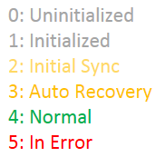
Key tests
DFSReplication and WinRM services –eq running
Critical DFSR events (last x hours)
DFSR Backlog
(Separate check for each replicated folder)
Replicated folder status
Anything other than 4 = BAD ☹

Slide 6

Working with Microsoft’s DFsr cmdlets
2 main troubleshooting commands provided by MS:
Output: text based information on each item pending replication
No summary or overall count included (unless verbose)
Most scripts online use ‘old school’ DFSRDIAG.exe
WMI based query to display status of replicated folder

Slide 7
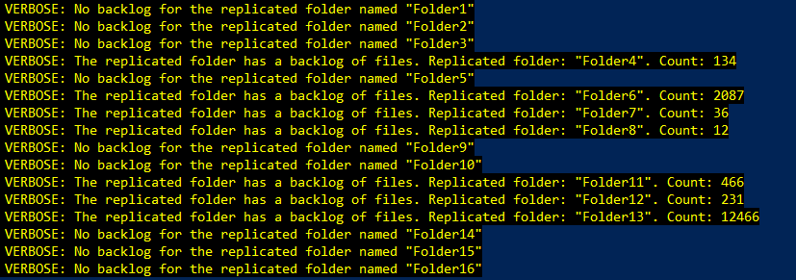
Get-dfsrbacklog
Key information only appears in verbose output:

Slide 8
Capturing verbose output
To capture verbose output for monitoring purposes
Redirect verbose output to success output stream:
Then use simple regex with -replace to capture the matched backlog summary value to a variable:

Slide 9



Separating the functions
Split the main check into sub functions:
Enumerate DFSR connections to other servers
Use the connection info to calculate outgoing backlogs
Calls the two child functions and generates status code and message info), then outputs to csv file.

Slide 10
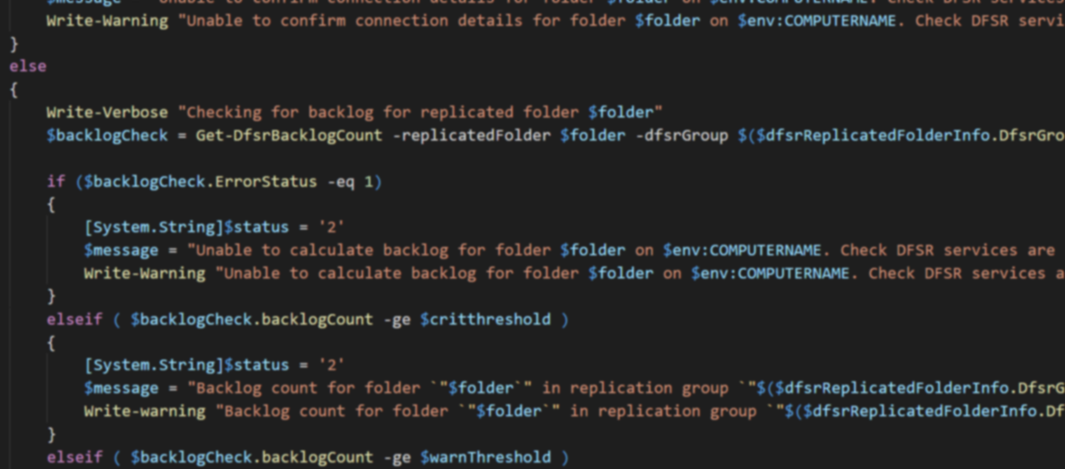
Quick review of module code
A quick look at the module code

Slide 11
Testing the new checks
All the module functions are called from main monitoring script
Idea was that this would only be a few lines long, simple and configurable
Unfortunately although the script worked in testing, in production it was rather unstable
Realised that the script would take upwards of 60 seconds to run, beyond Nagios default timeout for local checks
Monitor producing no output / spurious errors

Slide 12
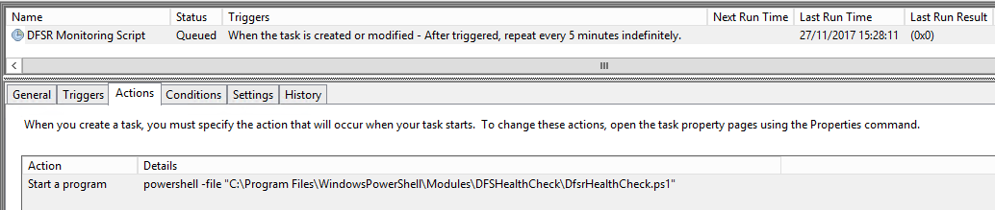
Adding another layer
Decided to run the caller script from Task Scheduler
The script would output to a file every 5 mins
Then add a 3rd basic script to be executed by Nagios
This would pull in the output from file and format for Nagios:

Slide 13
Control and Nagios scripts
A look at the control script, and
the final script to pull the output into
Nagios

Slide 14
Forming the output
Output into csv format:
# 27/11/2017 15:28:11
Status,CheckName,Output,
0,DFSRServiceStatus,DFSR Service is running,
0,WinRmServiceStatus,WinRM Service is running,
0,DfsrCriticalEvents,No critical events found in DFSR log in the last 1 hours.,
0,DFSRRepl_Folder1,Backlog count for folder "Folder1" in replication group "Group1" is 0.,
0,DFSRRepl_Folder2,Backlog count for folder "Folder2" in replication group "Group1" is 0.,
0,DFSRRepl_Folder3,Backlog count for folder "Folder3" in replication group "Group2" is 0.,
1,DFSRRepl_Folder4,Backlog count for folder "Folder4" in replication group "Group2" is 120.,
0,DFSRRepl_Folder5,Backlog count for folder "Folder5" in replication group "Group3" is 24.,
2,DFSRRepl_Folder6,Backlog count for folder "Folder6" in replication group "Group3" is 4094.,

Slide 15
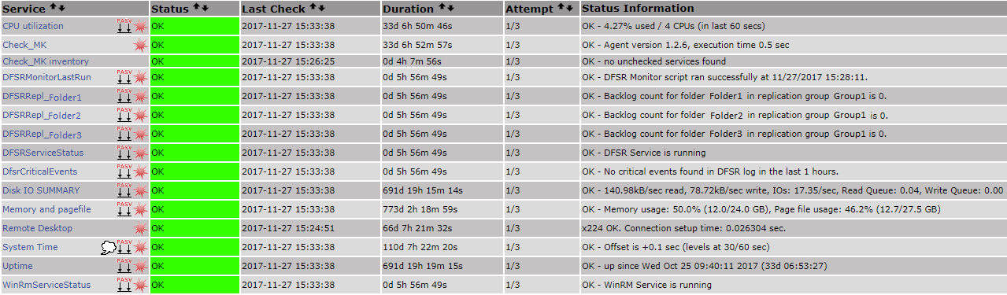
Integrating with The Nagios console
Final step to import CSV and pull data into Nagios:

Slide 16
Limitations / To do
Add support for multiple destination servers
Add a -reset parameter for Get-DfsrCriticalEvents check
Add -exclude parameter for replicated folders that don’t need to be monitored
Build into fully fledged module, separate functions, create help / module manifest etc.

Slide 17
Lessons Learned
Useful to fully understand the other technologies you are working with
There may be limitations such as execution timeouts
Difficult to fully test - there is always a chance of surprises when you put things in production
Microsoft native tools are not necessarily designed for all purposes
Also not necessarily consistent, and can be difficult to troubleshoot
I need to learn Pester!

Slide 18
Questions?

Slide 19
sources
Mathias Kettner blog (Check_MK author)
https://mathias-kettner.de/
Simon Wahlin Blog
http://blog.simonw.se/programmatically-capture-verbose-output-in-a-powershell-variable/
MSFT – DFSR PowerShell Module
https://docs.microsoft.com/en-us/powershell/module/dfsr/

Slide 20
ThankS for listening!
Tony Roud
@anthonyroud tonyroud@outlook.com github.com/tonyroud

