Slide 1

Implementing the technical aspects of Windows as a Service
Please don’t feed the penguin!

Slide 2

WaaS
Chaos & Order
Teamwork

Slide 3

Technical Evangelist?
Pluralsight Author
MCSE, MCSA, P-TSP
Microsoft Certified Trainer
@Bindertech - #KneeDeepinTech

Slide 4
What WaaS that?

Slide 5
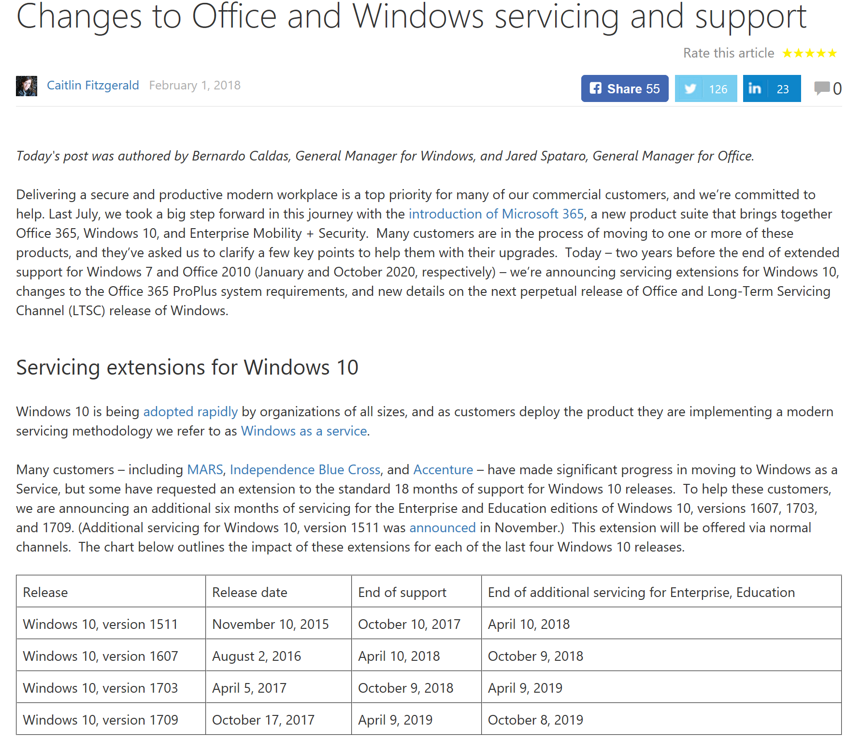
3 & 9
4-6
18
Notes:
https://blogs.technet.microsoft.com/windowsitpro/2018/02/01/changes-to-office-and-windows-servicing-and-support/
What’s changed:
All current versions (apart from 1511 that already received it) of Windows 10 Enterprise & Education gets 6 months additional servicing. DATES + “Additional PAID servicing options from 1607” – contact your account team. Other than that, as before.
I’ll mention Office as well:
ProPlus will only be supported on SAC versions that are being serviced.
From January 14 2020 – ProPlus will not be supported on LTSC, Windows Server 2016 and Windows 8.1 and older.
New virtualization options will be offered…
Office 2019 – H2 2018 (previews Q3 2018) – supported on Windows 10 SAC, W10 LTSC 2018, next LTSC of Windows Server. ONLY C2R!!! 5+2 years support (end 10/14 2025 – allinged with Office 2016)
Windows 10 LTSC – Fall 2018 – standard silicon support policy.
Windows as a Service is something you already know from your smart-phone, Macbook or in some cases even Linux-distribution. You also know the reason for it from any cloud-service you’ve ever used.
In essences, its all about delivering a more secure, more functional and always up-to-date Windows – quicker, simpler, faster and cheaper than what was possible before.
Today it works like this:
Every March and September a new Windows (and also Office ProPlus Configuration Manager and Windows Server) version (build) is released. Prior to that, Windows Insiders have had about 6 months to test new features, bash bugs and leave feedback. Each new version are released in what’s called the Semi-Annual Channel. So, you can stop referreing to builds as CB and CBB.
Each new version will have 18 months support from the date its released. Some time during the first 4-6 months, a version will be acknowledge by Microsoft as, essentially, business ready. The time frame MAY vary depending on the time it takes for software and hardware vendors to ensure support for the new version. It could also depend on the number of bugs that MAY be discovered during the first months of “piloting”.
When a build gets 18 months old, the support ends and you have a 60? Day grace-period to upgrade the remaining devices to the supported build of your choice.
So, you don’t NEED to upgrade more often than every 18 months, but you may WANT to do it, and I would recommend as fast as possible.
This is explained in great detail in the excellent post by my fellow speaker Michaels Niehaus in the “WaaS in a Nutshell” blogpost. Its not harder than that ☺

Slide 6


Slide 7
And then what?
You start all over again!

Slide 8
I TIL you…
Notes:
I like to use the terminology:
Let the right person, do the right thing, at the right time, with the mandate needed and in perfect harmony with the rest of the organization. That’s freakishly good.. If you remember that ill be perfectly happy ☺

Slide 9
physical
Let’s get technical

Slide 10
Windows Analytics

Slide 11
ConfigMgr
Notes:
We have more tools than ever before, it’s a matter of choosing which of them that are suitable for your organization.
Windows Update for Business – ConfigMgr/Windows Update – For devices that are not connected with bad or no connection, BYOD, Schools that requires limited management etc.
Windows Servicing – You want to control and distribute content, but other than that let Windows handle everything. You want to ONLY upgrade the OS. Automate as much as possible with included tools.
Task Sequence. You want full control, do more than one thing, currently easier integration with community tools etc.
Regardless, we need to have a few things. Collection structure, automation, application knowledge and handling, inventory, insight (Windows Analytics) etc.

Slide 12
Intune
Notes:
Azure Automation, Script (explain the script and why), Intune vs ConfigMgr, Update rings and explain the different DO-options.
HTTP Only (0) This setting disables peer-to-peer caching but still allows Delivery Optimization to download content from Windows Update servers or WSUS servers. This mode uses additional metadata provided by the Delivery Optimization cloud services for a peerless reliable and efficient download experience.
LAN (1 – Default) This default operating mode for Delivery Optimization enables peer sharing on the same network. The Delivery Optimization cloud service finds other clients that connect to the Internet using the same public IP as the target client. These clients then attempts to connect to other peers on the same network by using their private subnet IP.
Group (2) When group mode is set, the group is automatically selected based on the device’s Active Directory Domain Services (AD DS) site (Windows 10, version 1607) or the domain the device is authenticated to (Windows 10, version 1511). In group mode, peering occurs across internal subnets, between devices that belong to the same group, including devices in remote offices. You can use the GroupID option to create your own custom group independently of domains and AD DS sites. Group download mode is the recommended option for most organizations looking to achieve the best bandwidth optimization with Delivery Optimization.
Internet (3) Enable Internet peer sources for Delivery Optimization.
Simple (99) Simple mode disables the use of Delivery Optimization cloud services completely (for offline environments). Delivery Optimization switches to this mode automatically when the Delivery Optimization cloud services are unavailable, unreachable or when the content file size is less than 10 MB. In this mode, Delivery Optimization provides a reliable download experience, with no peer-to-peer caching.
Bypass (100) Bypass Delivery Optimization and use BITS, instead. For example, select this mode so that clients can use BranchCache.
https://docs.microsoft.com/en-us/windows/deployment/update/waas-delivery-optimization

Slide 13
You can’t do it alone
Notes:
That sure was a Cheeseburger of a demo! But – even though we, Client Management ppl, are the Navy SEALS, The Avengers, the Fantastic 4 and the Bananas In Pyjamas of IT-Pros. We cant do this alone.

Slide 14
Why?

Slide 15
Questions?

Slide 16
It is:
Challenging
Not hard
User Centric
Vital
Notes:
Three main points:
The technology you need to manage WaaS isn’t hard. But you may need to extend that to achive more – and If you haven’t started to plan for it, you REALLY should get going now. Don’t imagine that it will be possible to invent it while running it. You wont have neither time or success.
Its all about the user
Its also vital for your future career! Even if you stop managing Windows, User/Technology/The importance of process and caothic order.

Slide 17

Remember! Don’t drink and elevate!

Slide 18




Thank you!
simon.binder@bindertech.se
@Bindertech
Bindertech.se
Knee-Deep in Tech

