Slide 1

PowerShell & DEVOPS User Group
Scotland 21/03/2018
@ScotPSUG

Slide 2






scottish POWERSHELL & DEVOPS user group
Scottish PowerShell & Devops User Group
Organiser – Paul Broadwith (@pauby)
https://psdevopsug.scot
@scotpsug
https://git.psdevopsug.scot
https://facebook.psdevopsug.scot
https://video.psdevopsug.scot
https://call.psdevopsug.scot
@ScotPSUG

Slide 3
uk POWERSHELL & DEVOPS user groups
London PowerShell & Devops User Group
Organisers –
Iain Brighton (@iainbrighton)
Gael Colas (@gaelcolas),
Ebru Cucen (@ebrucucen)
Daniel Krebs (@dan1el42)
Ryan Yates (@ryanyates1990)
https://powershell.org.uk/
@lonpsug
@ScotPSUG

Slide 4
uk POWERSHELL & DEVOPS user groups
Southampton PowerShell & Devops User Group
Organiser –
Jonathan Medd (@jonathanmedd)
https://powershell.org.uk/
@uksthcoastpsug
@ScotPSUG

Slide 5
uk POWERSHELL & DEVOPS user groups
You can find details of all of the groups:
https://powershell.org.uk/
https://github.com/powershellorguk
http://psuguk.video
@ScotPSUG

Slide 6
agenda!
7.00pm – Welcome, introductions and agenda
@ScotPSUG

Slide 7
agenda!
7.15pm – RTFM - Runtime Type Fiddling for the Masses by Mathias Jessen (@iisresetme)
"One of PowerShell's core strength comes from the Extended Type System, which allows users to seamlessly interact with different data types like .NET, WMI, COM, XML etc. But what about the underlying type system, that of .NET? Let's take an adventure into the Common Type System and see what we can do to overcome some of the limitations imposed by ETS and PowerShell"
@ScotPSUG

Slide 8
agenda!
8.15pm – Break
@ScotPSUG

Slide 9
agenda!
8.20pm – All about PowerShell ScriptAnalyzer by Chris Bergmeister (@ChristophBergm)
Chris is a PowerShell Script Analyzer Community Maintainer.
@ScotPSUG

Slide 10
agenda!
9.30pm – Thanks you’s
@ScotPSUG

Slide 11
agenda!
7.00pm – Welcome, introductions and agenda
7.15pm – RTFM - Runtime Type Fiddling for the Masses by Mathias Jessen (@iisresetme)
8.15pm – Break
8.20pm – All about PowerShell ScriptAnalyzer by Chris Bergmeister(@christophbergm)
9.30pm – Thanks you’s
@ScotPSUG

Slide 12
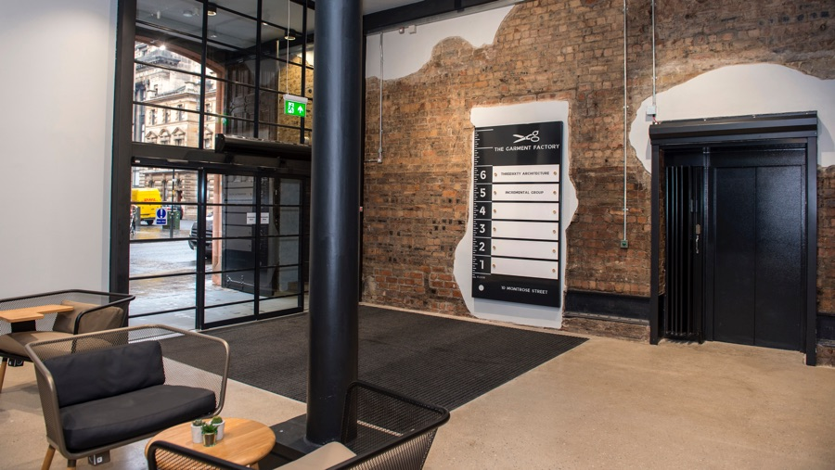


May meetup venue
Incremental group are kindly putting us up for our May meetup
Location - 5th Floor, The Garment Factory, 10-12 Montrose Street, Glasgow, G1 1RE
Website - https://garment-factory.co.uk
@ScotPSUG

Slide 13

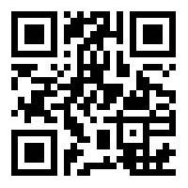
Join the PSUG Slack TEAM
We’re here:
https://get-psuguk.herokuapp.com
Or
http://bit.ly/2eQyxOD
@ScotPSUG

