Slide 1

PowerShell & DEVOPS User Group
Scotland 21/03/2018
@ScotPSUG

Slide 2







scottish POWERSHELL & DEVOPS user group
Scottish PowerShell & Devops User Group
Organiser – Paul Broadwith (@pauby)
https://psdevopsug.scot
@scotpsug
https://git.psdevopsug.scot
https://facebook.psdevopsug.scot
https://video.psdevopsug.scot
https://call.psdevopsug.scot
https://slack.psdevopsug.scot
@ScotPSUG

Slide 3
uk POWERSHELL & DEVOPS user groups
You can find details of all of the groups:
https://powershell.org.uk/
https://github.com/powershellorguk
http://psuguk.video
@ScotPSUG

Slide 4
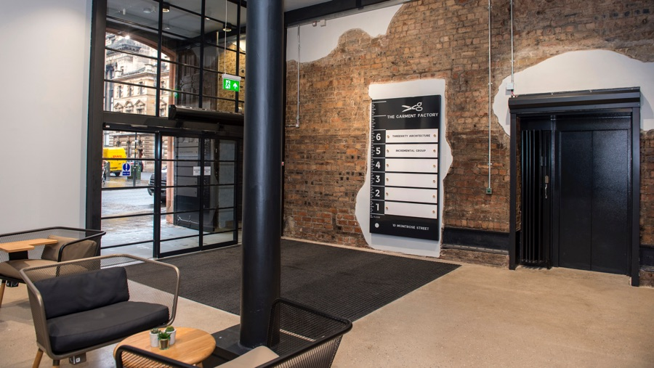


May meetup venue
Incremental Group are kindly hosting us for our May meetup
Location - 5th Floor, The Garment Factory, 10-12 Montrose Street, Glasgow, G1 1RE
Website - https://garment-factory.co.uk
@ScotPSUG

Slide 5

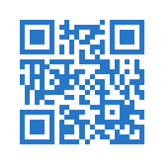

SAVE THE DATE
Scotland’s only FREE Data Platform Community Event
14
September
2018
A full day and 2 tracks of training sessions covering all
aspects of the Microsoft Data Platform:
SQL Server | Azure | Power BI | PowerShell | Business Intelligence | Data Warehousing | Analytics
Speaker Submissions now OPEN | Registration opens June
More info at:
SQLGLA.co.uk
@SQLGLA
Get news first with our mailing
list: http://bit.ly/sqlgla2018

Slide 6
Other PowerShell events
PowerShell & WinOps Fundamentals (Online monthly)
https://rebrand.ly/powershell-winops-fundamentals
@ScotPSUG

Slide 7
agenda!
7.00pm – Welcome, introductions and agenda
7.15pm – RTFM - Runtime Type Fiddling for the Masses by Mathias Jessen (@iisresetme)
8.15pm – Break
8.20pm – All about PowerShell Script Analyzer by Chris Bergmeister(@christophbergm)
9.30pm – Thanks you’s
@ScotPSUG

Slide 8
Let us know
If you want to present [10 mins/30 mins/1 hour?]
Any topics you are interested in?
@ScotPSUG

