Slide 1




Validate your powershell paramters with enums
Paul Broadwith
@pauby pauby.com github.com/pauby
Paul Broadwith @pauby

Slide 2



About me
Paul Broadwith
Freelancer since 2001
25 years in IT in the defence, government, financial services and nuclear industry sectors;
Contact Me
https://pauby.com
@pauby
https://github.com/pauby
https://www.linkedin.com/in/paulbroadwith/
Paul Broadwith @pauby

Slide 3
What IS AN ENUM
Short for enumerated (data) type;
Defines a set of values that a data type can have and restrict it’s value to those types;
Rules:
An enum can only hold one value;
The value of an enum is restricted to the defined set;
Each member of the defined set has an associated integer value starting from zero for the first member;
Paul Broadwith @pauby

Slide 4
10 do’s and don’t’s of powershell
Develop a style and stick to it
Use Advanced Functions
Leverage built-in validation
Name your things well
Filter left, format right
Sprinkle comments
Avoid technical debt, write help now
Use the pipeline and objects
Don’t pollute the users session
Go green with your code – Reduce, Reuse and Recycle
Paul Broadwith @pauby

Slide 5
Importance of the do’s and don’t’s of powershell
If you leave, get sick or get hit by a bus
Peer review easier
Post code online such as PowerShell Gallery or Github
Consistency leads to Trust leads to Reuse and Recycle
Consistency
Trust
Reuse and Recycle

Slide 6
Develop a style and stick to it

Slide 7
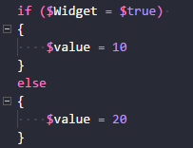
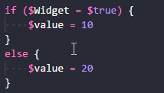
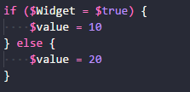


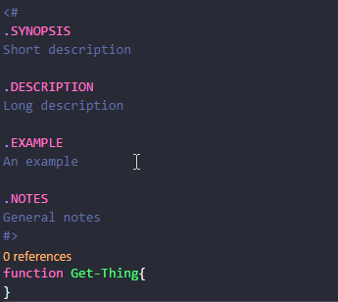
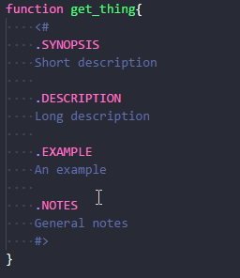


Develop a style and stick to it
Choose a bracing style, naming style, help style and comment style:
Whatever you choose, BE CONSISTENT!

Slide 8
Develop a style and stick to it
Don’t:
Use Hungarian Notation – dynamically typed language
Use aliases in code – they may not be available or change
Rely on positional parameters in code – they may change
Do:
Use full cmdlet, function and parameter names in your code

Slide 9
Use advanced functions

Slide 10
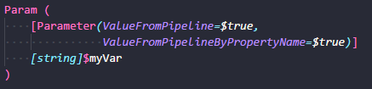
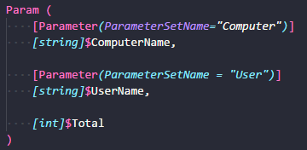
Why Use advanced functions
Allows your function to accept -Verbose, -Debug, -WhatIf, -Confirm, -ErrorAction and others.
Access to the pipeline
Parameter Sets

Slide 11
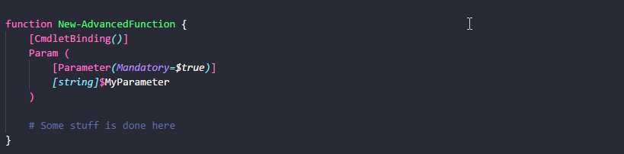
Just do it!
Define advanced function using [CmdletBinding()]
Use man about_functions_advanced

Slide 12
Questions?

Slide 13
resources
Paul Broadwith @pauby
PowerShell Practice & Style Guide
https://github.com/PoshCode/PowerShellPracticeAndStyle

Slide 14



Thank you!
Paul Broadwith @pauby
Paul Broadwith
@pauby pauby.com github.com/pauby

