Slide 1

PowerShell & DEVOPS User Group
21/10/2018
@ScotPSUG

Slide 2






scottish POWERSHELL & DEVOPS user group
Founder – Paul Broadwith (@pauby)
Co-Organiser – Craig Porteous (@cporteous)
Co-Organiser – Veronique Lengelle (@veronicageek)
psdevopsug.scot
@scotpsug
slack.psdevopsug.scot
video.psdevopsug.scot
git.psdevopsug.scot
meetup.psdevopsug.scot
@ScotPSUG

Slide 3
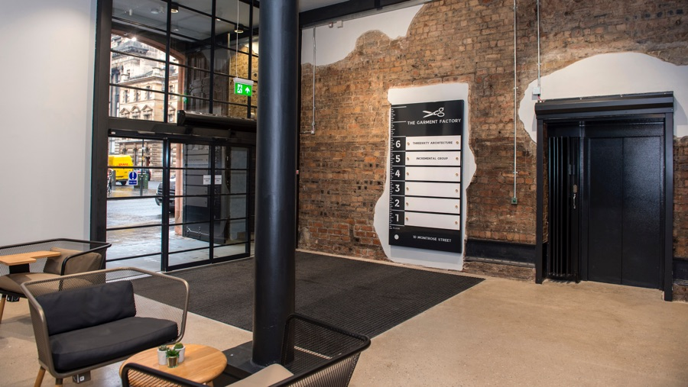
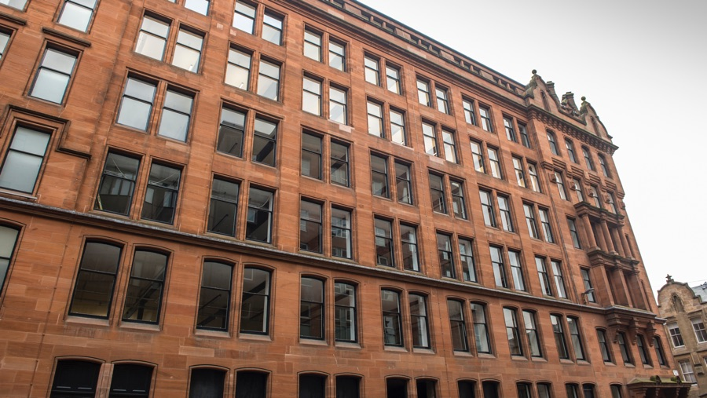

THANKS FOR THE VENUE
Incremental Group are kindly hosting us
Location - 5th Floor, The Garment Factory, 10-12 Montrose Street, Glasgow, G1 1RE
Website - garment-factory.co.uk
@ScotPSUG

Slide 4

THANKS FOR LUNCH!
More than just another recruitment business…
MBN Solutions Ingram House, 227 Ingram Street, Glasgow G1 1DA
Website: https://www.mbnsolutions.com
Tel: 0141 225 0130
@ScotPSUG

Slide 5


Slide 6

27 October, Incremental Group, Glasgow, G1 1RE

Slide 7
Want to speak?
If you want to present [10 mins/30 mins/1 hour?]
Any topics you are interested in hearing about?
@ScotPSUG

Slide 8
Slides, code and resources
https://pau.by/201810-workshop
https://github.com/psdevopsug/usergroup/tree/master/workshop/2018-10-dsc-automated-lab-jan-hendrik-peters
@ScotPSUG

Slide 9
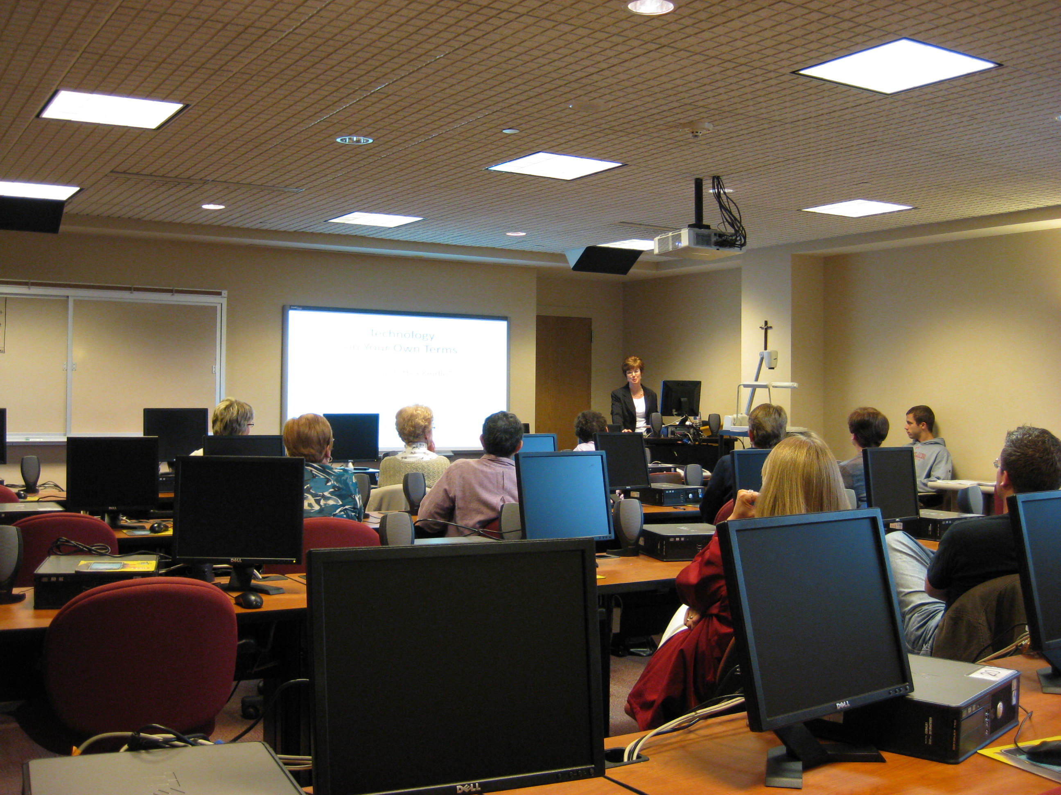
WORKSHOP: DSC AND AUTOMATED LAB
Jan-Hendrik Peters (@NyanHP) Microsoft Premier Field Engineer
21 October, Incremental Group
Covering:
Introduction to DSC;
Push vs Pull;
DSC In A Release Pipeline;
Advanced DSC;

