Slide 1
Network Topology Optimization for Bearing Rigid Multi-Agent Systems via Deep Reinforcement Learning and Graph Neural Networks
Noyan Erdin Kilic 2143466
04/08/2026

Slide 2
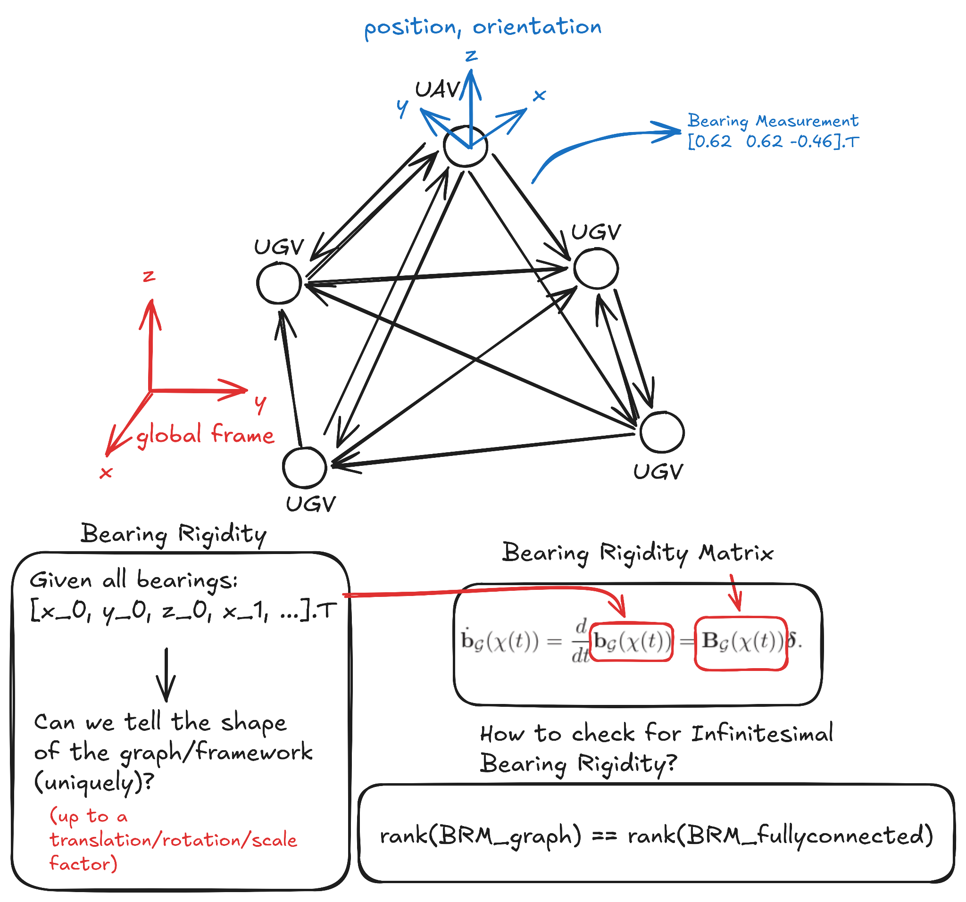
Bearing Rigidity Refresher
G. Michieletto, A. Cenedese, and D. Zelazo, “A Unified Dissertation on Bearing Rigidity Theory,” IEEE Trans. Control Netw. Syst., vol. 8, no. 4, pp. 1624–1636, Dec. 2021, doi: 10.1109/TCNS.2021.3077712.

Slide 3
Research Questions
Is there an optimal graph topology that balances sparsity and structural rigidity?
Can deep reinforcement learning be used to automatically construct such a topology?
What kind of an architecture can be used for the policy and how can it be trained?
Can a learned policy generalize to previously unseen network configurations?
What graph structures emerge, and what properties characterize them when optimized simultaneously for bearing rigidity and graph sparsity?

Slide 4
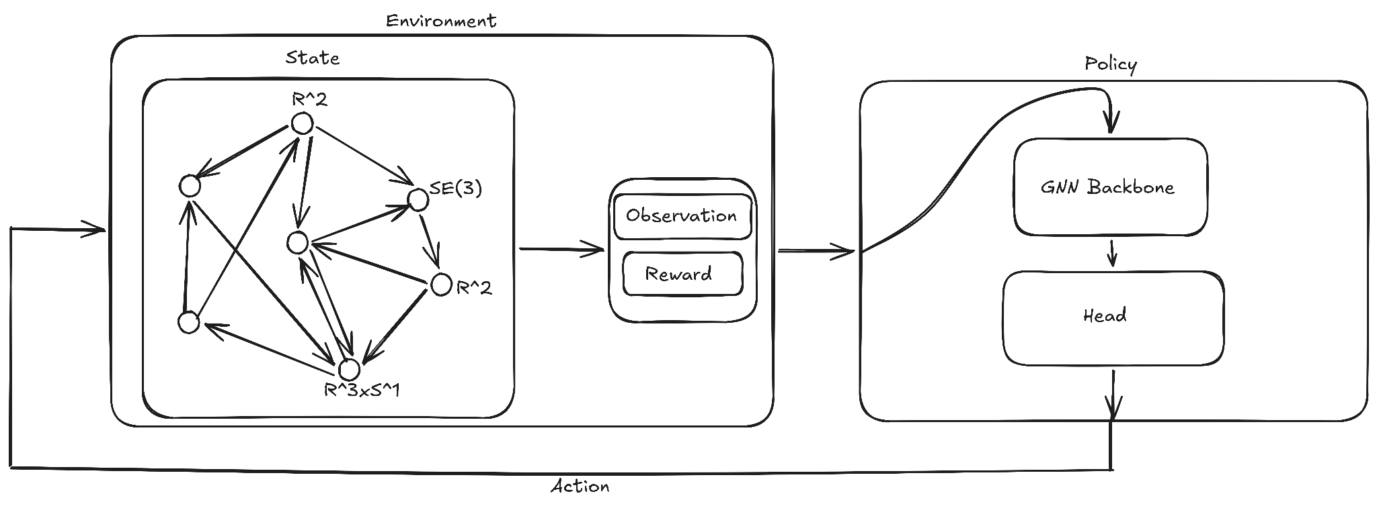
Approach

Slide 5
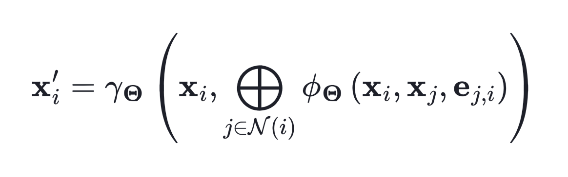
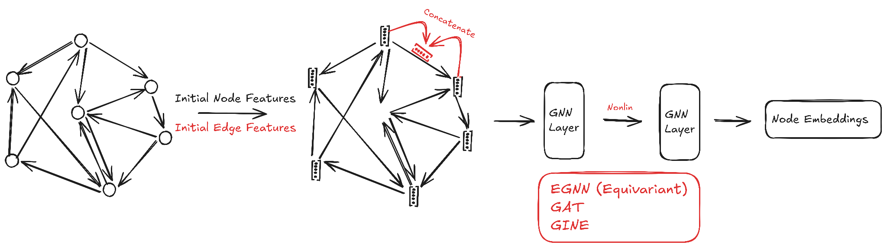
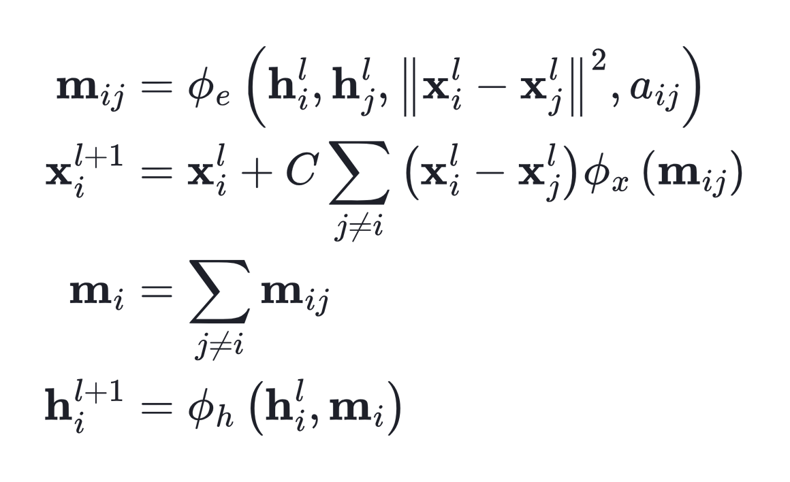
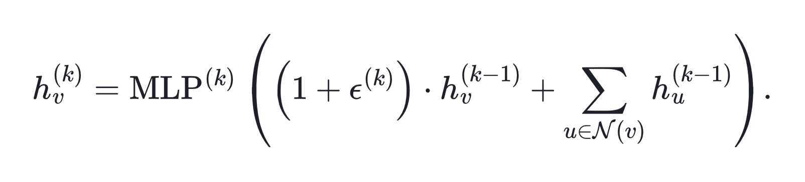
Graph Neural Networks
Message Passing Neural Networks
Equivariant Graph Neural Network
Graph Isomorphism Network
M. Fey and J. E. Lenssen, “Fast Graph Representation Learning with PyTorch Geometric,” Apr. 25, 2019, arXiv: arXiv:1903.02428. doi: 10.48550/arXiv.1903.02428.
K. Xu, W. Hu, J. Leskovec, and S. Jegelka, “How Powerful are Graph Neural Networks?,” Feb. 22, 2019, arXiv: arXiv:1810.00826. doi: 10.48550/arXiv.1810.00826.

Slide 6
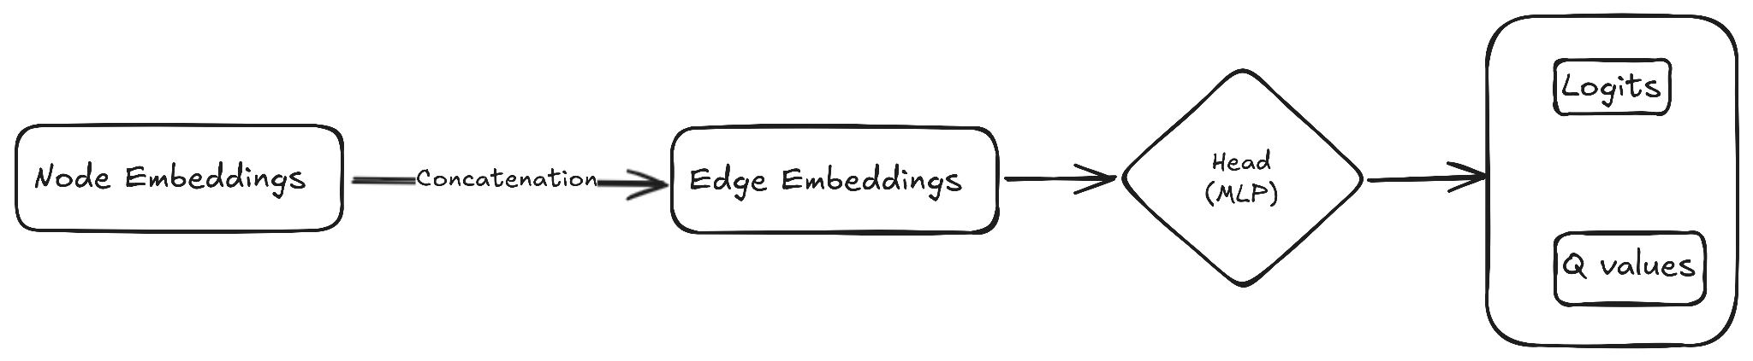
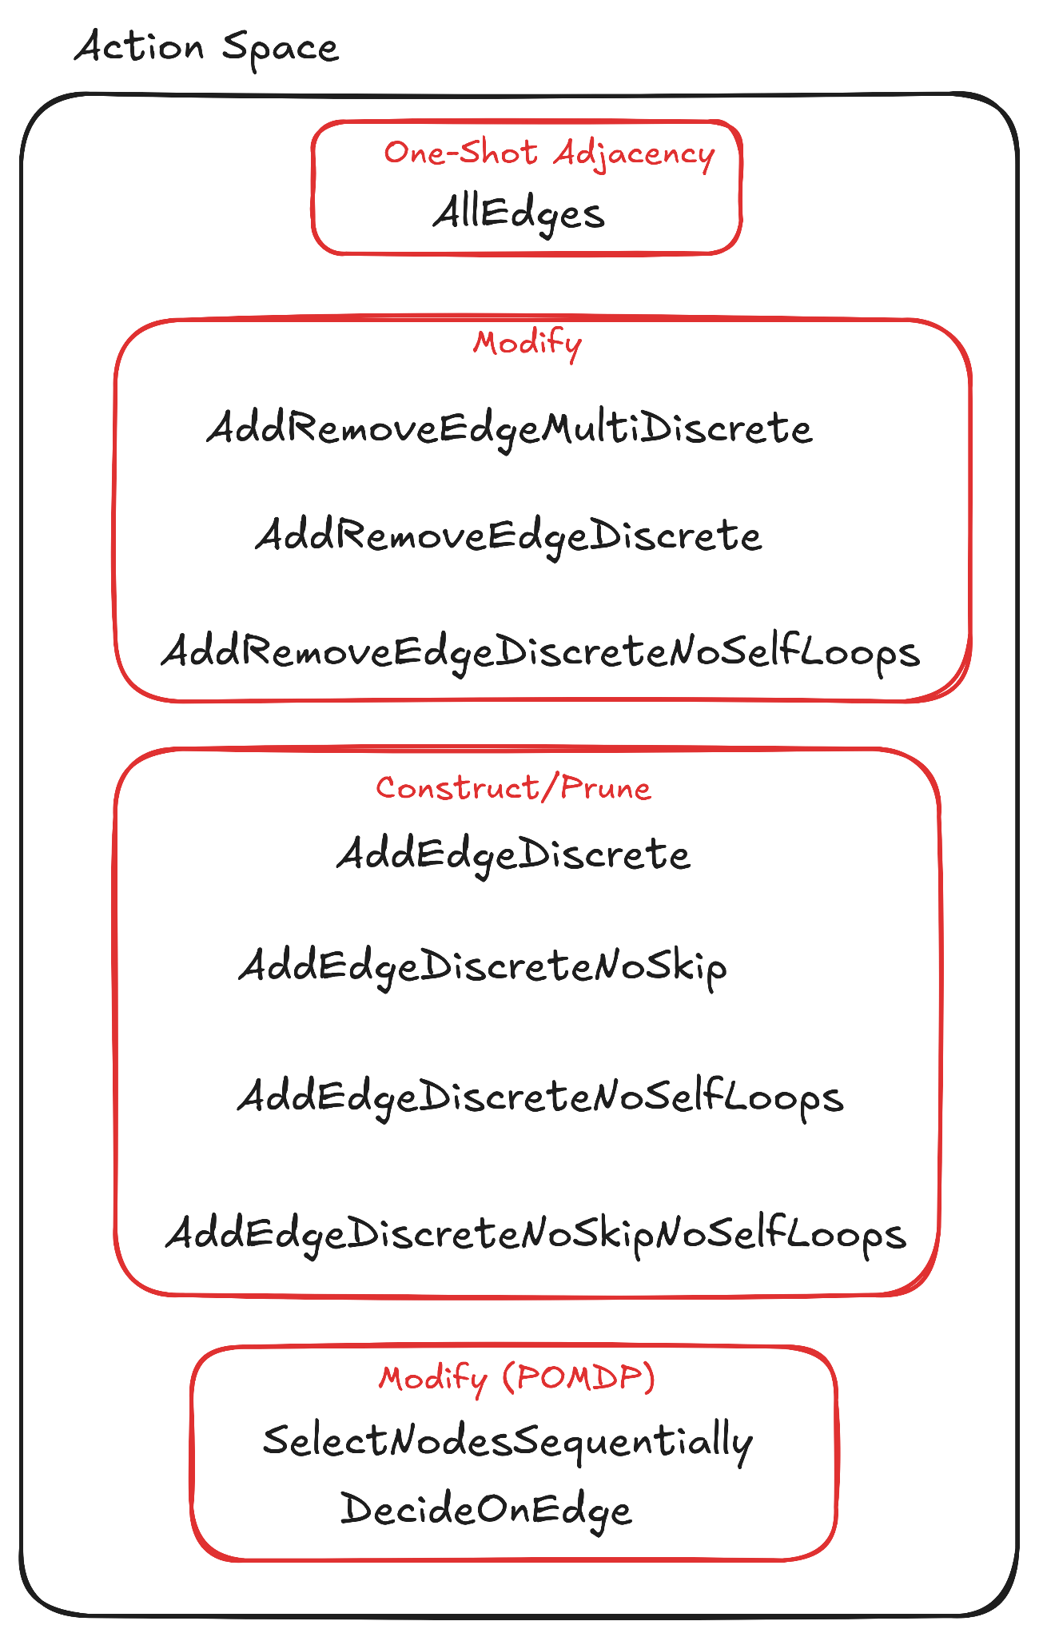
Environment Design - Action Space
vector -> [adj₀₀ adj₀₁ … adj_{n-1n-1}]
O(n²)
scalar -> [add₀ add₁ … add_{E-1} remove₀ … remove_{E-1} skip/stop]
O(m ~ n²)
scalar -> [add₀ add₁ … add_{E-1} skip/stop]
O(m ~ n²)
scalar -> [select₀ select₁ … select_{n-1} skip/stop] / [yes no skip/stop]
O(n) / O(1)

Slide 7
Environment Design - Observation Space
Problems/Considerations:
Absolute positions as node features -> GNNs can’t generalize
Absolute orientations as node features -> GNNs can’t generalize
Can’t use bearings as node features -> Node feature size depends on degree
We would like to use edge features for bearings -> GNNs are generally designed for node features
We don’t have much information in our state formulation (just poses and bearings) -> Need to derive information
(?) Using non-existent edge/bearing information would defeat the purpose -> Can only use current edges’ information
Observation
Node Features: {Domain (R^2, SE(3) etc.), In/Out Degree, Centralities (closeness, eigenvalue), Betweenness}
Edge Features: {Bearing (3-dim vector, Euler angles), Betweenness, Reciprocity, Common Neighbors}
Adjacency
(EGNN) Coordinates
(Selection action) Current Selection
Note: The graph theoretic node level features are not commonly used with graph neural networks since they have the ability to learn them implicitly.

Slide 8
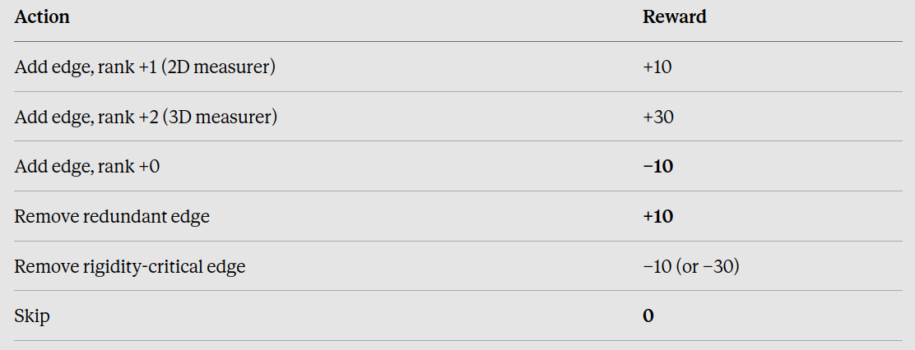
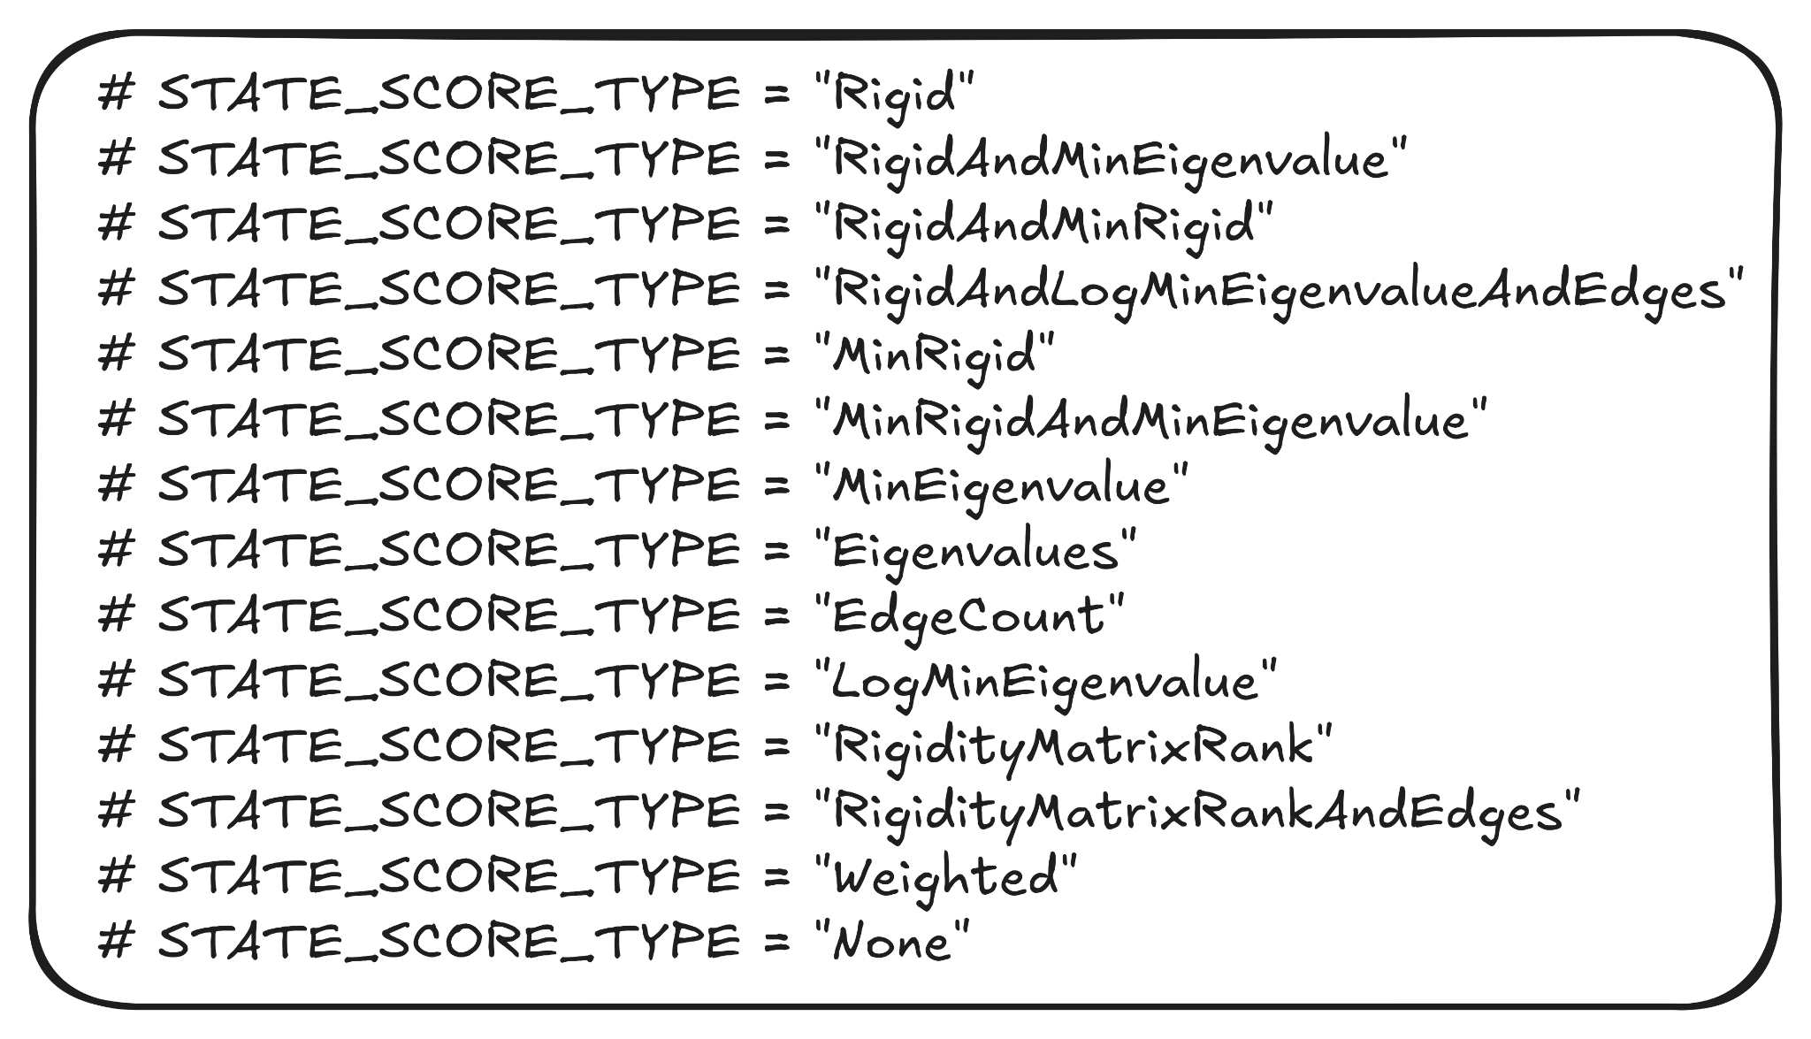
Environment Design - Reward
State Score:
How “good” the current state is
Weights are hyperparameters
Potential based shaping
Types of rewards (per step):
State reward (score_{curr} - score_{prev})
Time penalty
Action reward
Termination reward
-> Bonuses when the termination condition is met or
certain actions are taken.
20 10 0 0 0

Slide 9
Training Overview
Algorithms:
PPO and DQN, both via skrl
Actor / critic / Q-network selected automatically from (action space × observation type)
Same GNN backbone in all cases; only the action head changes
One episode:
Reset -> Random Graph
Per step: GNN -> action head -> masked action -> apply change -> reward
Terminate on condition
Action masking:
Invalid actions masked inside the model (−1e9 on the logit/Q-value), not in the environment
DQN applies the same mask to e-greedy exploration

Slide 10
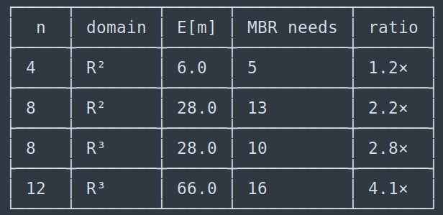
Generating Random Graphs
Directed Erdős-Rényi Model G(n, m)
Fixed number of nodes (and domains)
Random positions and orientations
Random number of edges:
  If sampled uniformly over all possible numbers of edges,
the expected value is: (n² - n)/2
However the minimum number of edges required for IBR
grows roughly linearly with n.
This means for most episodes, the graph will need
(possibly lots of) pruning. This makes learning construction
actions difficult.
Solution: Sample uniformly (or normal dist.) centered around
the expected minimum number of edges for rigidity.

Slide 11
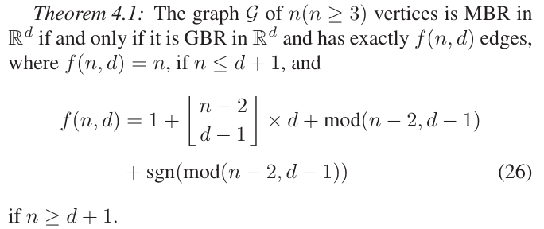
Termination Conditions
MBR:
For homogeneous networks in R^d, we have a closed form solution.
For heterogeneous networks, or homogeneous in higher level domains,
there is no closed form solution to the minimum number of edges
required for bearing rigidity.
Heuristic (Lower Bound): Count the DOFs each edge in the network
constrains. The minimum number of edges required for bearing rigidity
can be lower bounded by counting the total constrained DOFs greedily
by sorting the edges in order of number of DOFs they constrain.
Max steps:
Let the RL agent accumulate rewards as much as possible during the episode.
Relying on the agent taking the “skip” action when it thinks it reached the optimal state.
M. H. Trinh, Q. Van Tran, and H.-S. Ahn, “Minimal and Redundant Bearing Rigidity: Conditions and Applications,” IEEE Transactions on Automatic Control, vol. 65, no. 10, pp. 4186–4200, Oct. 2020, doi: 10.1109/TAC.2019.2958563.

Slide 12
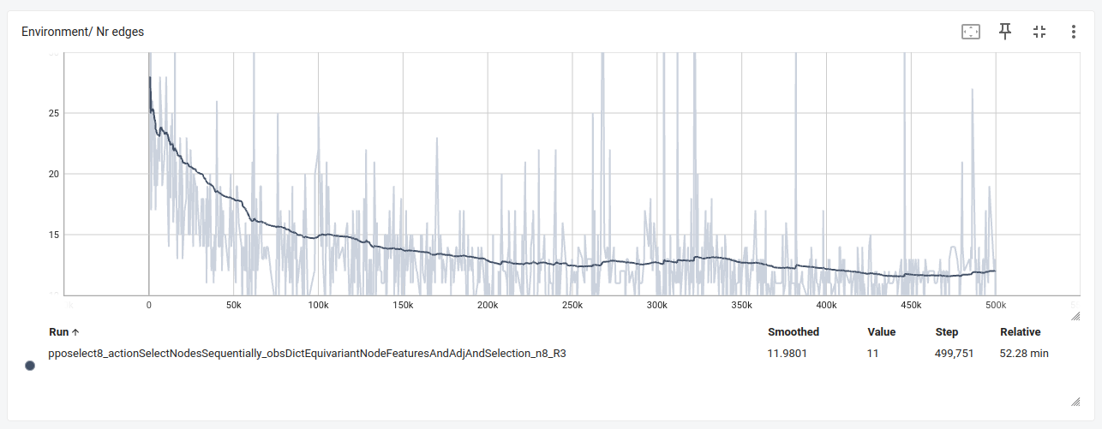
Training Results - pposelect8
Trained on:
8 nodes in R^3
“MaxSteps” termination
Model:
PPO
EGNN
Select Nodes action
M. H. Trinh, Q. Van Tran, and H.-S. Ahn, “Minimal and Redundant Bearing Rigidity: Conditions and Applications,” IEEE Transactions on Automatic Control, vol. 65, no. 10, pp. 4186–4200, Oct. 2020, doi: 10.1109/TAC.2019.2958563.

Slide 13
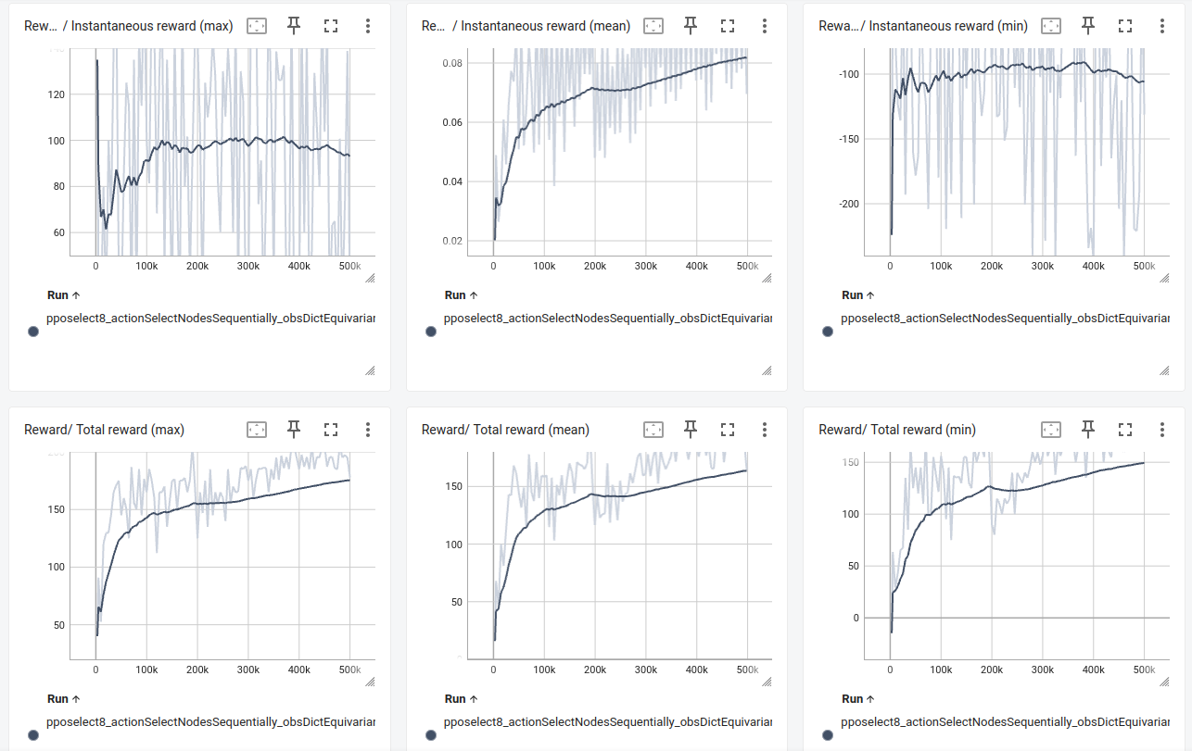
Training Results - pposelect8
M. H. Trinh, Q. Van Tran, and H.-S. Ahn, “Minimal and Redundant Bearing Rigidity: Conditions and Applications,” IEEE Transactions on Automatic Control, vol. 65, no. 10, pp. 4186–4200, Oct. 2020, doi: 10.1109/TAC.2019.2958563.

Slide 14
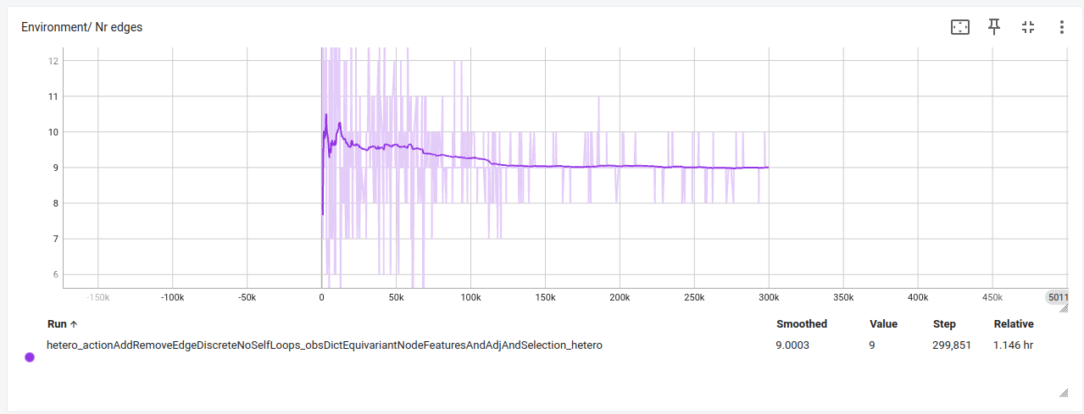
Training Results - hetero
Trained on:
5 nodes
4 in R^2
1 in SE(3)
“MaxSteps” termination
Model:
DQN
EGNN
Add/Remove action
M. H. Trinh, Q. Van Tran, and H.-S. Ahn, “Minimal and Redundant Bearing Rigidity: Conditions and Applications,” IEEE Transactions on Automatic Control, vol. 65, no. 10, pp. 4186–4200, Oct. 2020, doi: 10.1109/TAC.2019.2958563.

Slide 15
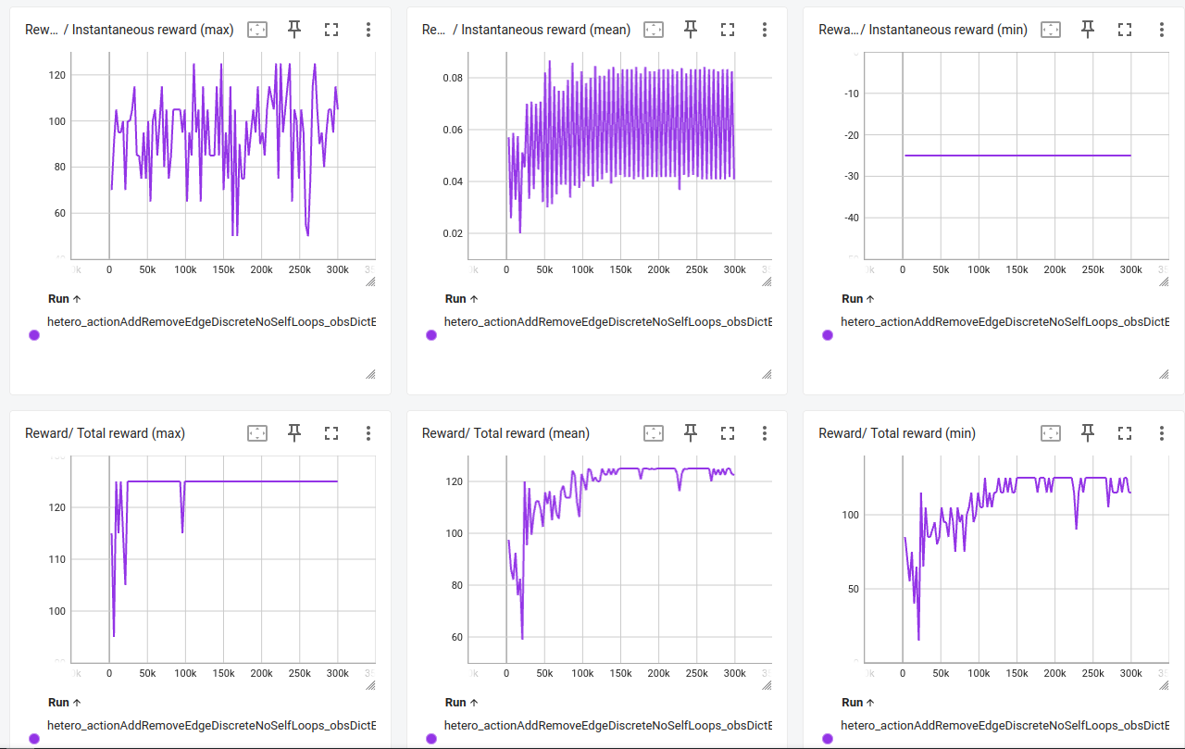
Training Results - hetero
M. H. Trinh, Q. Van Tran, and H.-S. Ahn, “Minimal and Redundant Bearing Rigidity: Conditions and Applications,” IEEE Transactions on Automatic Control, vol. 65, no. 10, pp. 4186–4200, Oct. 2020, doi: 10.1109/TAC.2019.2958563.

Slide 16
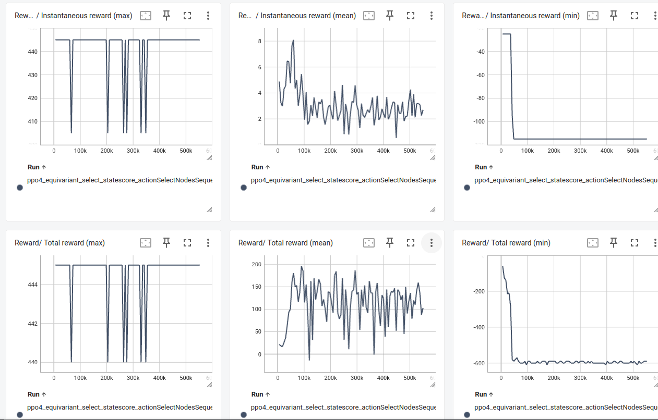
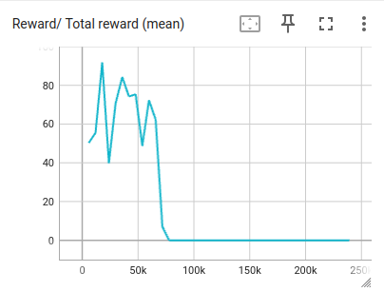
Training Results - problems
The figure below was from a DQN run with Select Node action type. The agent learned to select a node (which does not give a reward until the second selection) and then take the skip action to reset the selection.
M. H. Trinh, Q. Van Tran, and H.-S. Ahn, “Minimal and Redundant Bearing Rigidity: Conditions and Applications,” IEEE Transactions on Automatic Control, vol. 65, no. 10, pp. 4186–4200, Oct. 2020, doi: 10.1109/TAC.2019.2958563.

Slide 17

Inference Results - Hetero
M. H. Trinh, Q. Van Tran, and H.-S. Ahn, “Minimal and Redundant Bearing Rigidity: Conditions and Applications,” IEEE Transactions on Automatic Control, vol. 65, no. 10, pp. 4186–4200, Oct. 2020, doi: 10.1109/TAC.2019.2958563.

Slide 18
Inference Results - Hetero
Comparison on hetero
method |E| score %IBR %MBR steps n
----------------------------------------------------------
initial 7.25 91.50 20 0 0.0 20
greedy 9.00 190.00 100 55 5.2 20
random 9.60 183.00 95 30 86.3 20
learned 9.00 190.00 100 60 5.2 20
Comparison on 8 Nodes R^3
method |E| score %IBR %MBR steps n
----------------------------------------------------------
initial 12.70 127.00 45 0 0.0 20
greedy 10.65 293.50 100 40 11.2 20
random 14.80 243.00 70 0 35.1 20
learned 12.45 275.50 100 0 14.3 20
M. H. Trinh, Q. Van Tran, and H.-S. Ahn, “Minimal and Redundant Bearing Rigidity: Conditions and Applications,” IEEE Transactions on Automatic Control, vol. 65, no. 10, pp. 4186–4200, Oct. 2020, doi: 10.1109/TAC.2019.2958563.

Slide 19
Inference Results - pposelect8
Comparison on 8 Nodes R^3
Comparison on 4 Nodes R^2
method |E| score %IBR %MBR steps n
----------------------------------------------------------
initial 12.70 127.00 45 0 0.0 20
greedy 10.65 293.50 100 40 11.2 20
random 16.45 225.50 65 0 23.6 20
learned 12.95 268.50 95 40 34.2 20
method |E| score %IBR %MBR steps n
----------------------------------------------------------
initial 6.35 8.50 50 0 0.0 20
greedy 5.00 50.00 100 100 4.2 20
random 5.00 50.00 100 100 128.8 20
learned 5.00 50.00 100 100 71.3 20
Comparison on 16 Nodes R^3
method |E| score %IBR %MBR steps n
----------------------------------------------------------
initial 52.25 109.50 60 0 0.0 20
random 54.30 313.00 60 0 128.6 20
learned 40.10 475.00 95 15 558.3 20
M. H. Trinh, Q. Van Tran, and H.-S. Ahn, “Minimal and Redundant Bearing Rigidity: Conditions and Applications,” IEEE Transactions on Automatic Control, vol. 65, no. 10, pp. 4186–4200, Oct. 2020, doi: 10.1109/TAC.2019.2958563.

Slide 20
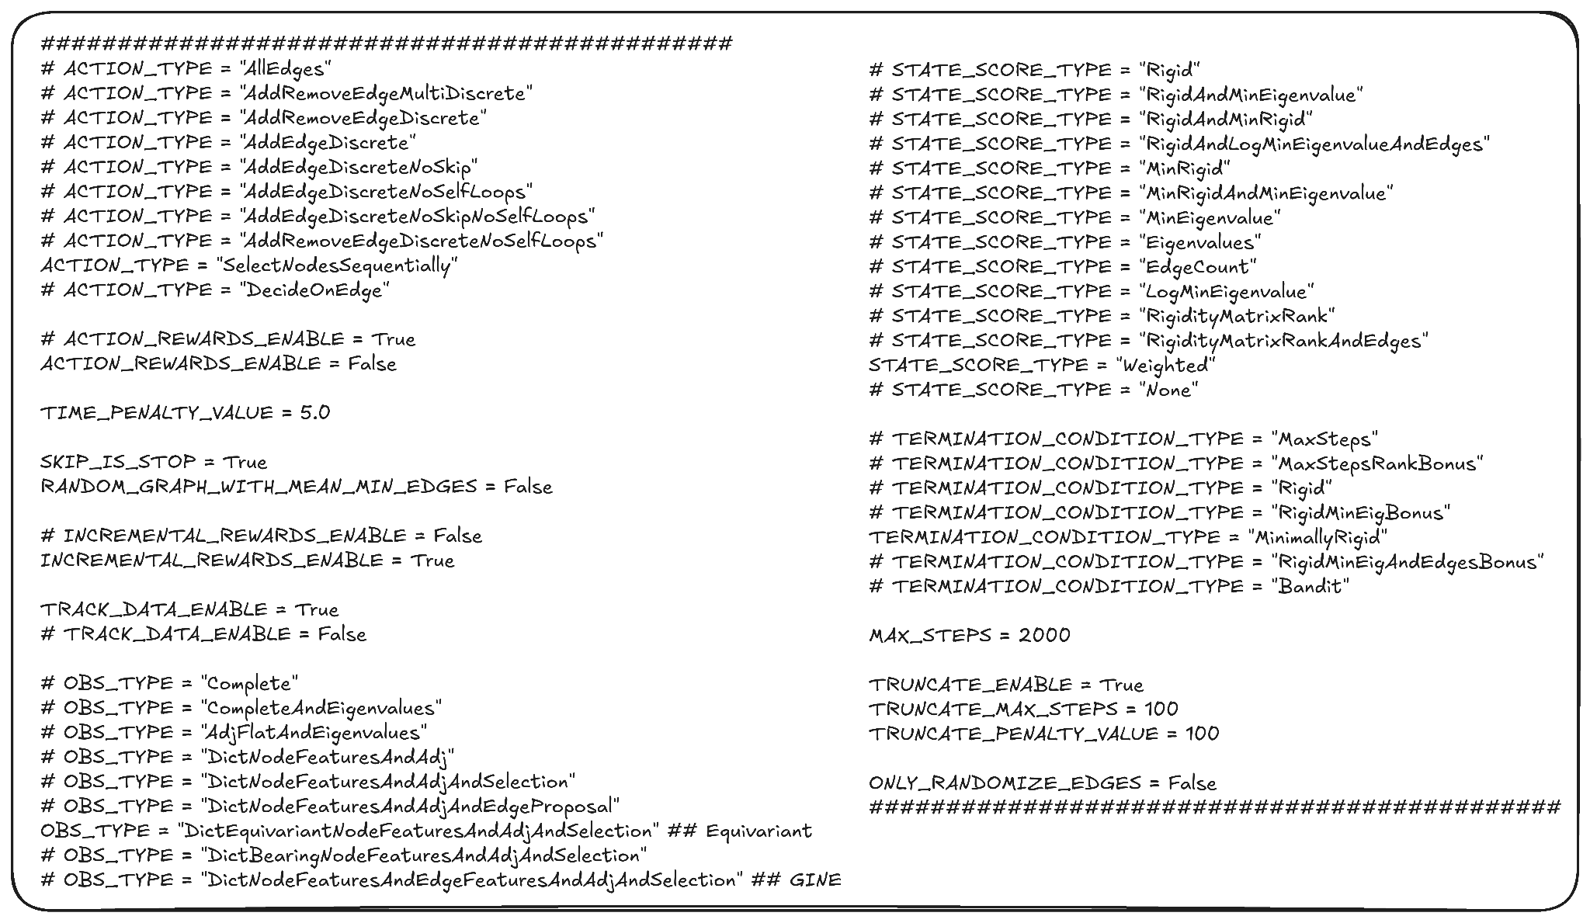
Configuration - Environment

Slide 21
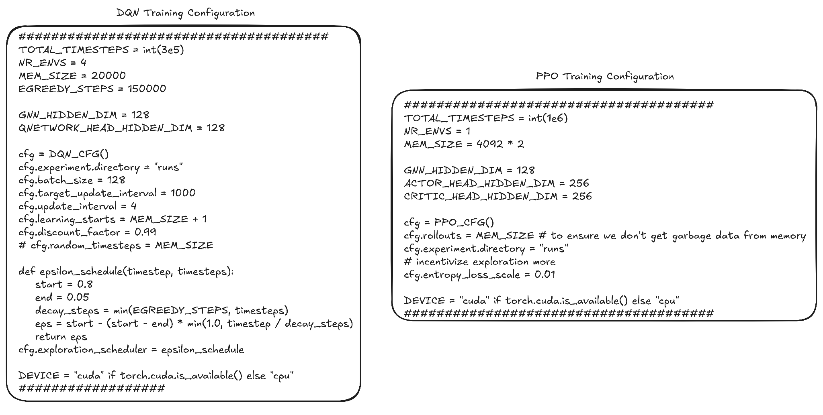
Configuration - Training

Slide 22
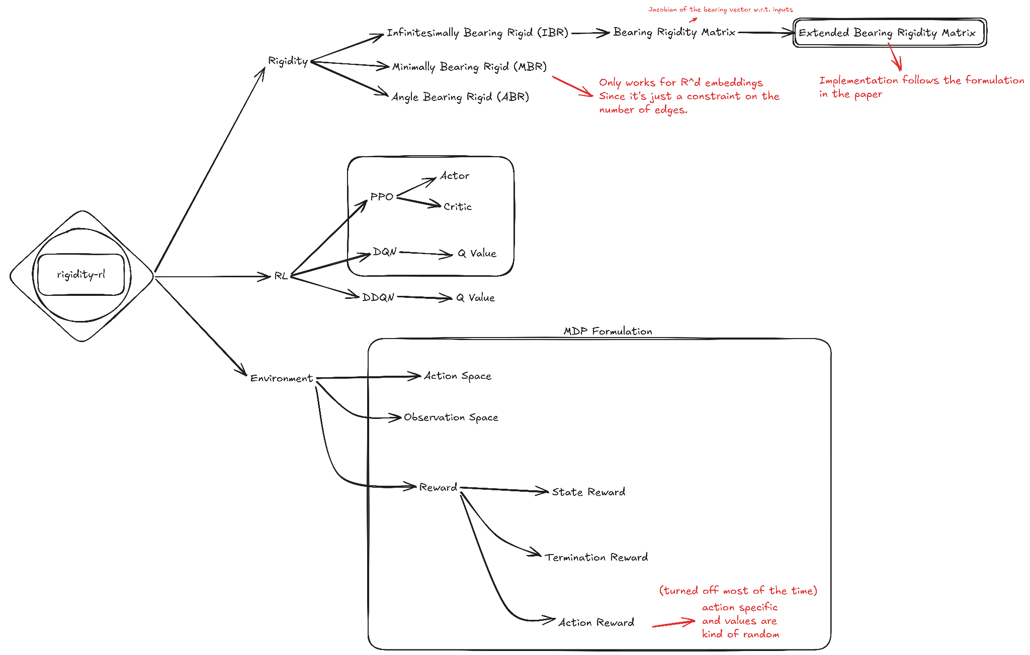
Misc. Notes

Slide 23
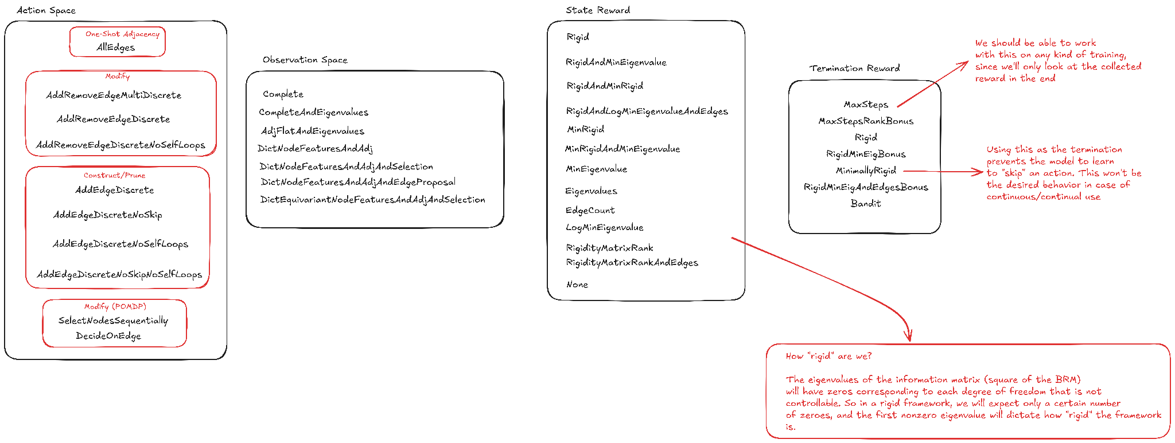
Misc. Notes

Slide 24
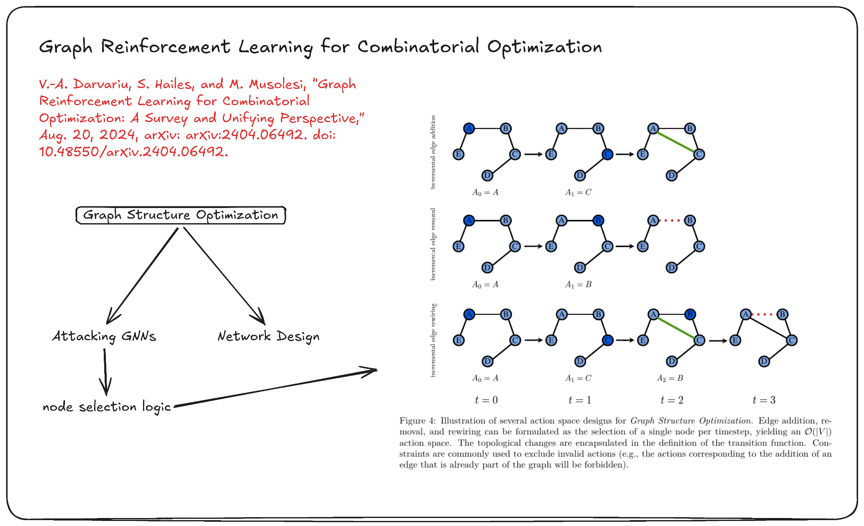
Graph RL CO Survey
Also:
Edge Rewiring
Using GIN GNNs.
Action masking.
Multi-Objective reward.
Only termination reward.
V.-A. Darvariu, S. Hailes, and M. Musolesi, “Graph Reinforcement Learning for Combinatorial Optimization: A Survey and Unifying Perspective,” Aug. 20, 2024, arXiv: arXiv:2404.06492. doi: 10.48550/arXiv.2404.06492.

Slide 25
Thoughts
Questions: Is there a conceptual problem in the environment design or training approach? Does reward function need tuning? What about observation? Do training hyperparameters need tuning? Is there an architectural problem?
Learning the “skip/stop” action is hard since it is (ideally) a good action only in one state.
A node’s rigidity (“locked” DOFs) depend on its domain and number of bearing measurements. The target node’s features do not matter for the rigidity of the base node, however its rigidity might. Then does it make sense to use message passing?
For training, random networks are generated (random number of edges). However, as the number of nodes grow, the minimum number of edges that can make the network IBR doesn’t grow as fast. This makes it difficult for the RL agent to train on high number of nodes. So for training, maybe we should create networks with number of edges centered around this minimum value?
Using Minimal Bearing Rigidity (MBR) on heterogeneous networks with R^d domain is quite helpful, mainly as a termination condition we can use during training. However there is no closed form formula for other domains or heterogeneous networks. Can we count the DOFs edges constrain? However not only the degrees of freedom vary per node, but the unobservable null space of the formation shifts depending on exactly which domains are interacting. Also, a node may not need a certain number of outgoing edges depending on the rigidity of the whole graph, so we can’t count the edges needed per node.
Maybe a better approach would be to let the RL agent figure out a graph configuration that is minimally rigid, and then consider another problem that is rewiring the current edges in the graph for the spectral properties.
What about pre-training the GNN for rigidity and using RL for the action head?

Slide 26
TODO
Rigidity: Investigate Eigenvalues in the state score.
Training times: Using a custom gymnasium environment currently, however the matrix rank, eigenvalue (SVD), centrality features etc. are quite expensive and training is slow. I am currently trying to rewrite the environment as a tensorized pytorch environment.
Approach Idea: Start with an empty graph and only add edges. Terminate when rigidity is reached and give a termination reward based on the state’s score. (we lose the “repairability”)
Approach Idea: Train two RL agents, one for construction and one for pruning. Let them run iteratively until they both converge (take a “done” action maybe).
Performance metrics and baselines: Greedy hill-climbing, Brute force, Neural-Combinatorial-Optimization?
MARL: I would like to try a CTDE multi-agent scheme. The actor network can see a k-hop neighborhood of the node, and the value network can stay the same as current one. What should k be?

