Slide 1
DATA ANALYTICS PROJECT
CareerSignal
Placement Intelligence &
Student Readiness Analytics
Tools: Python • PostgreSQL • SQL • Power BI | Domain: Educational Analytics • HR Intelligence

Slide 2
PROBLEM STATEMENT
The Challenge
Project Objectives
Colleges generate massive placement data but lack actionable insights to improve outcomes.
Without structured analysis, decision-makers fly blind — unable to identify which students need support or which recruitment channels deliver results.
1. Analyze student readiness across skills & academics
2. Measure placement performance by branch & tier
3. Map recruitment funnel efficiency end-to-end
4. Quantify skill impact on placement outcomes
This project bridges the gap between raw placement data and strategic decision-making.

Slide 3
DATASET OVERVIEW
5,000
Students
4 Relational Tables
20+ SQL Queries Executed
3 Power BI Dashboards
students
skills
Demographics, branch, college tier, academic scores
DSA, Python, SQL, communication & aptitude scores
applications
placements
OA attempts, clearances, interviews received per student
Placement status, package (LPA), offers received

Slide 4
DATABASE DESIGN — ER DIAGRAM
students
PK student_id
branch, cgpa,
internships, projects
skills
applications
placements
PK/FK student_id
dsa_score
python_score
sql_score
comm_score, aptitude
PK/FK student_id
oa_attempted
oa_cleared
interviews_received
PK/FK student_id
placed
package_lpa
offers_received
Primary Key: student_id | Foreign Key relationships established across skills, applications and placements tables

Slide 5
SQL ANALYTICS LAYER
20+ Analytical SQL Queries
Q1
Placement Rate
Q2
Branch-wise Package
Q3
OA Conversion
COUNT(placed=1) / COUNT(*)
AVG(package_lpa) GROUP BY branch
SUM(oa_cleared)/SUM(oa_attempted)
Overall & branch-wise placement %
Avg CTC per engineering branch
Online assessment pass-through rate
Q4
Top Performing Branch
Q5
Skill Performance
RANK() OVER (ORDER BY placement_rate)
AVG(dsa_score) GROUP BY branch
Ranked branches by placement success
Branch-wise skill comparison & placement benchmarking
Techniques Used: JOINs • CTEs • Window Functions • Aggregations • Ranking Functions

Slide 6
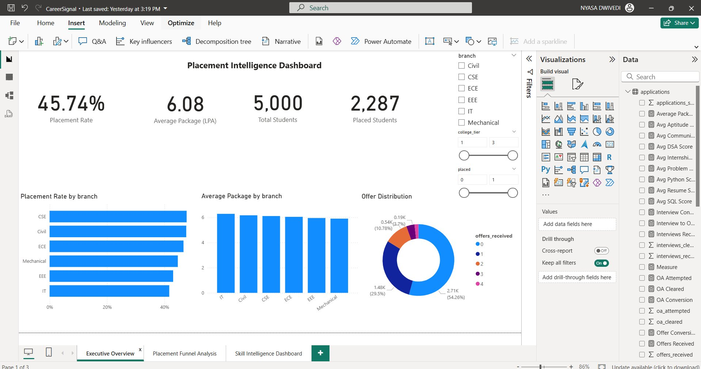
DASHBOARD 1 — EXECUTIVE OVERVIEW
Key Insights
45.74%
Overall placement rate
6.08 LPA
Average package
5,000
Total students tracked
2,287
Students placed
CSE
Highest Placement Rate Branch

Slide 7
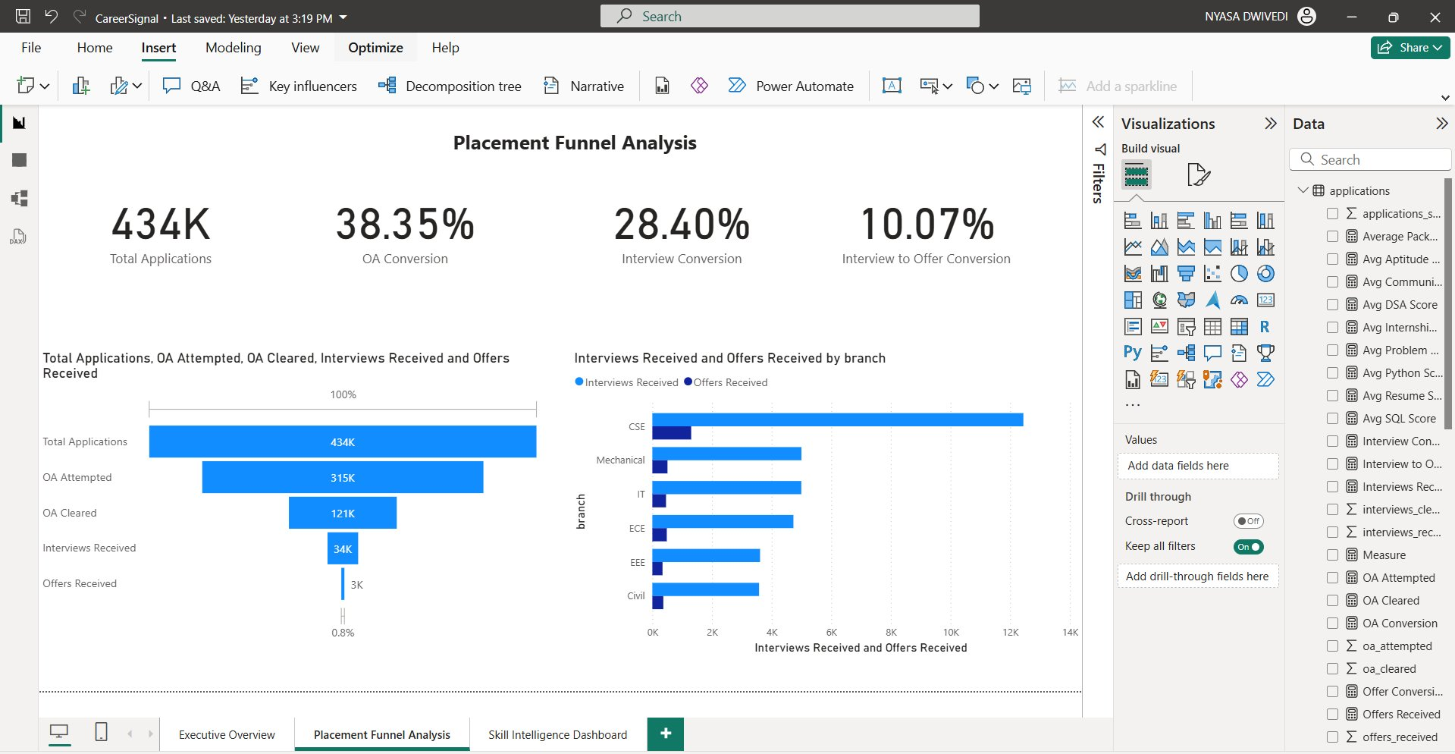
DASHBOARD 2 — PLACEMENT FUNNEL ANALYSIS
Funnel Metrics
434K
Total applications
315K
OA attempted
38.35%
OA conversion rate
28.40%
Interview conversion
10.07%
Interview→Offer rate
CSE
Most Interview Opportunities

Slide 8
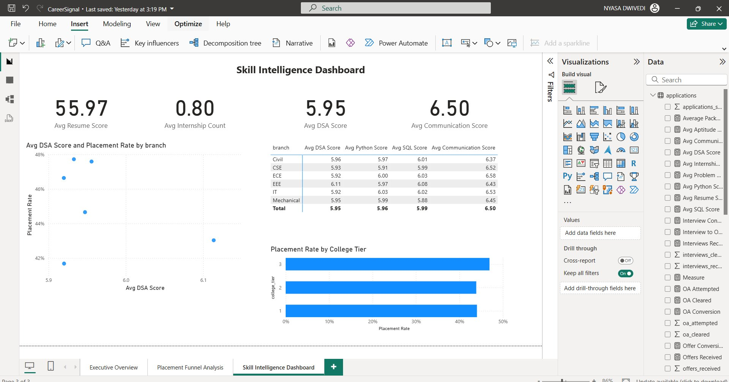
DASHBOARD 3 — SKILL INTELLIGENCE DASHBOARD
Skill Metrics
55.97
Avg resume score
0.80
Avg internship count
5.95
Avg DSA score
6.50
Avg communication
EEE
Highest DSA branch
Tier 3
Highest placement rate by college tier

Slide 9
MAJOR FINDINGS
45.74%
6.08 LPA
CSE Leads
Placement Rate
Avg Package
Top Branch
Only 45.74% secured placements — highlighting significant opportunity for institutional intervention.
Competitive average CTC across all branches, with CSE commanding the highest packages.
CSE consistently leads in placement rate, interview opportunities and average package.
38.35%
28.40%
Comm > Tech
OA Conversion
Interview Conv.
Skill Pattern
The largest funnel drop occurs between OA Attempted and OA Cleared — the critical intervention point.
Interview opportunities drop significantly after OA clearance, highlighting a key funnel bottleneck.
Communication scores remain consistently stronger than technical skills across all branches.

Slide 10
BUSINESS IMPACT
✓
Identified placement performance gaps across branches, enabling targeted faculty interventions.
✓
Measured end-to-end recruitment funnel efficiency from application to offer.
✓
Evaluated skill-readiness indicators to connect academic preparation with placement outcomes.
✓
Enabled data-driven placement strategy decisions for placement cells and career counselors.
✓
Built an interactive, filterable Power BI analytics solution across 3 dashboard pages.

Slide 11
PRODUCT VISION
CareerSignal
A placement intelligence platform concept that enables colleges to improve employability outcomes through analytics-driven interventions, recruitment funnel visibility, and student readiness insights.
Target Users
North Star Metric
Placement Officers
Placement Rate
Career Counselors
% of students securing employment
within the academic cohort
Students

Slide 12
FUTURE ENHANCEMENTS
Building the next iteration of CareerSignal
01
ML Placement Predictor
02
Real-Time Dashboard
Predict placement probability for each student using Random Forest / XGBoost models trained on historical data.
Live data integration via APIs — auto-refresh dashboards as placement data streams in during placement season.
03
Resume Recommendation Engine
04
Skill Gap Analysis Tool
NLP-powered engine that suggests resume improvements based on job descriptions and top-placed student profiles.
Identify individual skill gaps vs. industry benchmarks and generate personalized learning roadmaps per student.
CareerSignal • Placement Intelligence & Student Readiness Analytics • Built with SQL + Power BI

