Slide 1

Analyzing Technology Trends Through Survey Data
By Nyashadzashe Mugobo
05/04/2025

Slide 2



OUTLINE
1. Executive Summary
2. Introduction
3. Methodology
4. Programming Language Trends
5. Database Trends
6. Dashboards
7. Discussion
8. Overall Findings & Implications
9. Conclusion
10. Appendix

Slide 3

EXECUTIVE SUMMARY
This project provides a comprehensive analysis of current and future technology trends based on survey data from a global developer community. The focus areas include programming languages, databases, and respondent demographics.
Key findings:
JavaScript, Python and SQL are among the most widely used programming languages in 2024.
Emerging languages like Go and TypeScript show increasing adoption for the future, indicating a shift toward scalable, modern development stacks.
MySQL and PostgreSQL remain dominant in database usage, while MongoDB and Firebase are projected to grow in demand.
Dashboard visualizations revealed clear trends across age groups and education levels, showing that younger developers tend to adopt newer technologies faster.
The data highlights the need for businesses to adapt to evolving tech stacks and align hiring strategies with emerging tools and skills.

Slide 4

INTRODUCTION
Purpose of the Report: To analyze global developer survey data and uncover trends in programming languages, database technologies, and respondent demographics. The goal is to derive actionable insights for organizations, educators, and tech professionals.
Target Audience:
Technology leaders and recruiters
Data analysts and developers
Educators and curriculum designers
Business decision-makers in tech industries
Value of the Report:
Helps stakeholders stay updated on evolving technology trends
Assists hiring managers in identifying in-demand skills
Informs strategic decisions in training, recruitment, and product development
Enhances understanding of global tech demographics and preferences

Slide 5

METHODOLOGY
Collected job-related data via the GitHub Jobs API using Python, capturing live demand for tech skills across roles.
Performed web scraping on external sources such as IBM reports and Stack Overflow developer surveys to gather insights on technology usage, popularity, and salary trends.
Conducted exploratory data analysis (EDA) using Python (Pandas, Matplotlib) to identify key patterns, trends, and outliers in the data.
Used Jupyter Notebooks via Visual Studio Code to document, test, and visualize analysis steps in a structured manner.
Built interactive dashboards in IBM Cognos Analytics, using pie charts, map charts, line charts, and stacked bar charts to present insights across:
Current Technology Usage
Future Technology Trends
Demographic Profiles

Slide 6
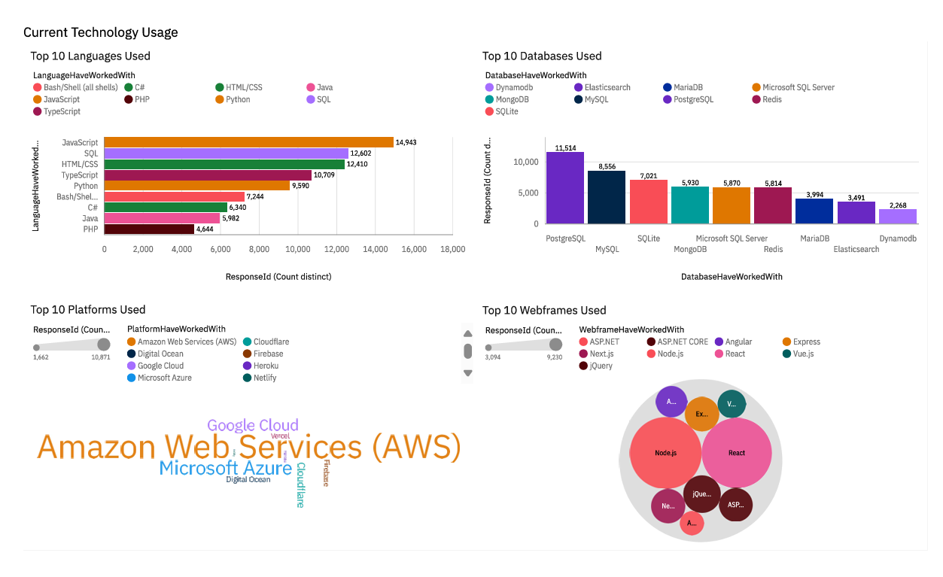
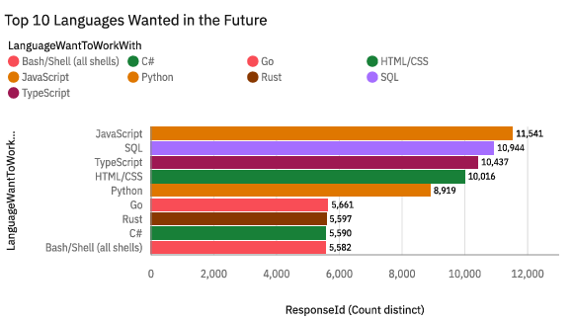
PROGRAMMING LANGUAGE TRENDS
Current Year
Next Year

Slide 7
PROGRAMMING LANGUAGE TRENDS - FINDINGS & IMPLICATIONS
Findings
Python is the most widely used programming language across respondents, especially in data analysis and scripting roles.
JavaScript ranks high due to its dominance in web development and full-stack environments.
TypeScript and Go are rising quickly, showing increasing popularity among newer developers and cloud-native teams.
Implications
Python skills will continue to be essential for data roles — learners should prioritize Python for analytics, AI, and automation.
The persistent relevance of JavaScript and its frameworks means front-end and full-stack skills will remain in high demand.
Emerging languages like TypeScript, Go, and Rust represent future opportunities — upskilling early could offer a competitive edge.

Slide 8

DATABASE TRENDS
Current Year
Next Year

Slide 9
DATABASE TRENDS - FINDINGS & IMPLICATIONS
Findings
MySQL and PostgreSQL lead as the most widely-used relational databases across respondents.
MongoDB is the most popular NoSQL database, particularly among startups and web applications.
Legacy systems like Oracle and Microsoft SQL Server still have strong adoption in large enterprises.
Interest in cloud-native databases like Firebase and Amazon Aurora is rising.
NoSQL systems (e.g., MongoDB, Redis) are expected to increase in use, especially in agile, high-speed development environments.
Implications
Developers and analysts should be proficient in SQL (especially with PostgreSQL and MySQL) for data-intensive roles.
Learning MongoDB or other NoSQL systems provides flexibility for working with unstructured data in modern apps.
Understanding enterprise databases like Oracle or MS SQL adds value for careers in legacy or enterprise environments.
Mastery of cloud-friendly databases will be key for staying aligned with infrastructure shifts.
Developers should consider multi-model database proficiency (both SQL and NoSQL) to stay versatile.

Slide 10

DASHBOARD
This section presents three interactive dashboards developed using IBM Cognos Analytics. Each dashboard is designed to visualize key insights from the survey data, covering:
Current Technology Usage – A snapshot of the tools, languages, and databases currently in use.
Future Technology Trends – A forward-looking view into emerging technologies and developer interests.
Demographics – Background information on the respondents, including age, country, and education level.
These dashboards transform raw data into intuitive visual stories, aiding stakeholders in understanding workforce trends and tech adoption patterns.
Link to the Dashboard:
https://us3.ca.analytics.ibm.com/bi/?perspective=dashboard&pathRef=.my_folders%2Fsurvey_data_assignment&action=view&mode=dashboard&subView=model0000019607533ea1_00000002

Slide 11
DASHBOARD TAB 1

Slide 12
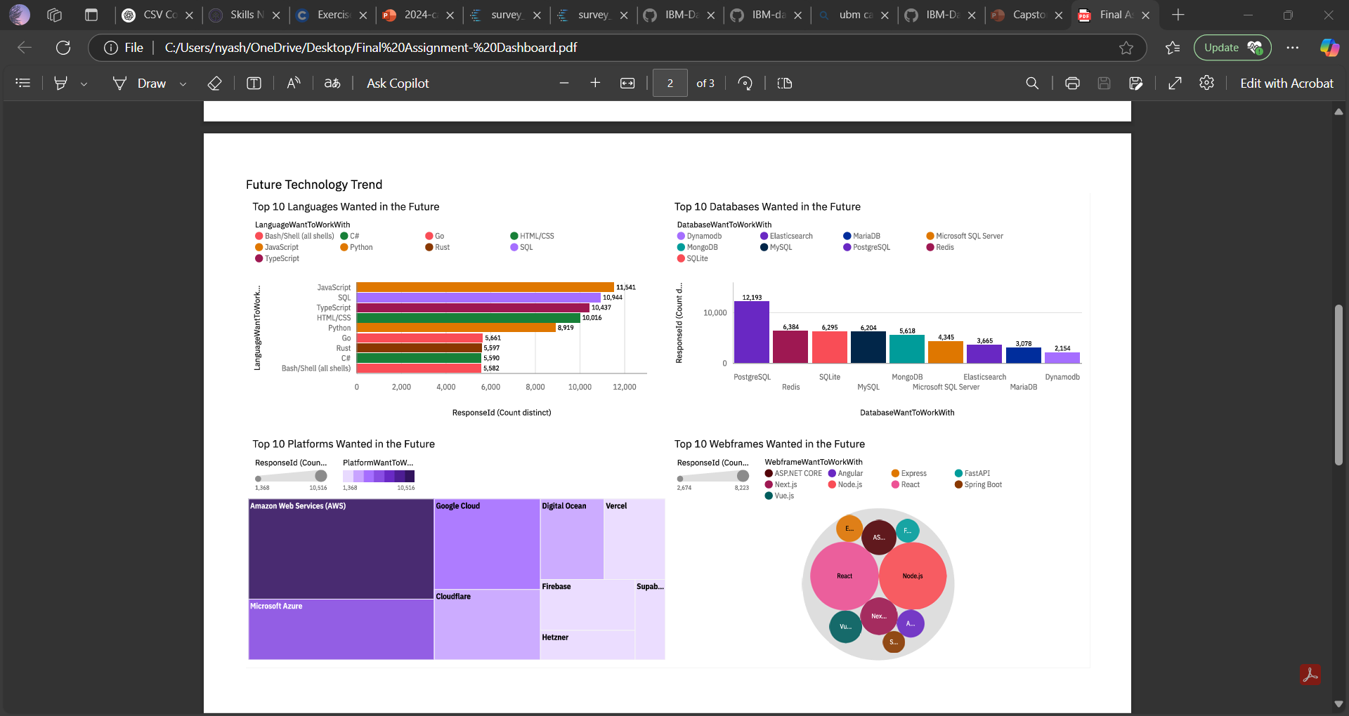
DASHBOARD TAB 2

Slide 13
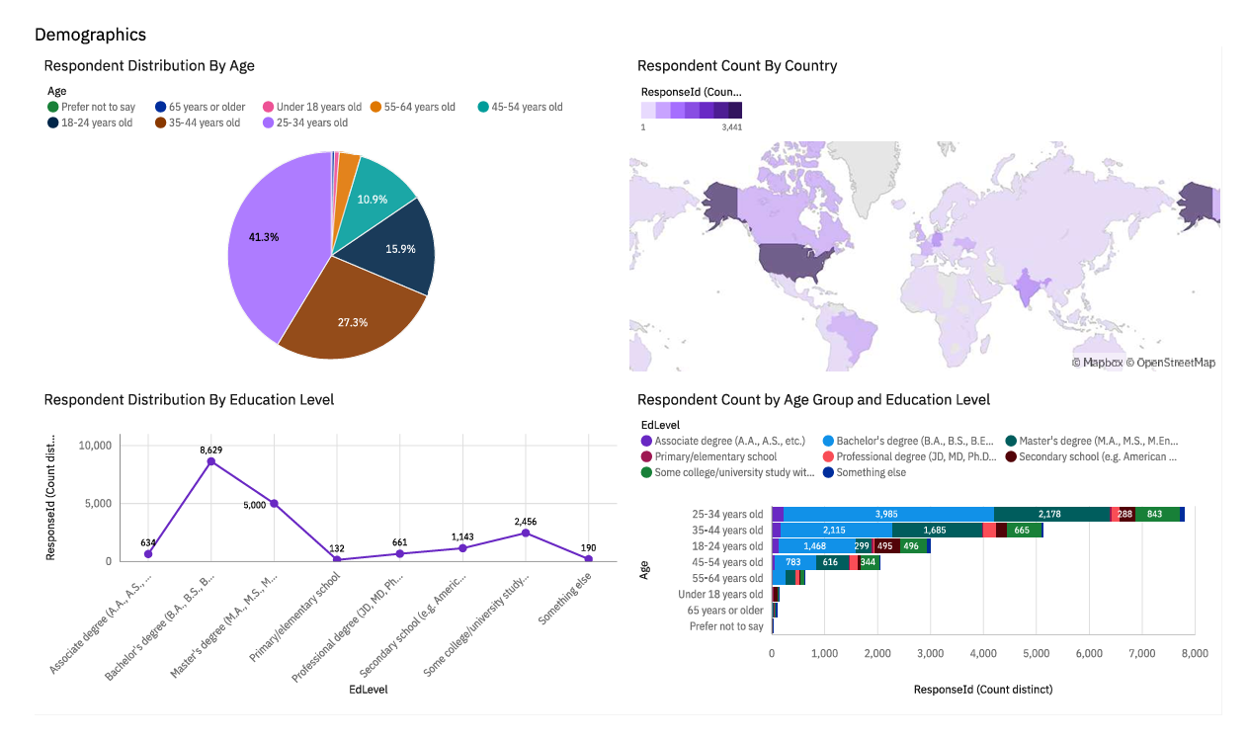
DASHBOARD TAB 3

Slide 14
DISCUSSION
📌 Current Technology Usage
Python, SQL, and JavaScript are the most commonly used programming languages.
MySQL, PostgreSQL, and MongoDB dominate current database usage.
Respondents frequently work with platforms like Windows, Linux, and AWS.
📌 Future Technology Trends
Javascript continues to be a priority for learning in the coming year.
Cloud-oriented databases such as Firebase and Amazon Aurora are gaining popularity.
Developers are showing increased interest in TypeScript, Go, and Kotlin.
📌 Demographics
Most respondents fall within the 25–34 age group, followed by 18–24.
The majority have a Bachelor’s or Master’s degree in a related field.
Participants are primarily located in North America, Europe, and India.

Slide 15
OVERALL FINDINGS & IMPLICATIONS
Key Findings
Python is the dominant language across both current usage and future interest, confirming its versatility and relevance.
Relational databases like MySQL and PostgreSQL remain the industry standard, while NoSQL options like MongoDB are rising in modern use cases.
Developers are increasingly exploring cloud-native platforms and modern tools such as Firebase, TypeScript, and Go.
The majority of respondents are early- to mid-career professionals, largely educated at the bachelor's level and based in tech-forward regions.
Key Implications
Learning Python and SQL is critical for new and existing professionals aiming to stay competitive.
Organizations should invest in cloud technology training and infrastructure, as the demand for scalable, flexible solutions grows.
Hiring strategies can benefit from targeting regions with emerging developer talent and aligning training programs with tech trends.

Slide 16

CONCLUSION
This project provided a data-driven view of the current and future landscape of technology skills and tools.
Key trends indicate a strong shift toward cloud technologies, and flexible database solutions.
Insights from the dashboards help identify where developers are focusing their learning and what organizations should prioritize for growth.
Continued monitoring of developer trends can support smarter hiring, training, and tech adoption strategies.

Slide 17
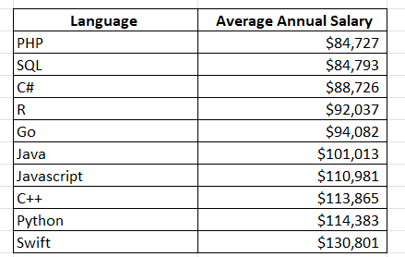

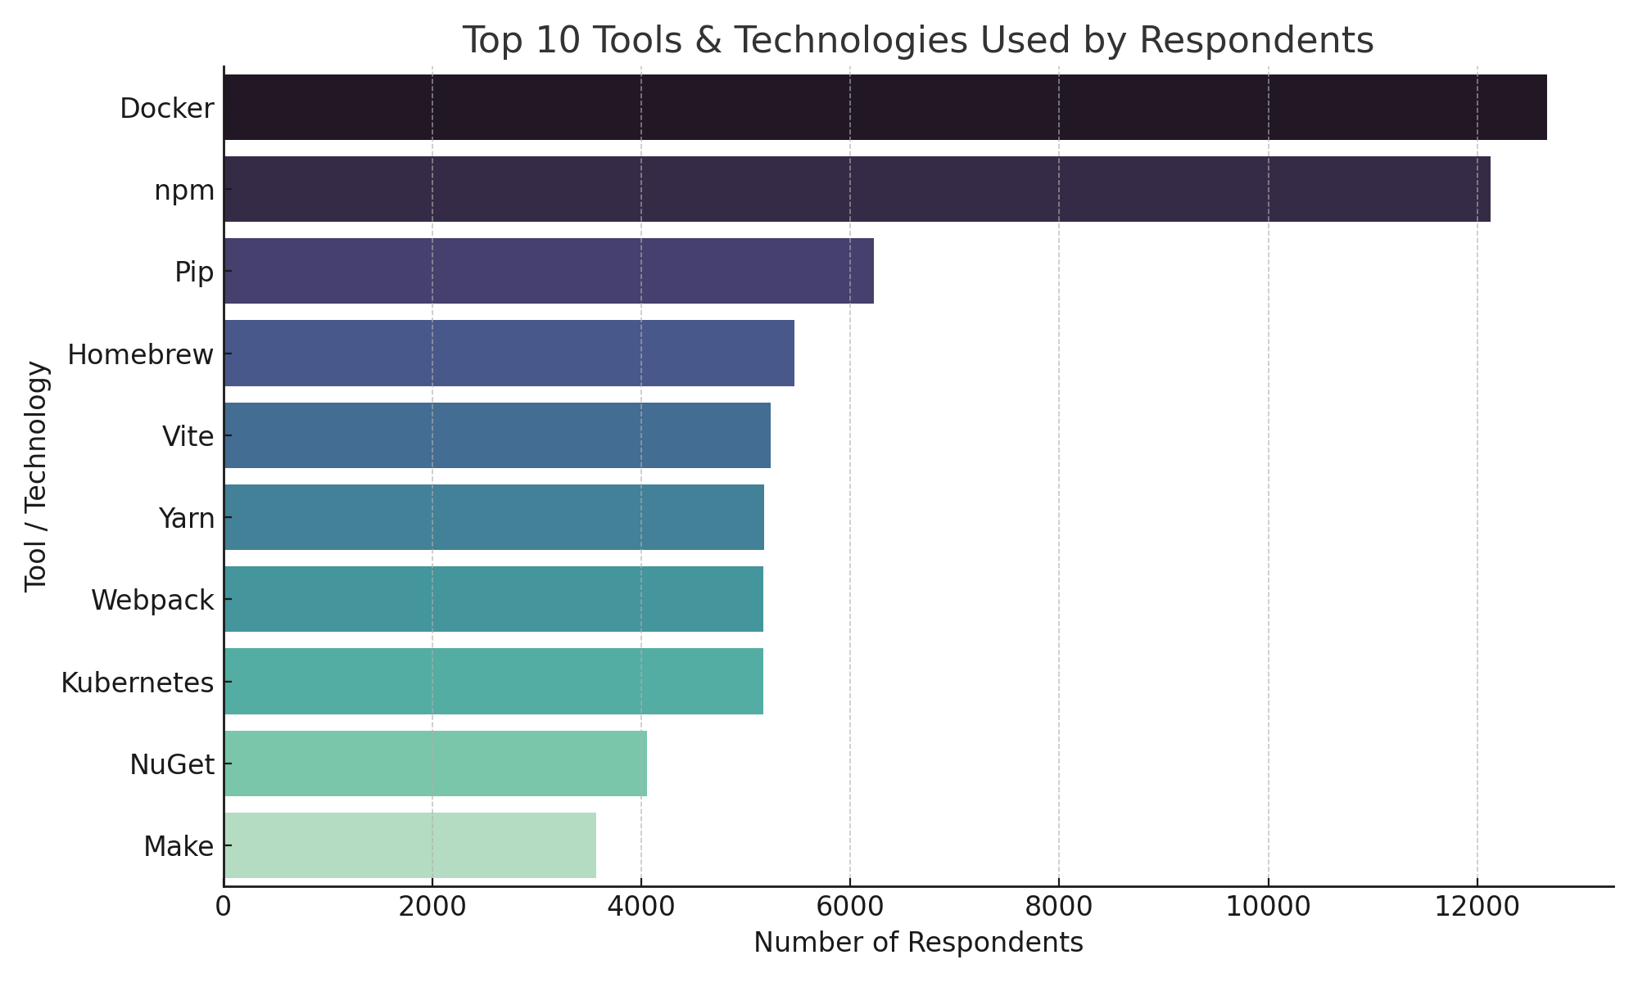
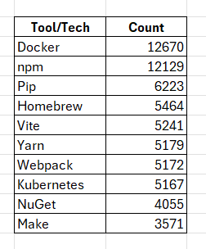
APPENDIX

Slide 18
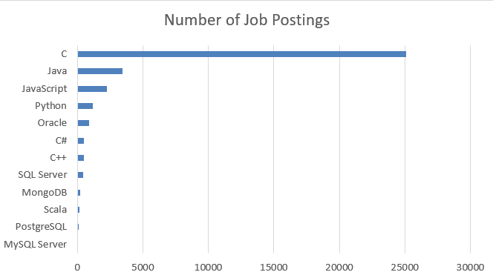
JOB POSTINGS
Job postings data collected using web scraping:

Slide 19
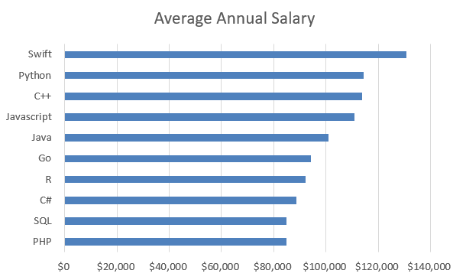
POPULAR LANGUAGES
Popular programming languages and their average salaries:

