Slide 1
Seis 635: Software analysis and design Hotel Checking system
Biniam G Haile Darius O. Nyaundi Elvis A. Ndenge Patrice A. Yemmene Eyad Shes

Slide 2
introduction
This is the final sprint for the third team project
We envisioned, designed and developed a Hotel Checking system (HCS)
Hotel employees may use this system to facilitate the check-in process of their guests, with membership-based priority.
This system is flexible to support varying business rules, a few user interface mechanisms (Front Desk, Housekeeping, and Reservation Services) and integration with third party systems
We followed the Unified Process

Slide 3
Summary of system features
System designed for hotel operations.
Guests will be checked in by the FrontDesk (worker) who will coordinate with housekeeping (worker) to insure the rooms are cleaned and ready for occupancy through the system.
RoomService will check minibar in room and enters minibar status in system as well.

Slide 4
Summary of system features
Once rooms are clean and minibar restocked, FrontDesk will check each Guest club-status (gold, silver or none- member) and assign rooms by priority.
If the room is not clean the Guest will have to wait based on priority status. There will be interactions between the <<Patrons>> <<FrontDesk>> <<RoomService>>and <<housekeeping>>.
There is also interface so that each of the users <<Patron>> <<FrontDesk>> <<RoomService>>and <<housekeeping>> may interact with each other via the system as well

Slide 5
Central Use case 1
HCIR: Patron Check In Room
Scope: Hotel reservations: Check-In Patron.
Level: User Goal
Primary Actor: FrontDest
Preconditions:
FrontDesk has logged in to the System. Patron must have confirmation number after previously reserving online. System has Patron’s reservation already stored in with name and confirmation number. Rooms must be clean and minibar must be restocked. Also the Patron must have priority status.
Success Guarantee (Post Condition):
Patron has a reservation already in the system and a confirmation number. Room is Vacant, clean and Minibar is restocked. Priority by membership is honored.

Slide 6
Central Use case 1
Success Guarantee (Post Condition):
Patron is out of room and checked out with front desk. MiniBar is restocked and rooms are vacant and clean. All MiniBar restocking fees are paid.
Main Success Scenario (Basic Flow):
Patron leaves the room.
HouseKeeping checks room occupancy.
HouseKeeping marks the room as Vacant Dirty (VD) in system once patron leaves.
InRoomDinning checks MiniBar in Room.
InRoomDinning marks MiniBar Not Restocked (MBNR) in System once Patron leaves Room.
Extensions (Alternative Flow):
Patron does not leave the Room so that Room is still Occupied (OC).
UCOR: Patron Check Out Room
Scope: Hotel reservations: Check-Out Patron.
Level: User Goal
Primary Actor: Patron
Preconditions:
HouseKeeping Checks if Room is occupied. FrontDesk Logs into system to check if room is occupied. Patron must leave room or will be charged for another night.

Slide 7
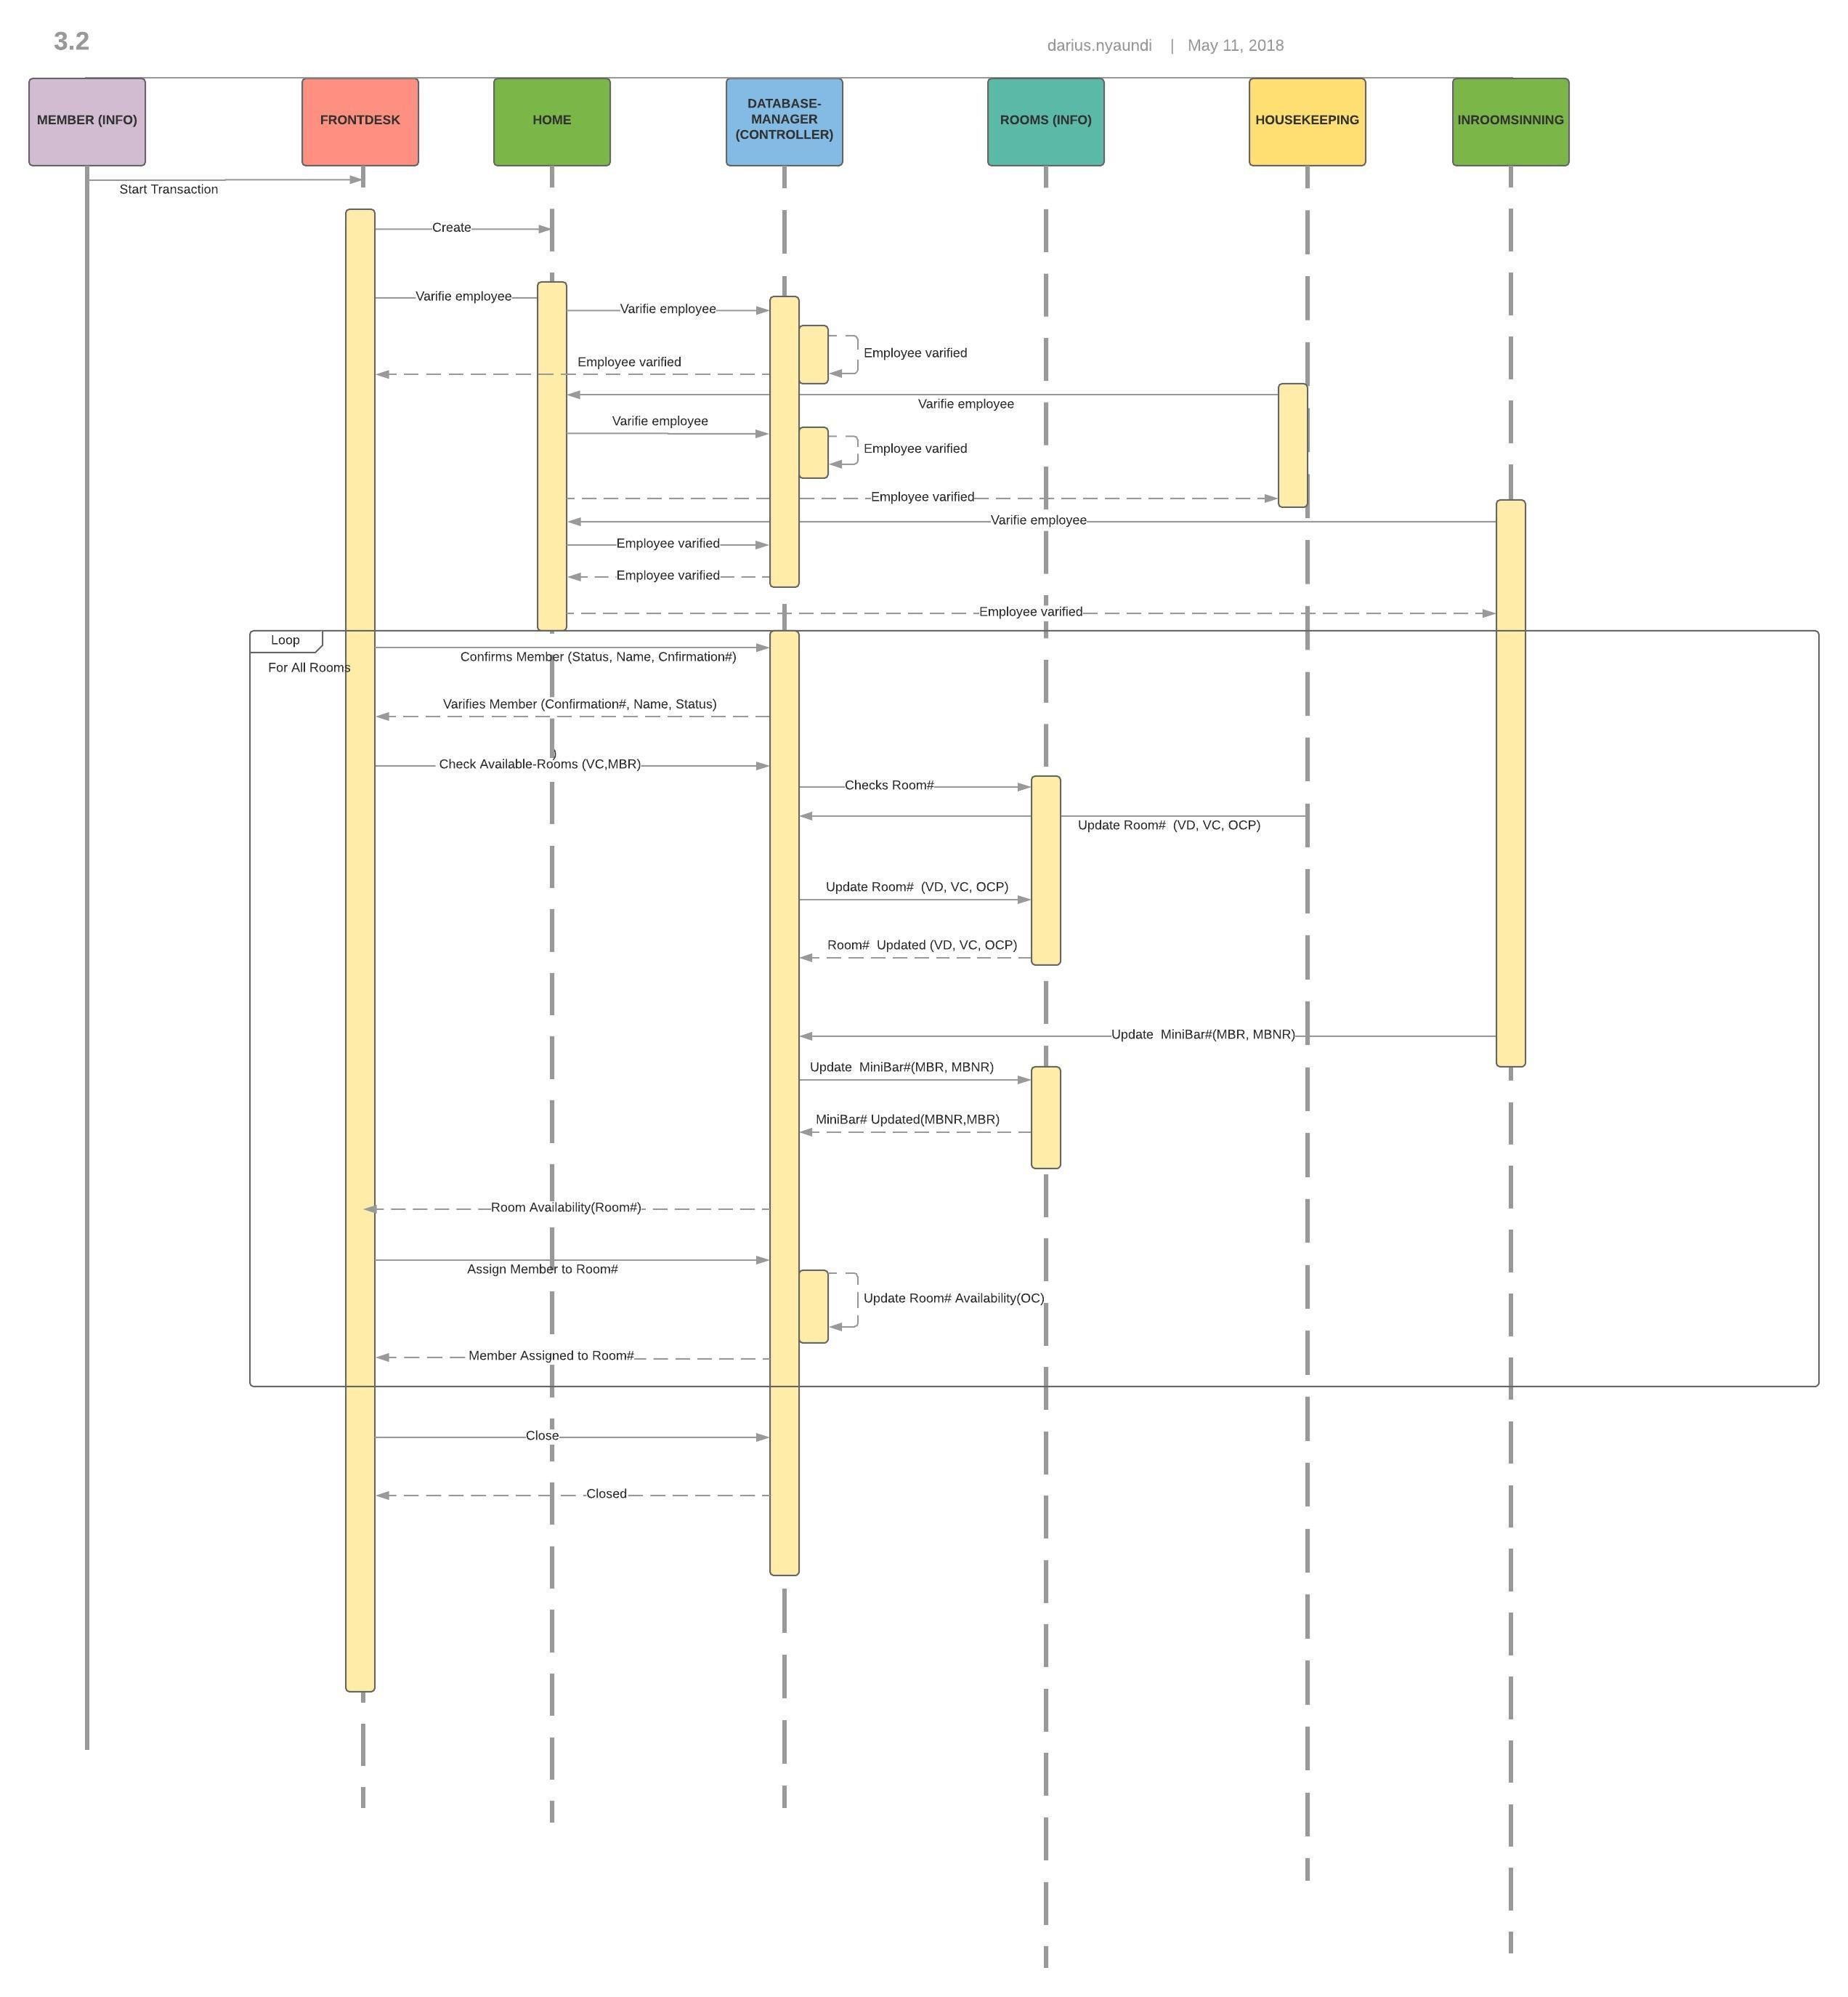
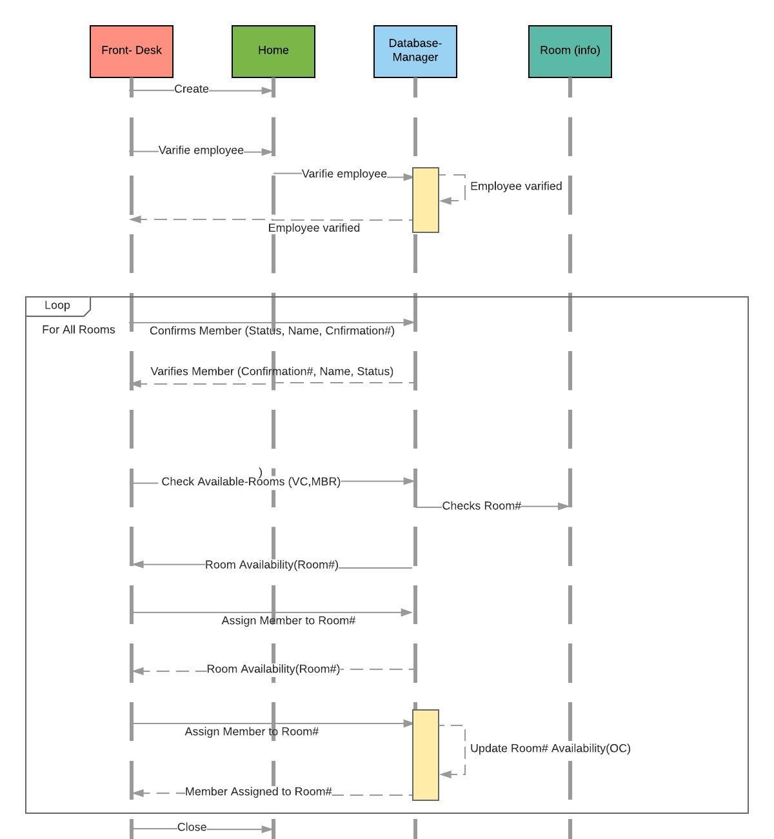
System sequence diagram

Slide 8
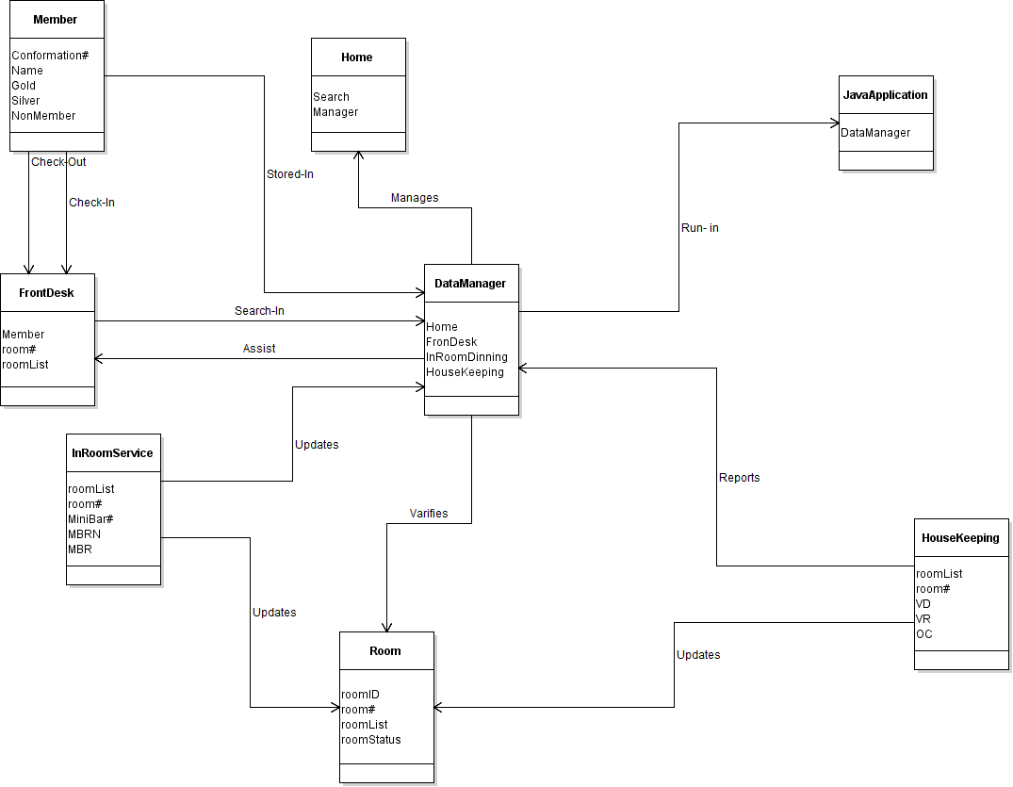
Domain class diagram

Slide 9
Reverse engineered Class Diagram

Slide 10
One code smell
Before
After

