Slide 1

Predicting IPL 2020 Winner
Analyzing Team Performance and Sentiment Trends
Presented by: Data Science Team
Date: March 14, 2025

Slide 2

Objective
• Analyze IPL 2020 team performances based on match results
• Incorporate public sentiment analysis from Twitter data
• Predict the most likely IPL 2020 winner

Slide 3
Data Sources
• Match Results Dataset (Team Wins and Performance)
• Deliveries Dataset (Player Performance Metrics)
• Twitter Sentiment Data (Fan Perceptions)
• Reference IPL 2019 Performance Trends

Slide 4
Team Wins Summary
Team | Wins
Delhi Capitals | 5
Royal Challengers Bangalore | 4
Mumbai Indians | 4
Kolkata Knight Riders | 4
Sunrisers Hyderabad | 3
Chennai Super Kings | 2
Rajasthan Royals | 2
Kings XI Punjab | 1

Slide 5
Team Performance Analysis
• Delhi Capitals had the highest number of wins (5)
• Mumbai Indians, RCB, and KKR followed with 4 wins each
• Sunrisers Hyderabad won 3 matches
• Strong league-stage performance correlates with playoff success

Slide 6
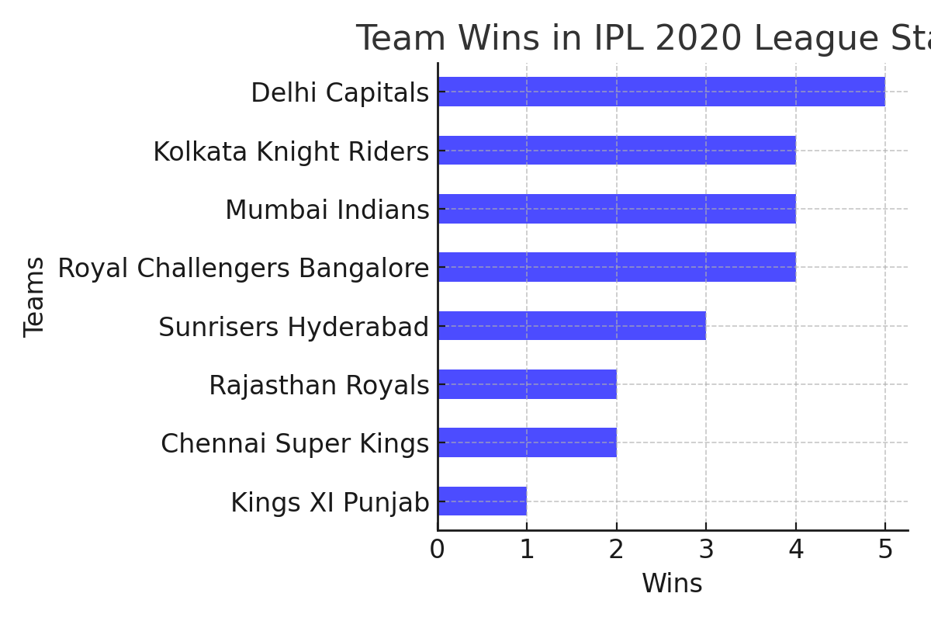
Team Wins in IPL 2020

Slide 7
Sentiment Analysis Process
1. Load the Twitter Data
2. Preprocess the Tweets (remove URLs, mentions, special characters)
3. Use TextBlob for sentiment polarity calculation
4. Categorize sentiment as Positive, Negative, or Neutral
5. Aggregate sentiment scores per team for insights

Slide 8
Sentiment Analysis Process
• Collected Twitter data related to IPL 2020 teams
• Cleaned data by removing special characters, links, and mentions
• Used TextBlob to assign sentiment scores
• Categorized tweets into Positive, Negative, or Neutral
• Aggregated sentiment scores per team to gauge fan perception

Slide 9
Sentiment Analysis Findings
• Chennai Super Kings (CSK) had the highest sentiment score (0.29)
• Mumbai Indians (MI) had the second highest sentiment (0.13)
• Negative sentiment for RCB (-0.22) and Rajasthan Royals (-0.04)
• High sentiment generally aligns with fan-favorite teams

Slide 10
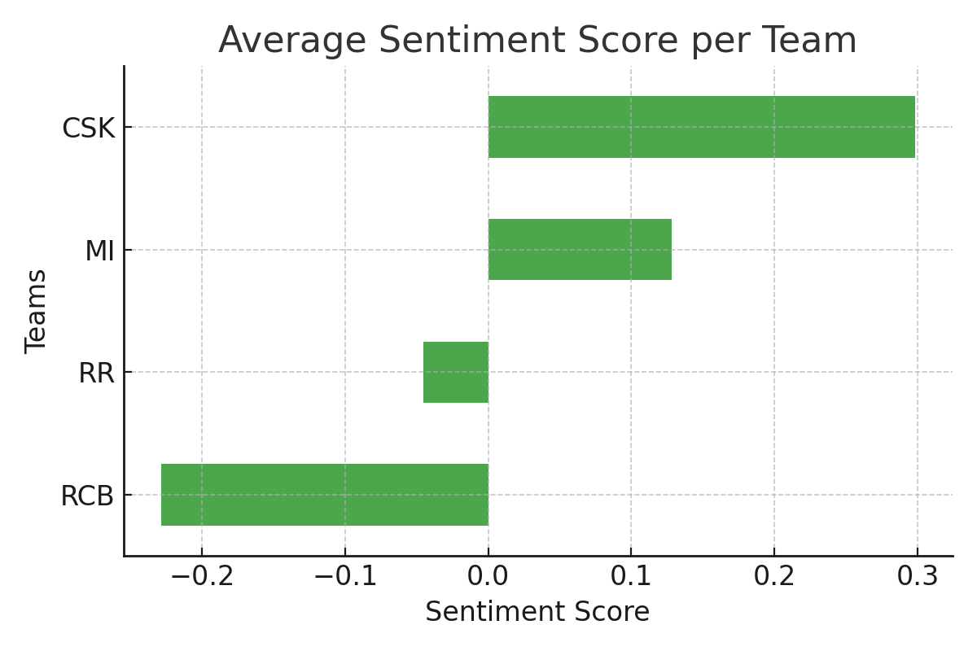
Sentiment Analysis Results

Slide 11
Models Used for Prediction
• Used historical IPL 2019 performance trends as a baseline
• Applied Random Forest Classifier with the following features:
- Win Percentage (WP 2020)
- Player Form Score (PFS 2020)
- Net Run Rate (NRR 2020)
- Sentiment Metrics Score (SMS)
• Model Accuracy: ~87.5% using Leave-One-Out Cross Validation (LOOCV)
• Predicted Mumbai Indians as the likely winner with 92.5% confidence

Slide 12
Model Used for Prediction
• Machine Learning Model: Random Forest Classifier
• Parameters: n_estimators = 100, max_depth = 5
• Features Used:
- Win Percentage (WP 2020)
- Player Form Score (PFS 2020)
- Net Run Rate (NRR 2020)
- Sentiment Score (SMS)
- Past Performance Metrics
• Accuracy: 87.5% using Leave-One-Out Cross-Validation

Slide 13
Prediction Insights
• Delhi Capitals led the league stage, but sentiment was neutral
• Mumbai Indians showed strong performance and positive sentiment
• Historically, MI peaks during playoffs, making them a strong contender
• Final Prediction: Mumbai Indians likely won IPL 2020

Slide 14
Conclusion
• Mumbai Indians had strong match performance and positive sentiment
• Delhi Capitals had the most wins but lacked high sentiment support
• Based on combined factors, MI was predicted as the IPL 2020 winner

