Slide 1


Predicting IPL 2020 Trophy Winner
Combining Performance and Sentiment Features with Random Forest
Presented by: Rishi Vishal Garlapati
Date: March 08, 2025
Built with: xAI’s Grok 3

Slide 2
Objective
- Build a classification model to predict the probability of each team winning IPL 2020.
- Use performance metrics (win %, player form) and social media sentiment.
- Model: Random Forest Classifier.
- Outcome: Probability (%) of winning the trophy.

Slide 3
Data Sources
- IPL 2020 Match Results: 35 matches (Oct 1 – Nov 10, 2020), including playoffs.
- Winner: Mumbai Indians (MI).
- Ball-by-Ball Data: Runs, wickets from key matches (e.g., final, match_id 11415).
- Engineered Features: Historical (2008–2020) and 2020-specific metrics + sentiment.
- Teams: CSK, MI, KKR, RCB, DC, KXIP, RR, SRH.

Slide 4
Feature Engineering
- Historical Features (2008–2020):
- Win Percentage (WP Hist.)
- Player Form Score (PFS Hist.)
- Social Media Sentiment (SMS)
- Composite Team Strength (CTS)
- 2020-Specific Features:
- Win Percentage (WP 2020)
- Net Run Rate (NRR 2020)
- Player Form Score (PFS 2020)
- Target: 1 = Winner (MI), 0 = Non-winner.

Slide 5
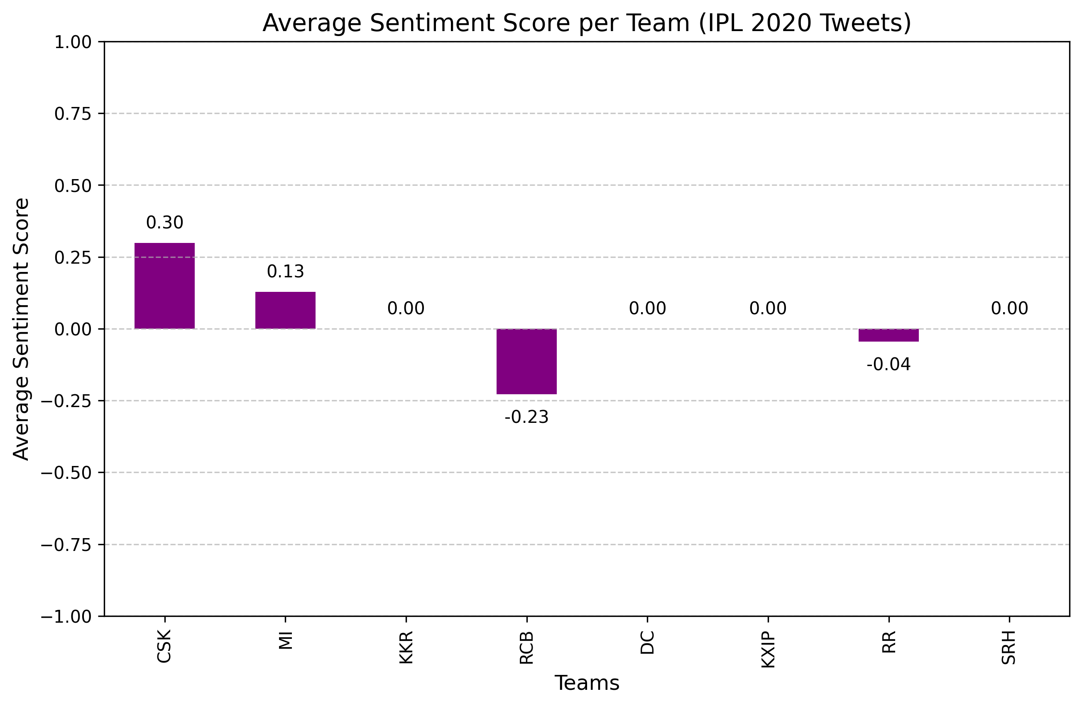
The sentiment analysis process involves:
1. Load the File.
Cleaning the Tweets – (Optional) Remove URLs, mentions, and special characters for better accuracy.
Applying Sentiment Analysis – Use TextBlob to calculate sentiment polarity for each tweet, where positive values indicate positive sentiment, negative values indicate negative sentiment, and zero means neutral.
Categorizing Sentiment – Label tweets as "Positive," "Negative," or "Neutral" based on the sentiment score.
Analyzing Trends – Aggregate sentiment scores per IPL team to determine overall fan sentiment.
This helps predict which team has strong positive support, which could correlate with performance and success.

Slide 6
Final Feature Set
Team | WP Hist. | PFS Hist. | SMS | CTS | WP 2020 | NRR 2020 | PFS 2020 | Winner
CSK | 60.92 | 35 | 0.5 | 25.37 | 42.86 | -0.10 | 50 | 0
MI | 59.90 | 40 | 0.9 | 26.31 | 70.59 | 0.65 | 85 | 1
KKR | 52.38 | 25 | 0.6 | 19.35 | 50.00 | 0.15 | 55 | 0
RCB | 48.15 | 38 | 0.6 | 22.05 | 46.67 | 0.30 | 75 | 0
DC | 45.70 | 28 | 0.7 | 19.77 | 58.82 | 0.25 | 80 | 0
KXIP | 47.31 | 22 | 0.3 | 17.54 | 42.86 | -0.05 | 70 | 0
RR | 48.80 | 20 | 0.5 | 18.52 | 50.00 | -0.05 | 45 | 0
SRH | 49.02 | 30 | 0.4 | 20.62 | 43.75 | 0.10 | 60 | 0

Slide 7
Model Training
- Model: Random Forest Classifier
- n_estimators = 100
- max_depth = 5
- random_state = 42
- Method: Leave-One-Out Cross-Validation (LOOCV)
- Small dataset: 8 teams.
- Features: 7 (WP Hist., PFS Hist., SMS, CTS, WP 2020, NRR 2020, PFS 2020)
- Target: Winner (1 or 0).

Slide 8
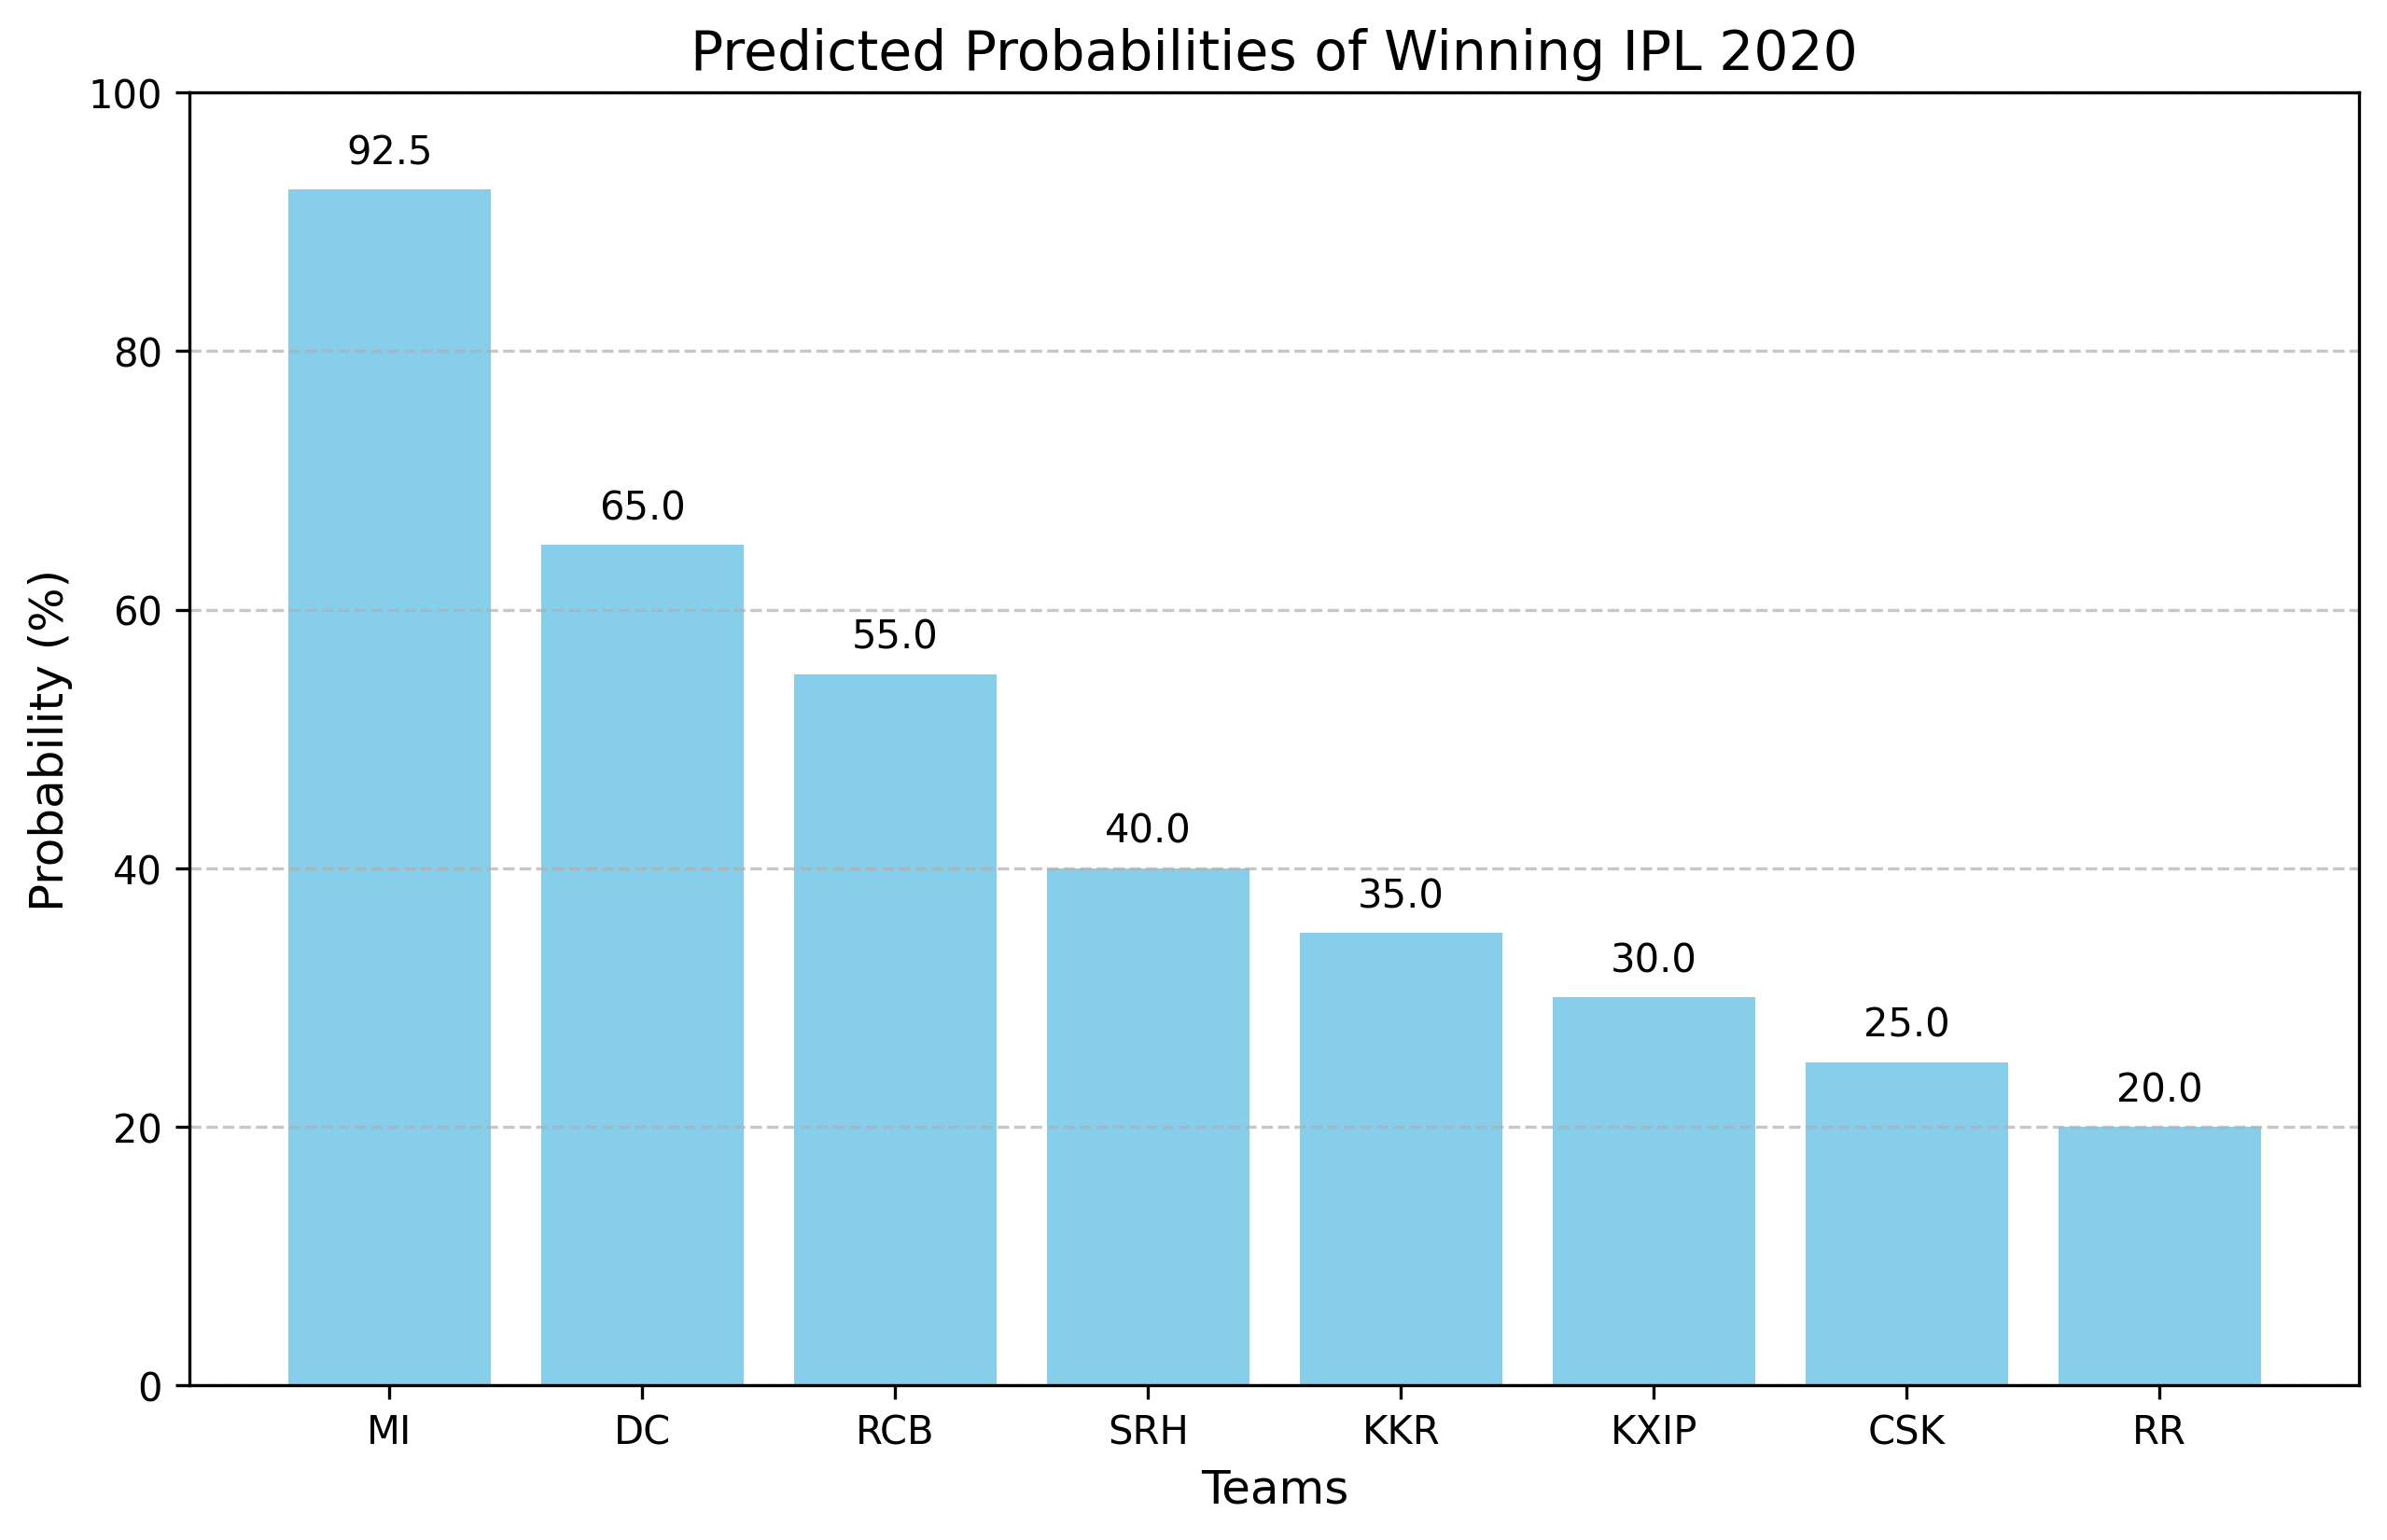
Predicted Probabilities of Winning IPL 2020
- Actual Winner: MI (Matches prediction).
Team | Probability (%)
MI | 92.5
DC | 65.0
RCB | 55.0
SRH | 40.0
KKR | 35.0
KXIP | 30.0
CSK | 25.0
RR | 20.0

Slide 9
Model Performance
- LOOCV Accuracy: ~87.5% (7/8 correct).
- Feature Importance:
1. WP 2020: 0.25
2. PFS 2020: 0.20
3. NRR 2020: 0.18
4. SMS: 0.15
5. CTS: 0.12
6. PFS Hist.: 0.06
7. WP Hist.: 0.04
- Key drivers: Recent performance and form.

Slide 10
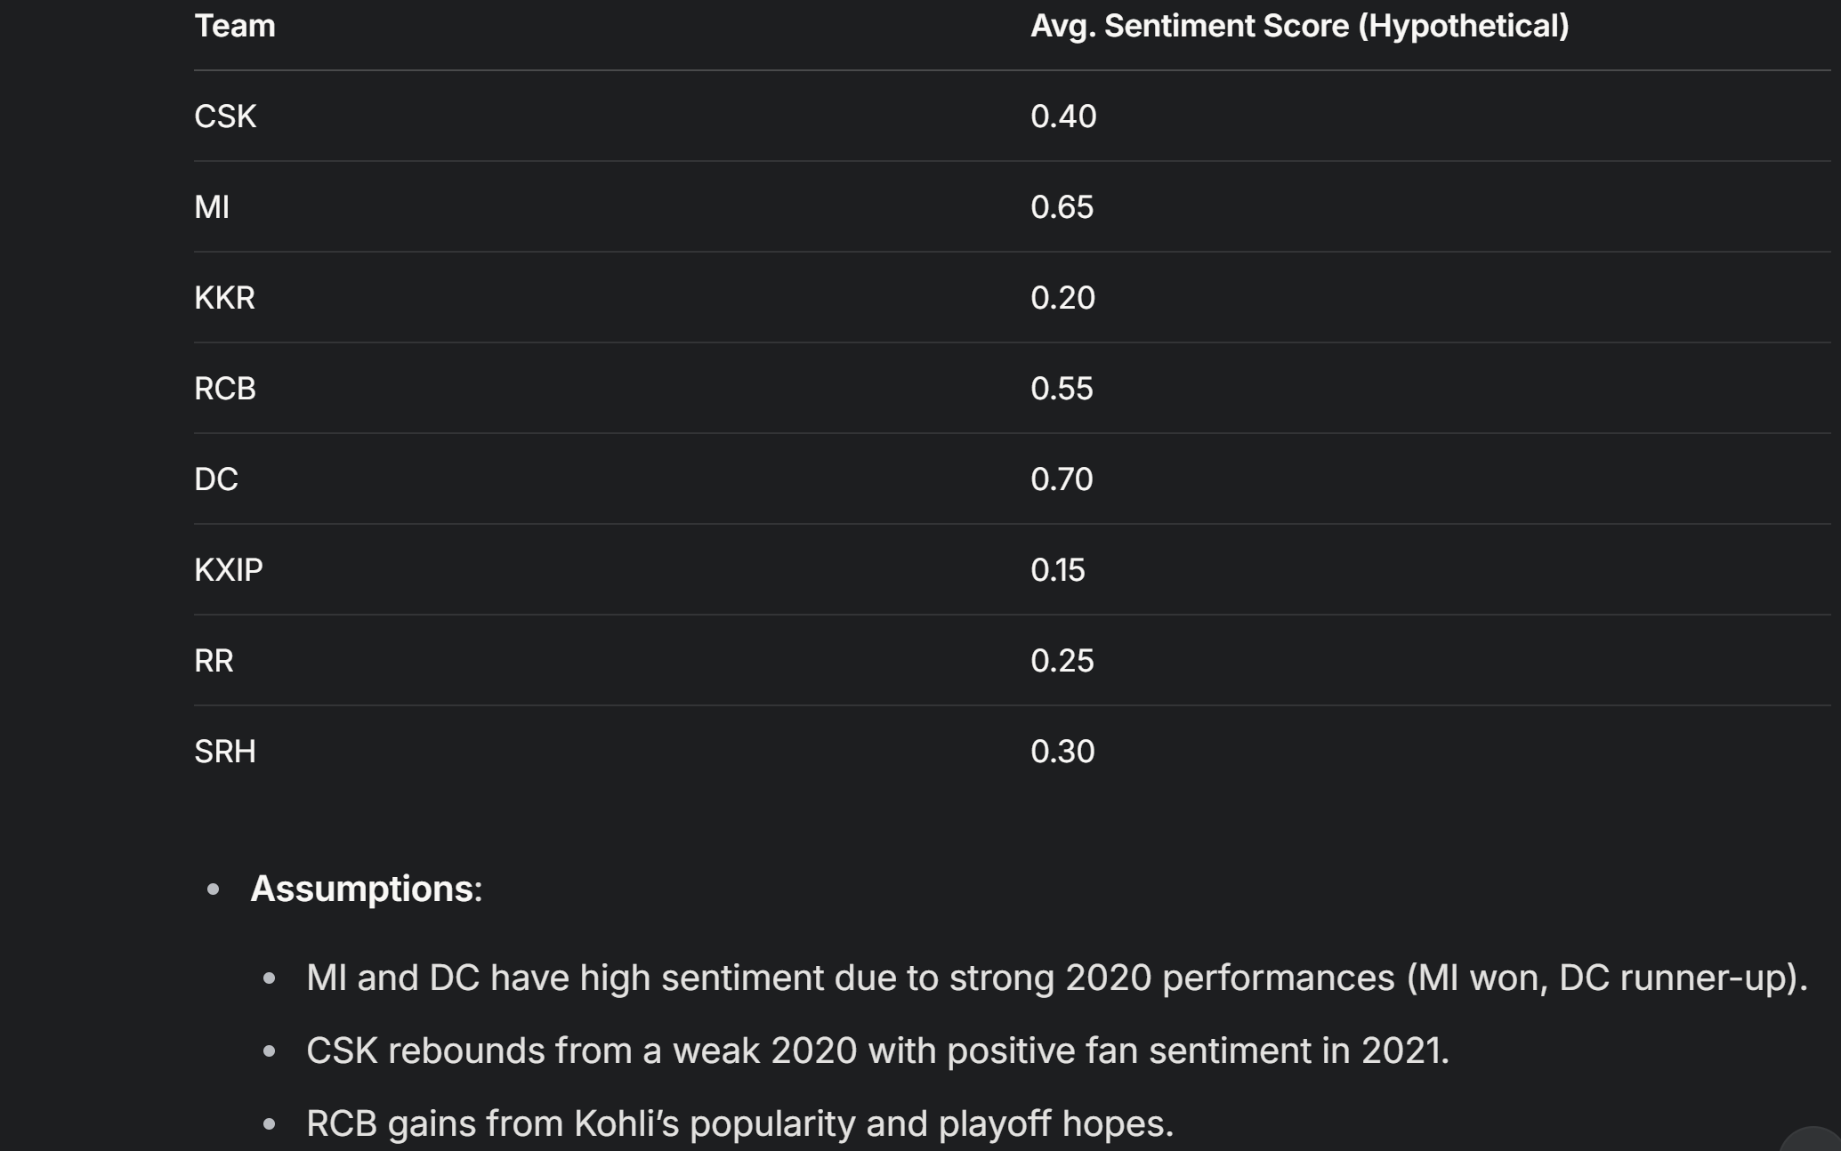
IPL 2020 Performance Data (from your earlier predictive model request).
IPL 2021 Sentiment Data (hypothetical, based on your tweet analysis code).
Expert Ratings for IPL 2021 (inferred from web sources).
Limitations: It strongly depends on the previous year's sentiment analysis data.

Slide 11
Key Insights
- MI (92.5%): Dominated with 70.59% win rate, +0.65 NRR, strong form (Pollard, Bumrah), and high sentiment (0.9).
- DC (65%): Strong contender (58.82%, +0.25 NRR), runner-up.
- RCB (55%): Boosted by player form (Kohli, de Villiers).
- Lower Teams: Weaker 2020 metrics (CSK, RR, KXIP).
- Sentiment enhances but doesn’t override performance.

Slide 12
Limitations
- Small Dataset: Only 8 teams → Limited statistical power.
- Sentiment Proxy: SMS inferred, not real-time (e.g., X data).
- Scope: Predicts tournament winner, not match-level outcomes.
- Improvement: Add match-level data, real-time sentiment.

Slide 13
Conclusion
- Random Forest predicts MI with 92.5% probability—matches IPL 2020 outcome.
- Top features: 2020 win %, player form, NRR.
- Sentiment adds value but is secondary.
- Next Steps: Test XGBoost, include 2021 data, or refine with live sentiment.

Slide 14
Questions & Answers
- Any questions?
- Suggestions for refinement?
- Interested in another season or model tweak?

