Slide 1

Air Quality

Slide 2
Why
Air pollution is a leading cause of death across the globe, and contributes to stroke, heart disease, lung cancer, and other respiratory illness.

Slide 3
How are we doing?
Data collected from year 1980 to present by EPA (Environment Protection Agency)
Data collected through the sensors
Downloaded the daily data between year 1980 – 2015 for New York tri-state area.
From 1980 to now, air quality getting better or worse?

Slide 4
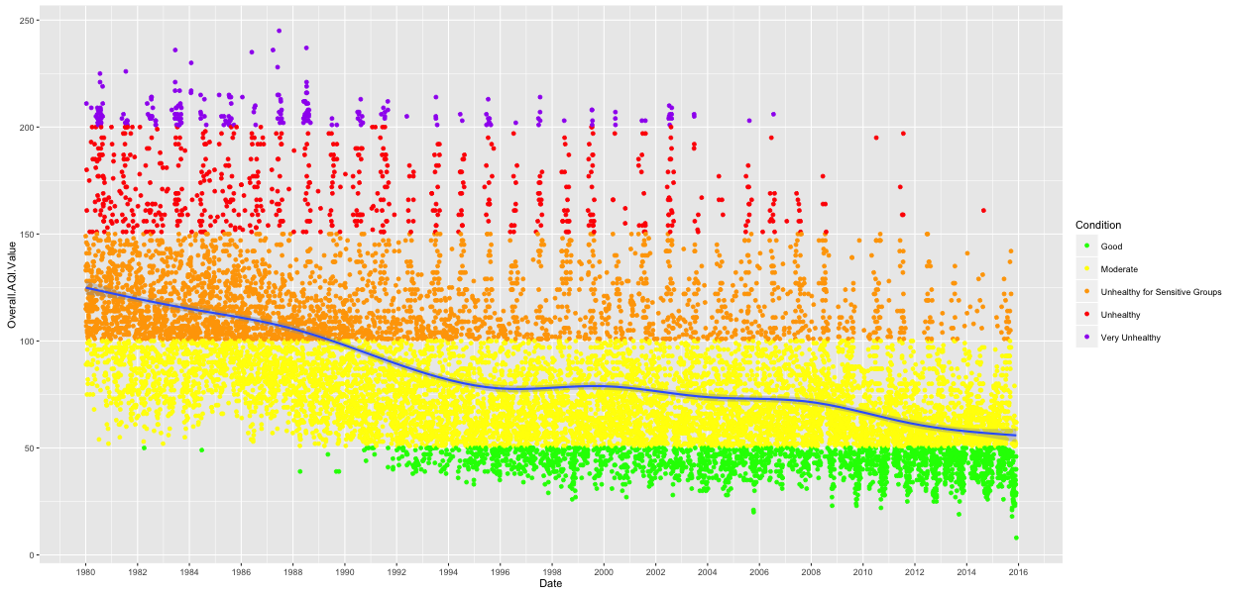
Air Quality Overview

Slide 5
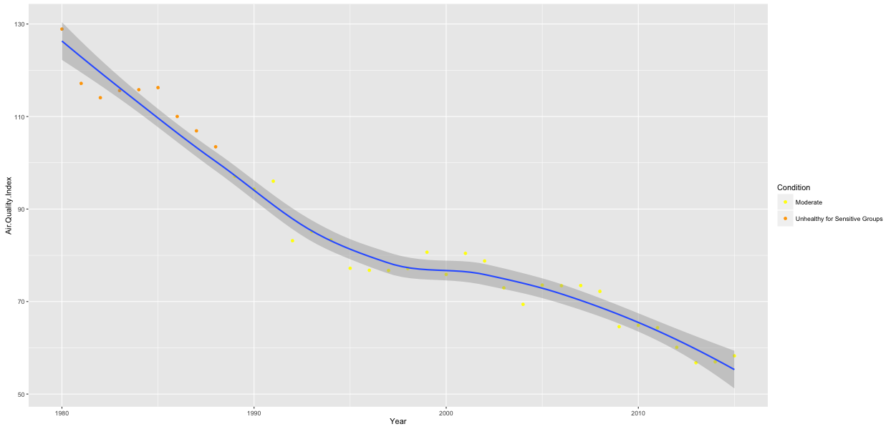
Air Quality is Better?
Clean Air Act (1963)

Slide 6
Air Quality Index
EPA calculates the AQI for five major air pollutants regulated by the Clean Air Act:
  Ozone
  PM (Particle pollution or particulate matter)
  CO (carbon monoxide)
  SO2 (sulfur dioxide)
  NO2 (nitrogen dioxide)
Overall AQI = max(Ozone, PM10, PM25, CO, SO2, NO2)

Slide 7
Sample Data
Date | Main Pollutant | Overall AQI Value | CO | SO2 | NO2 | Ozone | PM10 | PM25
01/01/2010 | PM2.5 | 86 | 16 | 41 | 46 | 26 | 0 | 86
01/02/2010 | PM2.5 | 45 | 13 | 14 | 18 | 27 | 19 | 45
01/03/2010 | PM2.5 | 50 | 13 | 14 | 21 | 28 | 0 | 50
01/04/2010 | PM2.5 | 60 | 13 | 19 | 28 | 28 | 0 | 60
01/05/2010 | PM2.5 | 54 | 13 | 23 | 33 | 29 | 0 | 54
01/06/2010 | PM2.5 | 51 | 11 | 20 | 26 | 29 | 0 | 51
01/07/2010 | PM2.5 | 59 | 13 | 19 | 42 | 29 | 0 | 59
01/08/2010 | PM2.5 | 70 | 19 | 23 | 35 | 30 | 18 | 70

Slide 8
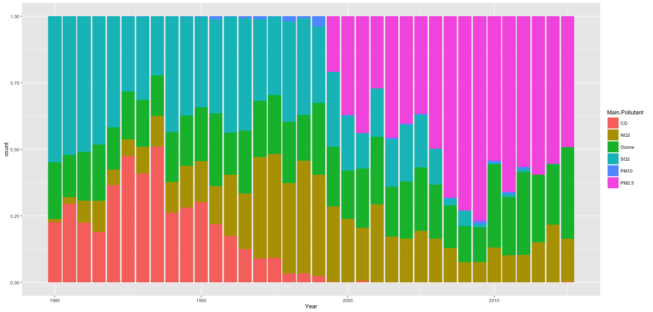
Bad Guys:
Ozone and Airborne Particles

Slide 9
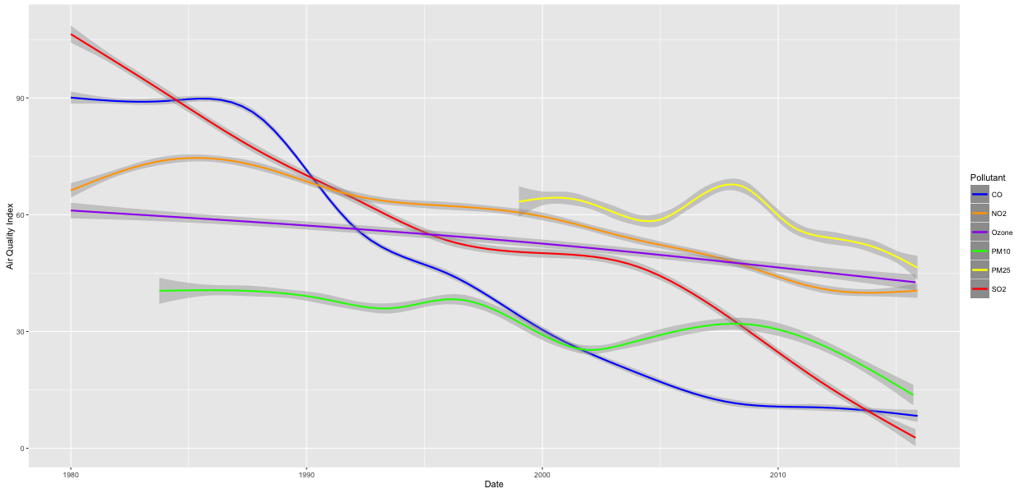
Individual Pollutant

Slide 10
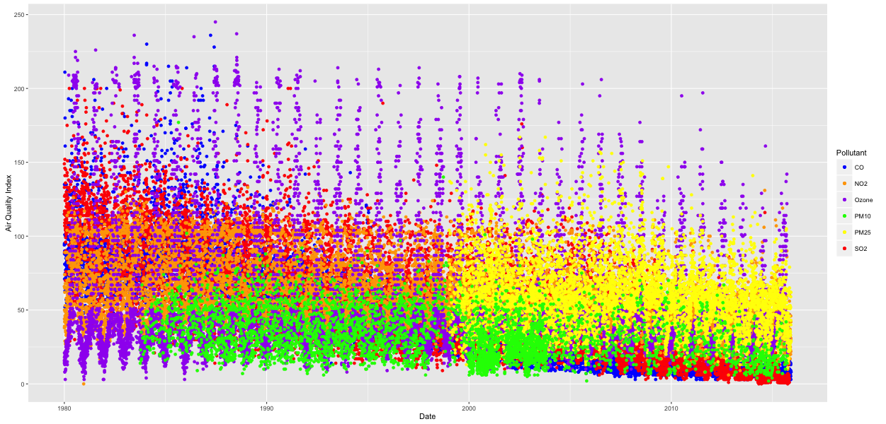
Individual Pollutant

Slide 11
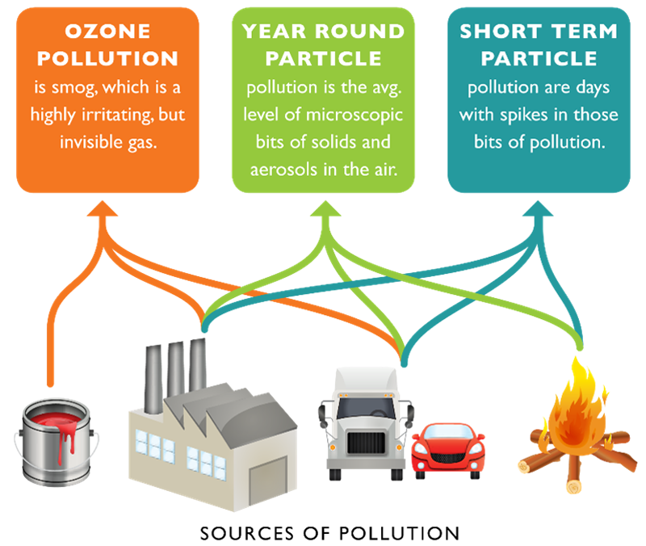
Sources of Pollution

Slide 12
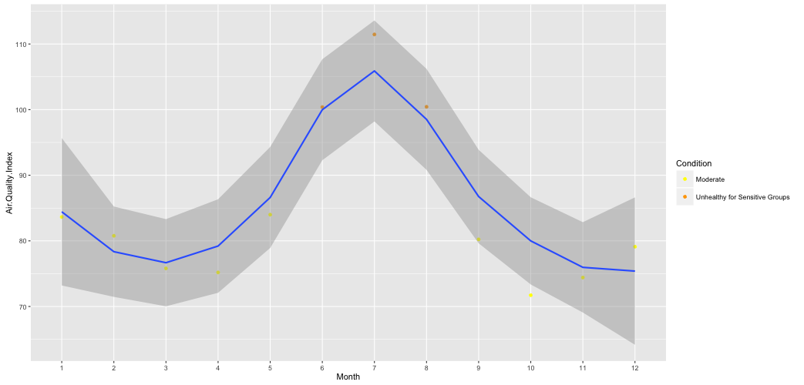
Bad Months

Slide 13
September 11, 2001
Air Quality of Manhattan on and after September 11, 2001?

Slide 14
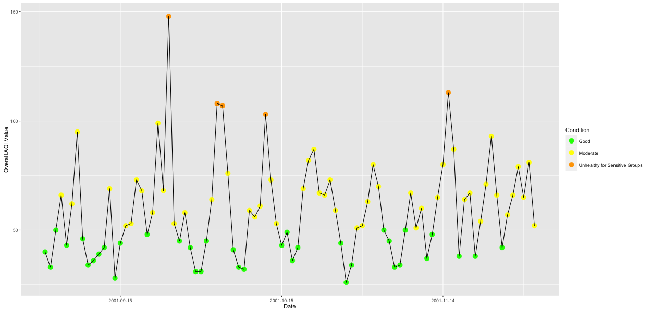
Surprise?!

Slide 15
September 11, 2001
EPA underestimated the toxicity of the air
WTC dust included asbestos and disturbingly high PH levels

Slide 16
Our Future
Assumption: statistically, in the past 3 years, AQI is acceptable and stable.
Make a difference: drive less, use less electricity, don't burn wood or trash, support measures in your community that can cut air pollution, etc.

Slide 17
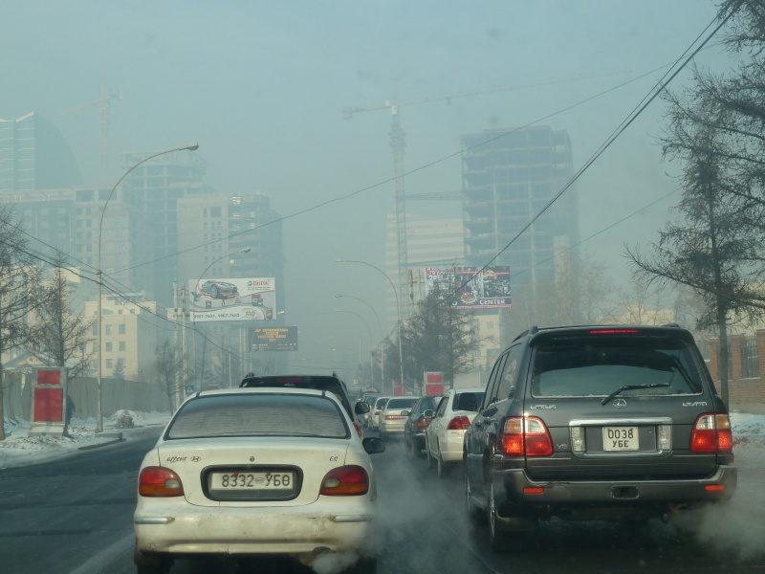
Save the World
Air quality continues to worsen in cities across the world

