Slide 1

EDA

Slide 2
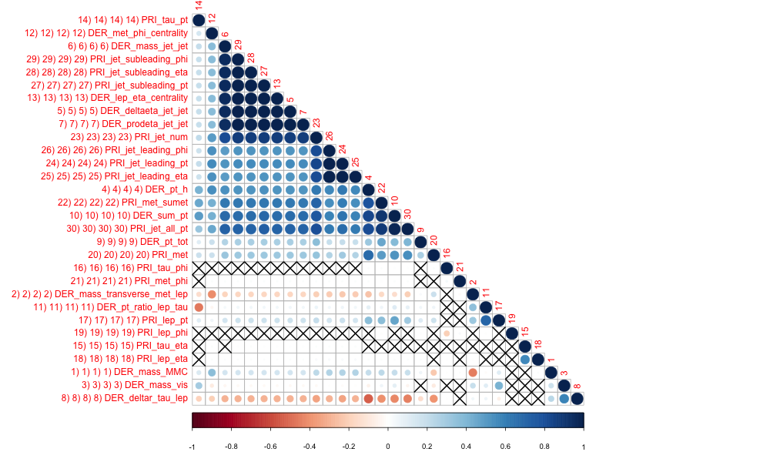
Statistically Significant Correlation Among Features

Slide 3
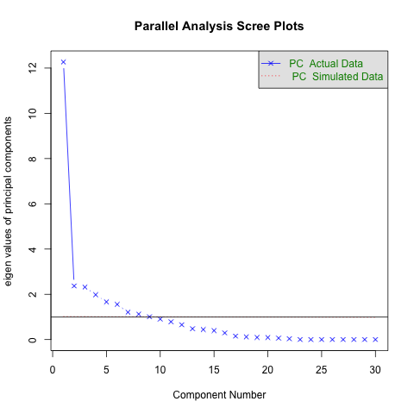
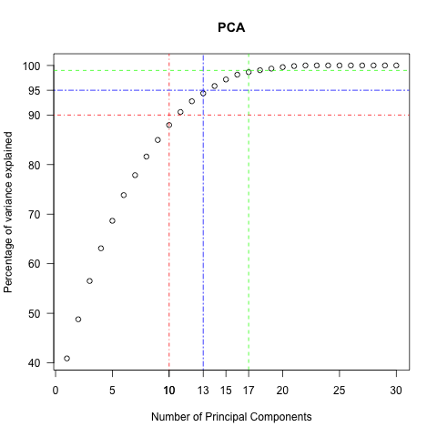
10 PCA Components Account for 90 % of Variance

Slide 4
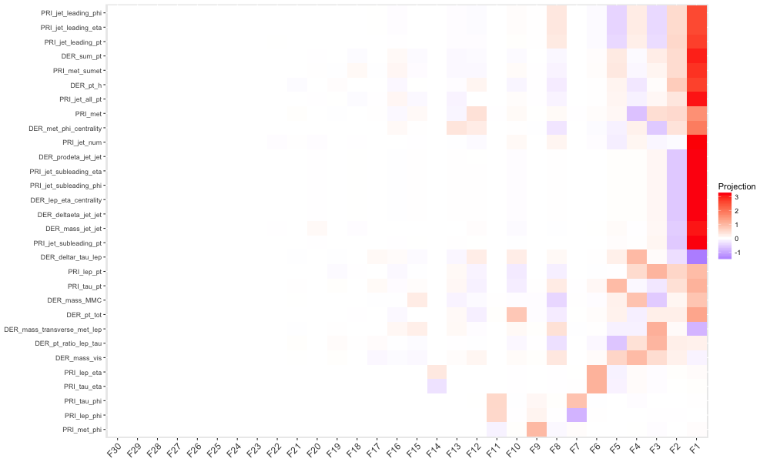
PCA Feature Vectors used to reduce number of features

Slide 5
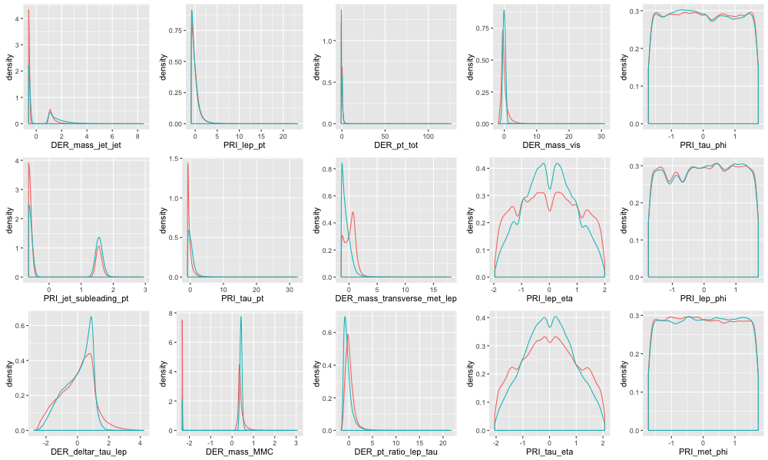
Least Influential Features cannot distinguish “s” from “b”

Slide 6
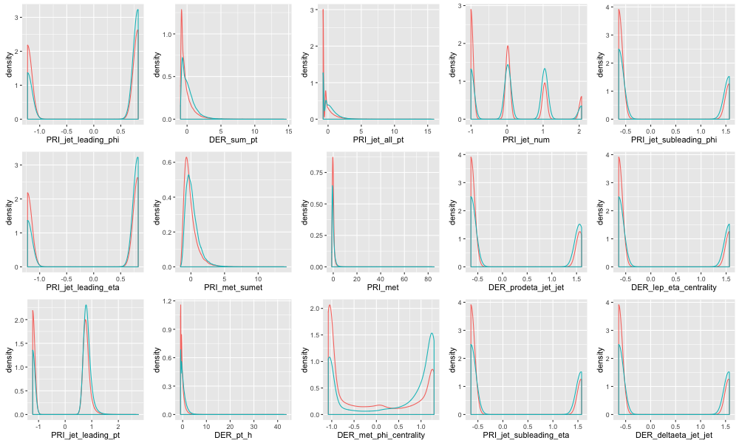
Higher weighted Variance can distinguish “s” and “b”

Slide 7
Undefined Variables by Jet No.
All Jets (0,1,2,3)
1 15.2456 1 DER_mass_MMC
No Jet and 1 Jet (0,1)
5 70.9828 5 DER_deltaeta_jet_jet
6 70.9828 6 DER_mass_jet_jet
7 70.9828 7 DER_prodeta_jet_jet
8 70.9828 13 DER_lep_eta_centrality
9 70.9828 27 PRI_jet_subleading_pt
10 70.9828 28 PRI_jet_subleading_eta
11 70.9828 29 PRI_jet_subleading_phi
No Jets(0)
2 39.9652 24 PRI_jet_leading_pt
3 39.9652 25 PRI_jet_leading_eta
4 39.9652 26 PRI_jet_leading_phi

Slide 8
EDA Insights
Last 5 variables in PCA feature plots have least influence in their current form
Remove all derived features (13) + above features (5) and use SVM and Neural Networks
Split training and test data into six categories according to level of undefined features

