Slide 1
KnoWhere
An App for Automatically Profiling your Commute using Smart Phone Sensor Data

Slide 2
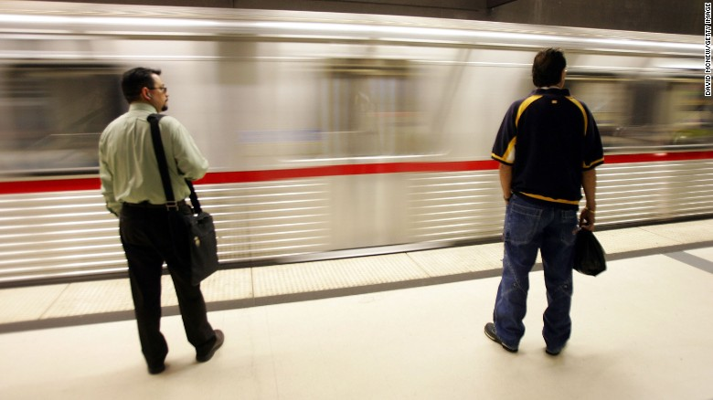
Commutes are Bad for you!
Higher Blood Sugar
Higher Cholesterol
Higher Depression Risk
Higher Anxiety
High Blood Pressure
Back Aches
Source: http://time.com/9912/10-things-your-commute-does-to-your-body/

Slide 3
Adding Data is a Drag

Slide 4
KnoWhere: Automatically Profile Your Commute

Slide 5
The Front End

Slide 6


The Database

Slide 7
MongoDB Collection Example
_id: ObjectId(...),
user_id: ObjectId(...),
timestamp: ISODate(...),
Data: [
Microphone Left Channel Level : ...,
Microphone Right Channel Level : ...
],
sensor: Microphone,
commute: True
iPhone

Slide 8
Data Collection from Smart Phones

Slide 9
Aglomerative Clustering

Slide 10
Sensor Data

Slide 11
Machine Learning: Predicting Times During a Commute

Slide 12
Feature Selection: GPS free tracking

Slide 13
Into the Woods: Random Forest Classification

Slide 14
ROC for the Classes

Slide 15
Demonstration!

Slide 16
Audiobook Recommendation System

Slide 17
Future Development

Slide 18
Thanks You!

