Slide 1
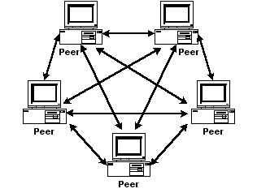

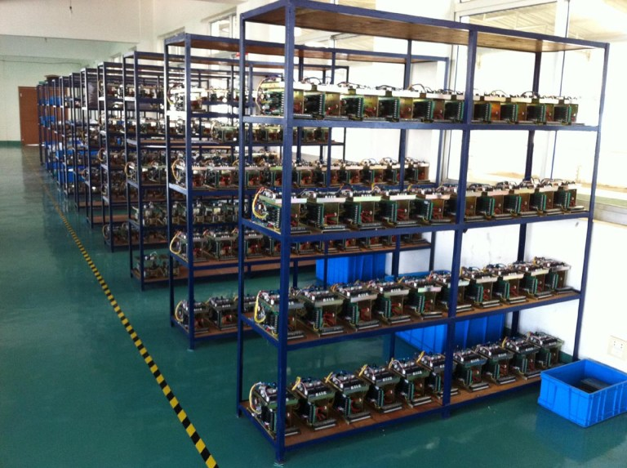
Bitcoin: Exploring its Volatile History

Slide 2
Presentation Outline
Bitcoin Introduction
Drastic Price Changes Indicated by News Events?
A Quantitative Exploration of the Nature of Bitcoin Behavior

Slide 3
What is Bitcoin? A currency?
Serves as a means of exchange
  May 7, 2017 ~ $1558.00 USD per 1 BC
  July 17, 2010 ~ $ 0.07 USD per 1 BC
  Annualized return ~ 333%
Decentralized
  No human central banking authority

Slide 4
What is Bitcoin? (continued)
Secure, anonymous, international
Limited in total amount
  21 million bitcoins by 2040
  16 million bitcoins currently in existence

Slide 5
How is it made?
Bitcoin is “mined” using a proof-of-work algorithm
  https://en.wikipedia.org/wiki/Proof-of-work_system
Based on a Blockchain algorithm
  The blockchain is the heart of Bitcoin

Slide 6
Peculiarities?
International
Serves certain niches
  Work around for currency export
  Money laundering
  Anonymous purchases
  Substitute for less stable currencies
On the border of legality
  How to bring into existing financial system?

Slide 7
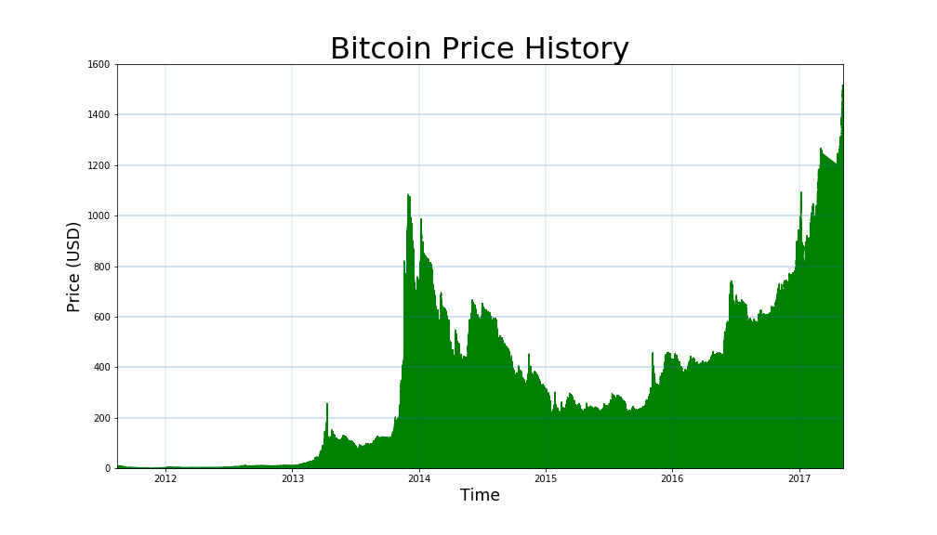
High Volatility

Slide 8
Basic NLP with Syuzhet in R
Correlation between the “sentiment” of a news article and the price movement?
Use Syuzhet package in R to analyze text of news articles and relate to the 10 day price difference
Found 61 articles and price history from 99bitcoins.com

Slide 9
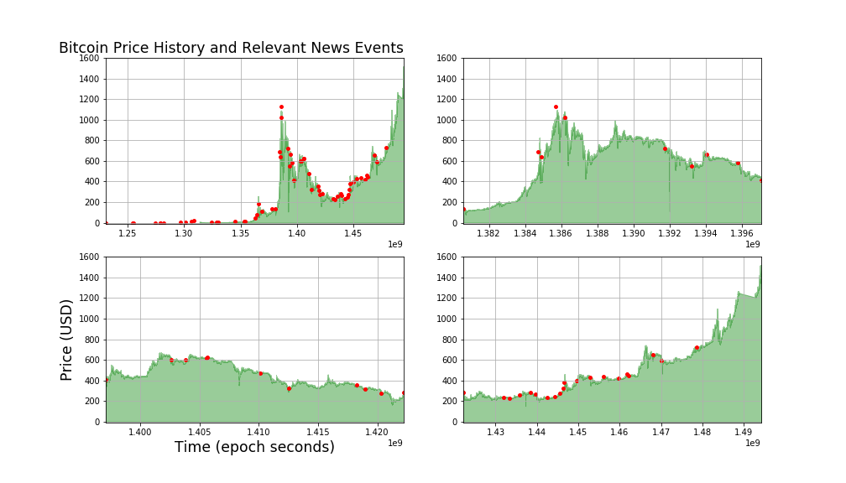

Slide 10
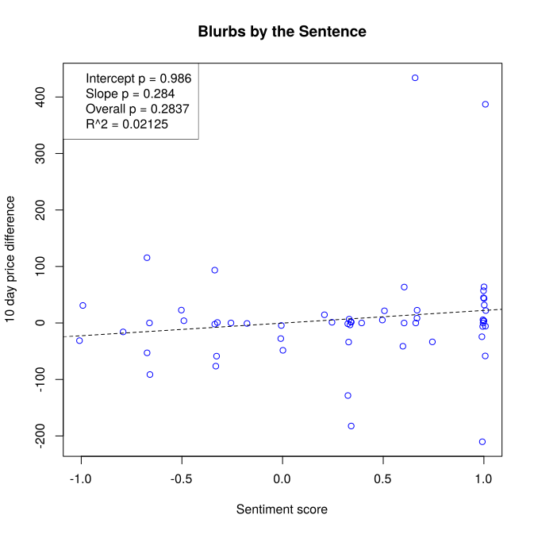

Slide 11
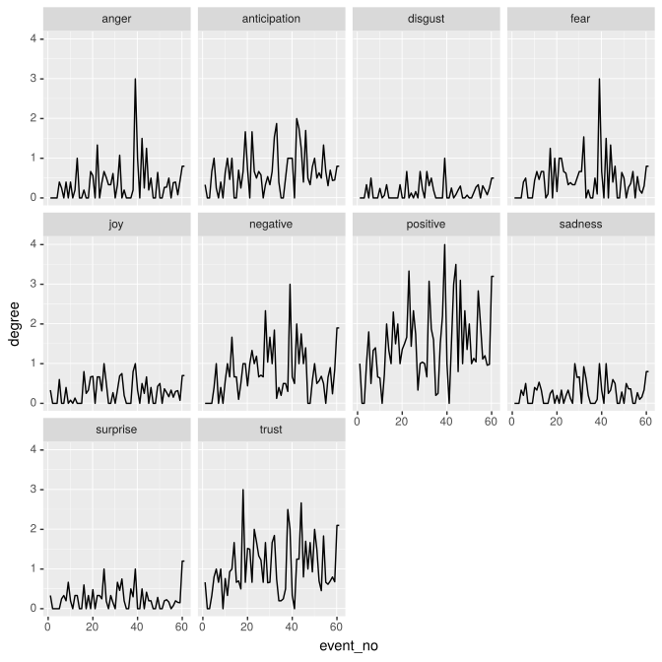

Slide 12
Moving on...
How to analyze th

Slide 13
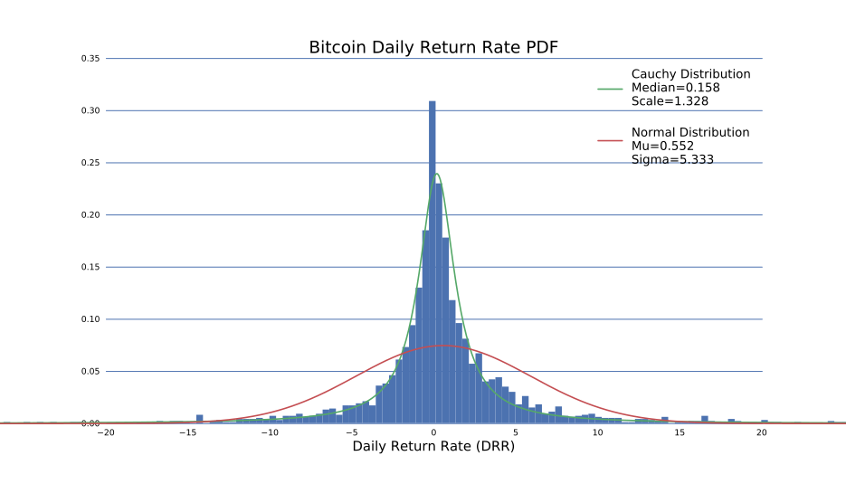

Slide 15
Future Directions
Get information from the block chain itself (blockr.io) for exchange independent data
  Transaction volume per coin
More robust pipeline for news articles
  More articles
  Control articles (weight by relevance?)
  Train on custom set

