Slide 1
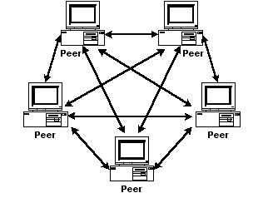

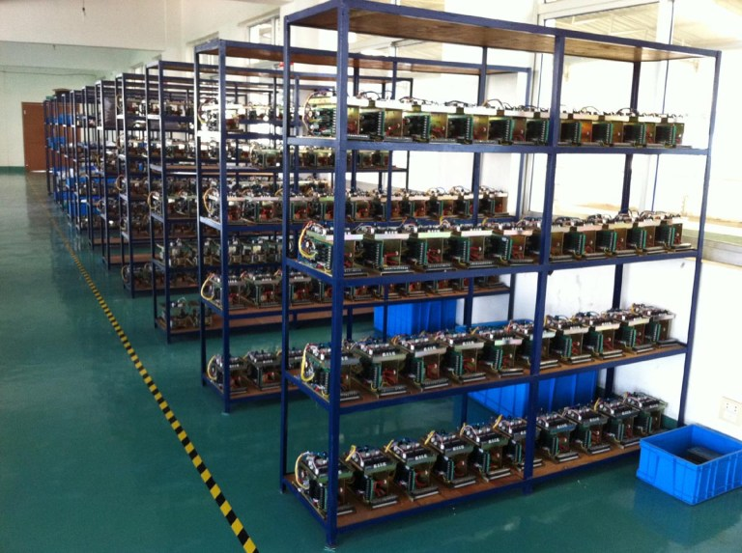
Bitcoin: Exploring its Short and Volatile History

Slide 2
Presentation Outline
Bitcoin Introduction
Text Analysis on Bitcoin-related news articles
Time Series Exploration

Slide 3
What is Bitcoin?
Serves as a means of exchange
  May 7, 2017 ~ $1558.00 USD per 1 BC
  July 17, 2010 ~ $ 0.07 USD per 1 BC
    Total Return Rate ~ 2225600%
    Annual Return Rate ~ 333%

Slide 4
What is Bitcoin? (continued)
Decentralized (P2P)
  No human central banking authority
Secure*, anonymous*, international
Limited in total amount
  21 million bitcoins by 2040
  16 million bitcoins currently in existence
Blockchain proof-of-work algorithm
  https://en.wikipedia.org/wiki/Proof-of-work_system
* I am not responsible for any financial losses or legal trouble you may incur while engaging in the buying or selling of products with bitcoin

Slide 5
Peculiarities?
Serves unique niches
  Move money without state interference
  Money laundering
  Anonymous purchasing
  Substitute for less stable currencies
On the border of legality
  How to bring into existing financial system?
  How to monetize?

Slide 6
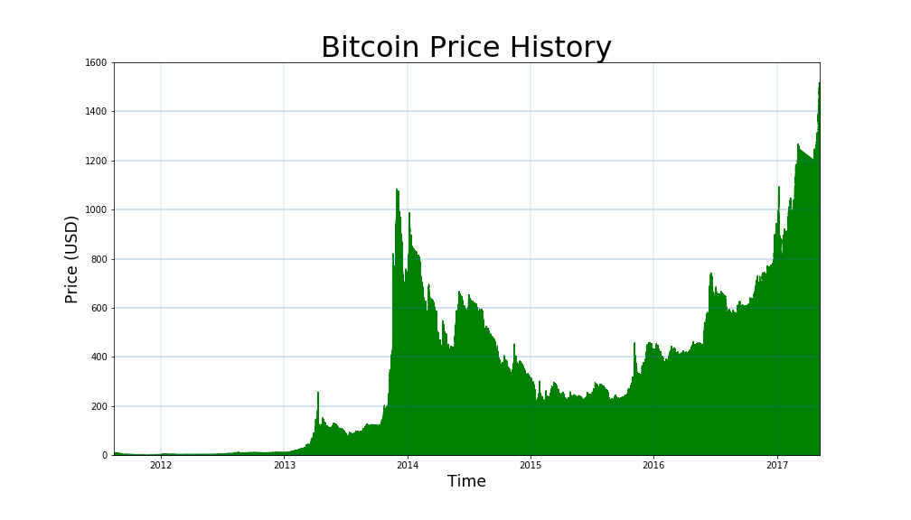
High Price Volatility

Slide 7
Sentiment Analysis with Syuzhet in R
Correlation between the “sentiment” of a news article and the price movement?
Use Syuzhet package in R to analyze text of news articles and relate to the 10 day price difference
Found 61 articles and price history from 99bitcoins.com

Slide 8
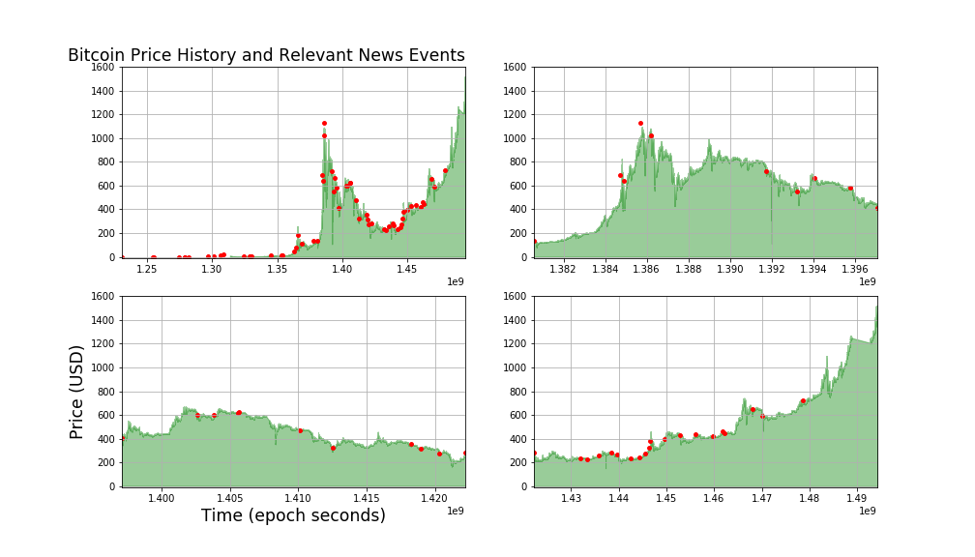

Slide 9
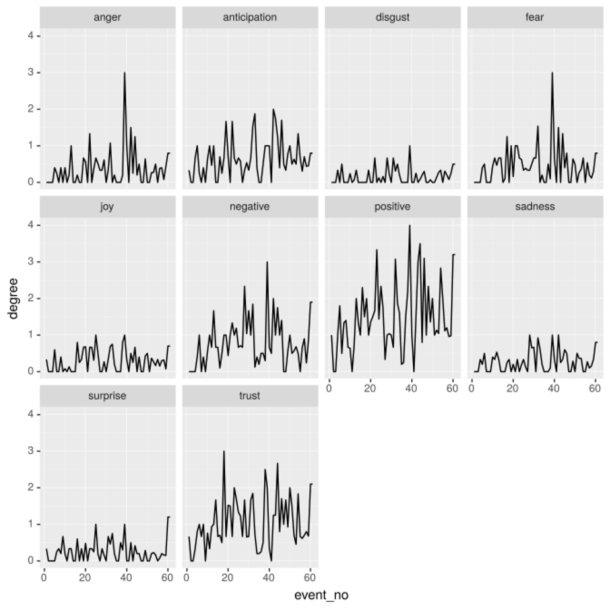

Slide 10
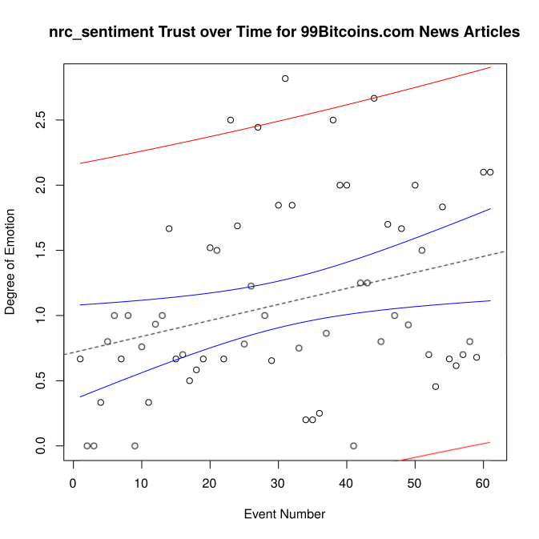
Residuals:
Min 1Q Median 3Q Max
-1.22024 -0.46937 -0.07944 0.52544 1.72078
Coefficients:
Estimate Std. Error t value Pr(>|t|)
(Intercept) 0.716599 0.180686 3.966 0.0002 ***
event_no 0.012284 0.005068 2.424 0.0184 *
---
Signif. codes: 0 ‘***’ 0.001 ‘**’ 0.01 ‘*’ 0.05 ‘.’ 0.1 ‘ ’ 1
Residual standard error: 0.6969 on 59 degrees of freedom
Multiple R-squared: 0.09055, Adjusted R-squared: 0.07514
F-statistic: 5.874 on 1 and 59 DF, p-value: 0.01845

Slide 11
Next Steps for Text Analysis
Correlate emotion movement to price movement
Python NLP?
Need more text i.e. coindesk.com
Multiple Linear Regression

Slide 12
Time Series Modeling
By digging into the price movements of the data on btc-e can I better understand its movement?
Working towards a bitcoin pricing model

Slide 13
The Price History Again

Slide 14
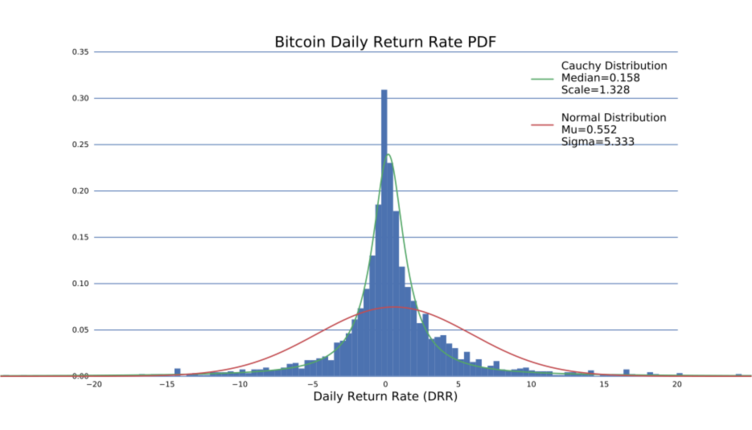
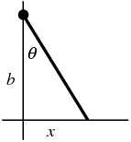

Cauchy Distribution

Slide 15
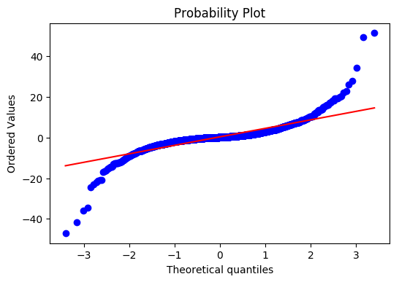
QQ plot for Daily Return Rate

Slide 16
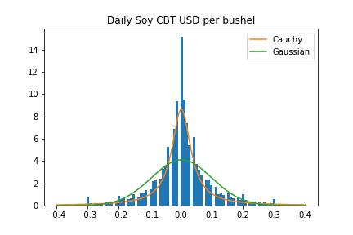
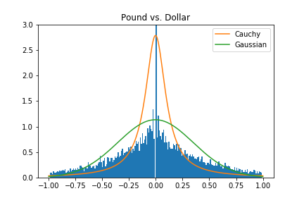
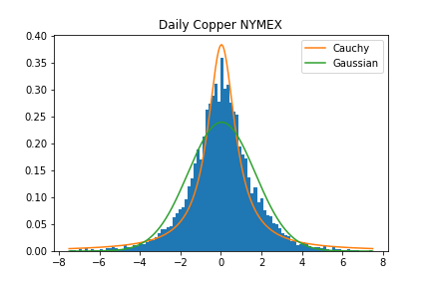
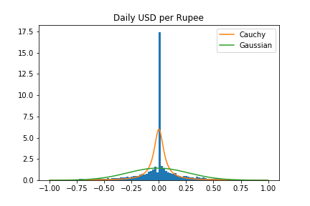
Commodities
Currencies

Slide 17
Bitcoin, Currency or Commodity?
Commonly thought of as a currency
  Somewhat of a misnomer
Bitcoin is akin to a commodity
  Scarce
  Accommodates a need
  Perceived intrinsic value
The answer to this question has legal and financial ramifications
  http://www.coindesk.com/bankruptcy-judge-bitcoin-property-currency/
  https://www.digitaltrends.com/business/cftc-defines-bitcoin-as-commmodity/

Slide 18
Future Improvements/Directions
Fit parameters!
Get information from the block chain itself (blockr.io) for exchange independent data
  Transaction volume per coin
Signal Processing
  Fast Fourier Transforms
  Auto-correlation
  Monte Carlo?
Differences among Various Exchanges

Slide 19
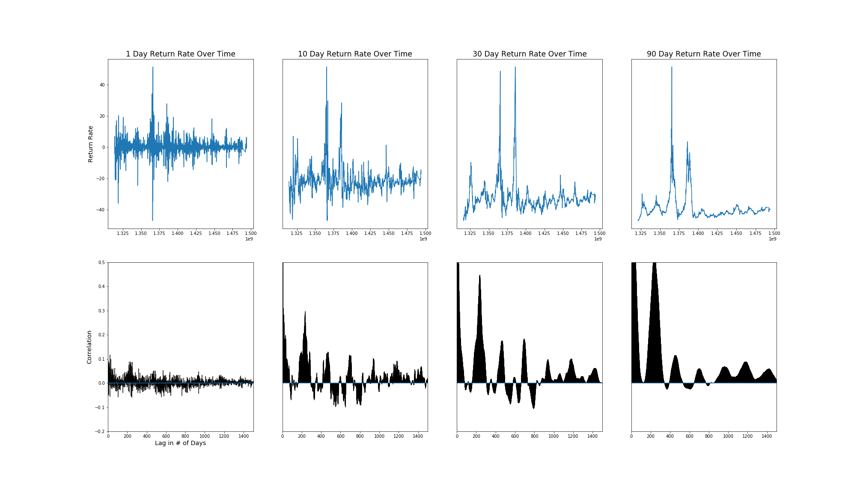
Autocorrelation Plots

Slide 20
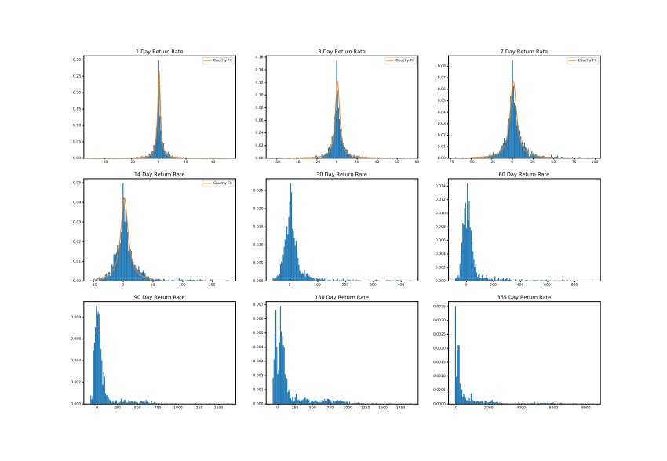
Various Bitcoin Return Rates

