Slide 1

Automating tasks with Actions
Claire Boyd
Data Scientist
NYC Department of Finance, Property Modeling & Valuation
boydclaire@finance.nyc.gov
claireboyd
Pablo Hernandez
Data Science Intern, UChicago Student
NYC Department of Finance, Property Modeling & Valuation
hernandezpablo1995@gmail.com
pabloher95

Slide 2

Agenda
Our task
How do we use GitHub actions to automate tasks?
How has this changed our internal processes?
What did we learn that we might do differently?
What else can we do with GitHub Actions?

Slide 3
Our task

Slide 4
Property Modeling @ NYC Department of Finance
Our team’s core function is to model the market value of all ~1.3M residential and commercial properties in New York City annually in order to tax all property owners equitably.
To do this, we rely on both internal and external data on individual property characteristics as well as geospatial characteristics to most accurately capture market value. Our work relies on accurate, up-to-date maps for geospatial workflows that help us highlight otherwise obscure patterns in the property market. Digital geometries are the key resource to link geographic attributes (boundaries, zoning) to each and every parcel.
Task: Get analysis-ready geometries for tax boundaries in (close to) real time

Slide 5
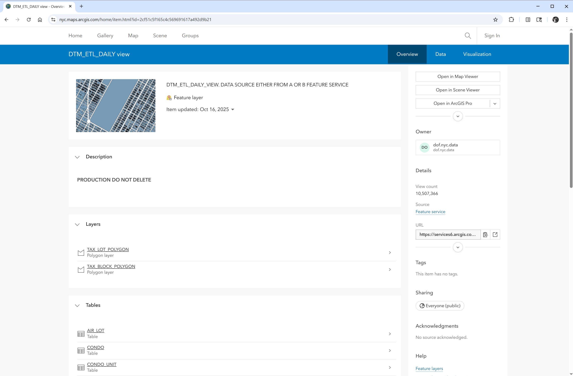
DOF’s Property Tax Map team provides daily updates to the feature collection, which is hosted on the Esri API for open access

Slide 6
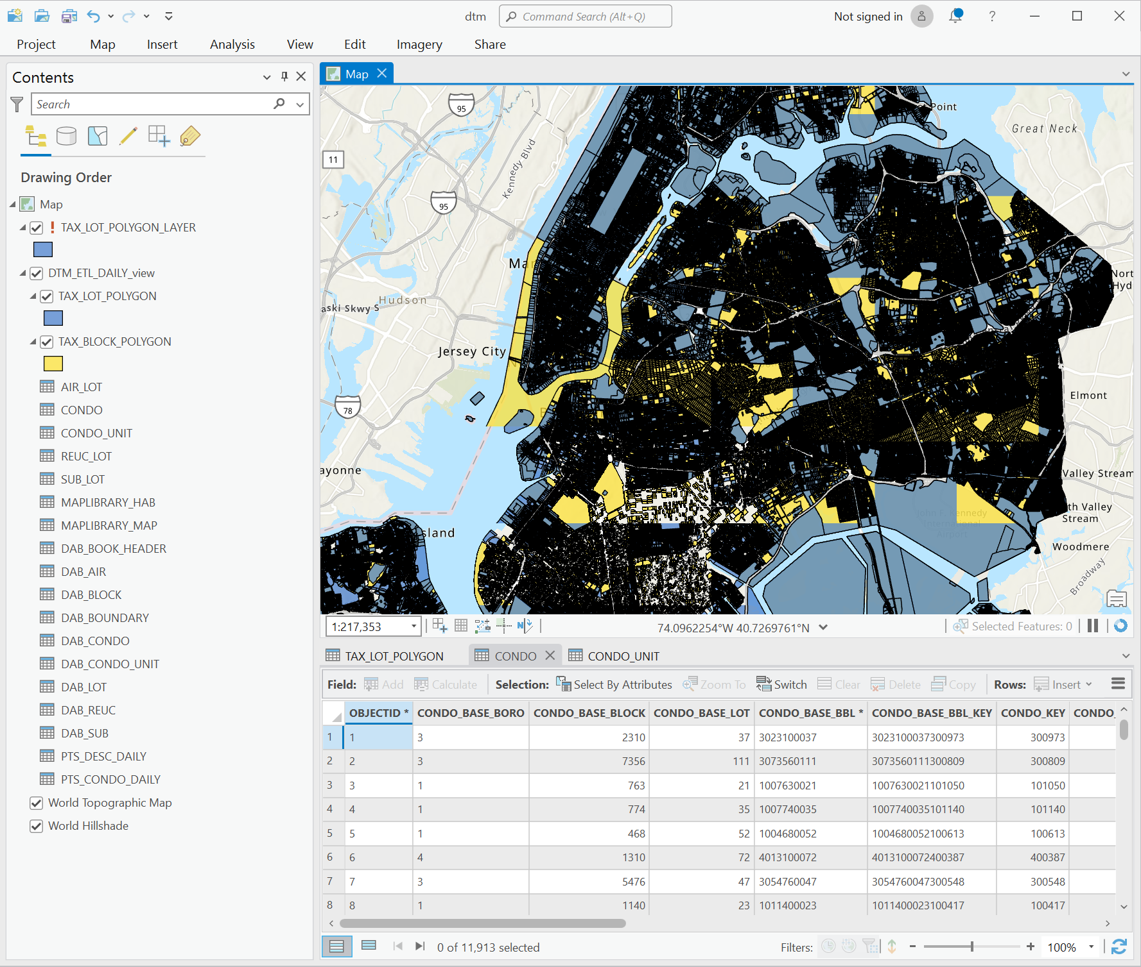
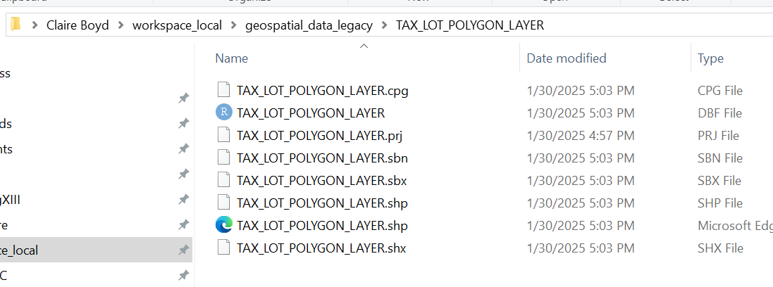
Previous approach
Manually download layers, ad hoc data processing, local storage, out-of-date file sharing
Update Layer & Dissolve By Geography in ArcGIS Pro
Locally Export & Store Shapefiles
(for polygons or centroids)
Ingest .shp files into R/python and join with relevant tabular data

Slide 7
Reflections on previous approach
TLDR: It worked well for our needs. When you completed this process, it accomplished our goal of getting the most up to date geometries for the type of geography you wanted (e.g. tax lot centroids).
But, after doing the process a few times, it was clear there could be a better solution:
It duplicated work across team members: we didn’t have a centralized place to look for these most up to date files for each level of geography, so we would typically just re-do the process
It was easy to forget a step (e.g. dissolving, merging condo BBLs): the input feature layer from ArcGIS had multi-polygons for some lots so you need to dissolve these polygons into one shape which I regularly forgot to do and would realize when I got duplicates downstream.
It used a few different programs when it could be a bit more simplified: If we could do it in one workflow without jumping between programs (ArcGIS, R)

Slide 8
What could we do to improve this process?
Level 1: Streamlined workflow
The inputs (regularly updated ArcGIS layers) are consistent– time is the only variable
Python could accomplish all of these steps sequentially, so we could more or less write one script (one .py file) to do the entire task start to finish
Modern tools (python) can easily communicate with map services (ArcGIS) to subvert manual extraction via the `arcpy` library

Slide 9
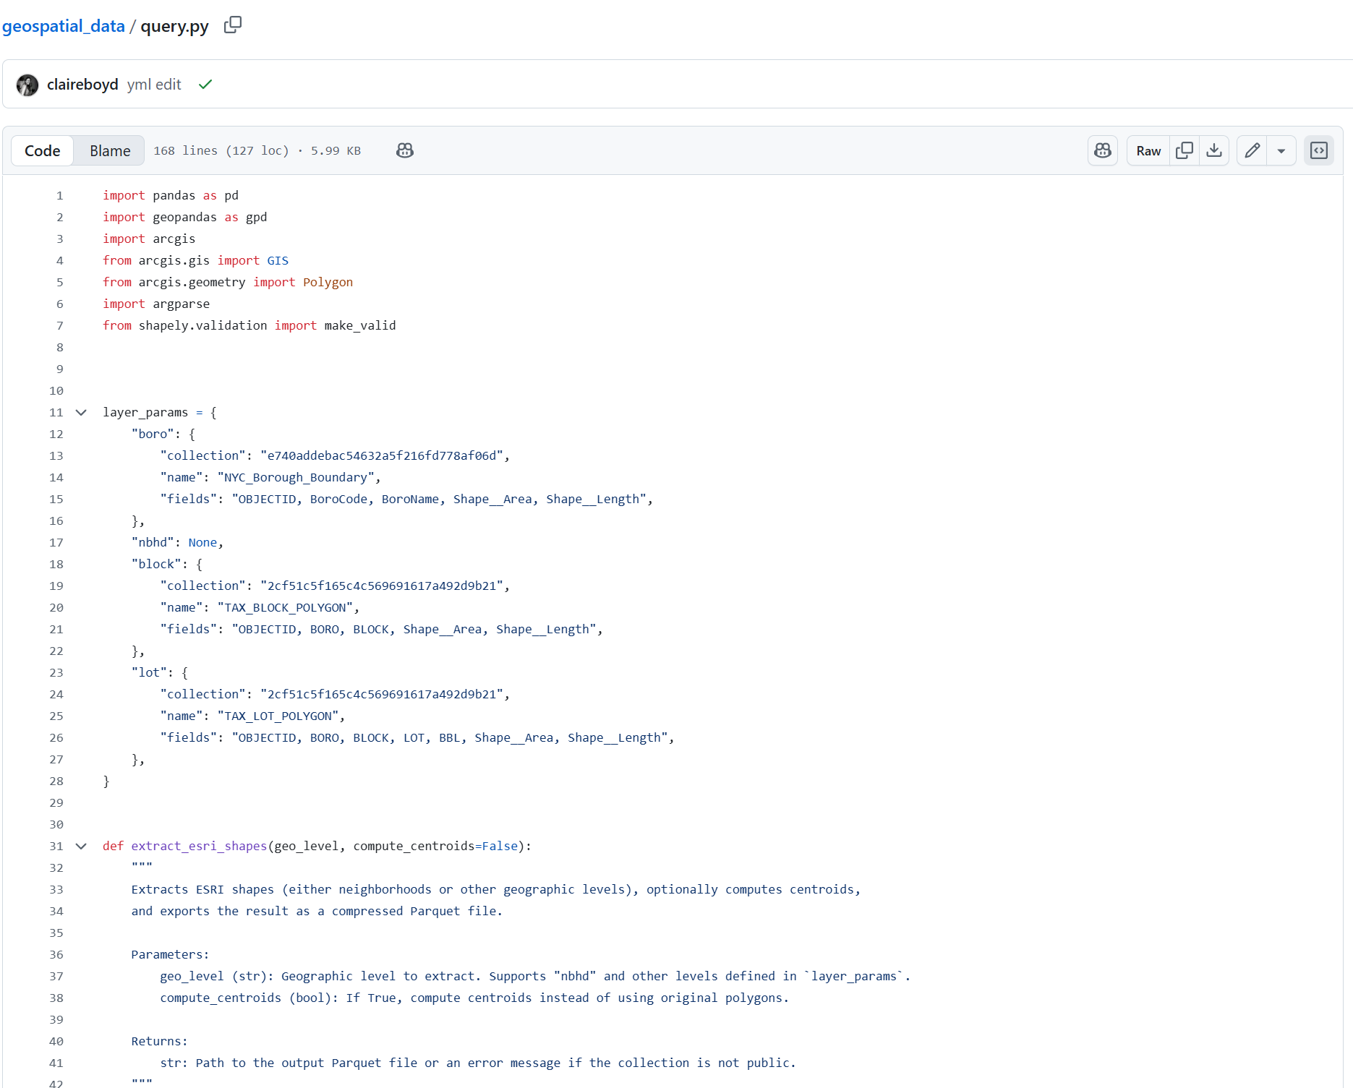
Revamped approach: query.py
[pablo – can you add in the main steps for the script here?]

Slide 10
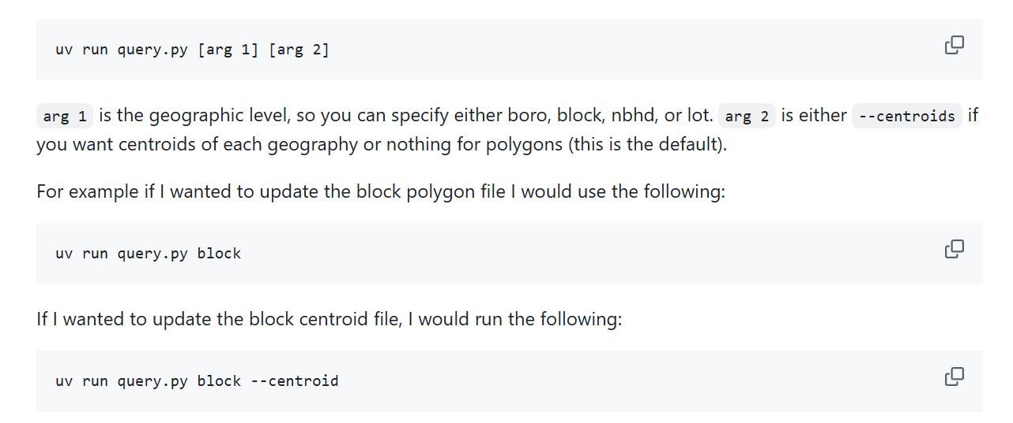
Local deployment

Slide 11
What could we do to improve this process?
Level 1: Streamlined workflow
The inputs (regularly updated ArcGIS layers) are consistent– time is the only variable
Python could accomplish all of these steps sequentially, so we could more or less write one script (one .py file) to do the entire task start to finish
Modern tools (python) can easily communicate with map services (ArcGIS) to subvert manual extraction via the `arcpy` library
Level 2: Automate it!
We could set up a way to run that python script on a schedule instead of running it manually
Periodic runs ensure that users can have the most up-to-date version in their work and keep track of what has changed
Establish a common, lightweight data format to extend across all unit’s projects that is compatible with our push towards open source (R/Python)
Introduce quality control by including tests and conditioning updates to successful runs

Slide 12
How do we use Actions to automate this?

Slide 13
What are GitHub Actions?
GitHub Actions are essentially free compute power to execute code using a series of instructions. It is Github’s service to automate workflows from a repository based on an event trigger using their virtual machines
How it works:
An action is configured by uploading a YAML file containing machine specifications, event triggers and a sequence of instructions (jobs) to be run from that machine’s shell into the ‘Actions’ section on a repository
Github ‘listens’ to the specified event, interprets these instructions, and allocates some of its computer resources to execute the routine
Perks:
Performance metrics, seamless updates to repository via git integration, calling third-party jobs into the routine, compatible with testing suites to add an extra layer of protection when modifying outputs

Slide 14
Our application

Slide 15
Questions?
Claire Boyd
Data Scientist
NYC Department of Finance, Property Modeling & Valuation
boydclaire@finance.nyc.gov
claireboyd
Pablo Hernandez
Data Science Intern, UChicago Student
NYC Department of Finance, Property Modeling & Valuation
hernandezpablo1995@gmail.com
pabloher95

