Slide 1


Slide 2


Slide 3

Automating tasks with Actions
Claire Boyd
Data Scientist
NYC Department of Finance, Property Modeling & Valuation
boydclaire@finance.nyc.gov
claireboyd
Pablo Hernandez
Data Science Intern, UChicago Student
NYC Department of Finance, Property Modeling & Valuation
hernandezpablo1995@gmail.com
pabloher95

Slide 4

Agenda
Our task
Previous approach
Level 1: Streamlined workflow
Level 2: Automated workflow with GitHub Actions
What we learned along the way
Q&A

Slide 5
Our task

Slide 6
Property Modeling @ NYC Department of Finance
Our team’s core function is to model the market value of all ~1.2M residential and commercial properties in New York City annually in order to tax all property owners equitably.
To do this, we rely on both internal and external data on individual property characteristics as well as geospatial characteristics to most accurately capture market value. Our work relies on accurate, up-to-date maps for geospatial workflows that help us highlight otherwise obscure patterns in the property market. Digital geometries are the key resource to link geographic attributes (boundaries, zoning) to each and every parcel.
Task: Get analysis-ready geometries for tax boundaries in (close to) real time

Slide 7
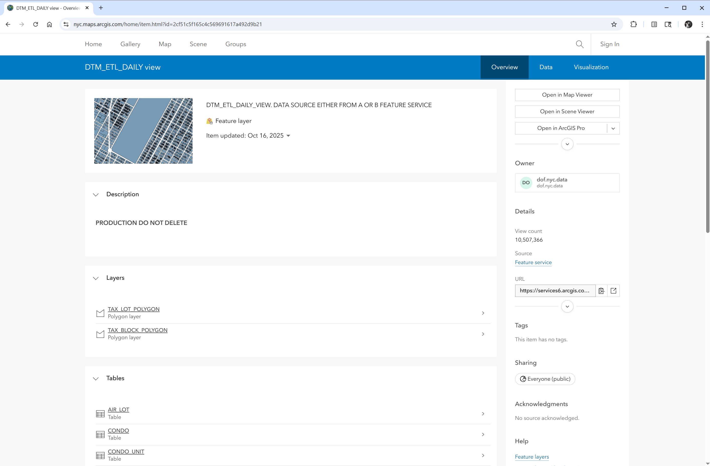
DOF’s Property Tax Map team provides daily updates to the feature collection, which is hosted on the Esri API for open access

Slide 8
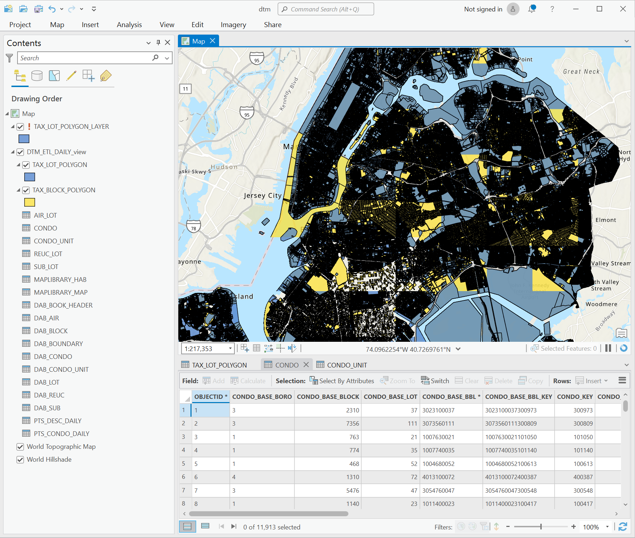
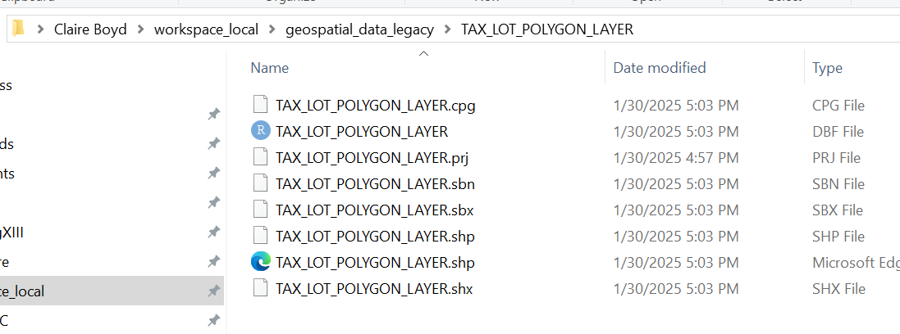
Previous approach
Manually download layers, ad hoc data processing, local storage, out-of-date file sharing
Update Layer & Dissolve By Geography in ArcGIS Pro
Locally Export & Store Shapefiles
(for polygons or centroids)
Ingest .shp files into R/python and join with relevant tabular data

Slide 9
Reflections on previous approach
TLDR: It worked well for our needs. When you completed this process, it accomplished our goal of getting the most up to date geometries for the type of geography you wanted (e.g. tax lot centroids).
But, after doing the process a few times, it was clear there could be a better solution:
It duplicated work across team members: we didn’t have a centralized place to look for these most up to date files for each level of geography, so we would typically just re-do the process
It was easy to forget a step (e.g. dissolving, merging condo BBLs, applying a CRS transformation): the input feature layer from ArcGIS had multi-polygons for some lots so you need to dissolve these polygons into one shape which I regularly forgot to do and would realize when I got duplicates downstream.
It used a few different programs when it could be a bit more simplified: If we could do it in one workflow without jumping between programs (ArcGIS, R)

Slide 10
What could we do to improve this process?
Level 1: Streamlined workflow
The inputs are consistent (regularly updated ArcGIS layers) – time is the only variable
Python could accomplish all of these steps sequentially, so we could write one script (one .py file) to do the entire task start to finish
Modern tools (python) can easily communicate with map services (ArcGIS) to subvert manual extraction via the `arcgis` library

Slide 11
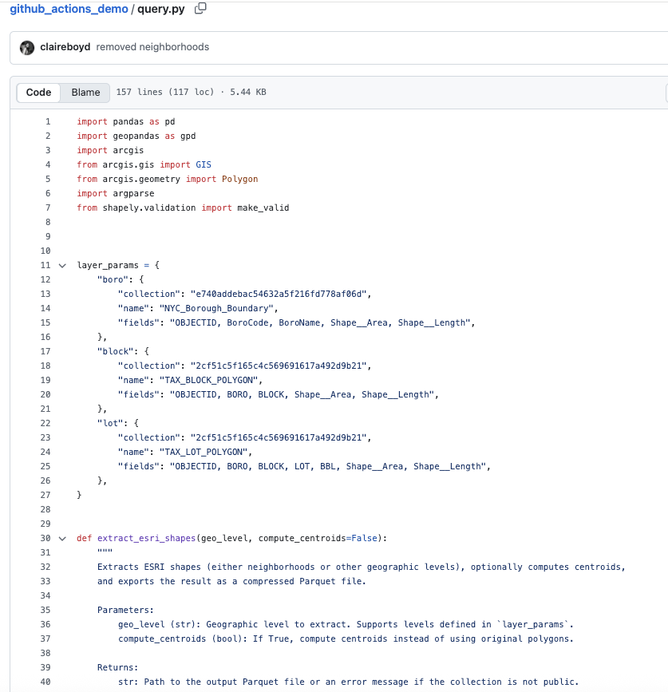
Revamped approach: query.py
Inputs: geographic level (borough, block, lot) and shape type (polygon or centroid)
Process:
Using arcgis python library, retrieve most recent feature layer and its metadata
Extract geometries from the features
If needed, convert to centroids
Standardize CRS to 4326 and retain geometrically valid entries
Preserve geometry IDs and object columns
If “lot” is selected, merge BBLs to Condo BBLs for easier joining with parcel data
Outputs: static parquet file

Slide 12
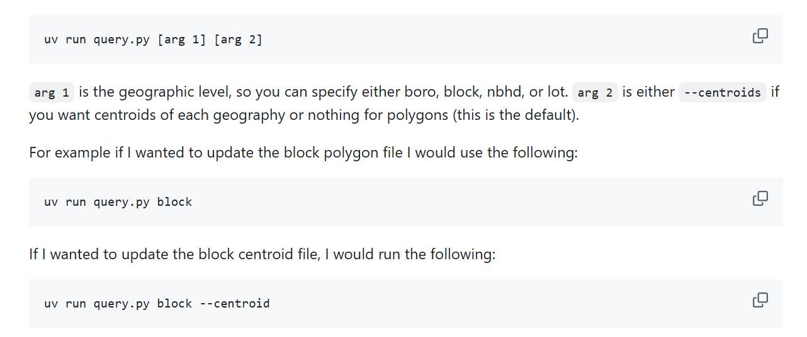
Local deployment

Slide 13
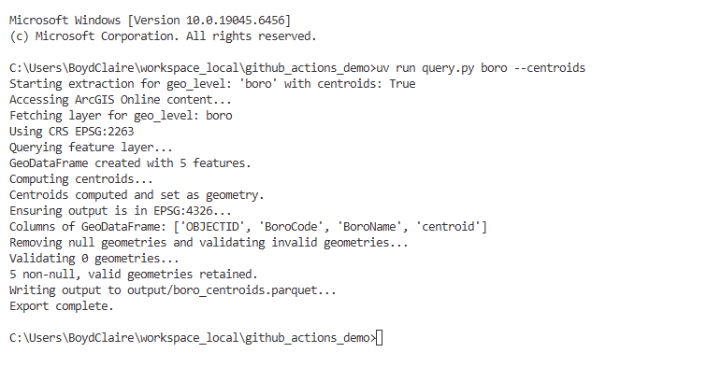
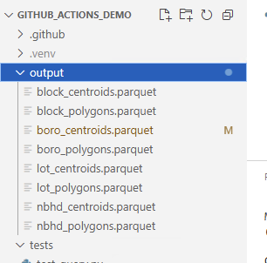
Local deployment
With one line of code on my command line…
…I get an up-to-date file stored locally.

Slide 14
What could we do to improve this process?
Level 1: Streamlined workflow
The inputs (regularly updated ArcGIS layers) are consistent– time is the only variable
Python could accomplish all of these steps sequentially, so we could write one script (one .py file) to do the entire task start to finish
Modern tools (python) can easily communicate with map services (ArcGIS) to subvert manual extraction via the `arcgis` library
Level 2: Automate it!
We could set up a way to run that python script on a schedule instead of running it manually
Save it in one place, so it’s not duplicating efforts
Periodic runs ensure that users can have the most up-to-date version in their work and keep track of what has changed
Establish a common, lightweight data format to extend across all unit’s projects that is compatible with our push towards open source (R/Python)
Introduce quality control by including tests and conditioning updates to successful runs

Slide 15
How do we use Actions to automate this?

Slide 16
What are GitHub Actions?
GitHub Actions are essentially free compute power to execute code using a series of instructions. It is GitHub’s service to automate workflows from a repository based on an event trigger using their virtual machines
How it works:
An action is configured by uploading a YAML file containing machine specifications, event triggers and a sequence of instructions (jobs) to be run from that machine’s shell into the ‘Actions’ section on a repository
GitHub ‘listens’ to the specified event, interprets these instructions, and allocates some of its computer resources to execute the routine
Perks:
Performance metrics, seamless updates to repository via git integration, calling third-party jobs into the routine, compatible with testing suites to add an extra layer of protection when modifying outputs

Slide 17
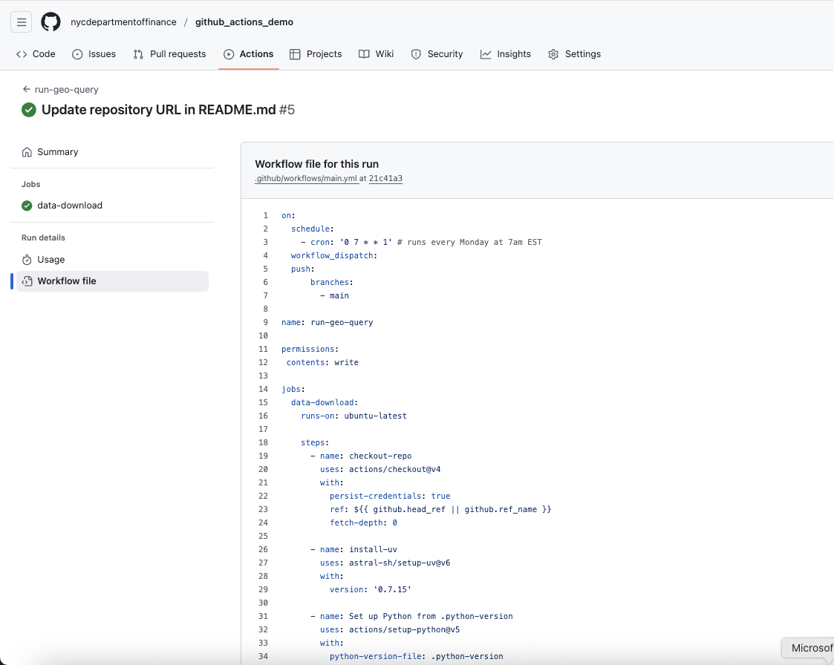
.yml file
Components
On: how the action is triggered
Schedule
On given actions (pull requests, pushes to main/branches)
Workflow dispatch (manually triggered)
Jobs: what the action does
Preset or self-defined sets of instructions of “steps” (there is an “Action” Marketplace)

Slide 18
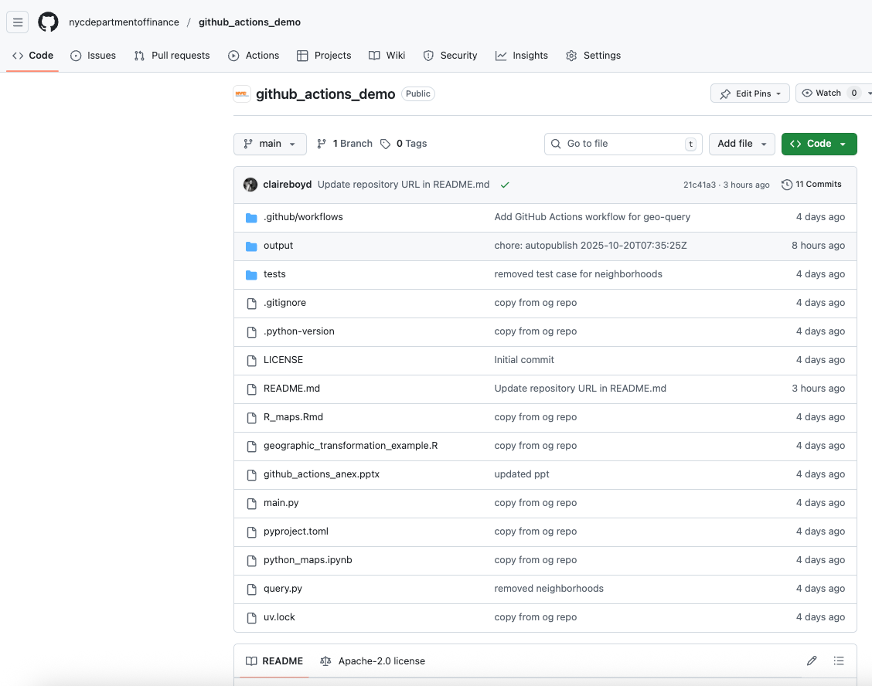
Set up our project in a GitHub repository

Slide 19
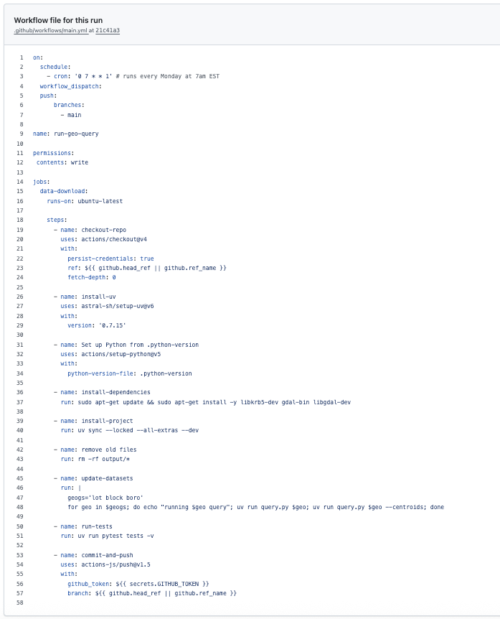
Our application: main.yml
Define an event trigger: We chose a timed routine that executes the code every monday morning so that each week we can have a fresh version of the geometries updated by Tax Map
Choose a VM: Initialize an Ubuntu 24.04 instance
Check out the repository in its current state using pre-configured credentials
Install program requirements:
uv (python env manager), python, additional dependencies for system compatibility
Erase current version of datasets
Loop over python code to query, preprocess and save most recent datasets for different scales (boros, blocks, lots) and desired geometry types (polygons, centroids)
Run tests to check for valid data types and formats
Commit and push changes from virtual machine into remote repo

Slide 20
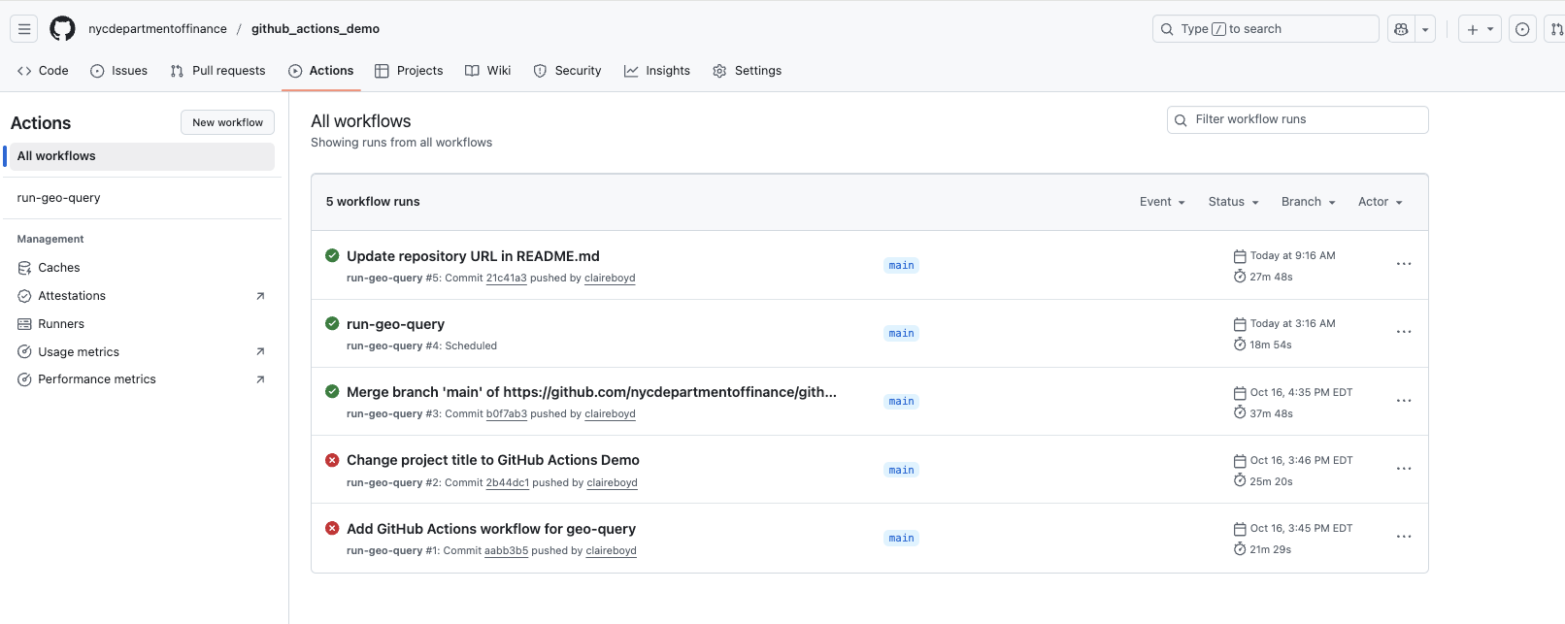
Workflows: an execution of the .yml files

Slide 21
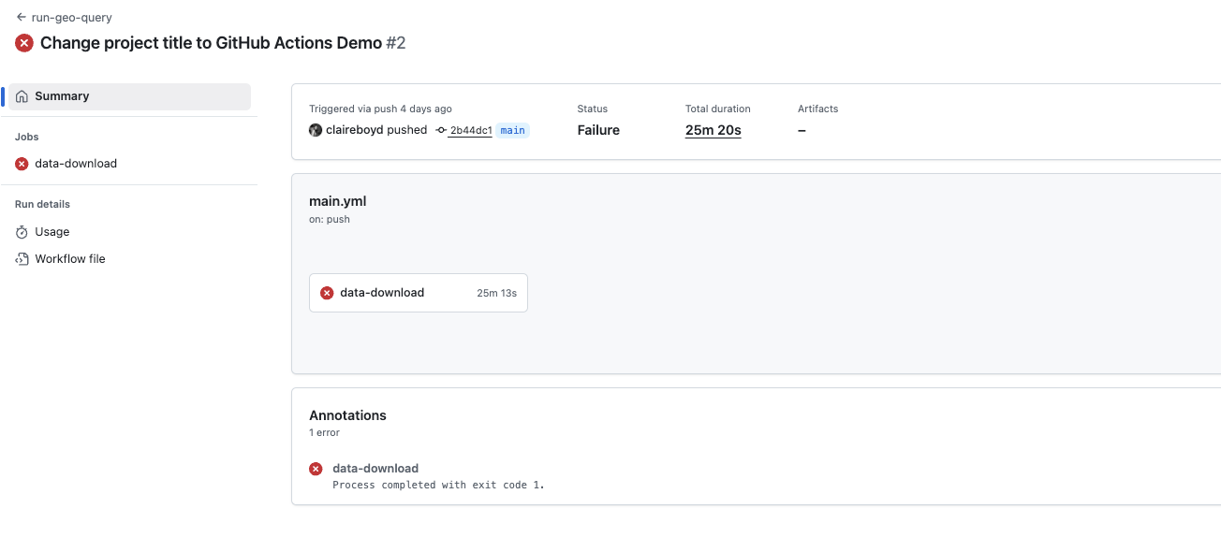
Debugging a failed workflow

Slide 22
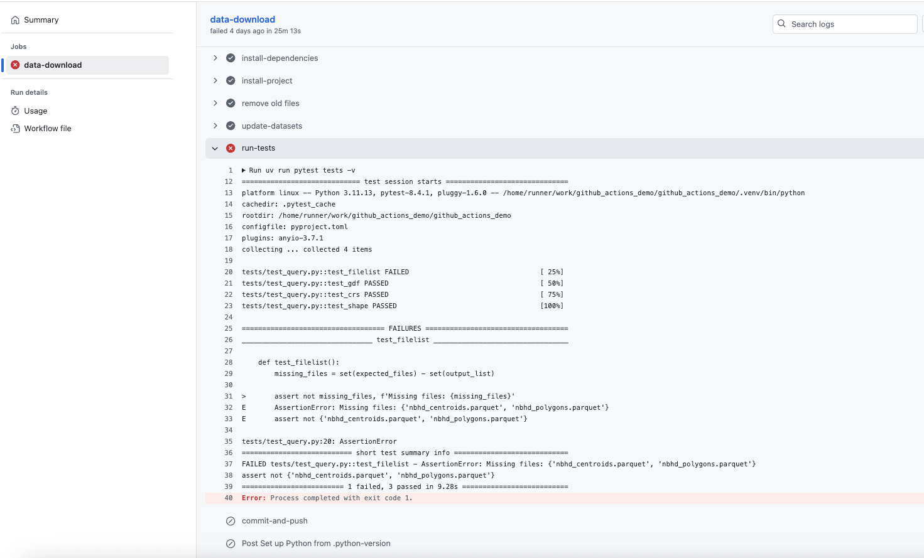
Debugging a failed workflow

Slide 23
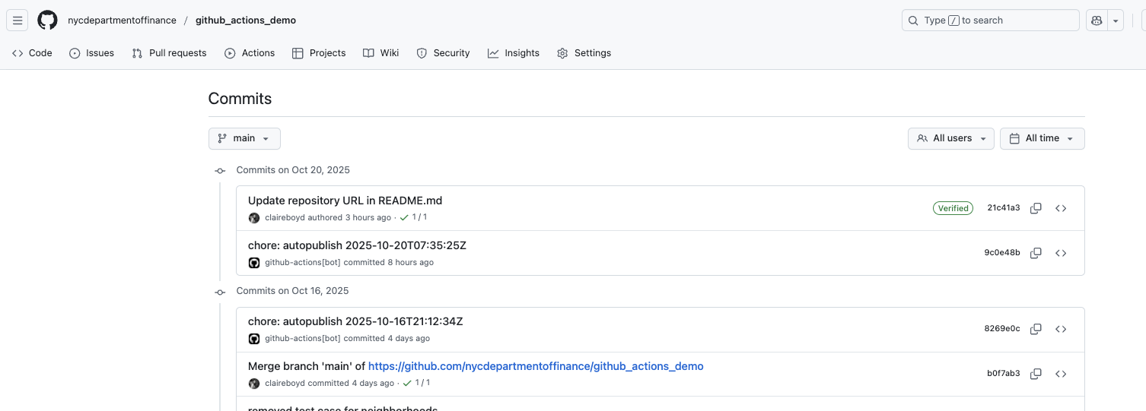
Current status
Our GitHub Action now updates static parquet files to our repository every Monday morning at 7AM, so we know where to go for the most up-to-date geometries, and they are immediately ready for analysis.

Slide 24
What can we do with this?
Workflow overhaul: Action handles repository maintenance, while users focus on querying the output on demand from a single ‘source of truth’ in a modern, standardized format (GeoParquet) that is known for its storage and I/O efficiency
Customization: Python code handles API requests, CRS transformations and desired feature types, and produces datasets in a tabular layout that contain ID information (BBL, etc) to facilitate merge with other projects
Modularization: Repository can be modified by regular contributors to include changes to the python code without breaking the automation stage. In its current state, we have settled for specific geometry types and projections that are most compatible with our other projects at the cost of broader-range customization.
CI/CD development: future applications may include switching to state-based triggering via caching, additional fine-tuning to geospatial preprocessing, tweaking storage and compression setup to bypass GitHub’s limits, and implementing artifacts (GH feature to share data between actions) for analytical workloads

Slide 25
Actions

Slide 26
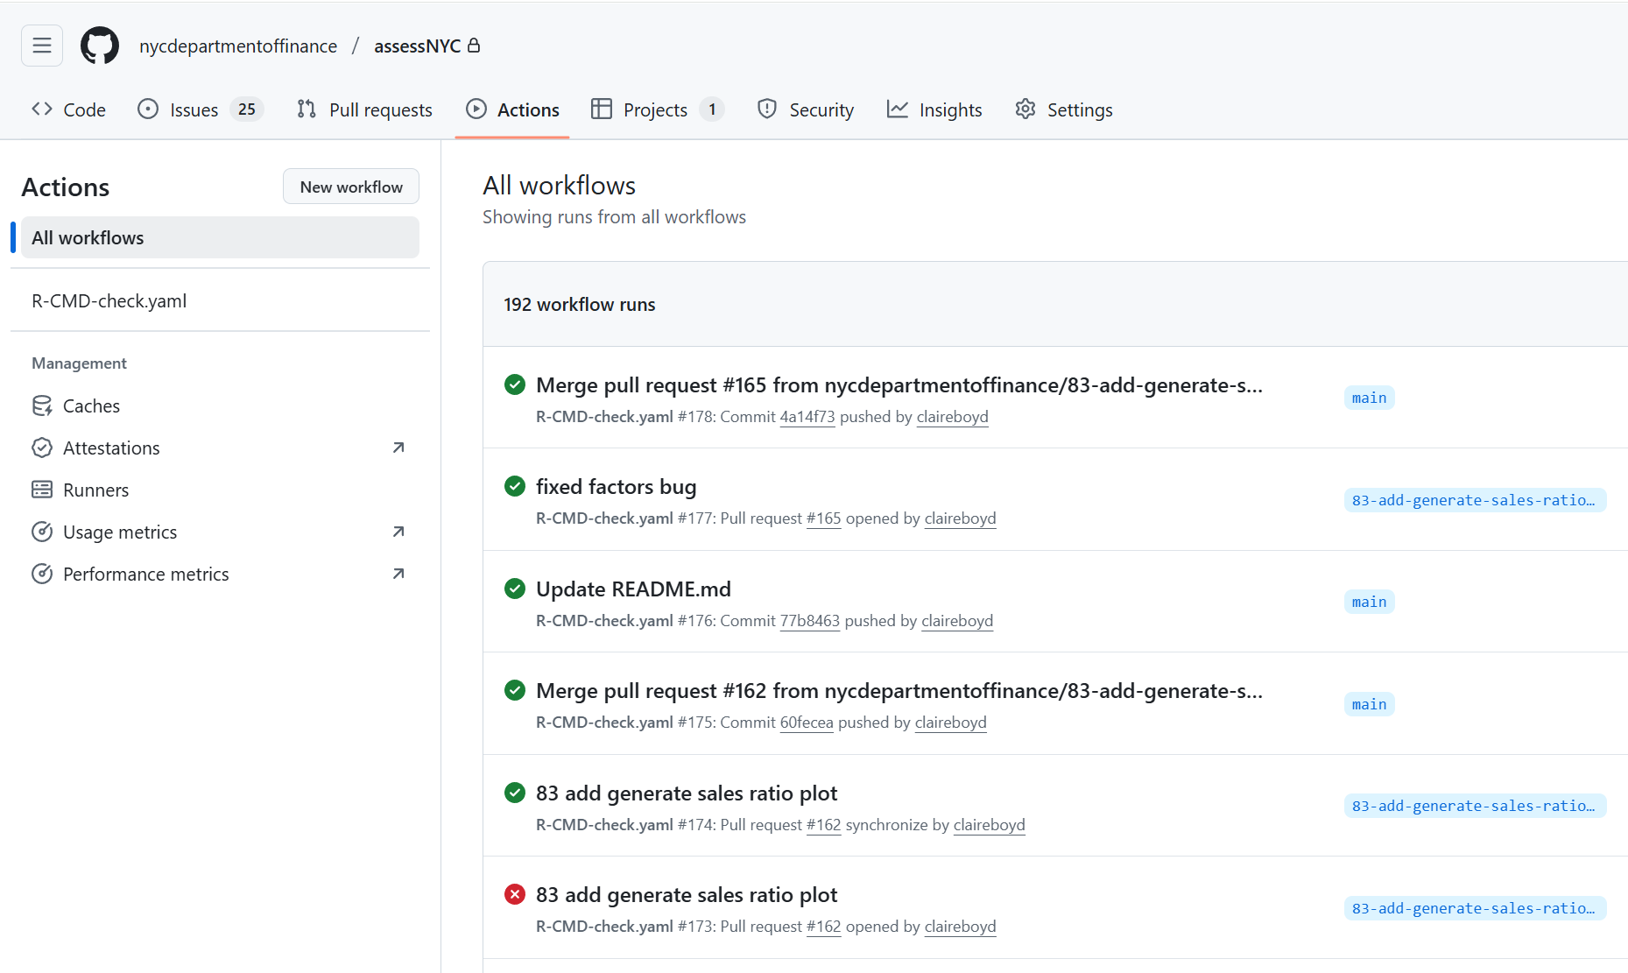
Other use cases
Sky is the limit!
Testing: We currently use actions to test any updates to our internal R package assessNYC. We have built a test suite to ensure stability of the package as we change structure/functionality.
To do this, we run checks on:
commits to open pull requests
all merges from other branches to main (can only push to main if all tests pass)

Slide 27
What we learned from experimenting with GitHub Actions
Start local: Before trying to implement an action, make sure that you can deploy something locally first.
Start by thinking about a small task that you can figure out a way to execute with one or few lines of code from the command line.
Create an MVP and test it locally by making sure that you can run it from the command line and the outputs are what you expect
Use virtual environments (uv): This is a great excuse to get into a good practice of using virtual environments in order to replicate your work on other virtual machines that much faster.
By already having had a venv set up with this project, it took only 1 more action step to ensure the virtual machine would install all the packages we needed to execute our script
Dispatch on command first: No need to test if the scheduler works before you know your .yml is set up correctly. Use an on-command trigger first and then expand to other triggers.

Slide 28
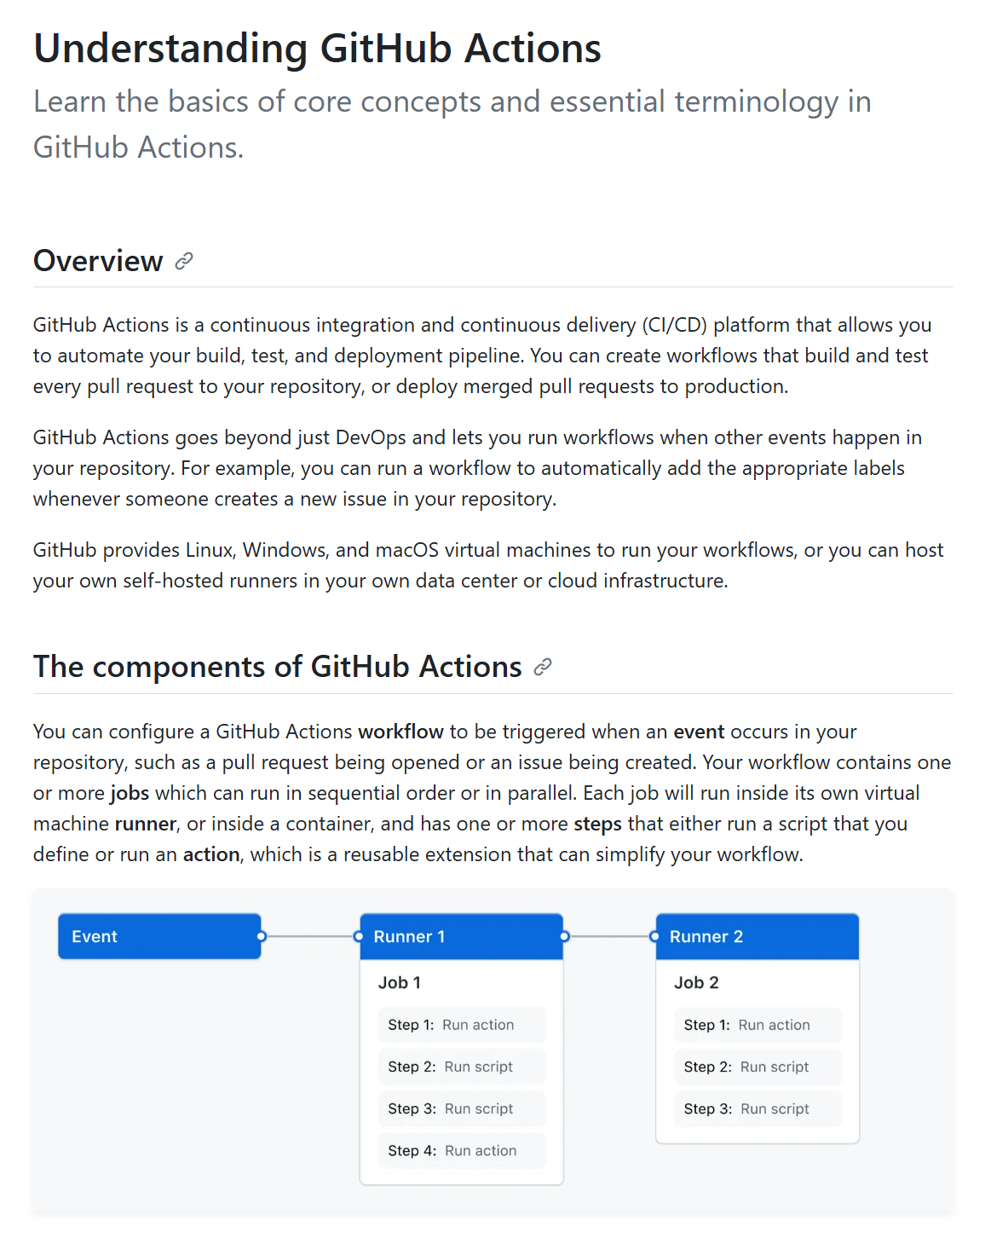
Getting started
As always, GitHub docs are accessible and thorough: https://docs.github.com/en/actions
Feel free to poke around on this copy of our repo to see the example in action: https://github.com/nycdepartmentoffinance/github_actions_demo

Slide 29
Questions?
Claire Boyd
Data Scientist
NYC Department of Finance, Property Modeling & Valuation
boydclaire@finance.nyc.gov
claireboyd
Pablo Hernandez
Data Science Intern, UChicago Student
NYC Department of Finance, Property Modeling & Valuation
hernandezpablo1995@gmail.com
pabloher95

