Slide 1
Docker
Kurzgesagt - In a Nutshell

Slide 2

About Me
Apprenticeship System Admin/Engineer
CS Degree at BFH
Consulting Years
  Public Cloud Provider, Telco Provider, Medtech
  DevOps / Automation Engineer, Software Engineer
  .NET Core, Java Spring Boot and a lot of Tooling
Securiton
  Intrusion Alarm System
  Software Engineer
  C++, Go and a lot of Tooling
Christian Nydegger
LinkedIn

Slide 3
Intro
Goals of today's lecture
You can classify Docker
You know the basic concepts of Docker
You can apply those concepts
You know about Docker-Compose

Slide 4
What are Containers?

Slide 5
What are Containers?
A container is a standard unit of software that packages up code and all its dependencies so the application runs quickly and reliably from one computing environment to another.
Wait.. that just sounds like an ordinary software package?
  Yes but it is so much more
A Software package can be
  an executable like MS Word
  a library like Flask or Numpy
  a simple python script
An application often depends on libraries
Notes:
Depending on the source, the definition of a software package varies. There are sources stating that a software package is a collection of software products. However, in such cases it is more accurate to speak of a software suite than a software package. An example could be Microsoft Office.
A software package can be an executable like Firefox, but this is not necessarily always the case. It can also be a library package containing a collection of types and functions.
The key takeaway of this slide is that containers have something to do with with packaging code and its dependencies.
Sources:
https://www.docker.com/resources/what-container

Slide 6
What are Containers?
OS-level virtualization is an operating system (OS) paradigm in which the kernel allows the existence of multiple isolated user space instances, called containers..
So it is a virtual machine?
  Yes, in a way :)
Notes:
The term OS-Level virtualization may sound confusing but will be explained over the course of the next few slides.
The key takeaway of this slide is that containers have something to do with virtualization.
Sources:
https://en.wikipedia.org/wiki/OS-level_virtualization

Slide 7
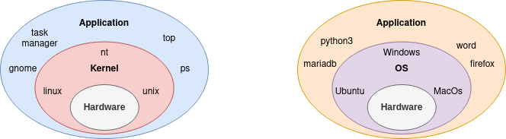
What are Containers?
What defines an Operating System?
Kernel abstracts Hardware
OS is more than a Kernel
  It also includes various tools like
Notes:
Bare metal programming, also known as interacting directly with hardware, is difficult and requires a very specific type of programmer with a lot of expertise in both simple programming languages and computer architecture.
The kernel is a software-based abstraction of the hardware that provides programmers with a rich API. It offers many things like process or memory management. The complexity of a modern kernel like the Linux kernel is unique and very few people actually work at this level (compared to the number of web developers).
An operating system usually consists of a kernel and additional software that runs "on top" of the kernel. In addition to a kernel, common operating systems such as Windows, Ubuntu or MacOS usually offer a graphical user interface and a rich collection of tools.
For the purposes of this lecture we will use the following definition of an operating system. It consists of everything you have on your system after a clean installation of the operating system, with no additional packages installed. This may include a graphical user interface, but does not necessarily have to be the case. Linux servers usually only offer a terminal with no graphical user interface.
This mix of kernel and additional software that defines an operating system is visualized by mixing the colors red (kernel) and blue (application), resulting in purple.

Slide 8
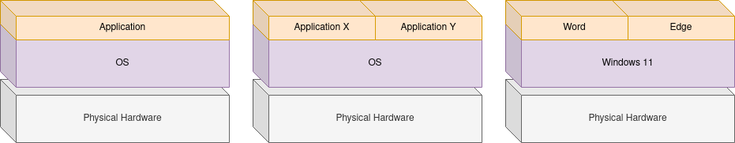
What are Containers?
Bare Metal Machine
Applications can
  pack up all dependencies
    Lots of duplications but no interference
  make us of shared dependencies
    No/less duplications but interference
Notes:
A setup like it is visualized is most common in consumer electronics like your notebook or mobile phone.
Most modern software packages like Word, Edge or Firefox are heavily dependent on libraries. If you have access to a Debian based system like Ubuntu, open a terminal and type apt-cache depends firefox and you will see that it has many dependencies.
Libraries by themselves are usually useless, but very important to avoid code duplication. It would be very inefficient to keep rewriting basic functionalities like a random number generator. When a library is used by a program, the program has it as a dependency. There are different approaches how to deal with dependencies.
One way is to put a program and all its dependencies together in one big package. A popular exponent of this approach is Snap. The disadvantage is that dependencies may be used by more than one application, each with its own copy.
Another approach tries to work around this problem by using shared dependencies. This means if two applications depend on the same library, it will only be installed once, but will be used by both. A common exponent of this approach is dpkg (Debian package), which is still the default on most Debian-based systems such as Ubuntu.
The disadvantage of shared dependencies is that conflicts or incompatibilities can arise. So if an application depends on a specific library version that is not available on the operating system, the application fails to install. Considering that most dependencies have dependencies of their own, this can be a real problem. If you're running a stable Debian release (tested and approved by the Debian project), you rarely have the latest version of an application because it has dependencies that aren't available.

Slide 9
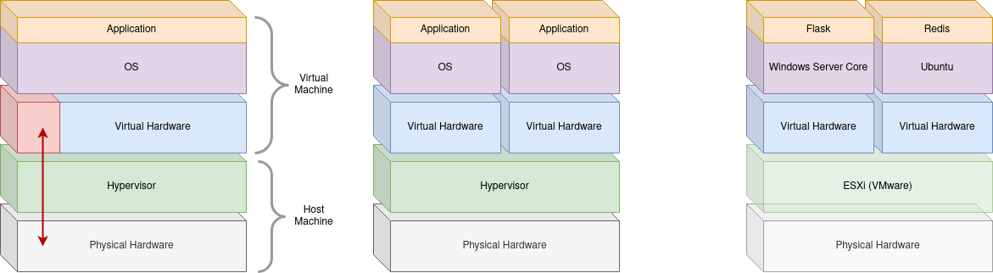
What are Containers?
“Traditional” Virtual Machine
Isolated Instance with its own Hardware and OS
Notes:
Hypervisors are a complicated subject in themselves, but for the purposes of this lecture, it is sufficient to know that they enable virtualization by introducing a virtual hardware layer.
Simulating/emulating multiple virtual machines generates a fair amount of overhead. To optimize resource efficiency, most modern hypervisors support direct hardware access in certain cases (red arrow on the left most graphic).
Multiple operating systems can run on the same host/machine, with each instance having its own isolated virtual hardware.
Technically, the operating system is unaware that it's running on virtual hardware provided by a hypervisor. So from the perspective of the application and the operating system, the hypervisor and the physical hardware layer do not exist. In practice, you often install some tools on the virtual machine that communicate with the hypervisor. However, this is a detail and not so important in the context of this lecture.
With this form of virtualization it is possible to run different kind of operating systems on the same host which is visible on the left most graphic.
The MariaDB service and the Apache service each run in their own virtual machine and are therefore isolated and cannot interfere with each other.
Both services can be hosted on individual bare metal machines to achieve isolation, but in practice this is not common as it is simply less flexible.
Another reason is resource economics. If the workload is not evenly distributed, a machine can have a lot of idle time. This may seem irrelevant, but on a large scale it becomes crucial to run systems in an efficient manner.

Slide 10

What are Containers?
Project Setup
Simple Web Application Setup
Nginx as Load Balancer
Flask to implement Rest Service
Redis as Persistence Layer
Notes:
Nginx is a very popular web server that can also be used as a load balancer.
Flask is lightweight python web framework.
Redis is key-value store often used for caching purposes.

Slide 11
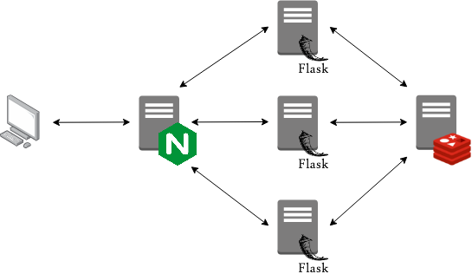
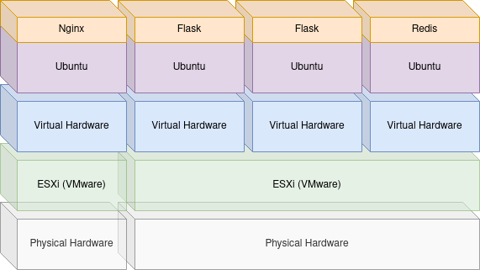
What are Containers?
“Traditional” Virtual Machine
Notes:
In this hypothetical scenario the amount of work per user request is by far the biggest for the flask instances. If the request density is getting higher, the flask instance will eventually run out of resources which will lead to lower response times. In the meantime, the nginx and redis instances are mainly idling around.
With bare metal machines there are two options. The first one is to shut down the affected instance and add more resources. Giving the machine more resources is called vertical scaling. This of course has its limits because there is only a finite number of memory slots. The second option is to buy another machine so the load is distributed. This is called horizontal scaling. Both options are possible with a bare metal machine setup but it is slow, expensive and the problem with the two other services idling around remains.
With virtualization both vertical scaling as well as horizontal scaling can be achieved by configuration. The resources not needed by nginx and redis can be used by the flask instance instead. Because this is can be done by configuration the reaction time if certain services faces a resource shortage is really fast compared to a bare metal setup. This also results in a improved overall resource efficiency.
With virtualization at hand it is also possible to setup a failover scenario by running multiple flask instances. These flask instances do not necessarily have to run on the same physical machine but can be hosted on a different machine running a hypervisor. The transfer of a virtual machine from one host machine to another is a very simple process.

Slide 12
What are Containers?
VM vs. Bare Metal Machine
Isolated Instance
Improved Resource Economy
Horizontal vs. Vertical Scalability
  Memory Slots are limited :)
Virtualization Overhead
  Loss of Performance
  Lots of Duplications

Slide 13
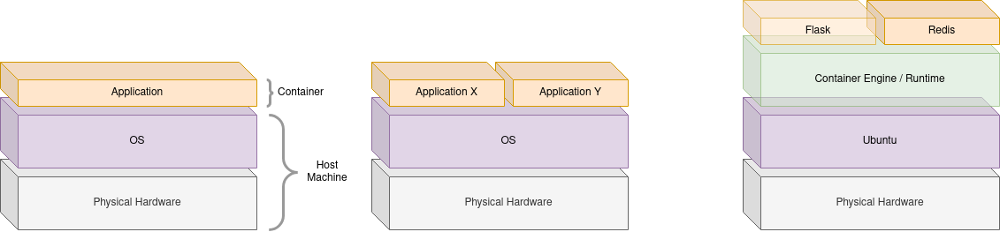
What are Containers?
Container
Isolated Instance
No overhead of Virtual Hardware or Multiple Operating Systems
  Isolation is achieved by kernel features not virtualized hardware
Notes:
The effort involved in virtualizing hardware and running multiple operating systems is still too high in many cases. This is where containers come into play. They are lightweight without sacrificing the desired features that a virtual machine offers, namely isolation and flexibility.
Unlike virtual machines, the isolation is not achieved through virtualization of hardware, but through a handful of features offered by the operating system, more specifically the kernel itself. Hence the name OS-level virtualization. A container is basically an ordinary process which is isolated by different linux kernel features.
The central feature cgroup was introduced into the Linux kernel in 2008 by Google engineers. Given that Google is constantly running millions of services, resource economics is an important issue for them and it's no surprise that they need such technology to improve the overall efficiency.
One important thing to point out is that this is a Linux feature only, there are no Windows or Unix based containers! The reason that Windows has support for Docker is a feature called Windows Subsystem for Linux. WSL is basically a virtual Linux machine running on Windows. Same for macOS.
In theory, a container can also be created by hand without a container engine, but it's not very convenient. And this is where container engines/runtimes come into play.

Slide 14
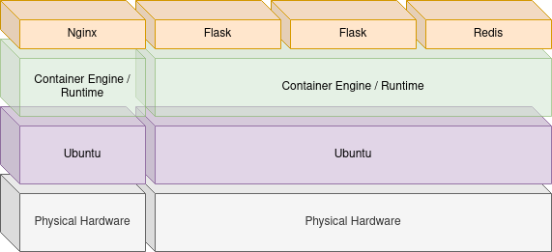
What are Containers?
Container
Notes:
The same scenario can be run with containers to reduce virtualization overhead while retaining all the benefits.
Containers can be deployed/run on any linux host machine

Slide 15
What are Containers?
Container vs. VM
Less overhead
  Isolation not by virtualized hardware
Increased Performance
  Direct Hardware Access
  There is a tendency
Smaller Footprint
  There is a tendency

Slide 16
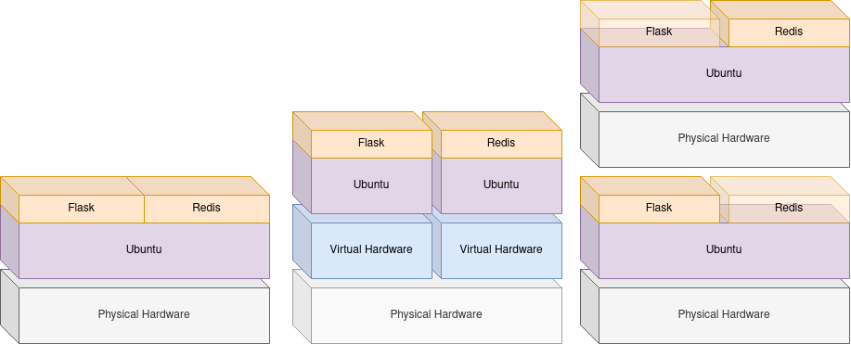
What are Containers?
Bare Metal vs. Virtual Machine vs. Container
More flexibility
More efficient
More convenient

Slide 17
Break
If there are any questions, feel free to approach me

Slide 18
Docker Intro
Set of Tools to work with Containers
Alternatives
  Podman
  LXC
Why Docker?
  Well established
  Big Community
Terminology
  Container
  Image
  Dockerfile
  Registry

Slide 19

Docker Intro
Container
Runtime instance of a Docker Image
Can be compared to an Object

Slide 20

Docker Intro
Image
Docker images are the basis of containers. An Image is an ordered collection of root filesystem changes and the corresponding execution parameters for use within a container runtime. An image typically contains a union of layered filesystems stacked on top of each other. An image does not have state and it never changes.
Blueprint to instantiate Containers from
Can be compared to a Class
Notes:
Sources:
https://docs.docker.com/glossary/

Slide 21

Docker Intro
Dockerfile
A Dockerfile is a text document that contains all the commands you would normally execute manually in order to build a Docker image.
Instructions for Docker to build Image
Declares how the Docker Image looks like
A human readable representation of the Docker Image
Notes:
Sources:
https://docs.docker.com/glossary/

Slide 22
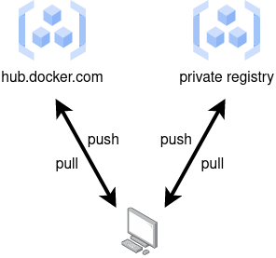
Docker Intro
Registry
Hosts Docker Images
  Can be searched by docker search
Default is hub.docker.com
  Can be accessed by browser
Private registry can be setup
  Available as an Image itself

Slide 23
Docker Intro
Demo

Slide 24

Docker Intro
Process
Write Dockerfile
Build Image from it
Instantiate Image to run Container
Push Image to Registry if desired

Slide 25
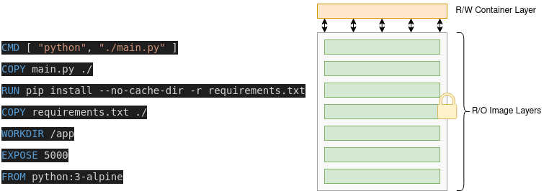
Docker Intro
Layer Concept
Image consists of ReadOnly Layers
Container ReadWrite Layer represents Container State

Slide 26
Docker Intro
What not to do
Treat a Container like a Virtual Machine
Upgrade Containers
  internals
  Upgrade Dockerfile and rebuild Image instead
Reuse Containers
  Run a new container instead
  If a container is gone, let it rest
Run multiple Services in on Container
  Run a container for each service instead

Slide 27
Break
If there are any questions, feel free to approach me

Slide 28
What problem might occur with Docker?
Notes:
Docker manages individual Containers
Dockerfile describes a single Image / Service
Can become messy for a System that consists of multiple services
Starting, Configuring individual Containers
Scripts are hard to maintain and not in line with the declarative nature of a Dockerfile

Slide 29
Docker-Compose Intro
Compose is a tool for defining and running multi-container Docker applications.
Compose File
  Instructions for Compose to configure and run individual Services
Similar command set as Docker
  Application level:
    Up, Down, Build, ..
  Container level:
    Start, Stop, Run, ..

Slide 30
Docker-Compose Intro
CLI
  Instantiate individual Containers with docker run
  Very inconvenient and error prone
Script
  Essentially wrap individual commands in a bash script
  Technically possible
  Scripting vs. declaring
Compose File
  Declare your multi container application

Slide 31
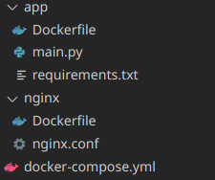
Docker-Compose Intro
version: '3.7'
services:
app:
# refers the directory to build image from
build: app
# container is only started once redis was started
depends_on:
- redis
nginx:
# explictly sets a container name instead of defering it
container_name: nginx
# refers the directory to build image from
build: nginx
# declares port mapping, equivalent to docker run -p 80:80 ..
ports:
- 80:80
# container is only started once app was started
depends_on:
- app
# more services if necessary
Notes:
Content of docker-compose.yml file on the left hand side
Treeview of project on the right hand side

Slide 32
Docker-Compose Intro
Demo

Slide 33
Your Task
Dockerize a small web application
The goal is to implement a tiny web service similar to the examples discussed during the lecture. It can be a simple ping or something a bit more sophisticated. The only requirement for the service is that the persistence layer is used. The example discussed during the lecture implemented a simple hit count stored in a redis store.
Other requirements are:
The rest service and all its dependencies must be packed in a Docker Image.
The redis store must be run as a container
The application can be managed with docker-compose
The application can be load balanced
It is recommended to us redis and flask but not a must
Deliverables:
Create one GIT-Repository per group and hand-in at least one solution

Slide 34
Q&A

