Slide 1
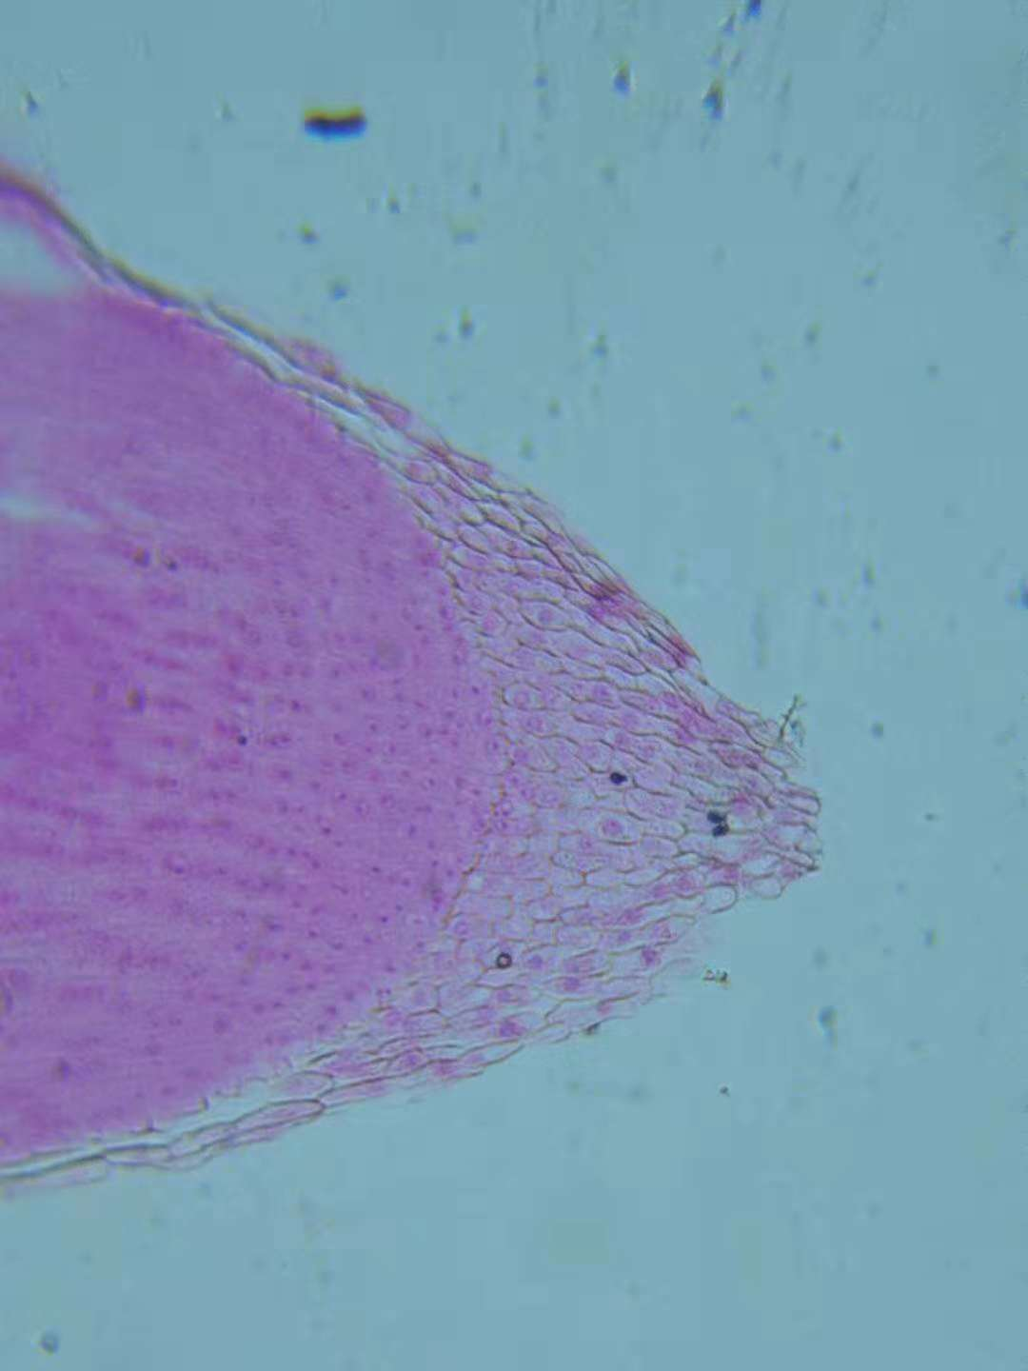
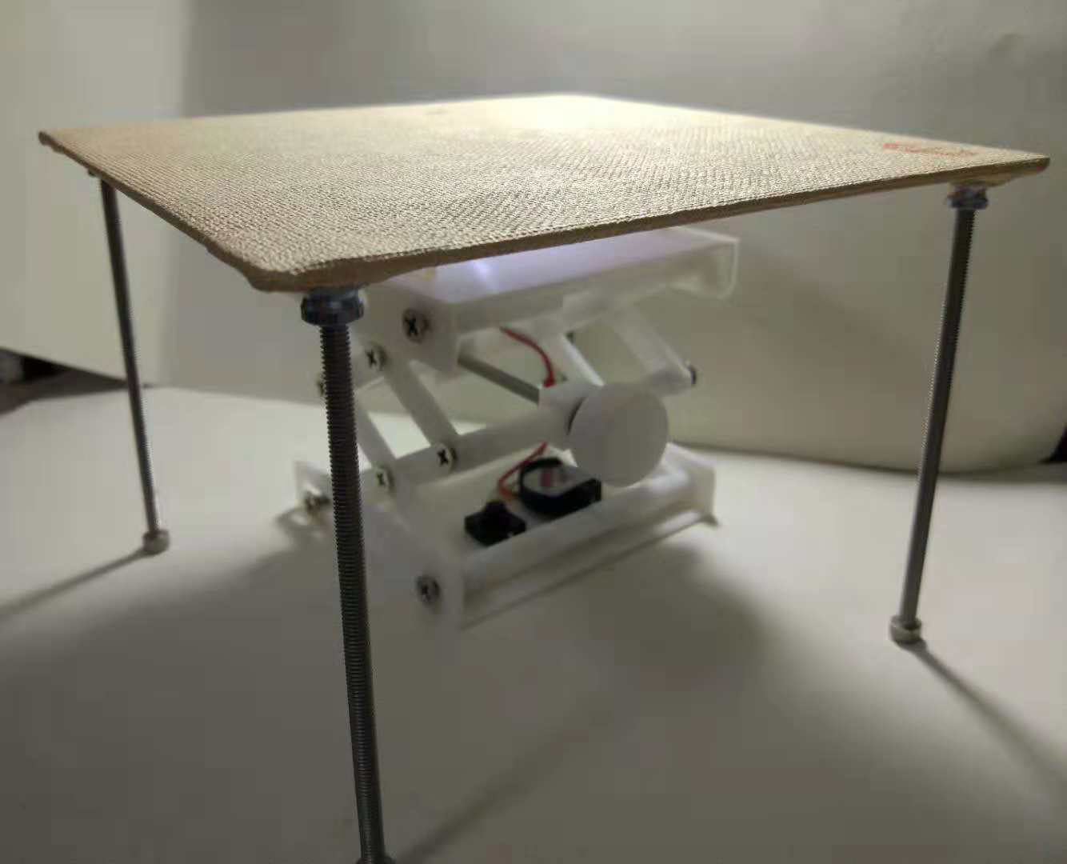

ZScope
Device that can protect your Intellectual Property on your research via Block chain technology

Slide 2

区块链 Blockchain
买币Coins
转账Transactions
交易Exchange

Slide 3

区块链 Block chain NOT only merely use in money transactions
不仅仅只是用于
金钱交易

Slide 4


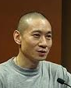
医学界发生过多次学术造假的事件 It’s happened many medical fraud in medical industry in the past
哈佛
日本
小保方晴子
皮耶罗·安佛萨
Piero Anversa
中国
韩春雨

Slide 5

我们希望让医学界能用上区块链的技术来确保实验结果的真实，并保护知识产权 We hope to improve the Intellectual protection and authenticity of experimental results via the blockchain technology

Slide 6
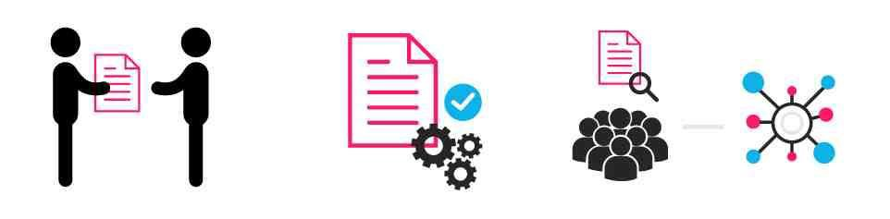
我们认为，医疗设备可以具有执行智能合约功能，Zscope项目 We believe that medical device may link with a smart contract to perform Intellectual property protection function, via our Zscope project

Slide 7






2.创建项目目录Create a project directory
IPFS
3.创建媒体流Create a video stream
zscope
1.发布到主链 Publish in blockchain

Slide 8
1.Publish _Doc(Project, DOC) 在主链上执行智能合约，记录项目。 在Github/zsopeorg中创建项目工程，保存文档 Execute smart contracts on the main chain to record projects. Create a project project in Github/zsopeorg and save the document
Zscope提供一个管理网站，提供科研项目的智能合约接口
Zscope provides a management website that provides a smart contract interface for research projects

Slide 9
2.publish_video(project, address) -发布zsope项目视频到直播平台 - Publish zsope project video to live broadcast platform 3.subscribe(PROJECT) - 第三方读取智能合约，获取项目信息 - Third party reads smart contract to get project information

Slide 10
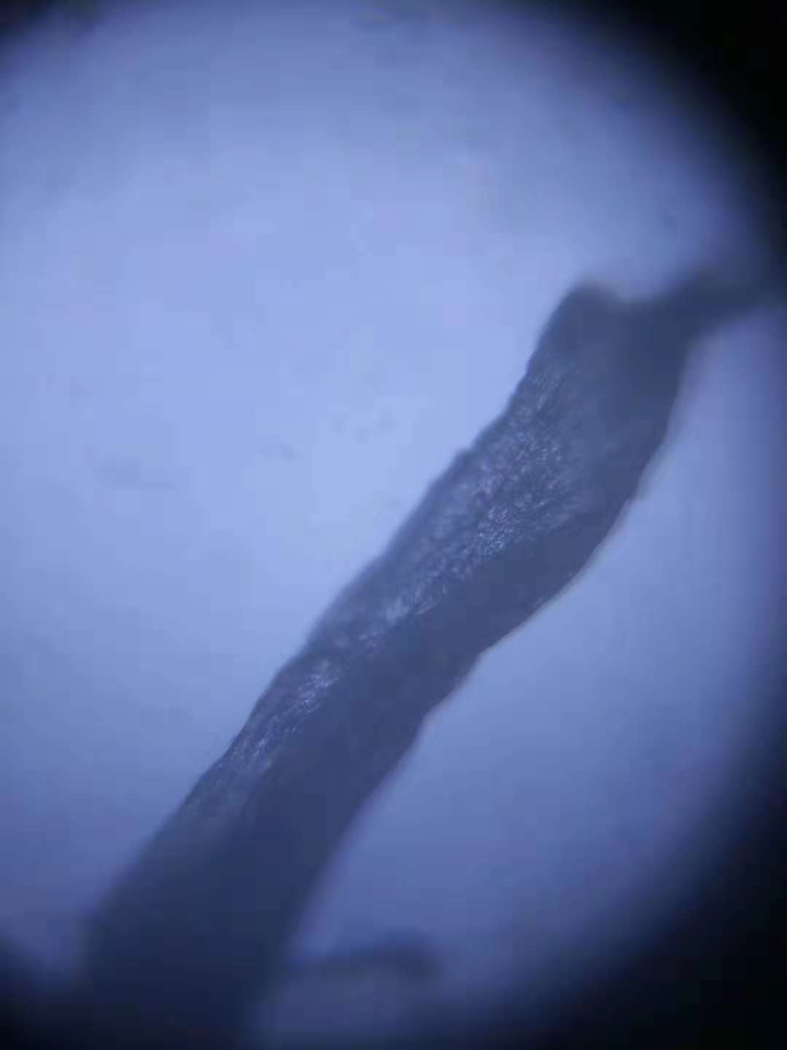
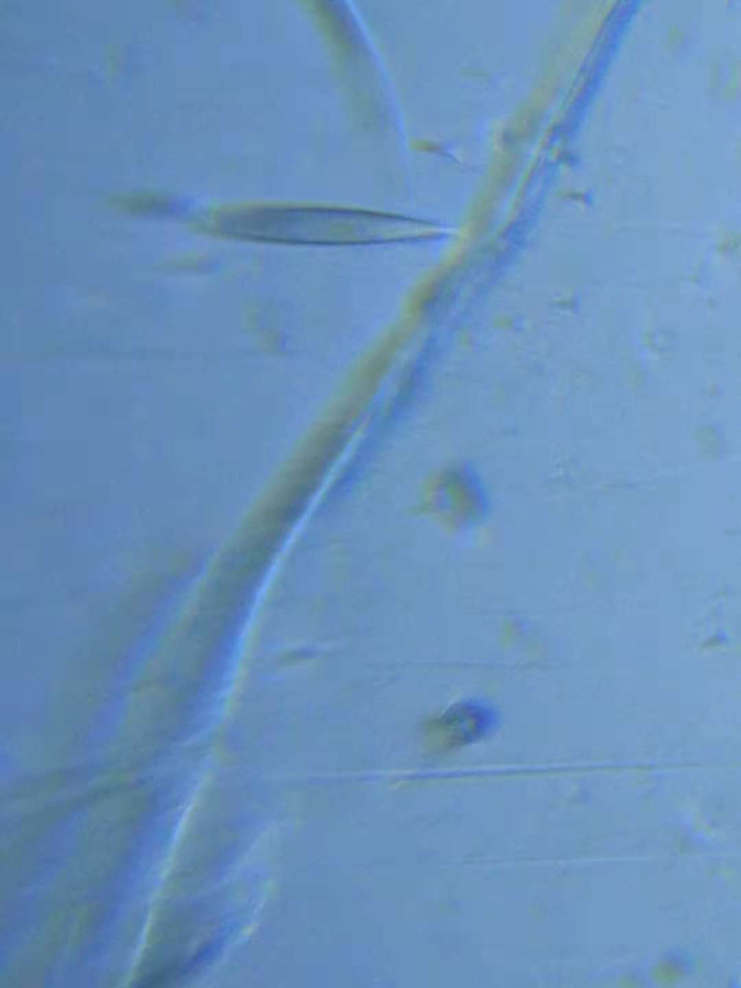
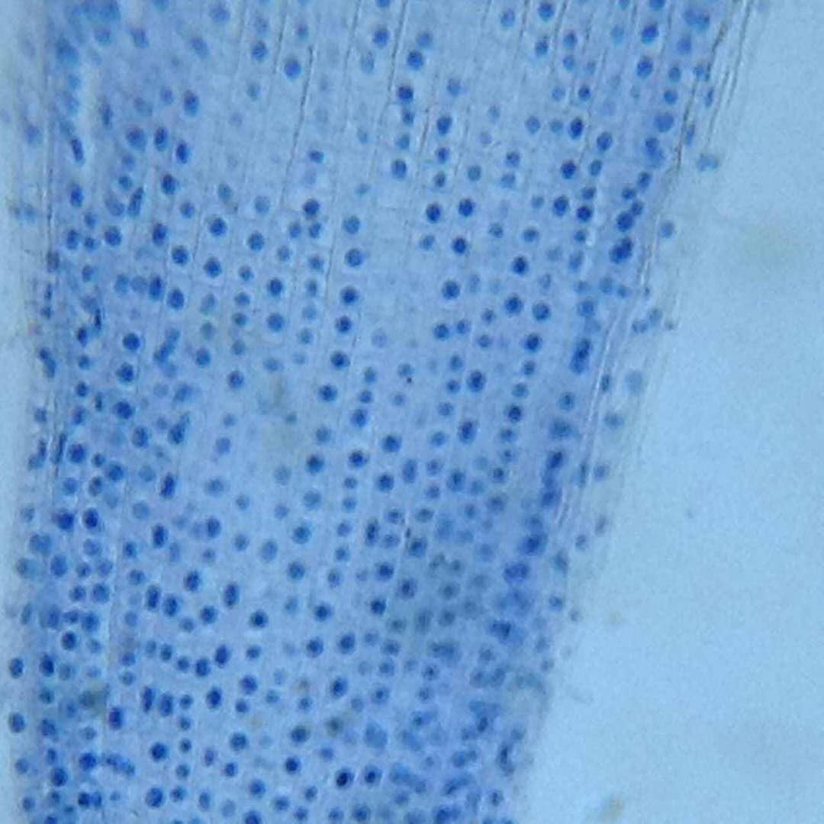
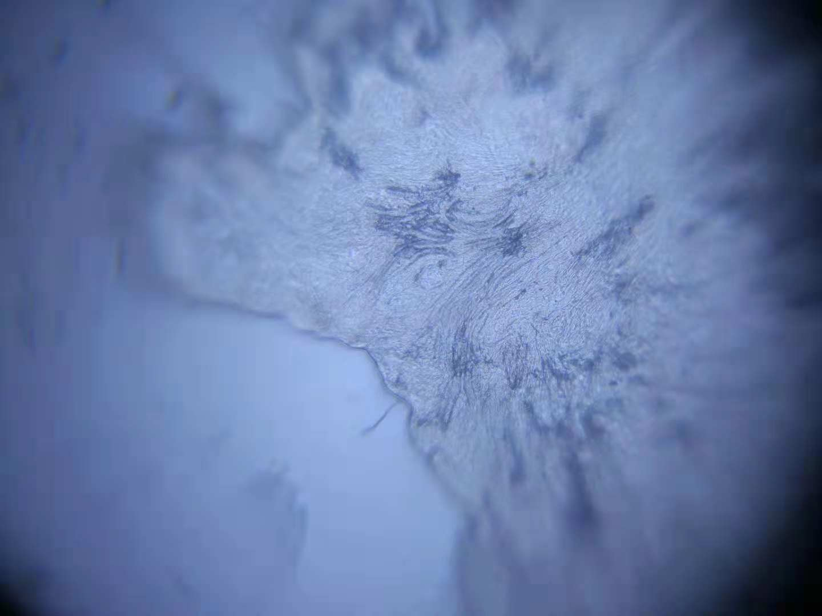
医学界的同行，可以第一时间在通过查询智能合约而看到实时的实验结果甚至是视频直播 Peers in The medical industry can view real-time experimental results or even live video broadcasts by querying smart contracts.

Slide 11
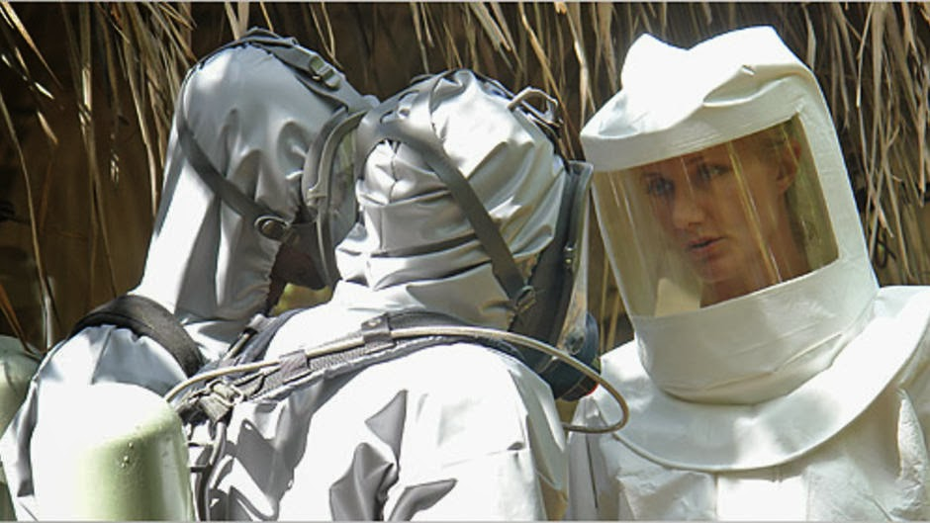
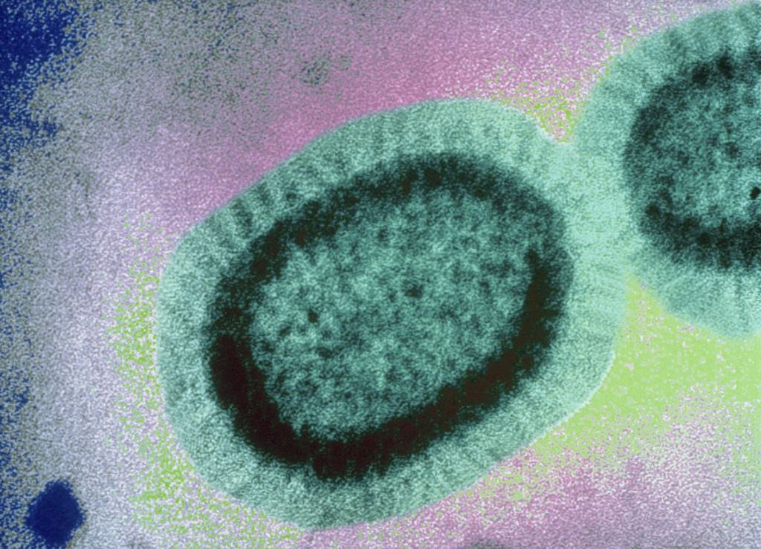
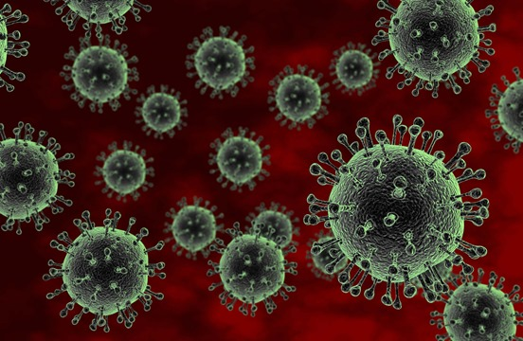
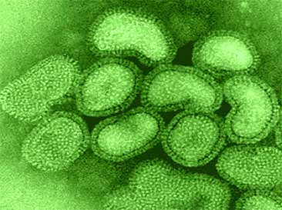
实验的结果，也可以结合区块链，将结果第一时间向全世界发布，同时也能保护发现者的知识产权 The results of the experiment can also be Released in the blockchain at the first time, in which while discoverer's intellectual property can be protected.

Slide 12
因为时间关系，我们此次比赛，结合了显微镜做了一个初步原型 Owing to limitation of the time, we have made a preliminary prototype with this microscope within the 24 hours

Slide 13
谢谢 Thanks

