Slide 1
Eco-Warriors Plant Based Nutrition
I learned about plant based nutrition for athletes from watching Game Changers produced by Jackie Chan and Arnold Schwarzenegger. Many UFC fighters, NFL players, tennis players and other athletes are now eating a 100% plant-based diet. That means NO ANIMAL PRODUCTS like dairy, eggs, meat, seafood, etc.

Slide 2
My site’s URI
Please click here to go to my site: https://nyck33.github.io/ecoWarriors/
Hosted for free on GitHub Pages
Graffiti Font called “Urban Slick” used as an experiment. Not super legible but fun to look at. From:
https://www.google.com/search?client=ubuntu&channel=fs&q=free+graffiti+font&ie=utf-8&oe=utf-8

Slide 3
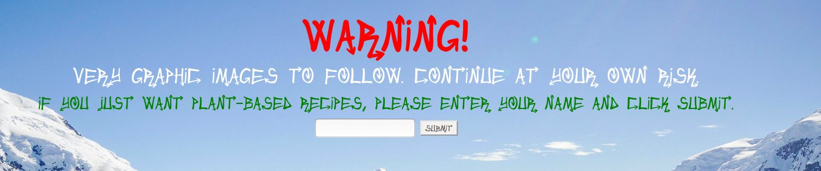
JS input validation on index.html
Please enter your name into the input box: Nobu
This shows a link to the Game Changers recipes website.
Any non-alpha input including white space results in a polar bear image appearing.

Slide 4
HTML for validation
HTML:
<section class="name-validator-form">
<div class="row mb-3">
<div class="col-xl-12">
<h1><strong>Warning!<br>
Very Graphic Images to Follow. Continue at Your Own Risk.</strong></h1>
<h4>If you just want plant-based recipes, please enter your name and click submit.</h4>
<div class="input-box">
<input id="nameInput">
<!--<button id="submit-name" onclick="nameValidator()">Submit</button>-->
<button id="top-button">Submit</button>
<button id="clear-button">Clear</button>
</div>
<p id="topMsg"></p>
</div>
</div>
</section>

Slide 5
JS tips I learned from seasoned pros
Never use alert, use console.log.
Don't use on... attributes, keep your JS in JS by finding your element and using addEventListener.
Don't set content via innerHTML. Build the nodes you need (by using document.createElement), and set their textContent instead, then append those wherever they need to go.

Slide 6
nameValidator.js
Please click here: https://github.com/nyck33/ecoWarriors/blob/master/js/nameValidator.js

Slide 7
Twitter Bootstrap CSS
Pre-made CSS that uses classes to access predefined grid and other CSS formatting. Up to 12 columns per row, ie. 12x1, 6x2, 4x3, 5 and 7, etc.
<hr class="featurette-divider">
<div class="row featurette"> //a row
<div class="col-md-6 order-md-1"> //column order is 1 for responsive
<h2>It's So Good, Let's Watch It Again.</h2>
<p class="lead">content

Slide 8
Bootstrap uses Flexbox
.flex-container {
display: flex;
flex-wrap: wrap;
}
<div class="flex-container">
<div>1</div>
<div>2</div>
<div>3</div>
<div>4</div>
<div>5</div>
<div>6</div>
<div>7</div>
<div>8</div>
<div>9</div>
<div>10</div>
<div>11</div>
<div>12</div>
</div>
Simple example to the right will stack 12 boxes without any row or column designation.
From: https://www.w3schools.com/css/tryit.asp?filename=trycss3_flexbox_flex-wrap_wrap

Slide 9
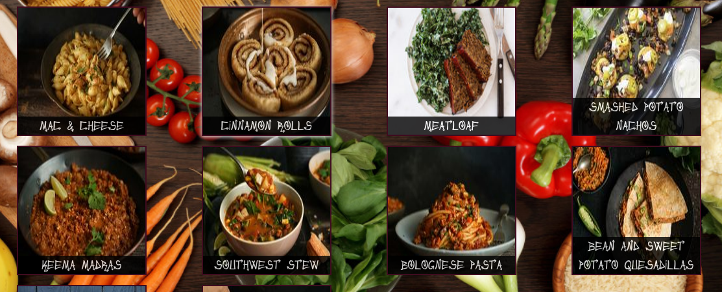
food.html
Here each food item is it’s own col-md-3 but 10 of them are packed into one row so they are grouped into rows of 4 cols automatically on a wide screen.
In Bootstrap.css, col-md-3 means a column that takes up 3 out of 12 total columns on a medium size screen.
You can also use a combination of classes like col-md-3 col-sm-6 so on a mid-size screen there 4 columns of size 3 and small size, 2 cols of size 6.

Slide 10
mark.js library
https://markjs.io/
Please see this fiddle: https://jsfiddle.net/julmot/hdyLpy37/
Need to write an external js script, mine is called navbarSearch.js: https://github.com/nyck33/ecoWarriors/blob/master/js/navbarSearch.js

Slide 11
parallax effect
https://www.w3schools.com/howto/howto_css_parallax.asp
Please see the bottom part of my carousel.css file: https://github.com/nyck33/ecoWarriors/blob/master/css/carousel.css

