Slide 1
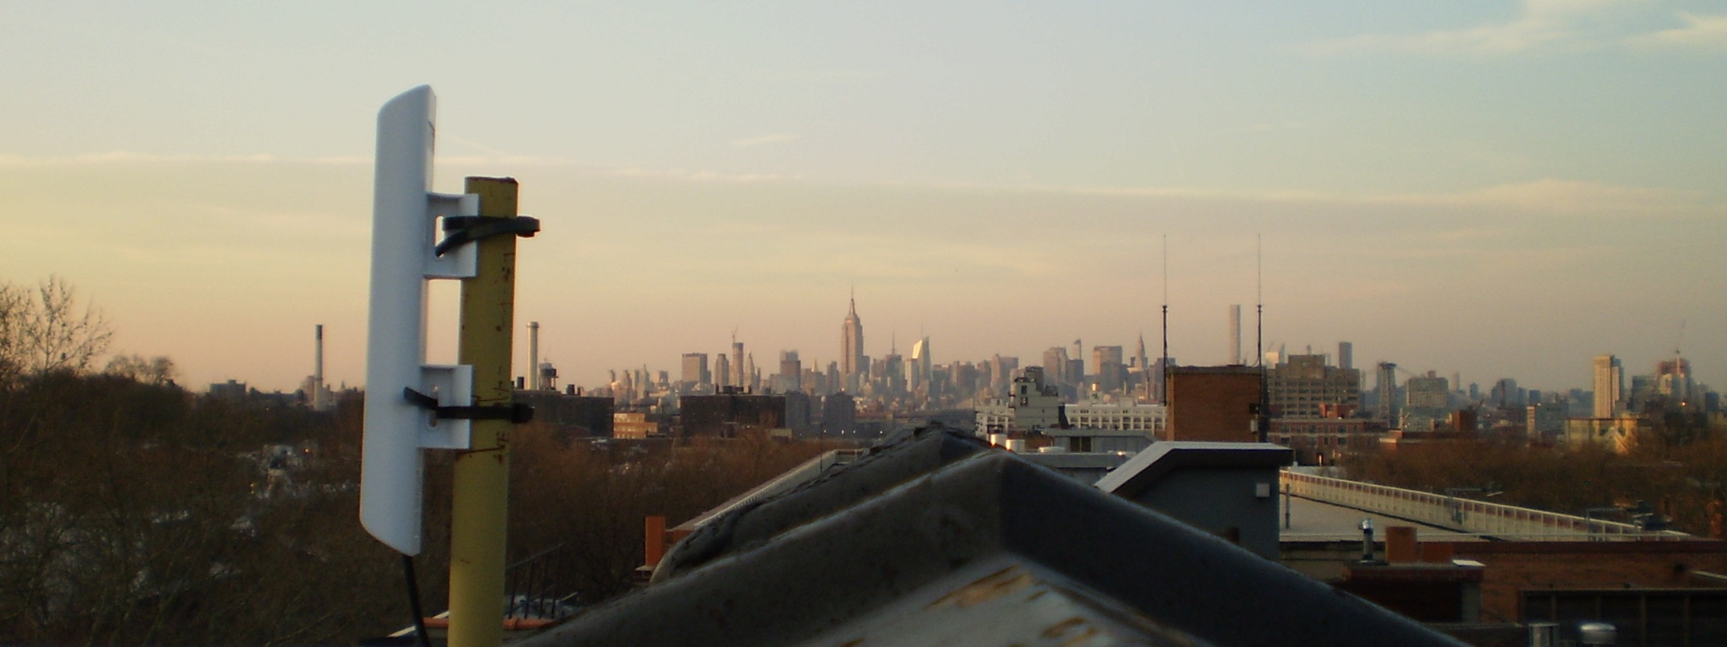
Bridging the Digital Divide:
Internet Access for Everyone
info@nycmesh.net

Slide 2
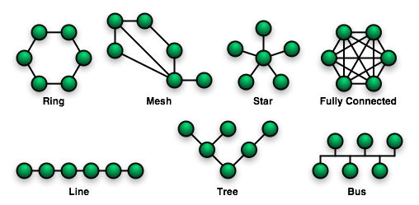
What is Mesh
Mesh is just one of many types of networks. It has many pros and cons, but in essence, we find that the mesh is
1. Social – a people-owned network of open communication, inherently run by consensus, and maintained without profit.
2. Economic--by collectivizing internet access and buying in bulk, we can deliver a reliable product for communities that cannot afford broadband, provide public access across the city, and work with libraries and schools to bring access directly to them without the use of any fiber or coaxial cable.
3. Technical– by distributing the processing power and network topology, we build a network that is more resilient to attack/spam, maintained by consensus, and fully independent of the WWW while still allowing access to users.

Slide 3
Reasons for Mesh
Self Configuring
Resilient – no single point of failure
Community-owned infrastructure
Neutral Network by design
Adding to network extends public wifi
Community building—localization of technology
Close the digital divide –mesh bandwidth is substantially cheaper
High symmetrical bandwidth
Infrastructure commons—built for people
Long-term self-sufficiency

Slide 4
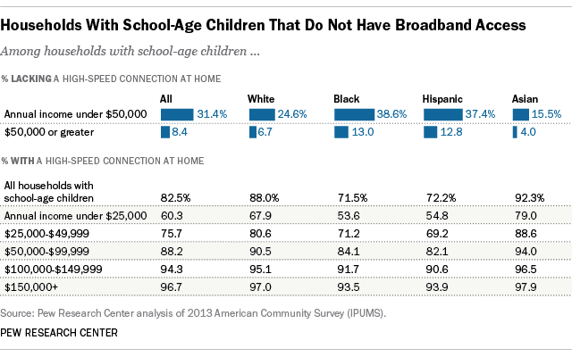

Slide 5
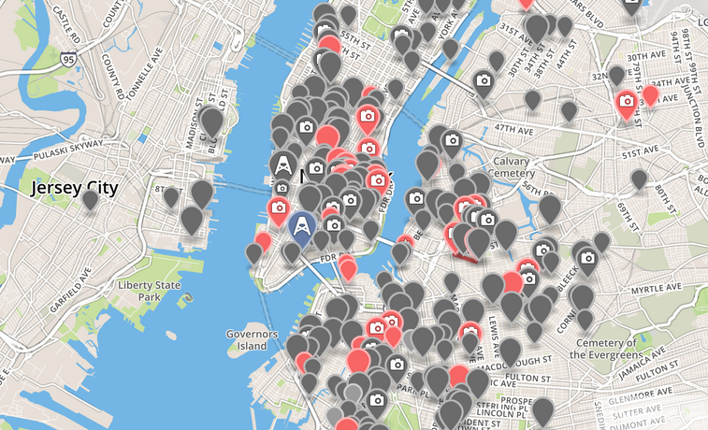

Slide 6
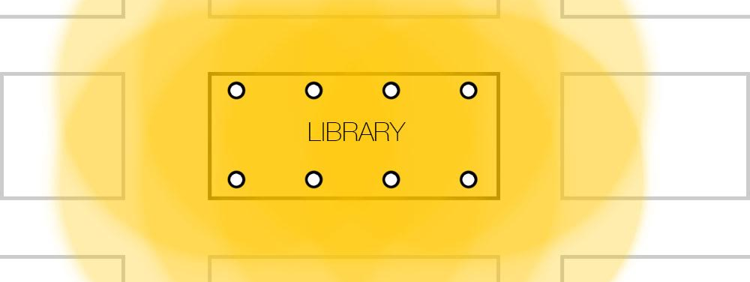
Assuming the library is the shortest building around, it’s coverage area is this.

Slide 7
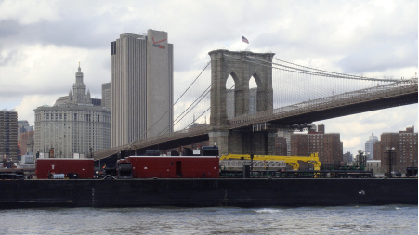
The old Verizon building by the Brooklyn Bridge, hosts our data center in one of 490 buildings around the world that comprise the backbone of the world wide web.

Slide 8
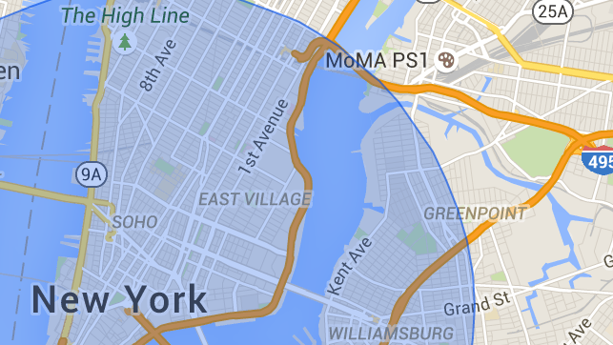
We easily have line of sight access to any of 3-5 million people. Depending on range, permanent access to our network requires only that a person purchase a router and point it at our building. The model below does not include long-range point to point connections capable of throughput up to 800Mb/s. It is only inclusive of areas that can be served for less than $200 per unit. In theory, our rooftop can see up to 50 miles-- all the way to Princeton NJ-- in a single hop!

Slide 9
We’re not Alone
Related Projects
Outernet—Global
Guifi—Spain
Freifunk-Germany
Tomesh--Toronto, Canada
Pymesh--Pudicherry, India
Sudo Mesh--Oakland
Portland Mesh
Seattle Mesh
Athens Wireless Metropolitan Network
Pittmesh—Pittsburgh
Reseau Libre—Montreal
WLAN Slovenia

Slide 10
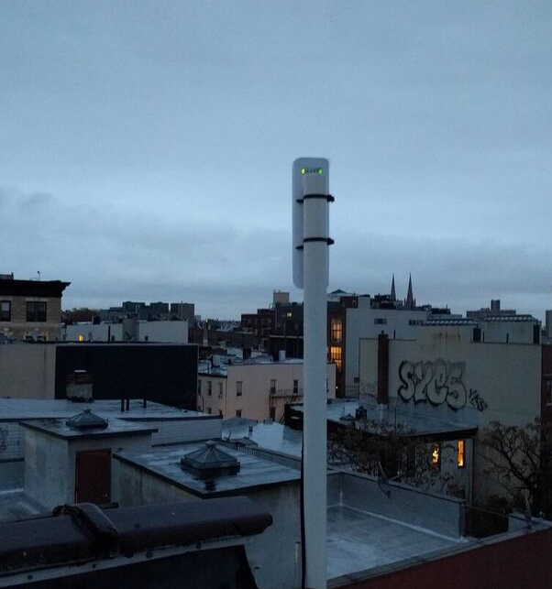
“Libraries and schools could add to this growing network of free broadband. Perhaps we should project Wi-Fi from every public building, with boosters to create a minimal level of home access as a public utility for all—and those who can afford a premium pay for one” ~Anthony Marx, NYPL President, New York Times, 8/13/16

Slide 11
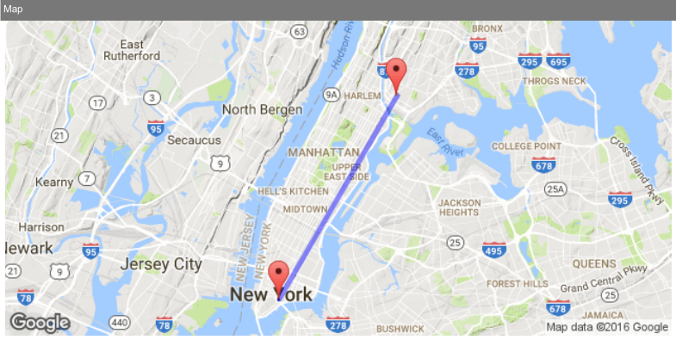

Slide 12
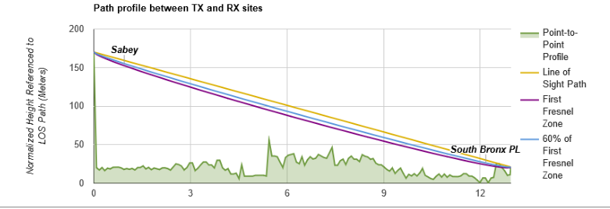

Slide 13
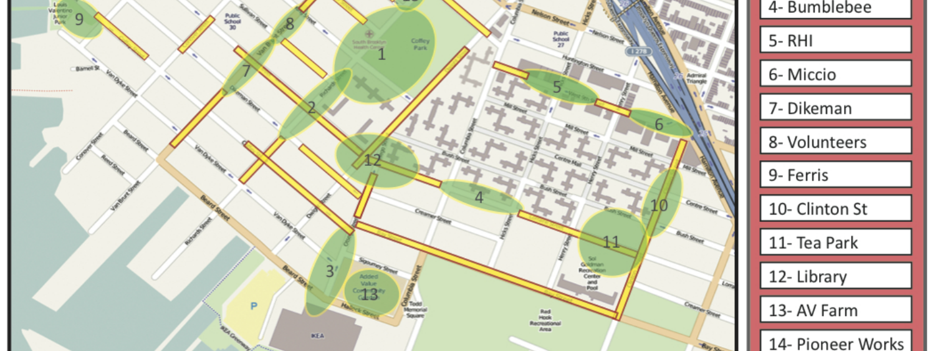
Red Hook Wifi
Started during Hurricane Sandy Relief
Built/maintained and grown by network coordinators, trained at the Red Hook Initiative
Provides access to NYCHA residences, Coffey Park, and the Waterfront

Slide 14
The Numbers ($150,000 USD)
93 Locations
  Start with 50< less than 1 install/ week
$2,200 per library
50*2200 = 110,000
Asking for $40 thousand more
  $15k for a year of access
  $5k for legal fees/insurance
  $5,000 outreach/educational materials
  $15k to stipends/grants for volunteers
    Maybe ask for more
    90% ROI for non-profit is unheard of
That 2200 is an overestimate, but includes
8 Rooftop access points that share wifi publicly
  $100 each
1 back-haul link, that connects to our datacenter in lower Manhattan, reducing concerns of DOITT and having access to your network
  $1k
4 X Omnidirectional antennas, placed inside or outside to provide access in the tradition of the library, but with more power and flexibility

Slide 15
What you Get
What we Need
We will hold a workshop when we do the installs, inviting members of the community to learn and get involved
We will maintain the network in perpetuity—no IT fees, no cost for data, and no mining of user data for any reason
Each library will have access capable of serving 1,000 users, the ability to share the same network with residences on the block, and anyone who can see the library.
We will train members of the community to expand access to the network
  Partners logo on our web page
  Rooftops libraries, offices, gov’t buildings
  Meeting Spaces
  A connection and reference to Department of IT, so we can get started on that bureaucratic process

Slide 16
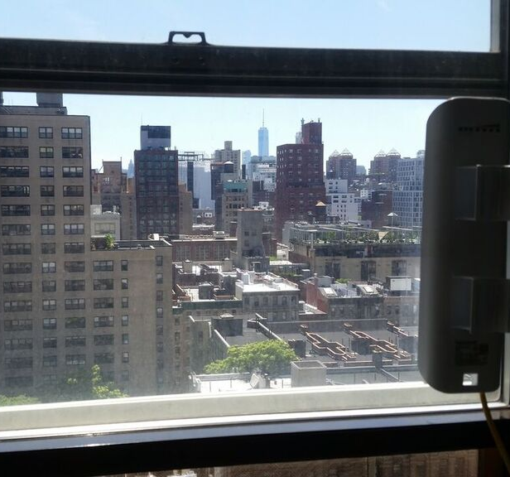
Thanks
  NYCmesh.net
  partners@nycmesh.net
  (646) 727-0866

