Slide 1


Mac Install-a-thon
2301-wdf-ny-dat-ft
Jan 2023

Slide 2
Software Installations
dBeaver
SQL client software application and a database administration tool
SQL editor with code completion and syntax highlighting
Able to connect to multiple dB servers including SQLite, MySQL, PostgreSQL
Tableau Public
A free platform to create and publicly share data visualizations online
Anaconda
A distribution of the Python programming languages for scientific computing (data science, machine learning applications, large-scale data processing, predictive analytics, etc.)
Simplifies package management and deployment

Slide 3

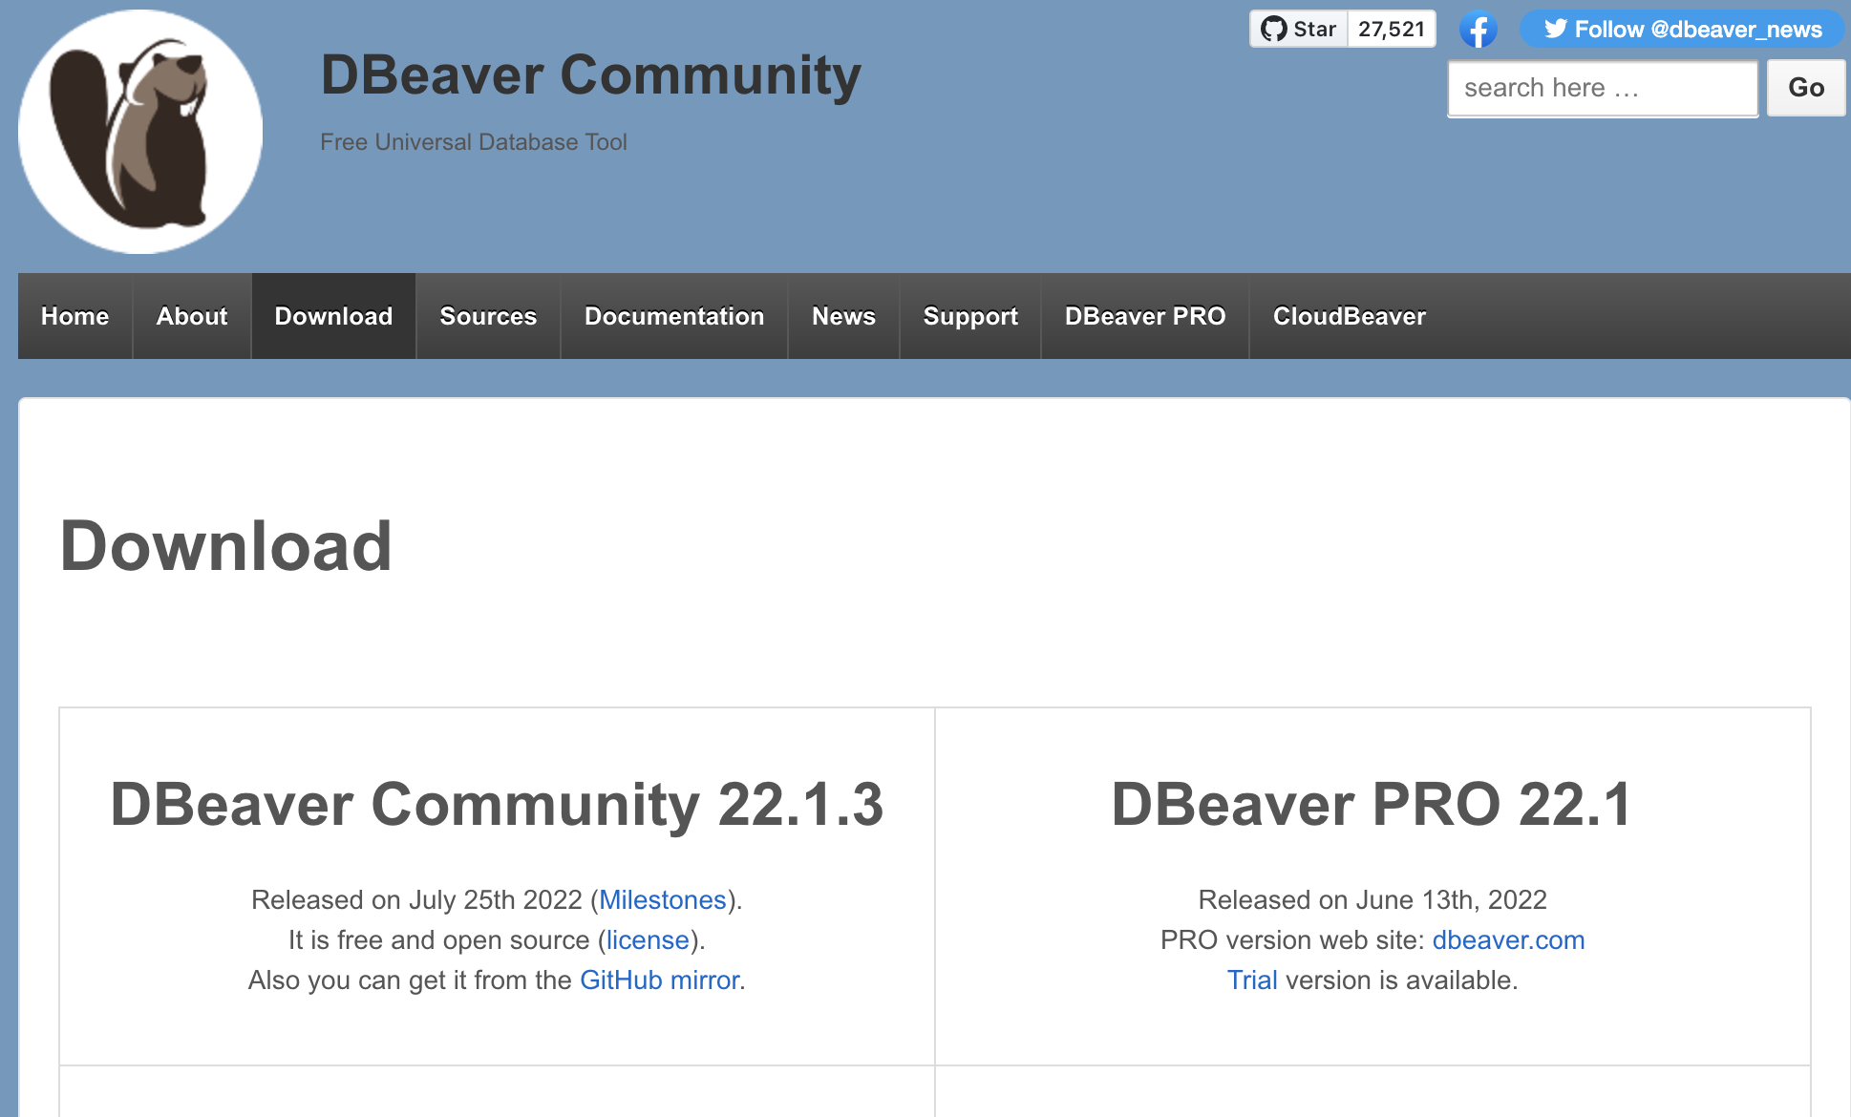
dBeaver Community
https://dbeaver.io/download/

Slide 4
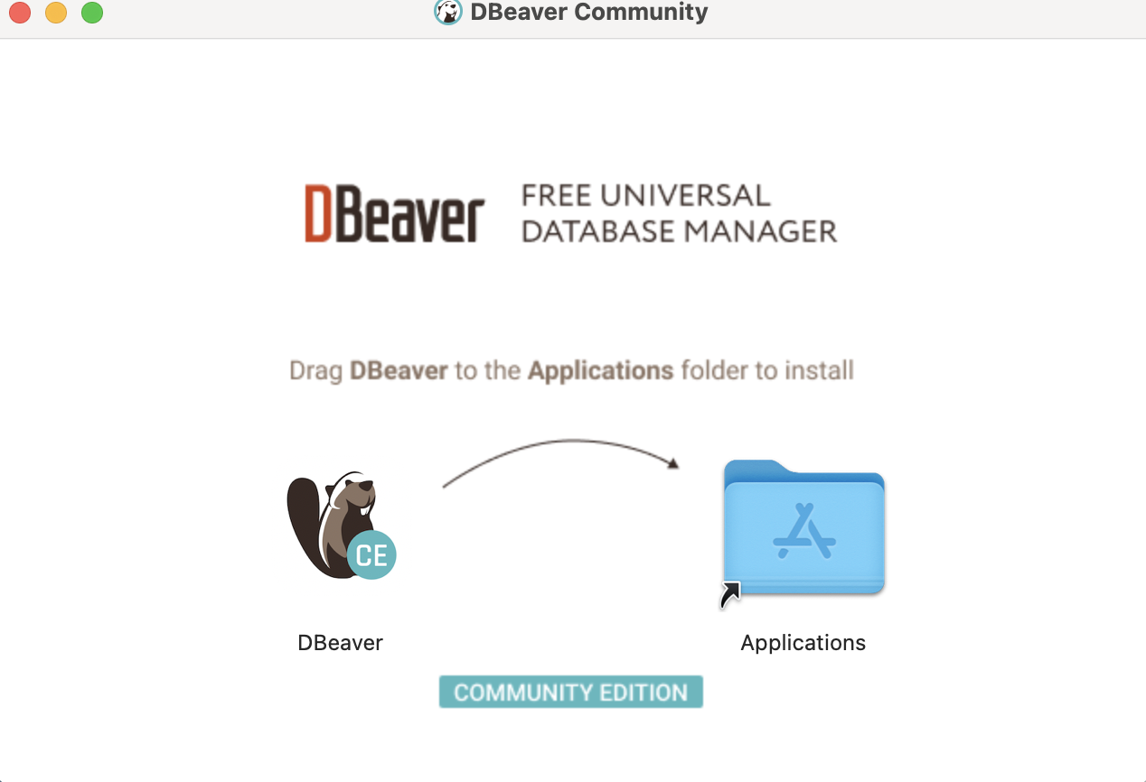
Drag dBeaver into the Applications Folder

Slide 5
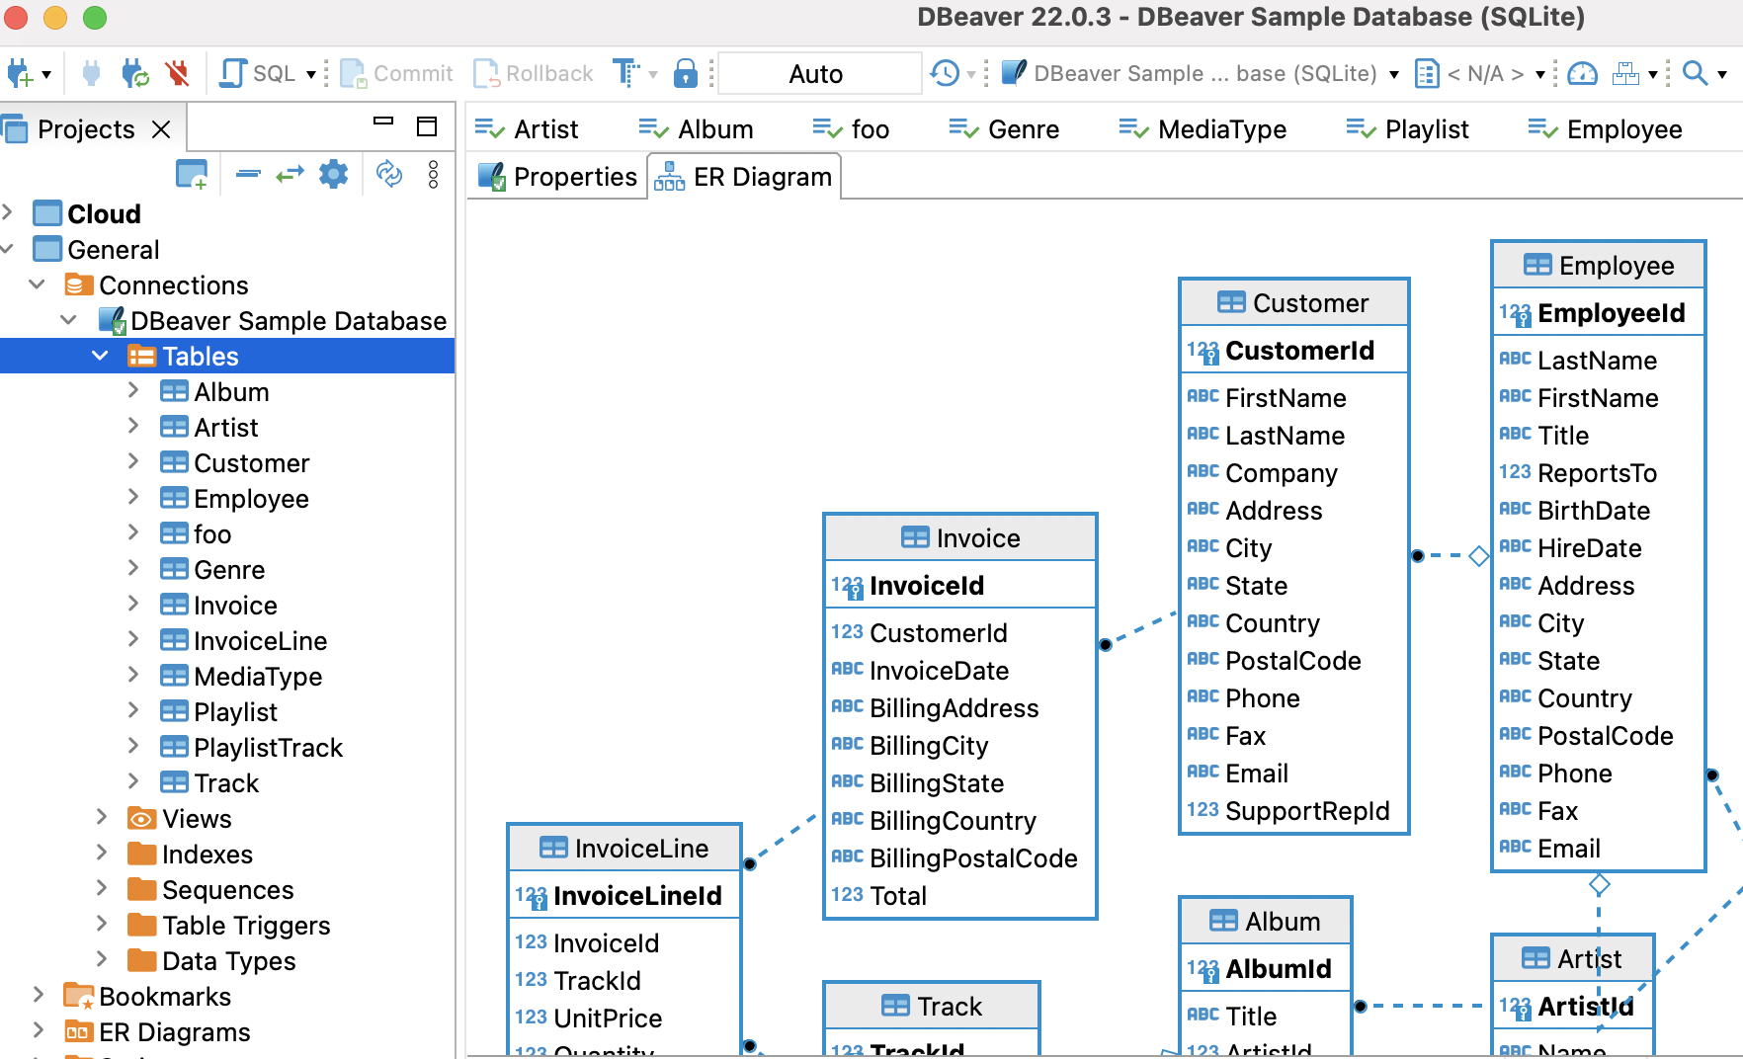
dBeaver Sample Database

Slide 6
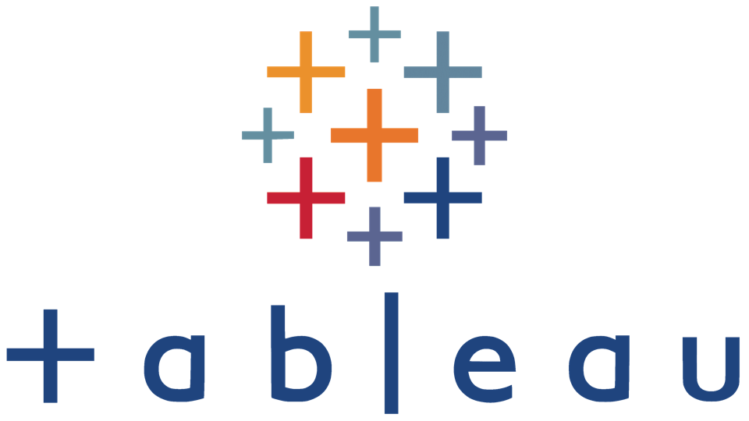
Tableau Public
https://public.tableau.com/en-us/s/download
Requirements:
macOS Mojave 10.14, macOS Catalina 10.15, and Big Sur 11.4+
Intel processors
M1 processors under Rosetta 2 emulation mode
1.5 GB minimum free disk space

Slide 7
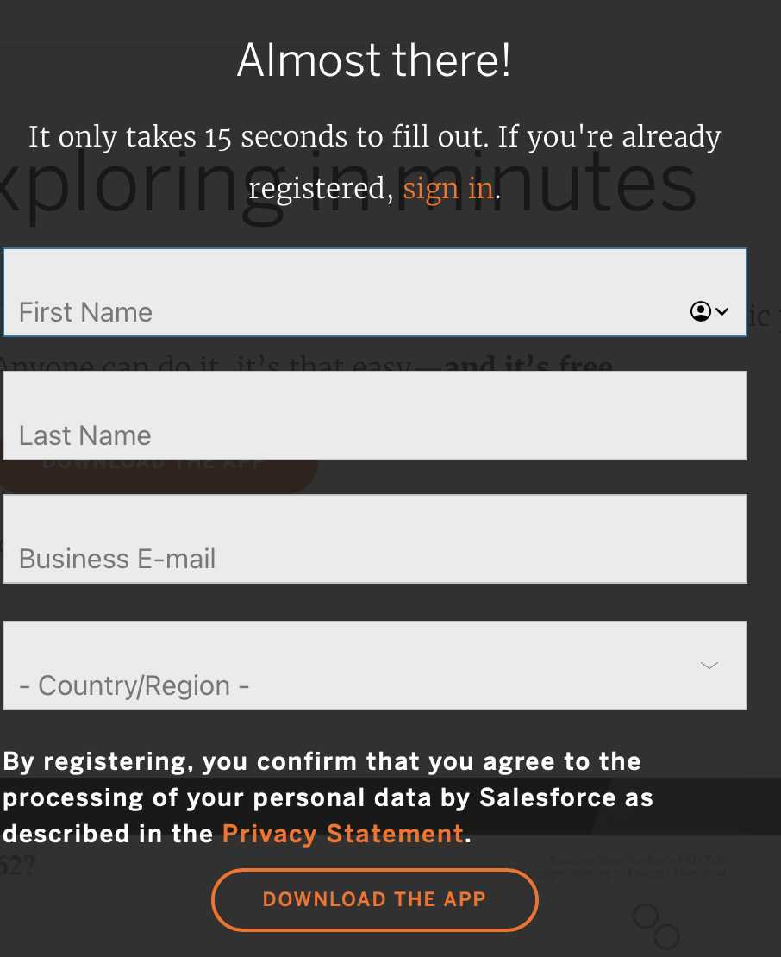
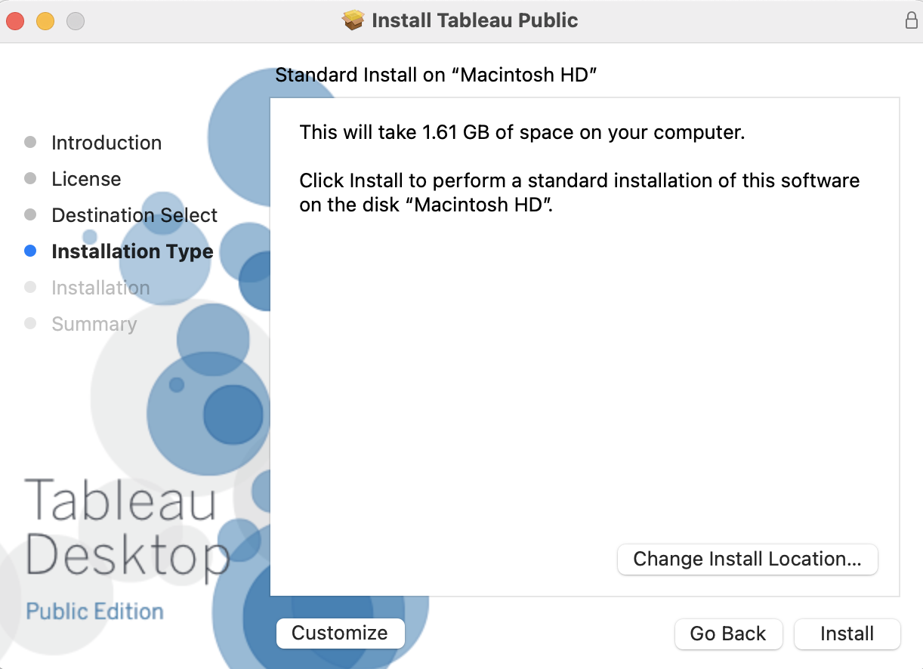
Register

Slide 8

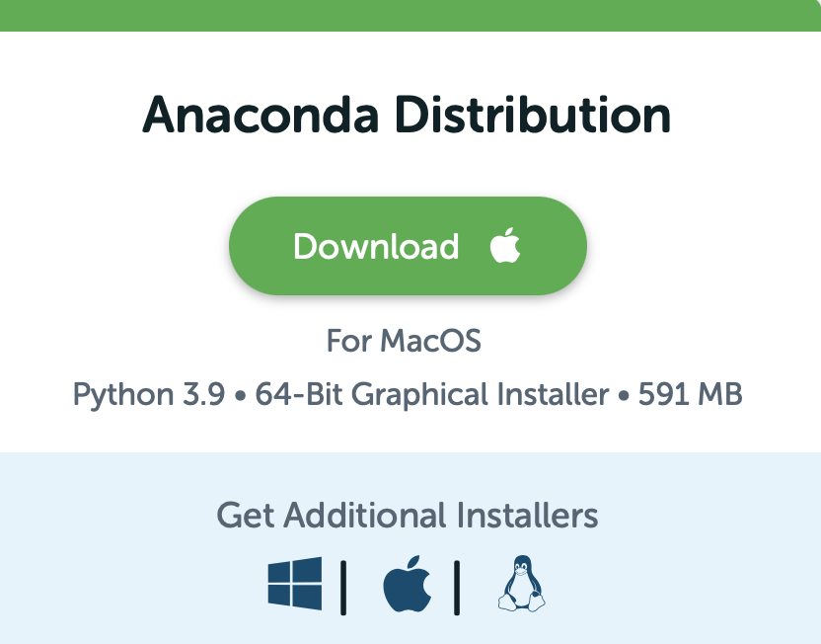
Anaconda
https://www.anaconda.com/products/distribution

Slide 9
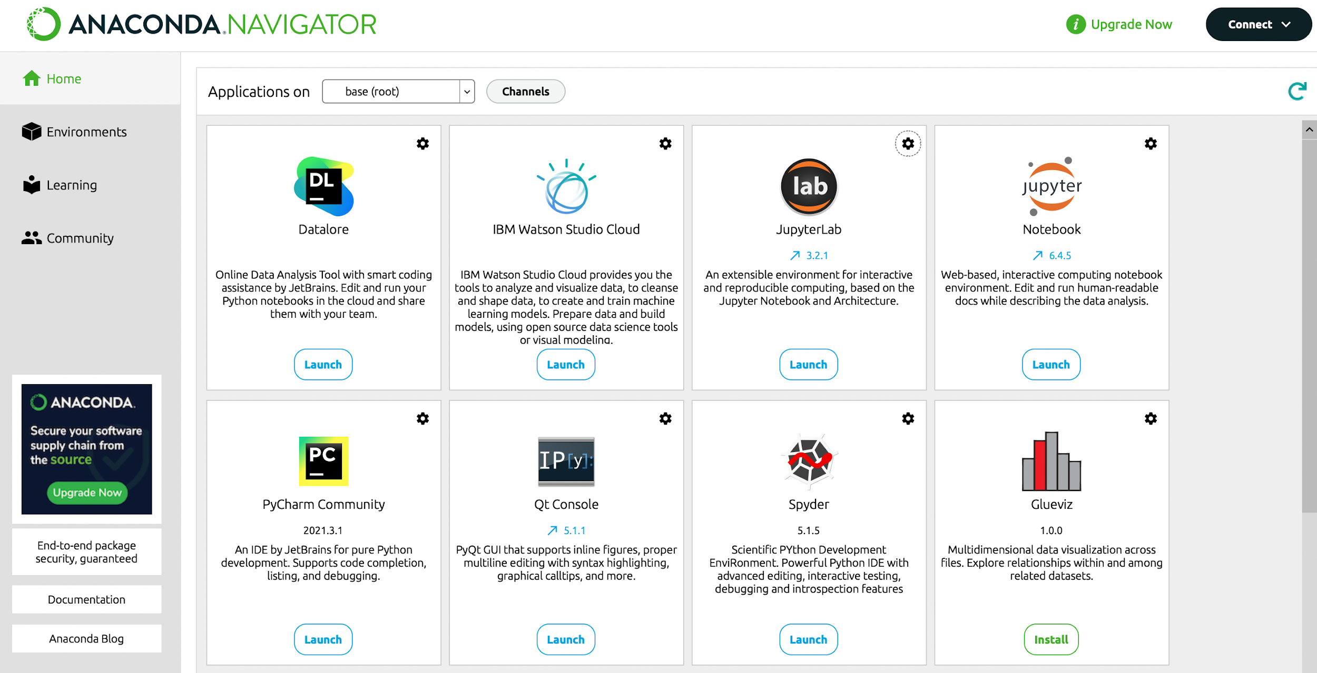
Anaconda Navigator

Slide 10
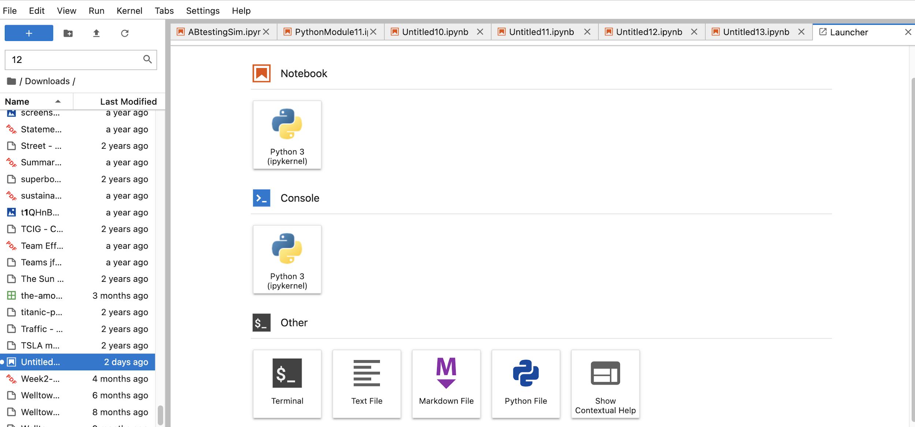
Jupyter Lab

