Slide 1
Chapter 12
Drivers and the Kernel

Slide 2
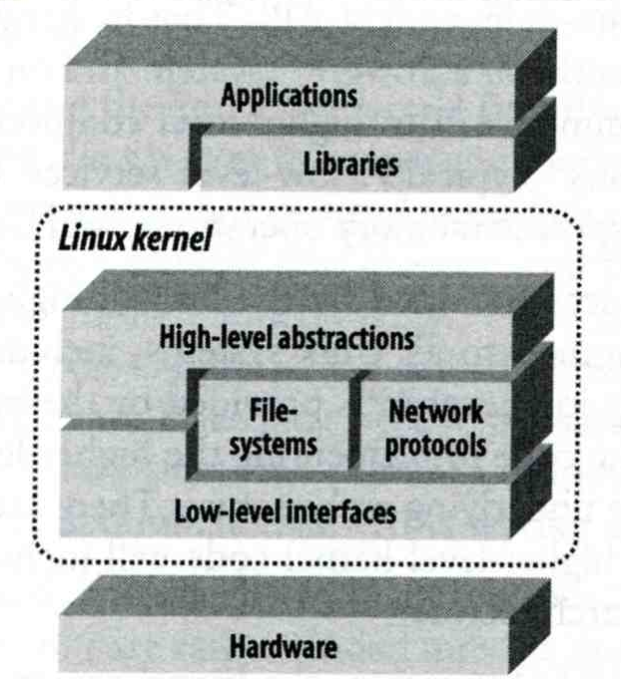
Roles of Kernel
Components of a UNIX System
  User-level programs
  Kernel
  Hardware
Two roles of kernel
  High-level abstractions
    Process managements
    File system management
    Memory management
    I/O management
  Low-level interface
    drivers

Slide 3
Kernel Types
Two extreme types
  Micro kernel
    Provide only necessarily, compact and small functionalities
    Other functions is added via well-defined interface
  Monolithic kernel (龐大的)
    Whole functionalities in one kernel
Modern OS
  Solaris
    Completely modular kernel
    Load necessarily module when it is needed
  BSD-derived system
    Explicitly specify the devices on kernel compile process
  Linux
    Between BSD and Solaris System

Slide 4
Kernel related directory
Build directory and location
System | Build Directory | Kernel file
FreeBSD | /usr/src/sys | /kernel (4.x) /boot/kernel (5.x)
Red Hat | /usr/src/linux | /vmlinuz or /boot/vmlinuz
Solaris | - | /kernel/unix
SunOS | /usr/kvm/sys | /vmunix

Slide 5
Why configure the kernel?
The native kernel is often big and common
Tailoring kernel to match site situation
  Purge unnecessary kernel devices and options
  Add functionalities that you want
OS patch
  Remedy security hole of kernel implementation
Fine-tune system performance
  Such as adjusting important system parameters
Adding device drivers

Slide 6
Building a FreeBSD Kernel
Kernel source
  /usr/src/sys
Kernel configuration file
  /usr/src/sys/i386/conf
    GENERIC, LINT (4.X)
    GENERIC, “make LINT” under this dir (5.x)
Steps to build a new kernel
  Edit /usr/src/sys/i386/conf/TYBSD
  % cd /usr/src ;
  % make KERNCONF=TYBSD buildkernel
  % make KERNCONF=TYBSD installkernel

Slide 7
Building a FreeBSD Kernel –
Configuration file (1)
Each line is a control phrase
  Keyword + arguments
Keyword | Function | Example
machine | Sets the machine type | i386 or amd64
cpu | Sets the CPU type | I586_CPU or HAMMER
ident | Sets the name of the kernel | TYBSD
maxusers | Sets the kernel’s table sizes | 0
options | Sets various comiple-time options | INET or INET6
device | Declares devices | fxp
Pseudo-device | Declares pseudo-devices | loop

Slide 8
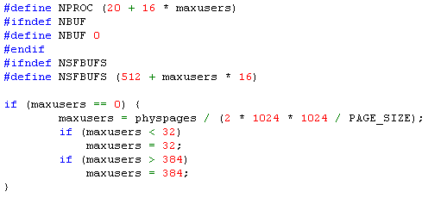
Building a FreeBSD Kernel –
Configuration file (2)
maxusers keyword
  The maximum number of simultaneous users
  Control the static sizing of a number of internal system tables by formula in subr_param.c
    # of processes
    # of file table entries
    # of buffers for terminal I/O
    …
  0 will cause the system to auto-size

Slide 9
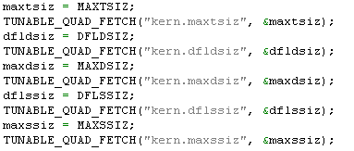
Building a FreeBSD Kernel –
Configuration file (3)
options keywords
  Define preprocessor symbol
    Ex: options INET
  Preprocessor symbol with specific value
    Ex: MAXDSIZ=“256*1024*1024”
From /usr/src/sys/kern/subr_param.c

Slide 10
Building a FreeBSD Kernel –
Configuration file (4)
device keyword
  Format:
  device device-name at connection-info port address irq interrupt
  Ex:
  device fxp
  device sio1 at isa? port IO_COM2 irq 3
  device apm0 at nexus? flag 0x20
  connection-info
    Tell the kernel where to find the device and what kind of device it is
  address
    the location of the device’s command and status registers in the address space of the bus
  interrupt
    the IRQ the device has been configured to use
  PCI drivers will determine the address, interrupt of device dynamically

Slide 11
Building a FreeBSD Kernel –
Configuration file (5)
Pseudo-device keyword
  Programs that act as device drivers but don’t have any real hardware
  Format:
  pseudo-device device-name number-of-instances
  Ex
    pseudo-device loop
    pseudo-device either
    pseudo-device pty

Slide 12
Tuning the FreeBSD Kernel
sysctl command
  Dynamically set or get kernel parameters
  All changes made by sysctl will be lost across reboot
  Use sysctl to tune the kernel and test it, then recompile the kernel
  Format:
  % sysctl [options] name[=value] …
  Ex:
  % sysctl –a list all kernel variables
  % sysctl –d kern.maxfiles print the description of the variable
  % sysctl kern.maxfiles print the value of the variable
  % sudo sysctl kern.maxfiles=2048

